Slide 1
Dropbox
Harish Panchumarthi
LAkshMI Shivani Reddy Bommineni
Gauri kALKUNDRI
Amulya Valupadasu
Mansi sOMAYAJULA

Slide 2

Objective
Develop a module to upload and download files from/ to cloud services.
Upload /Download an object
Internet
Amazon S3

Slide 3
Block Diagram
Stores the application requirements
INIT
Main flask application
APP
Stores downloaded files
DOWNLOADS

Slide 4
S3 interaction code
S3
User input via HTML
STORAGE
Stores uploaded files
UPLOADS

Slide 5
Components
dropbox /
static /
logo
main
generic
product_view
templates /
files
index
layout
login
signup
thank you

Slide 6
Lessons Learned
Creation of the virtual environment for the flask server using Linux.
Implementation of the Flask framework, SQLite database and Python tools.
Syncing the AWS S3 bucket

Slide 7
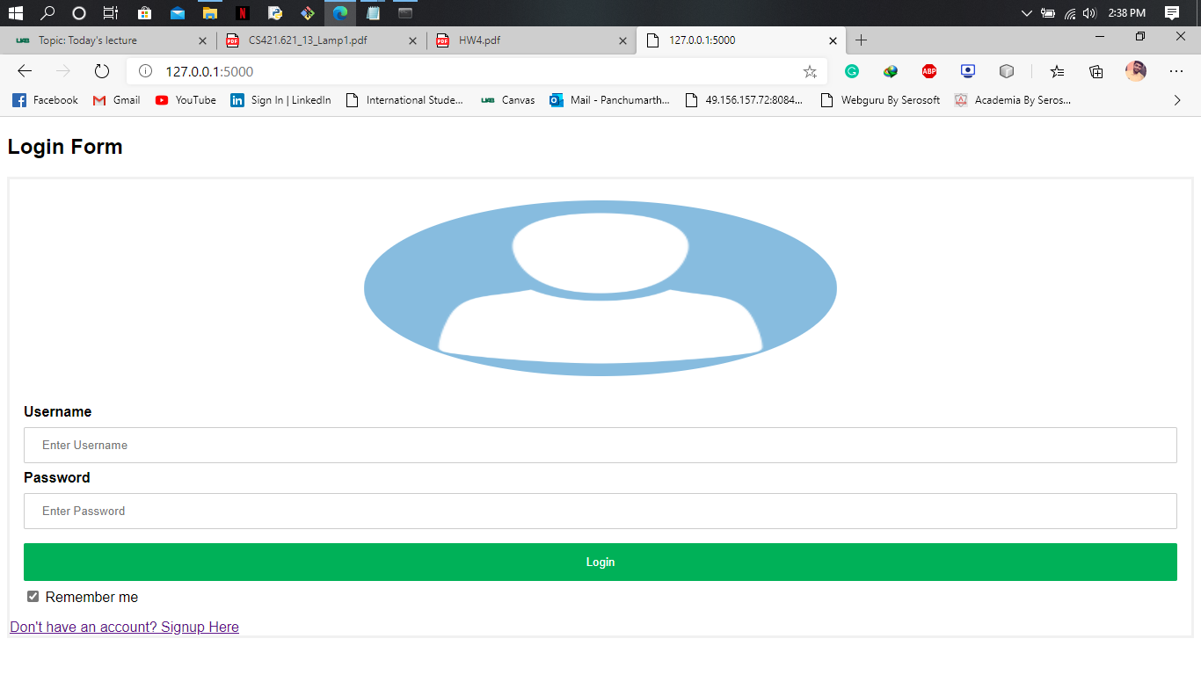
Demo

Slide 8
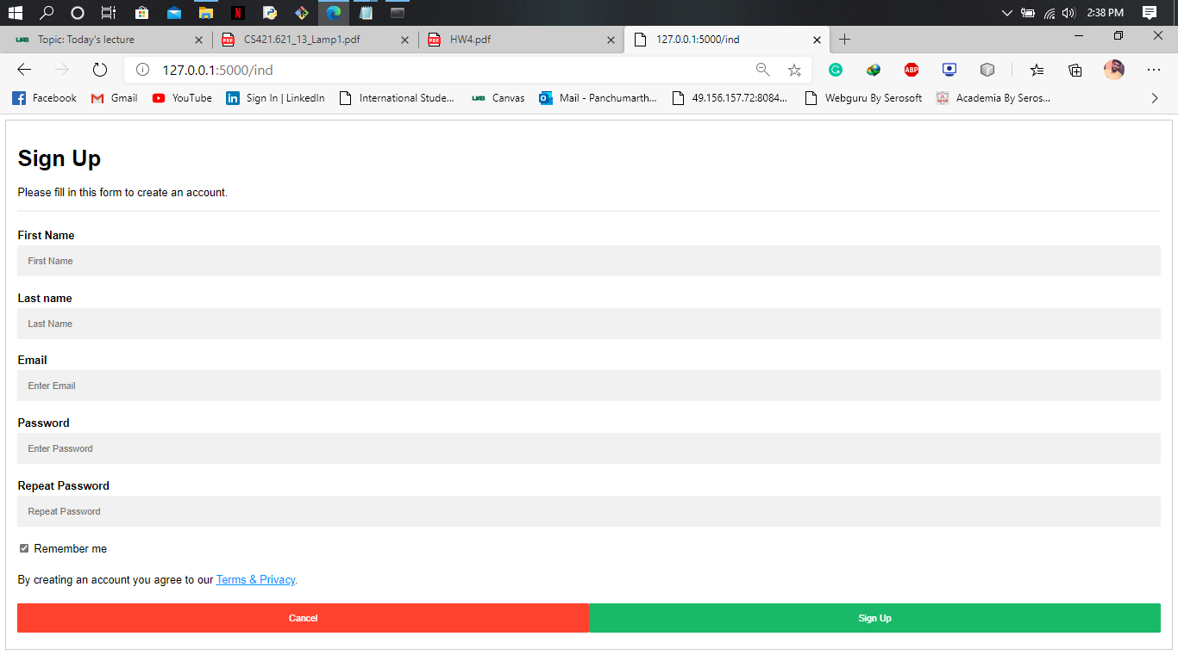

Slide 9
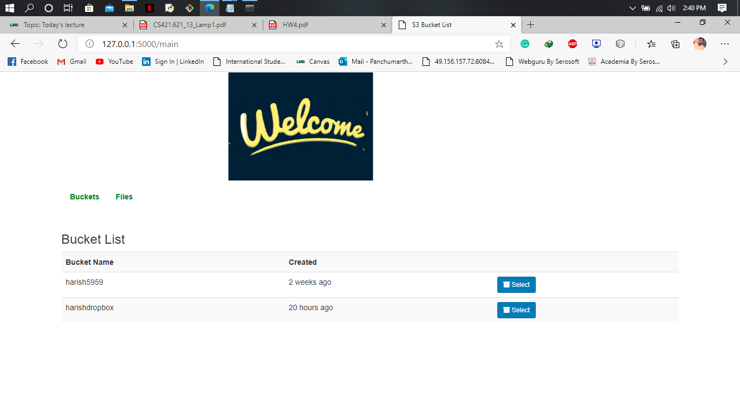

Slide 10
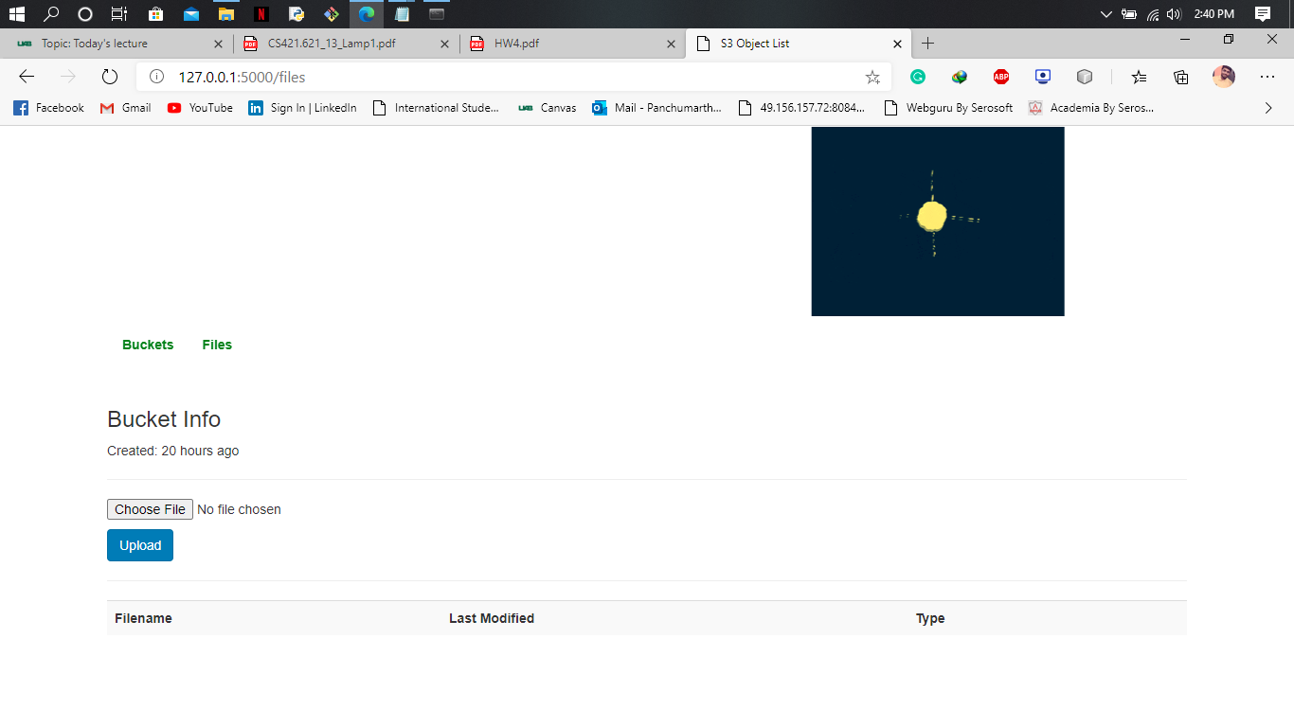

Slide 11
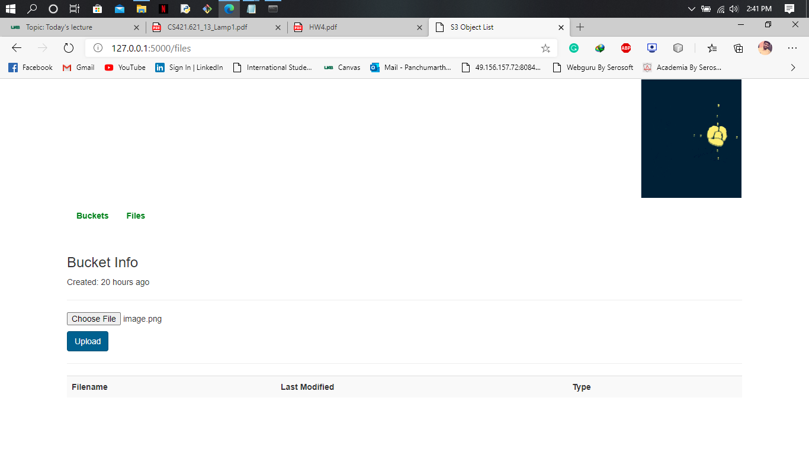

Slide 12
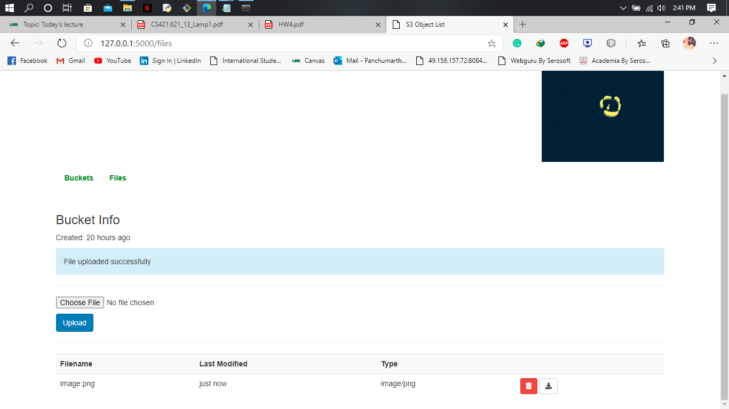

Slide 13
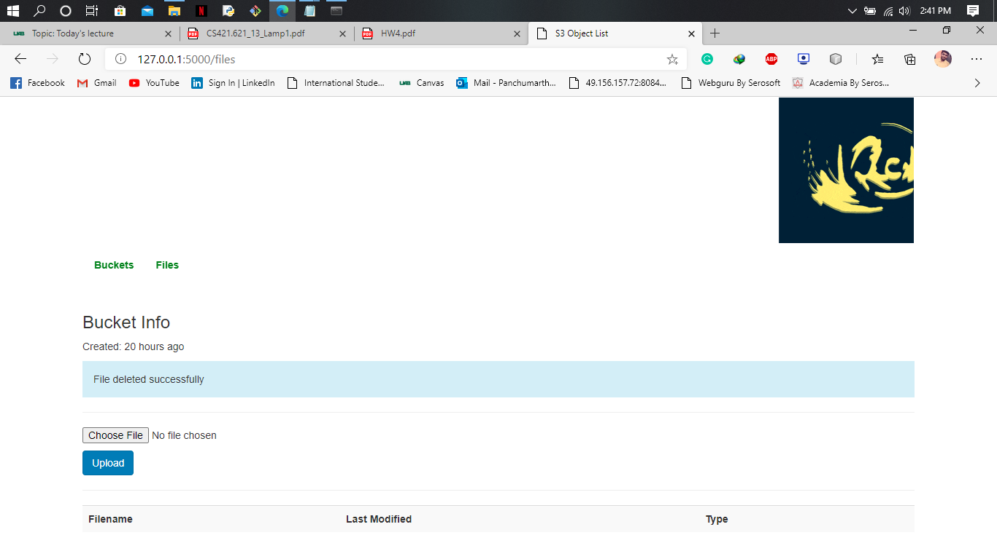

Slide 14
Task distribution
Front end: Mansi Somayajula, Amulya Valupadasu
File operations and file syncing in aws: Gauri Ganesh Kalkundri, Lakshmi Shivani Reddy Bommineni
User login, signup, buckets syncing, database linking and linking front end and backend in flask: Harish Panchumarthi
Report: Mansi Somayajula, Amulya Valupadasu, Lakshmi Shivani Reddy Bommineni
Presentation: Gauri Ganesh Kalkundri

