Slide 1


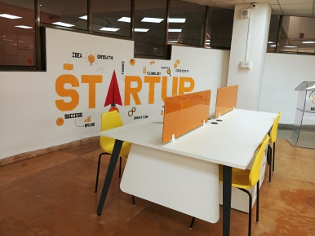
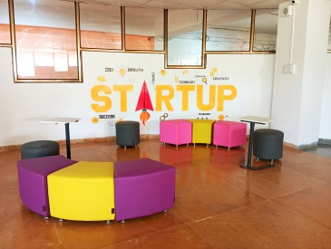
MUHS-DISHA MAHARASHTRA UNIVERSITY OF HEALTH SCIENCES Department of Innovations and Systems for Healthcare Associations
VISION
To empower aspiring technopreneurs, innovators, start-ups & advance stage ventures to create and scale responsible innovations and help build viable ventures. Propelling DISHA towards becoming one of the top hot-spot for healthcare & technology-led incubation-to-acceleration hub.
MISSION
To make MUHS-DISHA as a center of healthcare innovation, business and value creation by serving as a bridge between innovators, MUHS ecosystem, investors and industry.
To promote & facilitate resources for individuals, students and potential innovators to solve critical healthcare problems and scaling solutions to co-create commercially viable ventures
To reimagine healthcare future where we all, together strive to elevate health and prosperity for all.
OBJECTIVES
Incubation & Acceleration: Identify potential innovators/entrepreneurs, help them create business plans, provide mentors and monitor their progress.
Mentor Network: Identifying suitable mentors and strengthening the network of mentors to support the incubates.
Investor Network: Build a network of potential investors to provide funding opportunities.
Develop and Deliver: Knowledge building activities by organizing programs in the entrepreneurship domain, training sessions, and capacity/capability building for budding entrepreneurs.
Events and Workshops: Interdisciplinary knowledge sharing workshops/events/webinars for incubates.
Partnerships: Forging relevant global partnerships with other related organizations for providing services to incubatee

Slide 2

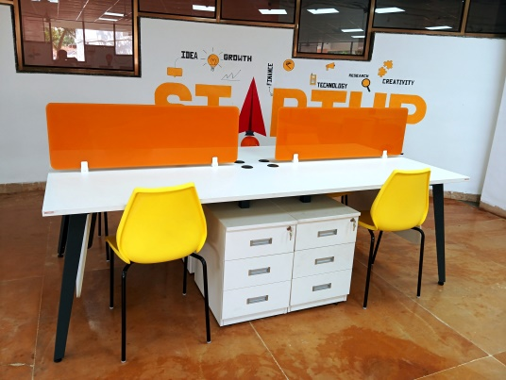
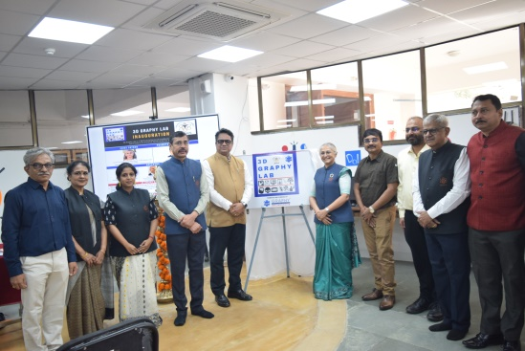
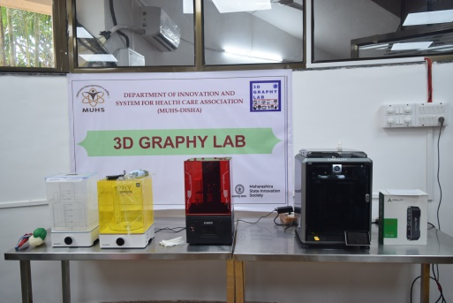
MUHS-DISHA MAHARASHTRA UNIVERSITY OF HEALTH SCIENCES Department of Innovations and Systems for Healthcare Associations
KEY MILESTONES
Established on 4 th December 2023
2024
Refurbished Space for Incubation centre with
equipments and facilities
MoU WITH 3D Graphy LLP and Inauguration of 3 D Printing facility for workshops
2025
Application process for Incubation for
first cohort started in January
Selection of Start ups for first Cohort achieved in April
STRATEGIC INITIATIVES
Upcoming Med Tech lab for innovation
and technology development at Mumbai
CORE VALUES
Innovation
Collaboration
Integrity
Inclusivity
Excellence

Slide 3




Slide 4
