Slide 1

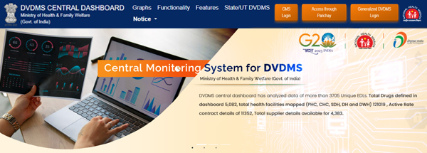
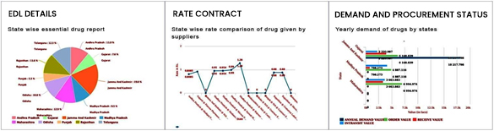
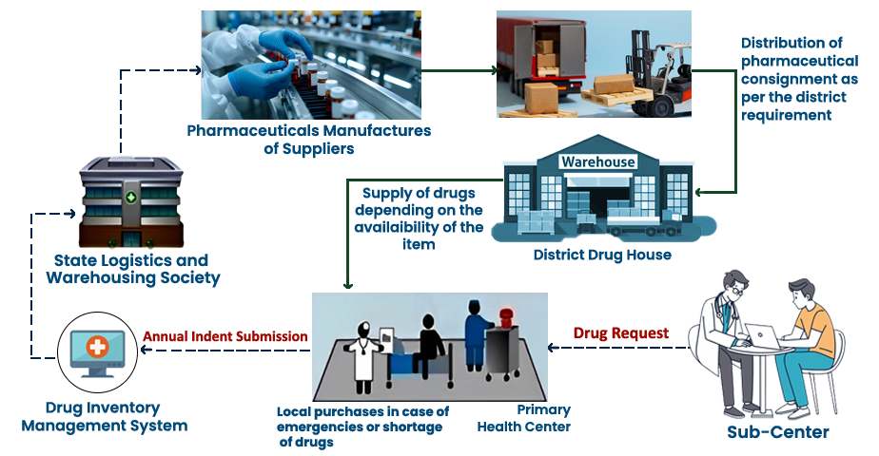
e-Aushadhi (Drug & Vaccine Distribution Management System)
e-AUSHADHI is a web based Supply Chain Management System that deals in purchase, supply, distribution and inventory management of various drugs, sutures, surgical and consumable items by linking various Regional/ District Drug warehouses (DWH), District Hospitals (DH), their sub stores like Community Health Centre (CHC), Primary Health Centre (PHC) and Sub Centres. The system also has the functionality for distribution of drugs to patients, thus enabling tracking of consumption till last mile.
KEY FEATURES
Web based on Open Source platform
Alert Management System
Centralised Dashboard
Dynamic Reporting and Data Analysis
Online/Offline Drug Distribution Counters
GS1 compliant barcode interface
Integration with payment gateway and SMS gateway
Integration with digital signature
Secured and configurable architecture
IMPLEMENTATIONS
STATES & UT : Rajasthan | Gujarat | Telangana | Bihar | Madhya Pradesh | Maharashtra | Punjab | Andhra Pradesh | Uttar Pradesh | Uttarakhand | Manipur | Himachal Pradesh | Jharkhand | Assam | Arunachal Pradesh | Mizoram | Nagaland | Odisha | Sikkim | UT (J & K | Puducherry | Ladakh | Chandigarh | Lakshadweep ) | DIMS-AP |DIMS-TS
NATIONAL PROGRAM : Central Dash Board-MoHFW |TB-MoHFW | FP-MoHFW | CMSS-MoHFW| MSO-MoHFW | NCVBDC-MoHFW | DGAFMS-MoD

Slide 2
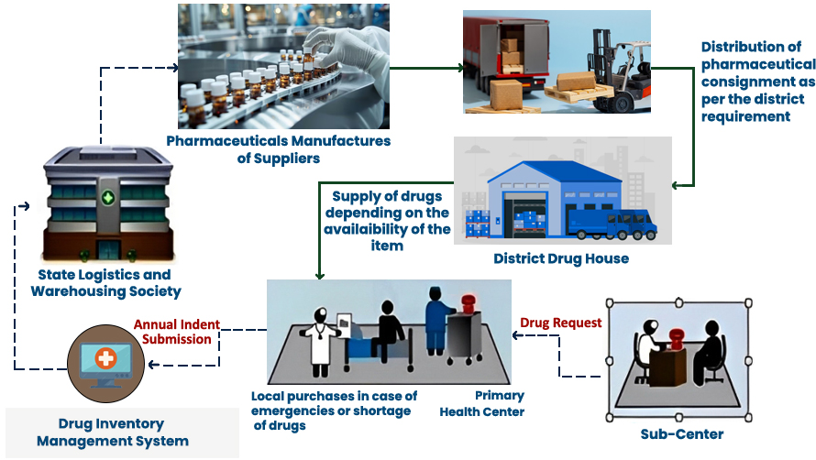
e-Aushadhi (Drug & Vaccine Distribution Management System)
e-AUSHADHI is a web based Supply Chain Management System that deals in purchase, supply, distribution and inventory management of various drugs, sutures, surgical and consumable items by linking various Regional/ District Drug warehouses (DWH), District Hospitals (DH), their sub stores like Community Health Centre (CHC), Primary Health Centre (PHC) and Sub Centres. The system also has the functionality for distribution of drugs to patients, thus enabling tracking of consumption till last mile.
KEY FEATURES
Web based on Open Source platform
Alert Management System
Centralised Dashboard
Dynamic Reporting and Data Analysis
Online/Offline Drug Distribution Counters
GS1 compliant barcode interface
Integration with payment gateway and SMS gateway
Integration with digital signature
Secured and configurable architecture
IMPLEMENTATIONS
STATES & UT : Rajasthan | Gujarat | Telangana | Bihar | Madhya Pradesh | Maharashtra | Punjab | Andhra Pradesh | Uttar Pradesh | Uttarakhand | Manipur | Himachal Pradesh | Jharkhand | Assam | Arunachal Pradesh | Mizoram | Nagaland | Odisha | Sikkim | UT (J & K | Puducherry | Ladakh | Chandigarh | Lakshadweep ) | DIMS-AP |DIMS-TS
NATIONAL PROGRAM : Central Dash Board-MoHFW |TB-MoHFW | FP-MoHFW | CMSS-MoHFW| MSO-MoHFW | NCVBDC-MoHFW | DGAFMS-MoD

