Slide 1
SMART METER
Team INNOVATORS
Anchal Hora
Surbhi Kumari
Nibha Kumari
Mansi Kesharwani

Slide 2
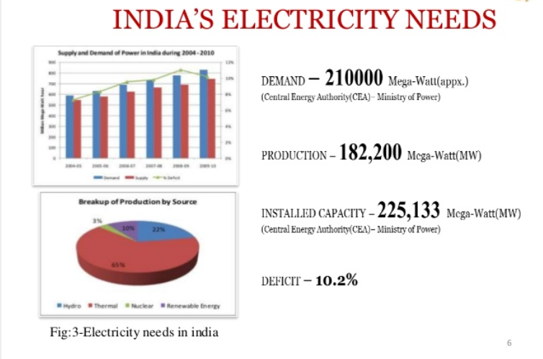
India is third largest producer of electricity in the world.​

Slide 3
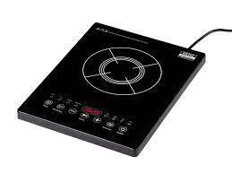
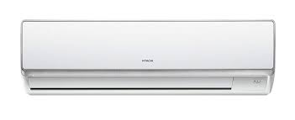

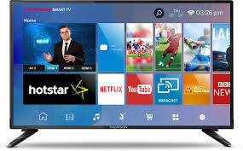

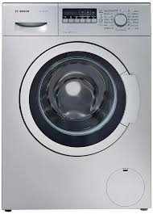
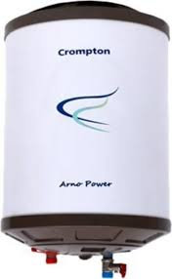

Problem faced by most of the people

Slide 4
OBJECTIVE
Electricity bill should lie within maximum limit as per the consumers requirement.

Slide 5
APPROACH
*Maximum target electricity bill for one month set by user.
*Maximum unit per month.
*Maximum unit used by devices per day.
*devices stops operating on exceeding maximum limit.
*user is notified through android app.

Slide 6
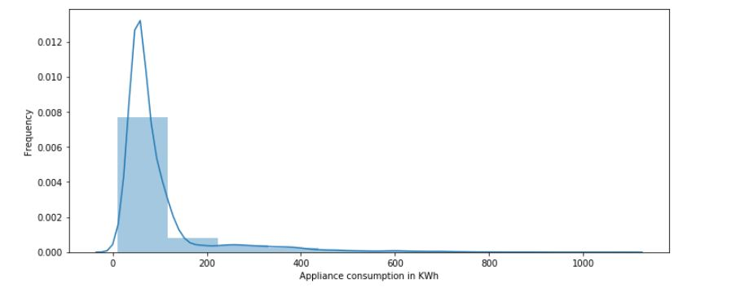
VISUALIZATION

Slide 7
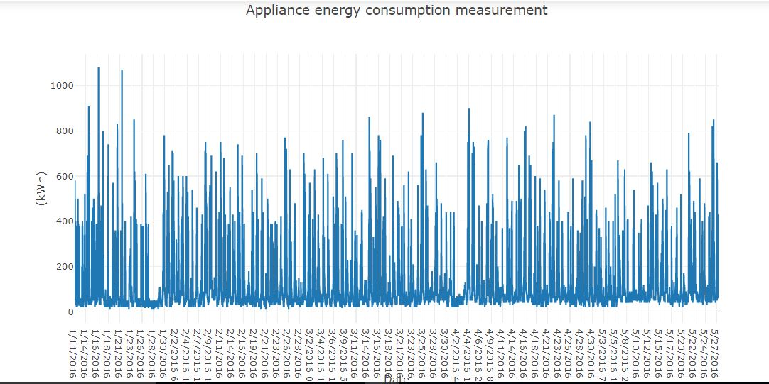

Slide 8
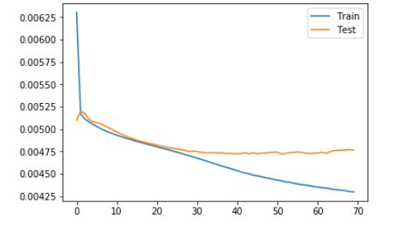
loss
epoch

Slide 9
ADVANTAGES
1.No hardware required for it's implementation (we have used hardware only for prototype purpose).
2. Cost effective
3.Energy consumption.
4.Consumers can save their money.
5.consumers get notification whenever their electricity consumption rate increases.

Slide 10
FUTURE SCOPE
Using machine learning we can futher enhance the consumer requirements.
GIS(Geographic Information Systems)can further be used to capture the real time data.

