Slide 1
Automated Defect Detection and Visual Inspection
for Quality Control in Manufacturing
Detection
Manufacturing
Automation
Neural Networks
Name:
Mansi Sapariya
Registration Number:
2448036
Project:
NNDL ESE1 Project

Slide 2
Introduction
The Problem with Manual Inspection
Our Solution
Traditional visual inspection methods are slow and inconsistent
Automated visual defect detection system using advanced deep learning models
Highly prone to human error
Fast, accurate, and scalable quality control
Leads to missed defects in manufacturing
Reduces reliance on manual labor
Results in production delays and increased costs
Improves overall product quality
Difficult to scale with increasing production volume
Enables real-time detection and quality assurance
Manual Process
AI-Powered
Improved Efficiency

Slide 3

Problem Statement
Key Challenges in Manufacturing Quality Control
Limited Access to Technology
Detection Complexity
Workflow Integration
Many manufacturing environments, especially Small-to-Medium Enterprises (SMEs), lack access to scalable, automated quality control solutions
Creating robust systems that can not only identify and classify a wide range of defects but also localize them precisely remains a significant challenge
Need for deep learning-powered systems that can optimize quality control processes and seamlessly integrate into existing production workflows
Our Project Focus
This project addresses these challenges by developing a comprehensive deep learning-based visual inspection framework that is both accurate and accessible to manufacturers of all sizes. The system aims to optimize quality control processes, reduce defect rates, and improve overall production efficiency.

Slide 4



Project Objectives
Develop a Deep Learning System
To create an automated visual defect detection system using deep learning techniques capable of accurately identifying and classifying defective vs. non-defective items.
1
Comprehensive Data Analysis
To perform a thorough Exploratory Data Analysis (EDA) on the MVTec Anomaly Detection dataset, evaluating image quality, understanding image properties, and comparing feature distributions between normal and defective samples.
2
Visualize and Analyze Defect Patterns
To analyze and visualize defect patterns and frequencies using class-wise heatmaps, histograms, and anomaly overlays to understand and predict common defect locations.
3
Implement and Evaluate Models
To implement and evaluate a set of complementary deep learning models (CAE, U-Net, and PatchCore) to ensure robust and reliable defect detection.
4
Pave the Way for Real-Time Integration
To create a foundation for integrating the inspection system into production lines, generating actionable insights for improving quality control workflows and optimizing resource allocation.
5
4
Neural Networks and Deep Learning Project Presentation

Slide 5
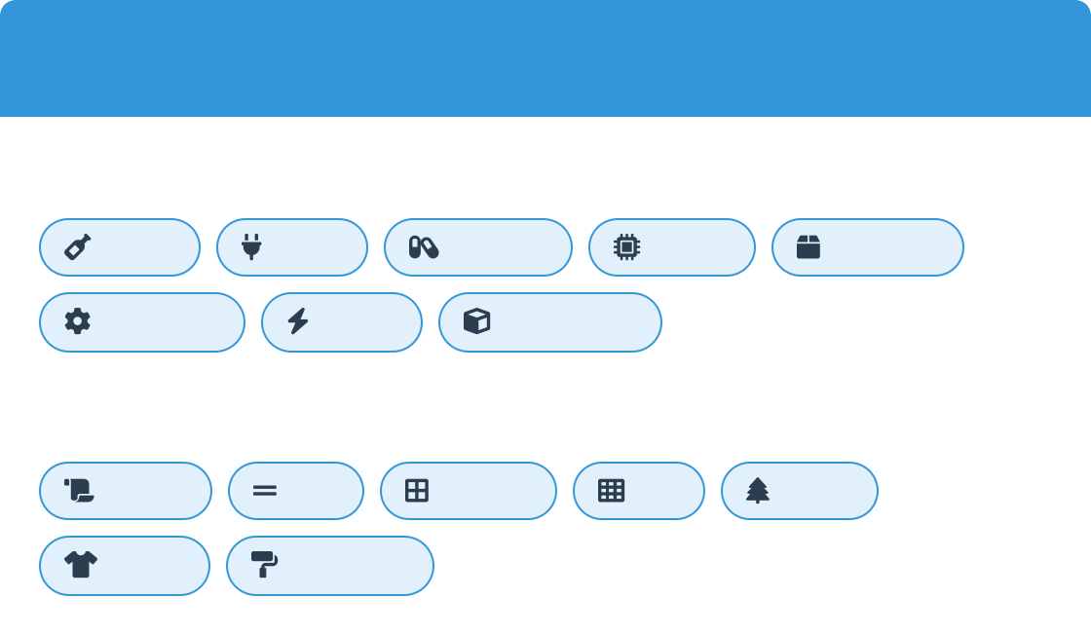

Dataset Overview - MVTec AD
MVTec Anomaly Detection Dataset
Categories & Defect Types
High-quality industrial benchmark dataset with over 5,000 high- resolution images
Object Categories:
Bottle Cable Metal Nut Screw
Texture Categories:
Carpet Grid
Fabric Wallpaper
Capsule
Circuit
Hazelnut
Contains 15 different object and texture categories
Toothbrush
Each category includes normal training images and test images with various defects
Designed specifically for anomaly detection in industrial inspection scenarios
Leather
Tile
Wood
Realistic use case that supports both classification and segmentation tasks
5,354
Total Images
3,629
Normal Training Images
1,725
Defective Test Images
73
Defect Variations
Why we chose this dataset:
Realistic industrial use case that supports both classification and segmentation, making it ideal for training robust models.
5
Neural Networks and Deep Learning Project Presentation

Slide 6
Methodology
Project Workflow
1 Data Preprocessing
Images were resized to uniform dimensions Normalized pixel values to range [0,1]
Applied data augmentation (rotation, flipping, brightness adjustments)
2
Exploratory Data Analysis (EDA)
Visualized class distributions between normal and defective samples Created defect frequency analysis
Generated heatmaps to identify common defect locations
3
Model Building
Convolutional Autoencoder (CAE): For reconstruction-based anomaly detection
U-Net: For pixel-level segmentation and defect localization PatchCore: For detecting subtle, feature-level anomalies
4
Interactive UI Development
Built Gradio web interface for interactive visualization Enabled real-time anomaly detection results Integrated side-by-side model comparison features
5 Evaluation Metrics
Mean Squared Error (MSE) for CAE reconstruction quality Mean Anomaly Mask for U-Net segmentation accuracy Anomaly Scores for PatchCore feature deviation detection
66
Neural Networks and Deep Learning Project Presentation

Slide 7

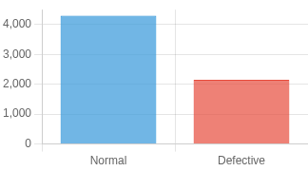
Exploratory Data Analysis (EDA)
Data Integrity Check
Class Distribution
Defect Visualization
6,452 images verified
Significant class imbalance detected
Side-by-side comparisons of normal vs. defective
All images valid and free of corruption
Majority of samples are normal (non- defective)
Ground-truth mask overlays for precise localization
High-resolution images suitable for detailed analysis
Used weighted sampling to prevent model bias
Heatmaps reveal defect clustering patterns
100% Data Integrity Maintained
Normal
Defective
Heatmap
Average Defect Heatmap Analysis
Heatmaps revealed that defects tend to cluster in specific structural areas (e.g., the rim of a bottle), providing insights for targeted inspections.
Low
Medium
High
7
Neural Networks and Deep Learning Project Presentation

Slide 8

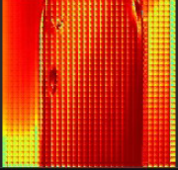
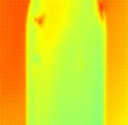
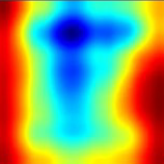



Final Model Output Visualization
Gradio UI Visualization Interface
Original Image
CAE Result
U-Net Result
PatchCore Result
Input test image from MVTec dataset
MSE Score:
0.0167
Mean Mask:
0.4168
Anomaly Score:
0.4649
Interpretation of Model Outputs
CAE MSE Score
U-Net Mean Mask
PatchCore Score
Medium-high score (e.g., 0.4649) indicates subtle feature-level deviation
Compares features to normal memory bank Effective for detecting small, nuanced defects
Low score (e.g., 0.0167) indicates image is close to normal patterns
High value (e.g., 0.4168) suggests a large defect region
High score flags a global anomaly
Precise pixel-level segmentation of defects
Focuses on reconstruction-based detection
Highlights exact boundaries of anomalies
8
Neural Networks and Deep Learning Project Presentation

Slide 9


Model Architectures
Convolutional Autoencoder
U-Net Segmentation
PatchCore
Input Image
Output Mask
Input Image
Encoder
Input Image
ResNet Backbone
Latent Space
Decoder
Memory Bank Feature Patches
Anomaly Score Map
Encoder-decoder with skip connections
Feature-based anomaly detection
Precise pixel-level defect localization
Compares test features to memory bank
Unsupervised encoder-decoder structure
Outputs detailed segmentation masks
Detects subtle, feature-level anomalies
Detects anomalies by measuring reconstruction error
High MSE indicates defects/anomalies
Multi-Model Approach: Complementary strengths for comprehensive defect detection
Global Anomalies Pixel-level Localization Subtle Feature Anomalies CAE U-Net PatchCore

Slide 10






Model Justification
Multi-Model Approach Advantages
Our multi-model approach was designed to leverage the unique strengths of each architecture, creating a comprehensive and robust defect detection system that outperforms single-model solutions.
Convolutional Autoencoder (CAE)
U-Net Segmentation
PatchCore
Excels at identifying global anomalies by flagging deviations from the overall learned "normal" image pattern.
Specializes in precise localization, generating pixel-wise segmentation masks that highlight the exact boundaries of a defect.
Captures subtle, feature-level anomalies by comparing image patches to a memory bank of normal features, detecting small, nuanced defects.
Global Pattern Recognition
Precise Localization
Reconstruction-Based
Boundary Segmentation
Feature-Level Detection
Subtle Anomalies
Combined System Benefits
Higher Accuracy
CAE
U-Net
PatchCore
Fewer False Negatives
Input Image
Parallel Processing
Robust Detection
Diverse Defect Coverage
10
Neural Networks and Deep Learning Project Presentation

Slide 11


Model Performance & Results
CAE Model
U-Net Model
PatchCore Model
Mean Squared Error (MSE):
0.0167 (Normal Images)
0.1458 (Defective Images)
Mean Anomaly Mask:
0.4168 (Defect Regions)
0.0213 (Normal Regions)
Anomaly Score:
0.4649 (Feature Deviation)
0.0128 (Normal Features)
Successfully learned normal patterns Strong at detecting global anomalies Lower MSE indicates better image reconstruction
Precise pixel-level localization
High sensitivity to defect boundaries Higher mask values for pronounced defects
Best at subtle, feature-level anomalies Highest sensitivity to small defects Effective on spatially limited anomalies
Complementary Performance Across Defect Types
Key Finding: Combined multi-model approach provides more comprehensive and reliable detection than any single model, capturing different types of defects with high accuracy.
11
Neural Networks and Deep Learning Project Presentation

Slide 12
Conclusion
Project Achievements
We successfully developed a multi-model deep learning framework for automated visual defect detection using a real-world industrial dataset (MVTec AD). Our combined approach using CAE, U-Net, and PatchCore provides a more comprehensive and reliable solution than any single-model system alone.
Multi-Model Synergy
Industrial Application
Quality Improvement
Combined strengths of three deep learning models to maximize detection capabilities across different defect types
Scalable, accurate visual inspection system that reduces manual errors and optimizes production workflows
Enhanced product quality and reduced inspection costs through automated, consistent detection systems
Impact on Manufacturing Sector
Reduced manual inspection time
Enhanced defect localization
Improved production quality
Reduced operational costs

Slide 13

Limitations & Future Scope
Current Limitations
Future Opportunities
May not generalize well to entirely new defect types or component shapes
Integration with real-time video feeds for live production line monitoring
Requires additional training data for novel defect categories
Deployment on edge devices for faster, on-site inference
Does not account for real-world variables such as lighting changes or motion blur
Extension to multi-class defect classification
Advanced transfer learning techniques to adapt to new products with minimal retraining
Computational requirements may be high for real-time applications
Deployment challenges in resource-constrained manufacturing environments
Integration with robotic systems for automated quality control and sorting
Current Challenges
Ongoing Research
Future Applications

