Slide 1
Swiggy data ANALYSIS
Teammates:
MANSI JAIN
IRIKA GUPTA
SWATI LATTA
YESHWANT JADHAV

Slide 2
INTRODUCTION
Swiggy has rapidly grown to become one of the most popular food delivery services in India.
Swiggy's platform allows users to order food from a wide range of restaurants in their area and have it delivered to their doorstep in a timely and convenient manner. Swiggy also offers a range of features such as real-time order tracking, in-app chat support, and multiple payment options to enhance the user experience.
In addition to food delivery, Swiggy has also expanded into other areas such as hyperlocal delivery, groceries, and medicine delivery. As of 2021, Swiggy operates in more than 500 cities across India and has a strong network of delivery partners and restaurant partners.

Slide 3
OBJECTIVE
Optimal location identification: Analyze swiggy data to pinpoint high-demand areas in bangalore for a new restaurant, ensuring a steady stream of customers.
Competitive analysis: Study existing successful restaurants in the chosen location to develop a competitive edge in cuisine, pricing, and marketing.
Customer rating optimization: Analyze customer feedback to improve restaurant offerings and service, increasing positive reviews and repeat business.

Slide 4
Problem Statement
BUSINESS OPPORTUNITY: The food delivery market is growing rapidly, and there is a significant opportunity to build a successful business in this space.
PASSION OF FOOD: If you have a passion for food and enjoy exploring different cuisines, a food delivery project can be a fun and rewarding way to explore that interest.
INNOVATION: The food delivery market is constantly evolving, with new technologies and business models emerging all the time. If you enjoy being on the cutting edge of innovation and entrepreneurship, a food delivery project may be an exciting challenge for you.

Slide 5
PROCEDURE
Scrape the data from swiggy’s website and analyze it.
After analyzing we have presented the data in table with details of different column.
Identify the various factors like highest rating, most popular cuisines, expensive restaurant, location wise rating via graphs.
Finally we managed to get insights from the data and we have made a dashboard according to it.

Slide 6
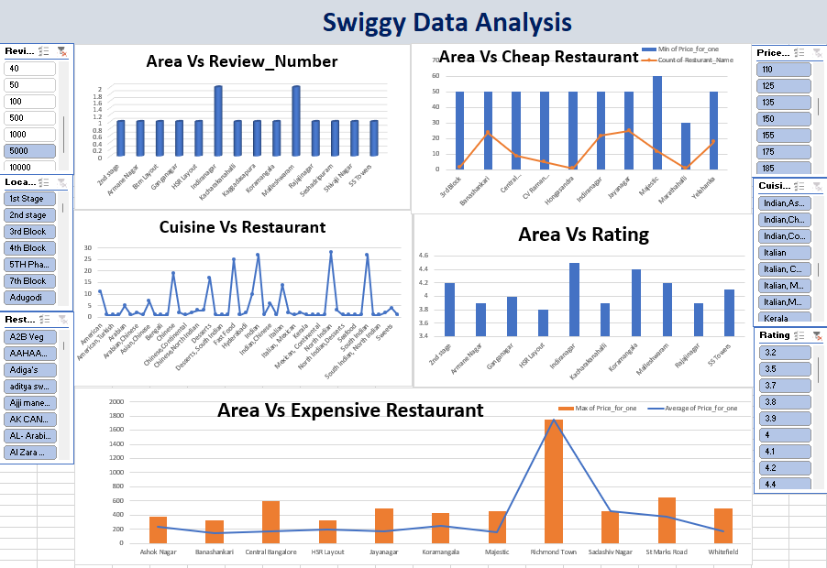
dashboard

Slide 7
insights

Slide 8
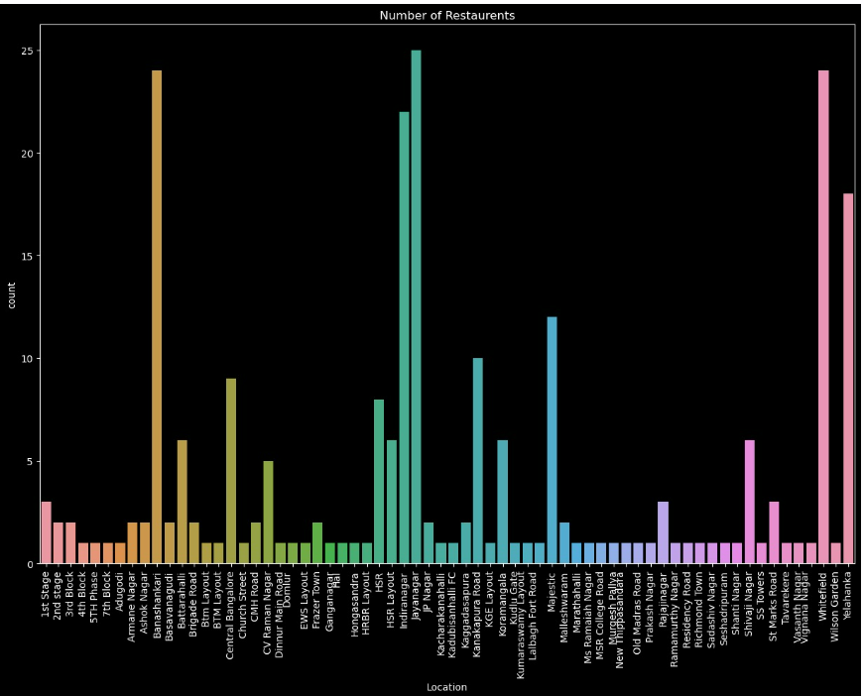
Area wise distribution of restaurant

Slide 9
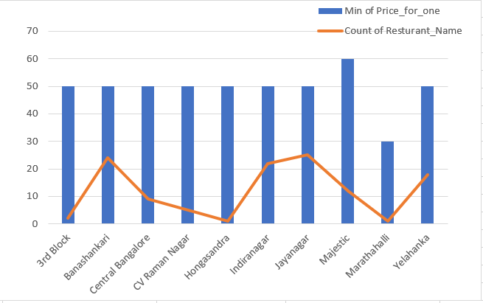
AREA WISE CHEAP RESTAURANT

Slide 10
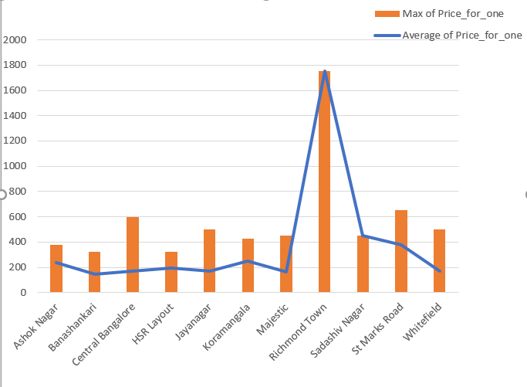
Area wise expensive restaurant

Slide 11
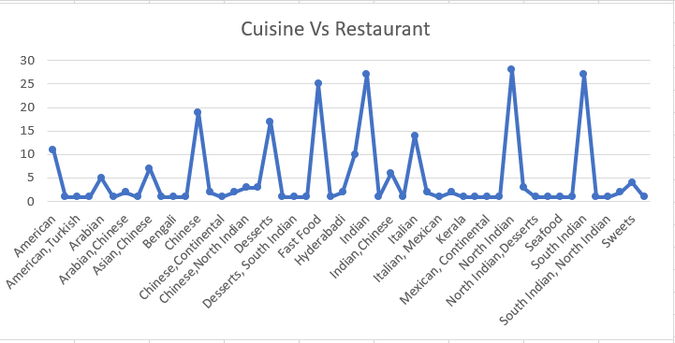
Number of restaurant for each type of cuisine

Slide 12
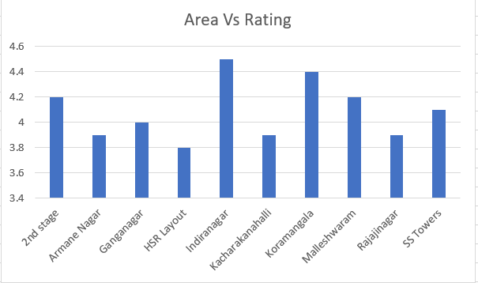
Area wise rating distribution

Slide 13
learning
Time management
Team work
Problem solving
New python library (like Selenium and Beautiful Soup)

Slide 14
challenges
Web Scrapping:
We have to explore the new python library (like Selenium and BeautifulSoup)
Time constraints
We have to complete this project in given time frame.

Slide 15
Future scope
Expansion into new markets
Integration with new technologies
Diversification of services
Sustainability

Slide 16
Thank you
Mansi Jain (PTDA_033)

