Slide 1



Presentation
CPU SCHEDULING ALGORITHM SIMULATOR
PRAYAS
2025
Presenter Name
MANSINGH : 24TEC2AIDS039
MISHIMAN SINGH: 24TEC2AIDS100
MEHUL SHARMA: 24TEC2AIDS098
PRIYANSHU SHEKHAR : 24TEC2AIDS103
Submitted to:-Mrs. Ruchi
Date:- 30/04/2026
www.vgu.ac.in

Slide 2

CPU Scheduling Algorithm Simulator
A Simulation-Based Study of Process Scheduling in Operating Systems
B.TECH CSE · OPERATING SYSTEMS PROJECT

Slide 3
Project Objectives
This project aims to bridge theory and practice by building an interactive CPU scheduling simulator.
1
2
Design & Develop
Implement Algorithms
Build a fully functional CPU scheduling simulator from the ground up
Code multiple classic scheduling algorithms for direct comparison
3
4
Analyze Metrics
Visualize Execution
Measure waiting time, turnaround time, and overall efficiency
Generate Gantt charts to illustrate process execution timelines

Slide 4

SYSTEM ARCHITECTURE
How the Simulator Works
The simulator is a software-based tool that models real CPU scheduling behavior. It accepts user-defined process parameters, applies the selected algorithm, and produces a clear visual output of execution order and performance results.
Accept Input
Apply Algorithm
Display Results
Process ID, arrival time, burst time, priority
User selects FCFS, SJF, Round Robin, or Priority
Gantt chart, waiting time, and turnaround metrics

Slide 5
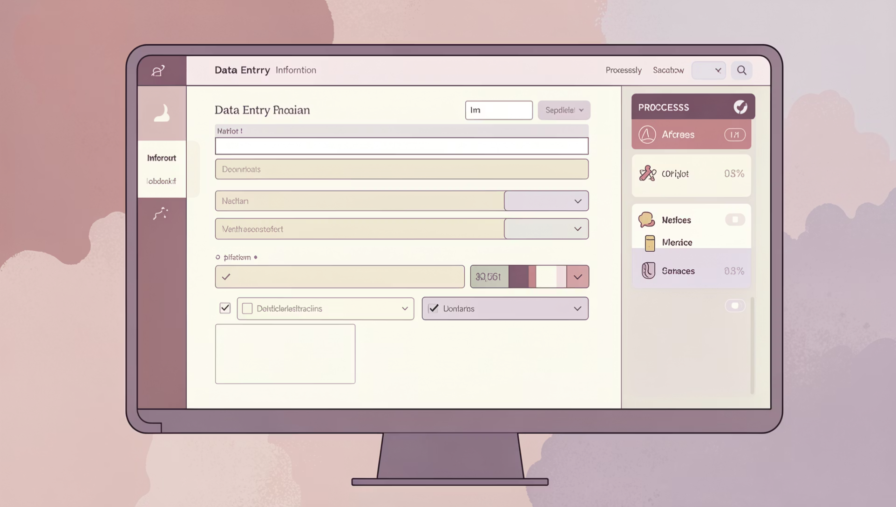
Input Parameters
The simulator requires the following process attributes to model scheduling behavior accurately:
Process ID
Arrival Time
Burst Time
Priority
Unique identifier for each process (P1, P2, …)
Time at which the process enters the ready queue
Total CPU time required for process execution
Integer value used by Priority Scheduling (lower = higher priority)
Time Quantum
Fixed time slice per process in Round Robin scheduling

Slide 6
Advantages & Real-World Applications
✅ Advantages
Clear visual representation of abstract scheduling concepts
Builds strong conceptual clarity for OS theory
Enables side-by-side algorithm comparison
Hands-on learning without hardware requirements
🎯 Applications
Operating Systems coursework and lab exercises
Performance benchmarking of scheduling strategies
Algorithm comparison for academic research
Foundation for understanding real OS kernels

Slide 7
Conclusion
CPU scheduling is a cornerstone of operating system performance. This simulator demonstrates that no single algorithm is universally optimal — each has trade-offs in fairness, throughput, and responsiveness.
Key Insight
Comparative Value
Algorithm choice directly impacts system efficiency and user experience
Side-by-side metrics reveal each algorithm's strengths and weaknesses
Educational Impact
The simulator transforms abstract OS theory into tangible, visual understanding

Slide 8
Acknowledgement & Thanks
We sincerely thank Mrs. Ruchi(Assistant Professor)for his continuous guidance.
Special thanks to our faculty members and technical mentors for their constant support and valuable feedback.
  Gratitude to our peers, professors, and institutions for academic &
  moral support.
THANKS!

