Slide 1

Analysis of Global AI Impact Using Python
DONE BY :
M M MOHAMED MANSOOR

Slide 2

01
CONTENTS
03
Introduction
Revenue Increase vs Job Loss Due to AI
02
04
AI Adoption by country
06
Total revenue increase due to AI countrywise
Average Adoption Rate Per Year
05
07
08
Total marketshare of Ai companies by Industry
Revenue Increase v/s Human AI Collaboration
Conclusion

Slide 3

01
INTRODUCTION
AI is changing the way content is created and shared around the world—from news articles and social media posts to videos and reports. As this technology becomes more common, it’s important to understand its growing influence.
In this project, I’m analyzing the Global AI Content Impact Dataset to explore how AI-generated content is impacting different countries and regions. Using Python with NumPy, Pandas, and Matplotlib, I’ll look at trends in content volume, measure impact scores, and visualize how things have changed over time.
The goal is to uncover patterns and insights that show how AI is shaping global content and communication.
This project focuses on performing data analytics on a real-world dataset to extract meaningful insights and understand underlying patterns. Using various data processing and visualization techniques, the goal is to explore, analyze, and interpret the dataset in a structured manner.
The analysis involves cleaning the data, identifying trends, generating visual summaries, and drawing conclusions based on statistical observations. This project helps demonstrate the application of data analytics in making data-driven decisions and presenting insights in a clear and concise format.

Slide 4
Libraries used
pandas – for data processing
numpy – for numerical operations
matplotlib – for plotting
seaborn – for advanced visualizations

Slide 5
DataSet Information
contains 200 records with 12 columns, including:Country, Year, and Industry
Metrics like:
AI Adoption Rate (%)
AI-Generated Content Volume (TBs/year)
Job Loss Due to AI (%)
Revenue Increase Due to AI (%)
Human-AI Collaboration Rate (%)
Consumer Trust in AI (%)
Market Share of AI Companies (%)
Categorical columns like Top AI Tools Used and Regulation Status

Slide 6
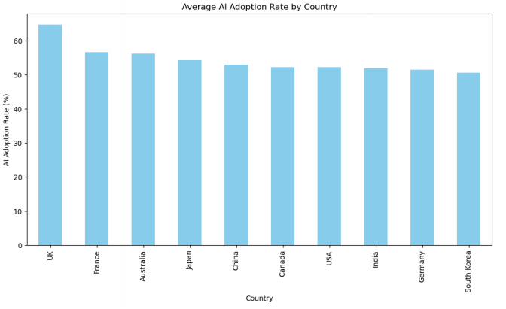
02
AI Adoption by country
plt.figure(figsize=(12, 6))
adopt_country = df.groupby('Country')['AI Adoption Rate (%)'].mean().sort_values(ascending=False)
adopt_country.plot(kind='bar', color='skyblue')
plt.ylabel("AI Adoption Rate (%)")
plt.title("Average AI Adoption Rate by Country")
plt.show()
AI Adoption by Country refers to how widely AI technologies are being implemented across different nations. It is measured as a percentage, indicating the extent of AI integration in sectors like business, healthcare, and education. This helps compare the technological advancement and readiness of countries in embracing AI.

Slide 7
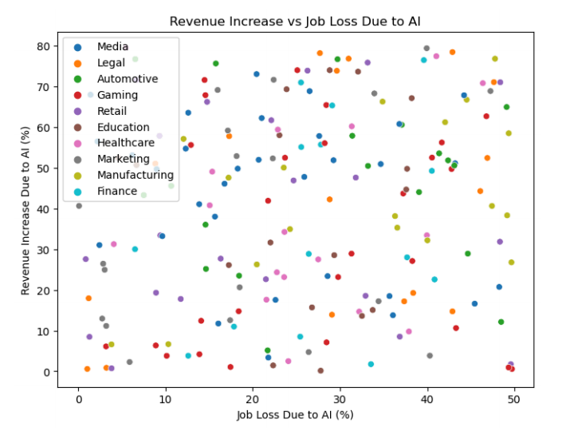
03
Revenue Increase vs Job Loss Due to AI
# Revenue vs Job Loss
import matplotlib.pyplot as plt
import seaborn as sns
plt.figure(figsize=(8, 6))
sns.scatterplot(data=df, x='Job Loss Due to AI (%)',y='Revenue Increase Due to AI (%)', hue='Industry')
plt.title("Revenue Increase vs Job Loss Due to AI")
plt.xlabel("Job Loss Due to AI (%)")
plt.ylabel("Revenue Increase Due to AI (%)")
plt.legend()
plt.show()
Revenue Increase vs Job Loss Due to AI compares the financial benefits of AI adoption with its potential negative impact on employment. It highlights the trade-off between business growth and workforce displacement. This analysis helps assess whether AI-driven revenue gains come at the cost of significant job losses.

Slide 8
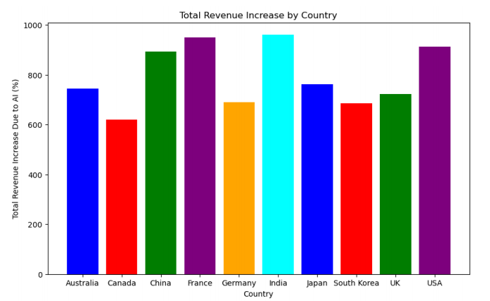
04
Total revenue increase due to AI countrywise
#Total revenue increase due to AI
import numpy as np
import pandas as pd
import matplotlib.pyplot as plt
# Load the dataset
df = pd.read_csv("Global_AI_Content_Impact_Dataset.csv")
# Group by 'Country' and sum the 'Revenue Increase Due to AI (%)' (acting as 'Total Sales')
region_sales = df.groupby("Country")["Revenue Increase Due to AI (%)"].sum()
# Plotting the sales by region (country)
plt.figure(figsize=(10, 6))
plt.bar(region_sales.index, region_sales.values, color=['blue', 'red', 'green', 'purple', 'orange', 'cyan'])
# Labels and title
plt.xlabel("Country")
plt.ylabel("Total Revenue Increase Due to AI (%)")
plt.title("Total Revenue Increase by Country")
# Show plot
plt.show()

Slide 9
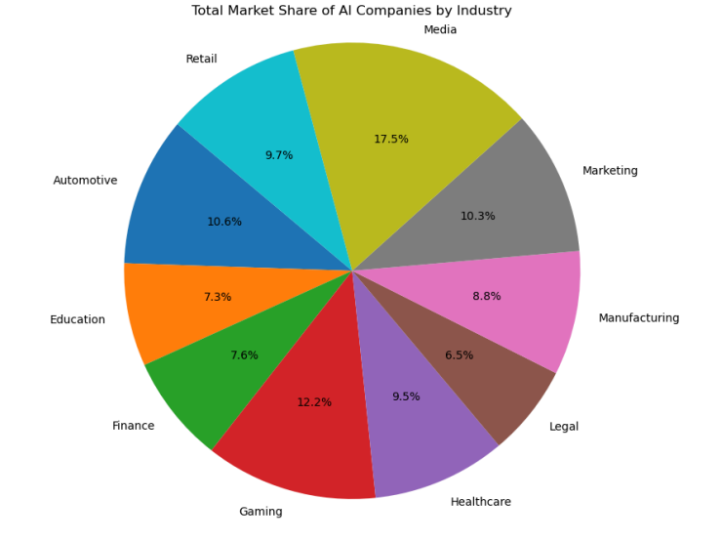
05
Total market share of AI companies by Industry
import pandas as pd
import matplotlib.pyplot as plt
# Load the data
df = pd.read_csv('Global_AI_Content_Impact_Dataset.csv')
# Group by Industry and sum market share
industry_market_share = df.groupby("Industry")["Market Share of AI Companies (%)"].sum()
# Plot pie chart
plt.figure(figsize=(8, 8))
plt.pie(industry_market_share, labels=industry_market_share.index, autopct='%1.1f%%')
plt.title("Total Market Share of AI Companies by Industry")
plt.axis('equal') # Make the pie chart circular
plt.show()

Slide 10
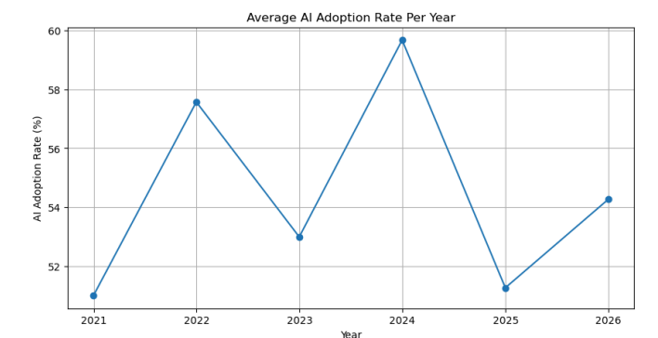
06
Average adoption rate per year
import pandas as pd
import matplotlib.pyplot as plt
# Load the data
df = pd.read_csv('Global_AI_Content_Impact_Dataset.csv')
# Convert 'Year' to datetime
df['Year'] = pd.to_datetime(df['Year'], format='%Y', errors='coerce')
# Set 'Year' as index
df.set_index('Year', inplace=True)
# Resample by year and calculate mean AI Adoption Rate
yearly_adoption = df.resample('Y').mean(numeric_only=True)['AI Adoption Rate (%)']
# Plot
plt.figure(figsize=(10, 5))
plt.plot(yearly_adoption.index, yearly_adoption, marker='o', linestyle='-')
plt.xlabel("Year")
plt.ylabel("AI Adoption Rate (%)")
plt.title("Average AI Adoption Rate Per Year")
plt.grid(True)
plt.show()

Slide 11
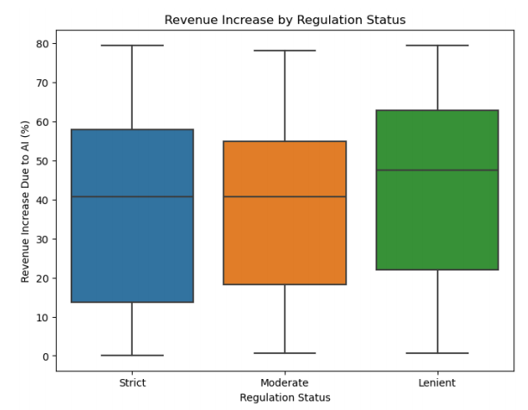
07
Revenue increase due to regulation status
plt.figure(figsize=(8, 6))
sns.boxplot(data=df, x='Regulation Status', y='Revenue Increase Due to AI (%)')
plt.title("Revenue Increase by Regulation Status")
plt.xlabel("Regulation Status")
plt.ylabel("Revenue Increase Due to AI (%)")
plt.show()
REGULATION STATUS:Describes the level of AI regulation affecting each company,region or industry.
Strict - Strong government or organizational regulations on AI use
Moderate - Some rugulations in place
Lenient - No significant AI regulation

Slide 12
CONCLUSION
This data analytics project highlights how data-driven insights can help us better understand the growing impact of Artificial Intelligence in modern society. The analysis reflects trends and patterns that point to AI’s increasing role in content creation, decision-making, and digital communication.
By analyzing the data, we gain a clearer view of how technology is shaping public perception, influencing industries, and affecting the way we interact with information. Such insights are crucial for guiding ethical, inclusive, and responsible use of AI in ways that benefit society as a whole.
The most profound impact revealed by this data is that AI adoption is not just transforming industries—it is reshaping the very structure of work and trust in technology. While companies see a measurable increase in revenue and efficiency, the societal cost is evident in job displacement and fluctuating consumer trust. simplify

