Slide 1
CANCER

Slide 2
Cancer, also called malignancy, is an abnormal growth of cells. There are more than 100 types of cancer, including breast cancer, skin cancer, lung cancer, colon cancer, prostate cancer, and lymphoma. Symptoms vary depending on the type. Cancer treatment may include chemotherapy, radiation, and/or surgery

Slide 3
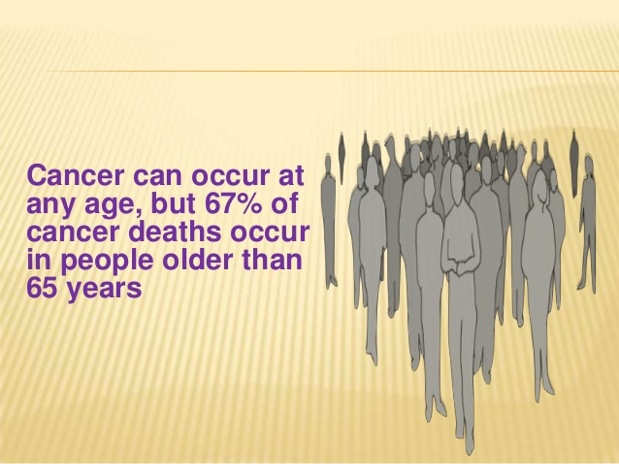

Slide 4
Cancer is a group of diseases involving abnormal cell growth with the potential to invade or spread to other parts of the body.
Not all tumors are cancerous; benign tumors do not spread to other parts of the body.
Possible signs and symptoms include a lump, abnormal bleeding, prolonged cough, unexplained weight loss and a change in bowel movements.

Slide 5
While these symptoms may indicate cancer, they may have other causes.
Over 100 cancers affect humans
Tobacco use is the cause of about 22% of cancer deaths.
Another 10% is due to obesity, poor diet, lack of physical activity and drinking alcohol.

Slide 6
Other factors include certain infections, exposure to ionizing radiation and environmental pollutants. In the developing world nearly 20% of cancers are due to infections such as hepatitis B, hepatitis C and human papillomavirus (HPV).
These factors act, at least partly, by changing the genes of a cell.Typically many genetic changes are required before cancer develops. Approximately 5–10% of cancers are due to inherited genetic defects from a person's parents.

Slide 7
Cancer can be detected by certain signs and symptoms or screening tests.
It is then typically further investigated by medical imaging and confirmed by biopsy
Cancer is often treated with some combination of radiation therapy, surgery, chemotherapy, and targeted therapy

Slide 8
Many cancers can be prevented by not smoking, maintaining a healthy weight, not drinking too much alcohol, eating plenty of vegetables, fruits and whole grains, vaccination against certain infectious diseases, not eating too much processed and red meat, and avoiding too much sunlight exposure
In females, the most common types are breast cancer, colorectal cancer, lung cancer and cervical cancer

Slide 9
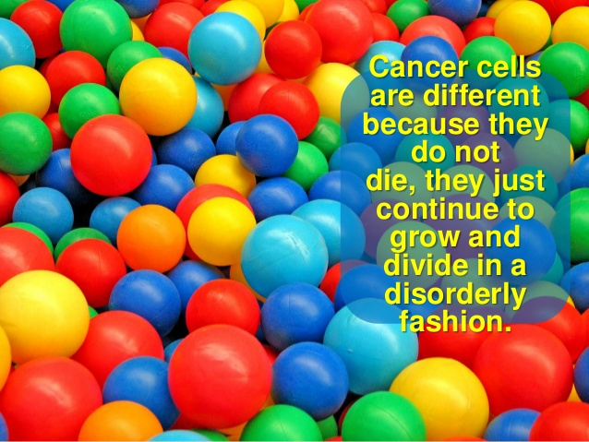

Slide 10
What are the main causes of cancer?
Gene mutations that occur after birth. Most gene mutations occur after you're born and aren't inherited. A number of forces can cause gene mutations, such as smoking, radiation, viruses, cancer-causing chemicals (carcinogens), obesity, hormones, chronic inflammation and a lack of exercise

Slide 11
How does the cancer occur?
Cancer starts when cells in a part of the body start to grow out of control. Cancer cell growth is different from normal cell growth. Instead of dying, cancer cells continue to grow and form new, abnormal cells. Cancer cells can also invade (grow into) other tissues, something that normal cells can't do

