Slide 1


Slide 2
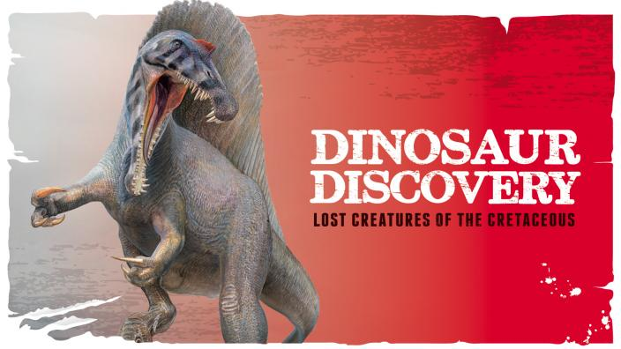
Jinnah Univerisity For Women Karachi
2nd Assignment Of Zoology
Topic : Dinosaur Discoveries
Group Members : Beenish Khan & Mehak Rafiq
Subject Teacher : Miss Marry Mehwish

Slide 3
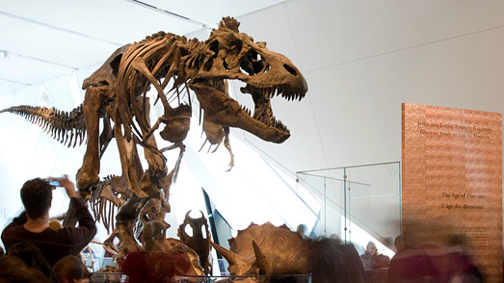
Introduction Of Dinosaur :-
Dinosaurs are a diverse group of animals of the clad Dinosaurian that first appeared during the Triassic period. Although the exact origin and timing of the evolution of dinosaurs is the subject of active research, the current scientific consensus places their origin between 231 and 243 million years ago.
however, the fossil record indicates that birds are the modern descendants of feathered dinosaurs, having evolved from thereof ancestors during the Jurassic Period, and are now termed "avian dinosaurs“.

Slide 4
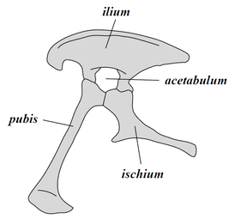
Classification :
Dinosaurs belong to a group known as archosaurs, which also includes modern crocodilians. Within the archosaur group, dinosaurs are differentiated most noticeably by their gait. Dinosaur legs extend directly beneath the body, whereas the legs of lizards and crocodilians sprawl out to either side.
Collectively, dinosaurs as a clade are divided into two primary branches, Saurischia and Ornithischia
Saurischian pelvis structure (left side)
Early saurischians—"lizard-hipped", from the Greek sauros (σαῦρος) meaning "lizard”and ischion (ἰσχίον) meaning "hip joint"—retained the hip structure of their ancestors, with a pubis bone directed cranially, or forward.

Slide 5
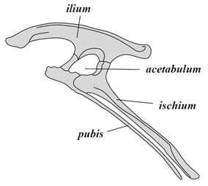
By contrast, ornithischians—"bird-hipped", from the Greek ornitheios (ὀρνίθειος) meaning "of a bird" and ischion (ἰσχίον) meaning "hip joint"—had a pelvis that superficially resembled a bird's pelvis: the pubis bone was oriented caudally (rear-pointing). Unlike birds, the ornithischian pubis also usually had an additional forward-pointing process
Ornithischian pelvis structure (left side)
. Ornithischia includes a variety of species which were primarily herbivores. (NB: the terms "lizard hip" and "bird hip" are misnomers – birds evolved from dinosaurs with "lizard hips".)

Slide 6
1: Largest and Smallest :
Scientists will probably never be certain of the largest and smallest dinosaurs to have ever existed. This is because only a tiny percentage of animals ever fossilize, and most of these remain buried in the earth.
The smallest dinosaur known is the bee hummingbird, with a length of only 5 cm (2.0 in) and mass of around 1.8 g (0.063 oz).
There were larger dinosaurs, but knowledge of them is based entirely on a small number of fragmentary fossils. Most of the largest herbivorous specimens on record were discovered in the 1970s or later, and include the massive Argentinosaurus, which may have weighed 80000 to100000 kilograms (90 to 110 short tons)

Slide 7
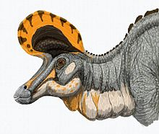
2: Comumnication :
Modern birds are known to communicate using visual and auditory signals, and the wide diversity of visual display structures among fossil dinosaur groups suggests that visual communication has always been important in dinosaur biology.
In addition, other, non-vocal, methods of producing sound for communication include hissing, jaw grinding or clapping, use of environment (such as splashing), and wing beating (possible in winged maniraptoran dinosaurs).
Artist’s impression of a striking and unusual visual display in a Lambeosaurus magnicristatus .

