Slide 1
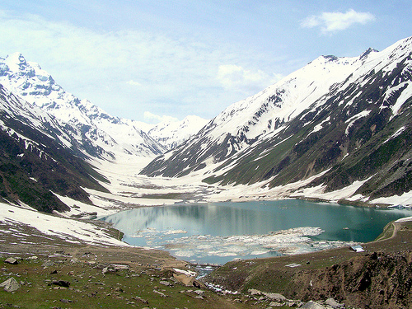
Jinnah University For Women
2nd Presentation Of Zoology
TOPIC: National Parks Of Pakistan
Group Member: Beenish Khan & Mehak Rafiq

Slide 2
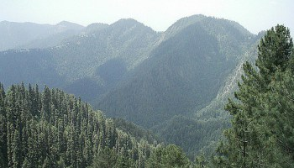
AYUBIA NATIONAL PARK
Ayubia National Park was established in 1984 in an east corner of Khyber Pakhtunkhwa, province of Pakistan. In 1998 it was expanded form its original size of 1,684 hectares (4,161 acres) or 16.84 km2 (6.50 sq mi) to 3,312 hectares (8,184 acres). Since then it has been managed by the Khyber Pakhtunkhwa Wildlife Department

Slide 3
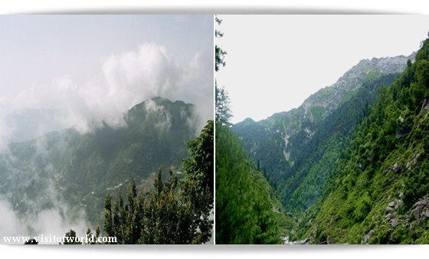
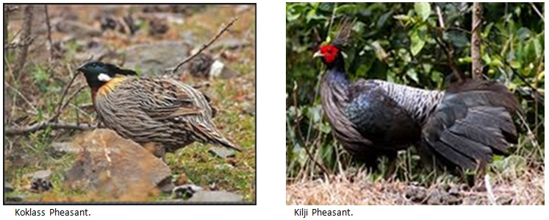
CLIMATE:
. The park remains snow-capped through the later part of winters.
Rainfall: 1,244 cm
Temperature: 3 °C - 11 °C
WILD LIFE:
The park holds 104 species of plants. The main floral species are Cedrus deodara, blue pine, yew, silver fir, horse chestnut and oak. The park harbors up to 203 species of birds. Many species of birds, including the golden eagle, the vulture, Eurasian sparrowhawk and the hill pigeon among others can be found here. Ayubia National Park supports 31 species of mammals. Animals such as the Asiatic leopard, hill fox and flying squirrel can be found here.

Slide 4
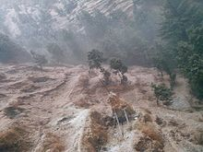
DARWAZA AYUBIA:
Darwaza is a village near Ayubia, situated in the Abbottabad district Union Council Palak, Khyber Pakhtunkhwa, Pakistan. The population of Darwaza is about 5000.
Chamb is a small Mohalla of Village Darwaza which is at a distance of about 2 km from Kuza Gali. Chamb is linked to main Ayubia. The population of Chamb is around 1000 and the main places of Chamb are Butti, Kohri, Purana Chamb, Upper Chamb and Lower Chamb.
Ander Kote is a village near Riyali with a population of about 1000 people.
Bagla is a mohalla near Jandala with deobandi Sunni Majority population. Bagla is on the way of Khaira Gali Darwaza Road.
Bantan is considered to be the main hub or in other words, the capital of Darwaza

Slide 5
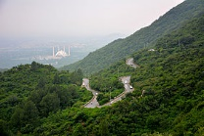
Margalla Hills National Park
Margalla Hills National Park (MHNP) is a national park located on the north of the Islamabad City, within the Islamabad Capital Territory in Pakistan. Established in 1980, MHNP cover's approximately 17,386 hectares (67.13 sq mi), Tilla Charouni with a height of 1,604m is tallest peak in the park. MHNP is a popular tourist destination, with Daman-e-Koh and Pir Sohawa serve as popular hill stations.

Slide 6
Flora and fauna:
In the north, stand pines and groves of oak. The fauna is mainly Indo Himalayan, with some overlapping of Palearctic species. Margalla hills have beautiful torrents gushing down in the monsoon. Natural springs are also present. Margalla has a variety of mammals, they include the Indian leopard, gray goral, barking deer, wild boar, golden jackal, red fox and others.
campaigns:
Margalla Hills Society established in 1989 is a registered non-governmental organization with its Head Office in Islamabad, Pakistan. It is managed by an elected executive council. Its main objective is to preserve the natural environment of Margalla Hills National Park and prevent shrinkage of the green areas; to promote public interest in conservation

Slide 7
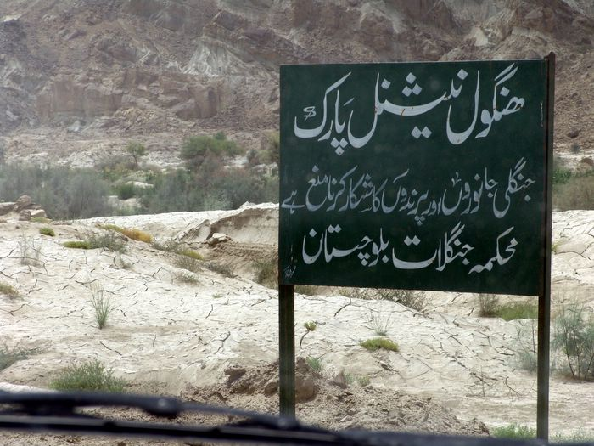
Hingol National Park
Hingol National Park or Hungol National Park (Urdu: ہنگول ) covers an area of 1,650 square kilometres (640 sq mi) and is the largest National Park in Pakistan. It was established in 1988.Hingol is the largest of National Parks of Pakistan and lies on the Makran coast in Balochistan. There are worship places of GANESH DEVA,MATA KALI,GURU GORAKH NATH DOONI,BRAHAM KUNDH

Slide 8
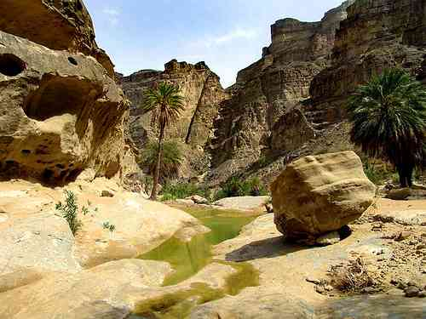
Flora and fauna:
Large areas of the park are covered with drift sand and can be classified as coastal semi desert. The park includes the estuary of the Hungol River which supports a significant diversity of bird and fish species.
Some 250 plant species were recorded in the initial surveys including 7 yet undescribed species. Many more species are yet to be collected. Hingol National Park is known to support at least 35 species of mammals, 65 species of amphibians and reptiles and 185 species of birdsTotal population is estimated over 3000.
Conservation:
According to independent reports 20 staff members, 18 game watchers and 2 deputy rangers, are currently responsible for the management of the park. They are under the guidance of the park manager, who reports to the conservator and the Secretary of Wildlife, Forest, Livestock, Environment and Tourism.

Slide 9
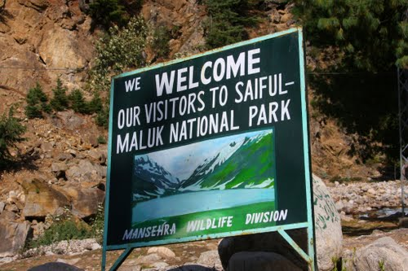
Saiful Muluk National Park

Slide 10
Longitude and latitude:
The Latitude of Saiful Maluk National Park is 34.8581. The Longitude of Saiful Maluk National Park is 73.6889. The Latitude and Longitude of Saiful Maluk National Park is 34.8581 and 73.6889 respectively. Saiful Maluk National Park is located in sub-locality, locality, District, Khyber Pakhtunkhwa State of Pakistan Country.
Flora and fauna:
The flora includes the trees, shrubs, perennials, and herbs of the Himalayan Western Himalayan subalpine conifer forests and higher elevation Western Himalayan alpine shrub and meadows ecoregions. Some of the park's fauna includes the snow leopard, asiatic black bear, marmot, weasel, eurasian lynx, indian leopard, Himalayan snowcock, and the snow partridge

Slide 11
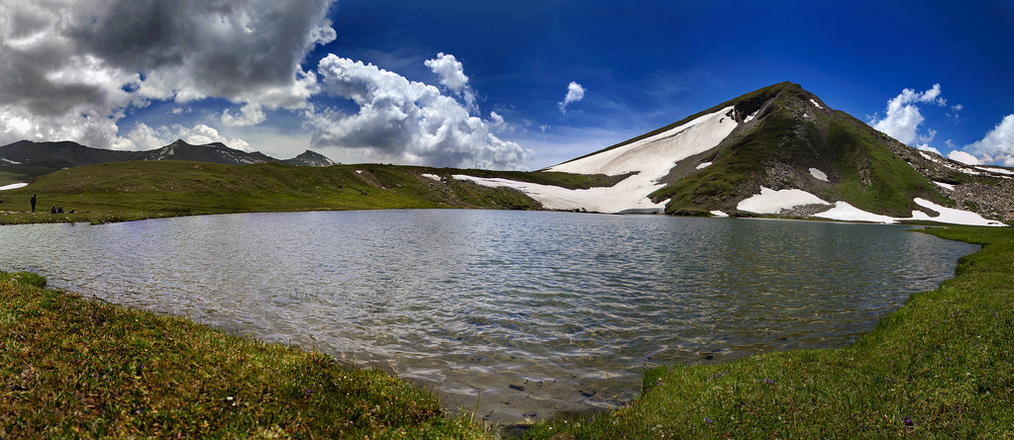
About:
A fairy tale called Saiful Muluk, written by the famous sufi poet Mian Muhammad Bakhsh, is associated with the lake. It is the story of prince of Persia who fell in love with a fairy princess at the lake. The impact of the lake beauty is of such extent that people believe that fairies come down to lake in full moon.
A poet and writer from Balakot, Ahmad Hussain Mujahid, has written the story of Saif ul Malook. The first edition of the book Saif ul Malook was published in 1999.

