Slide 1



A LabVIEW Demonstration
2nd WACOWC2019 Workshop
Presented by:
Dr Mojtaba Mansour Abadi
Dr Andrew Burton
Northumbria University, Newcastle, UK
Shahid Beheshti University, Tehran Iran
Sunday28 April 2019

Slide 2



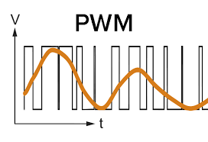
What is the plan for the demo?
Arduino Platform
+
&
→
Dimming LED controlled by PC
LabVIEW Script
PWM Signal

Slide 3
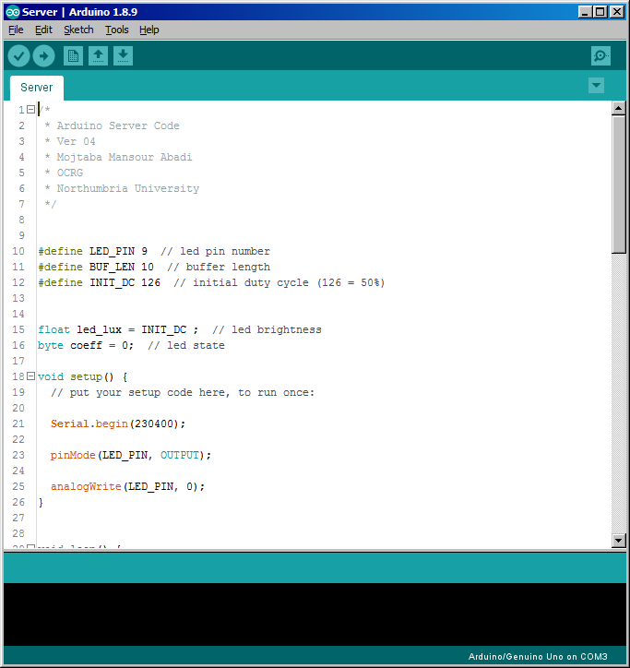
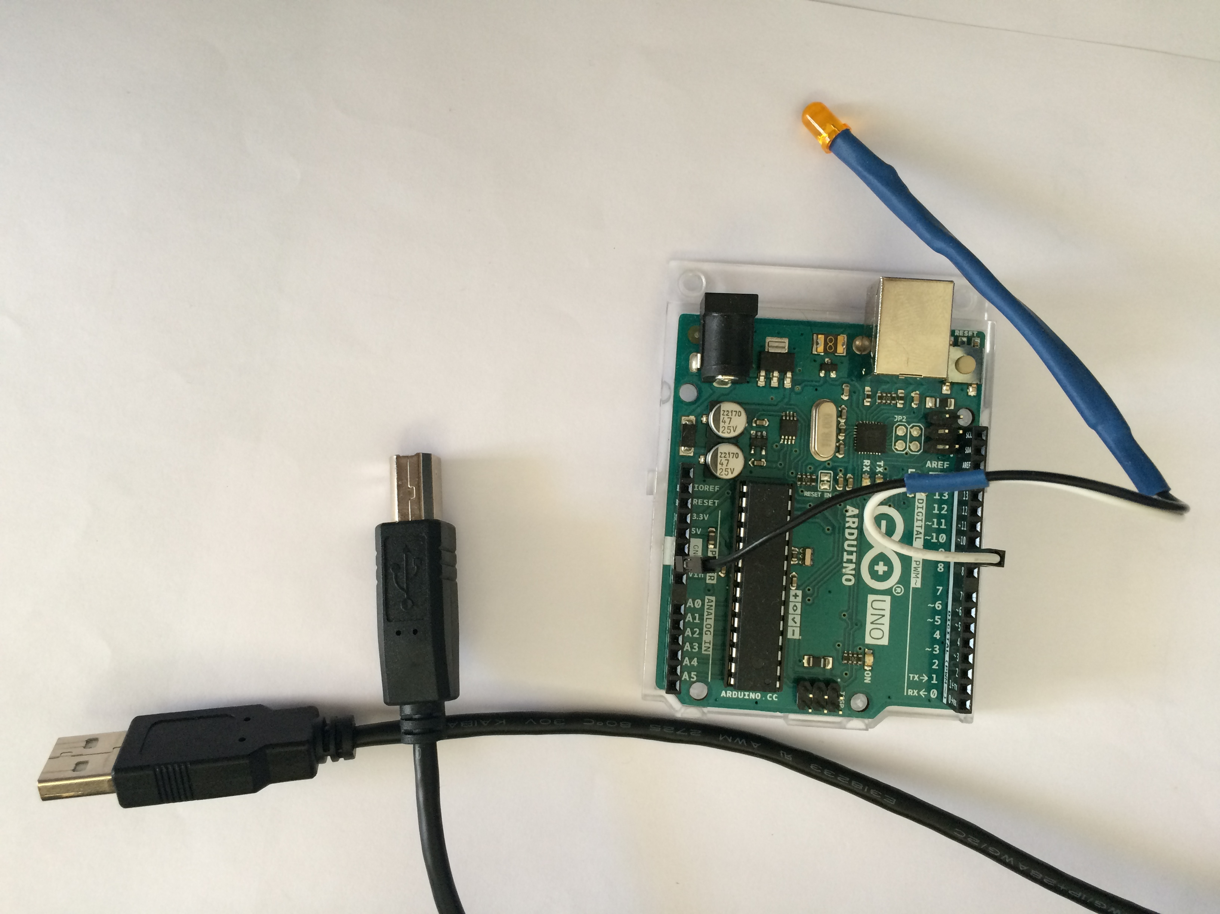
Arduino ≡ Server
1- Establishes a serial (USB) connection
2- Waits for message L:x$\n where x = [0-100]
3- Maps x to PWM range [0-255]
4- Adjusts the PWM output

Slide 4
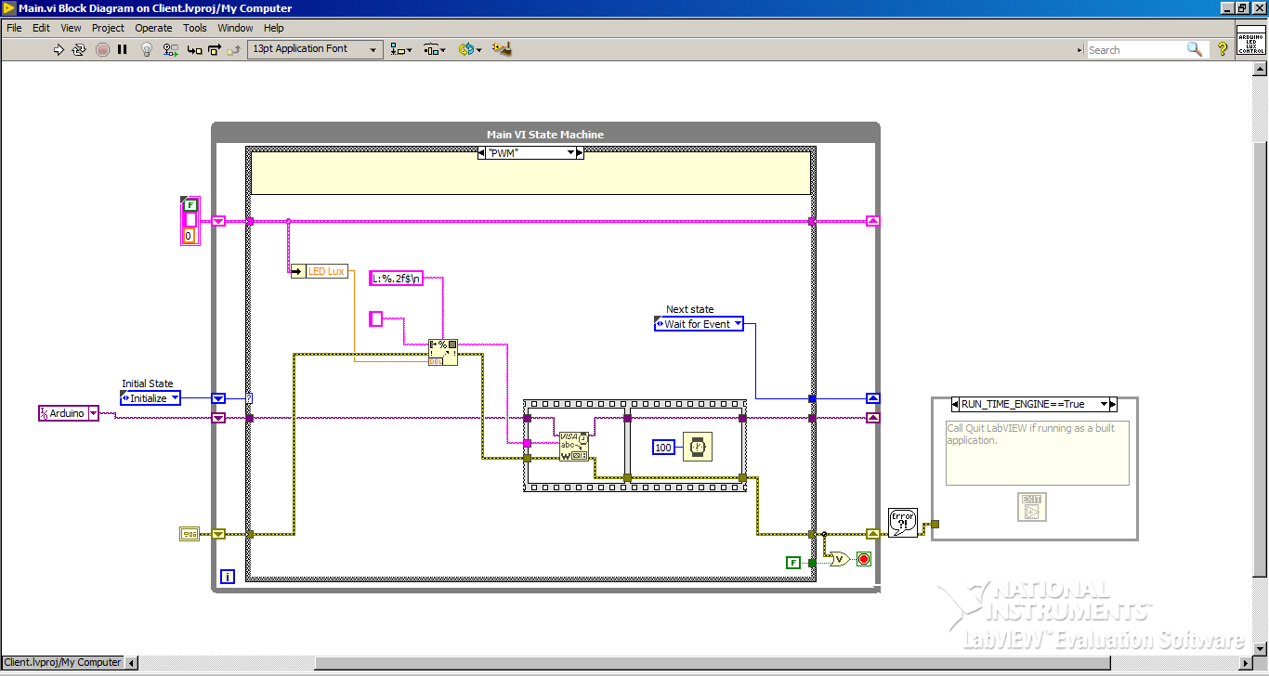
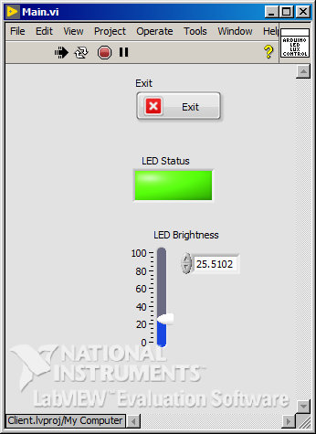
LabVIEW ≡ Client
1- Establishes the serial (USB) connection
2- Monitors the front panel GUIs
3- Generate the message
4- Sends the message to Arduino

Slide 5
Arduino FSM
Wait for the message
1
0
Set the PWM signal
Setup
2

Slide 6
LabVIEW FSM
Waits for the Event
State is changed
Brightness is changed
Change LED Brightness
Toggle LED State
0
Initialise

Slide 7
Let’s have a look at Arduino and LabVIEW codes!

Slide 8





Alternatives

Slide 9

Codes are available through https://github.com/MansourM61

