Slide 1

Artificial Intelligence for Games
CMP6206
Labs 1
Maths for AI: Vectors

Slide 2

Overview
Introduction to Vectors
Ensure:
  What is a vector?
    What is a scalar?
  Properties of vectors
    2D
    3D
  Consistent notation
  Adding, Subtracting, Multiplying
  Vector Distances
  Position Vector

Slide 3
What is a Vector?
Physical quantities, such as force, speed and time.
Useful to separate these physical quantities into two types.
  Quantities of the first type are known as scalars. These can be fully described by a single number known as the magnitude.
  Quantities of the second type are those which require the specification of a direction, in addition to a magnitude, before they are completely described. These are known as vectors.
Special methods have been developed for handling vectors in calculations, giving rise to subjects such as vector algebra, vector geometry and vector calculus.
Quantities that are vectors must be manipulated according to certain rules, some of which are described in this presentation.

Slide 4
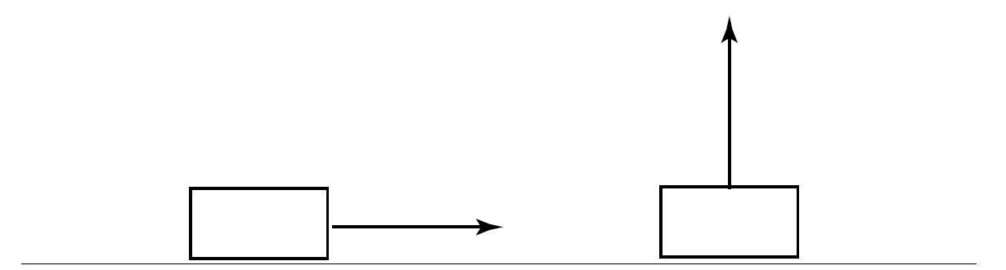
Scalar vs. Vector
Speed is a scalar quantity described by giving a single number in appropriate units.
For example ‘the speed of the car is 40 kilometres per hour’.
On the other hand velocity is a vector quantity and must be specified by giving a direction as well.
For example ‘the velocity of the aircraft is 20 metres per second due north’.

Slide 5
Common Quantities
Quantity | Type | S.I. Unit
Distance
Mass
Temperature
Pressure
Work
Energy
Displacement
Force
Velocity
Acceleration

Slide 6
Common Quantities
Quantity | Type | S.I. Unit
Distance | Scalar | Metre, m
Mass | Scalar | Kilogram, kg
Temperature | Scalar | Kelvin, K
Pressure | Scalar | Pascal, Pa
Work | Scalar | Joule, J
Energy | Scalar | Joule, J
Displacement | Vector | Metre, m
Force | Vector | Newton, N
Velocity | Vector | Metres per second, ms⁻¹
Acceleration | Vector | Metres /s/s, ms⁻²

Slide 7
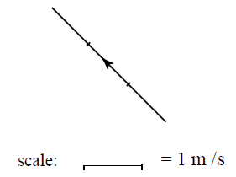
Visualising Vectors
Because a vector has a direction as well as a magnitude we can represent a vector by drawing a line.
The length of the line represents the magnitude of the vector given some appropriate scale.
The direction of the line represents the direction of the vector.
We call this representation a directed line segment.

Slide 8
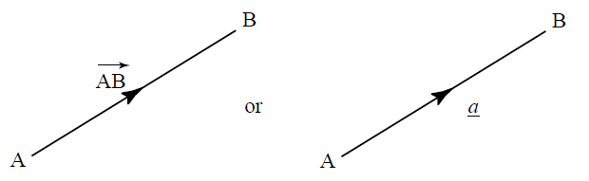
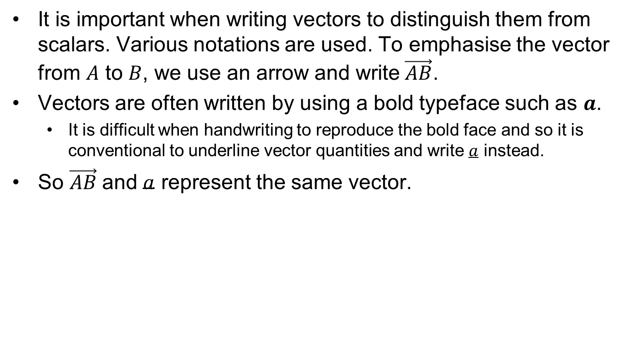
Vector Notation
It is important when writing vectors to distinguish them from scalars. Various notations are used. To emphasise the vector from $A$ to $B$, we use an arrow and write$\vec{AB}$.
Vectors are often written by using a bold typeface such as $a$.
  It is difficult when handwriting to reproduce the bold face and so it is conventional to underline vector quantities and write $a$ instead.
So $\vec{AB}$and $a$ represent the same vector.

Slide 9
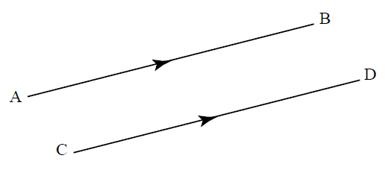
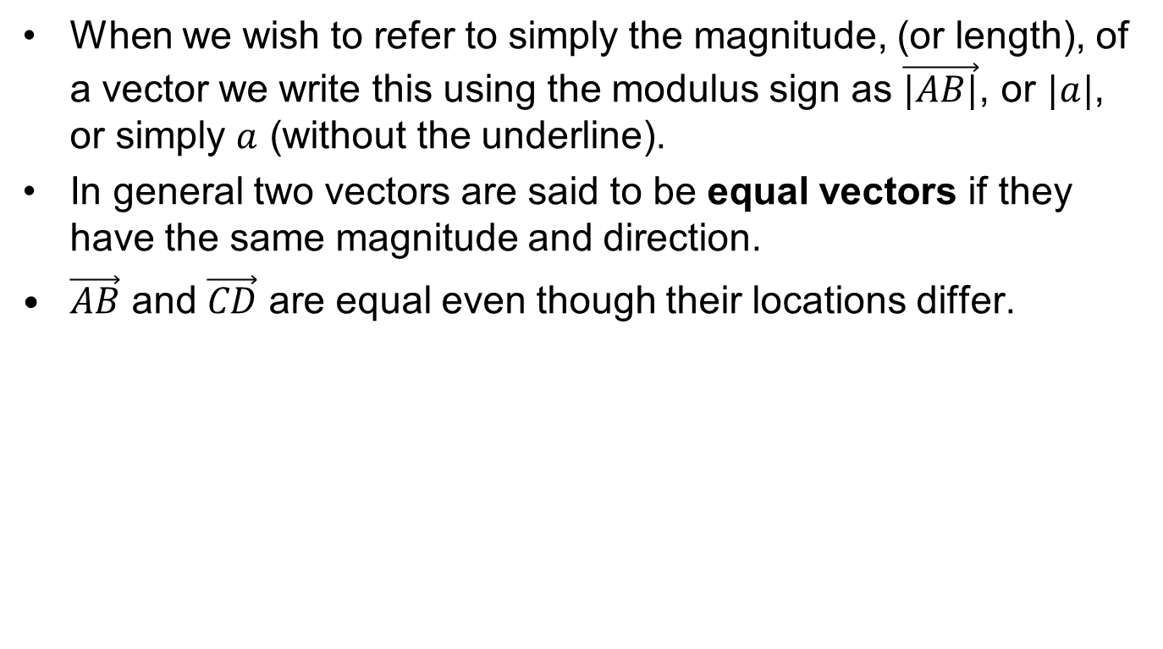
Vector Notation
When we wish to refer to simply the magnitude, (or length), of a vector we write this using the modulus sign as $\vec{|AB|}$, or $|a|$, or simply $a$ (without the underline).
In general two vectors are said to be equal vectors if they have the same magnitude and direction.
$\vec{AB}$ and $\vec{CD}$ are equal even though their locations differ.

Slide 10
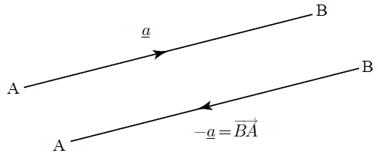
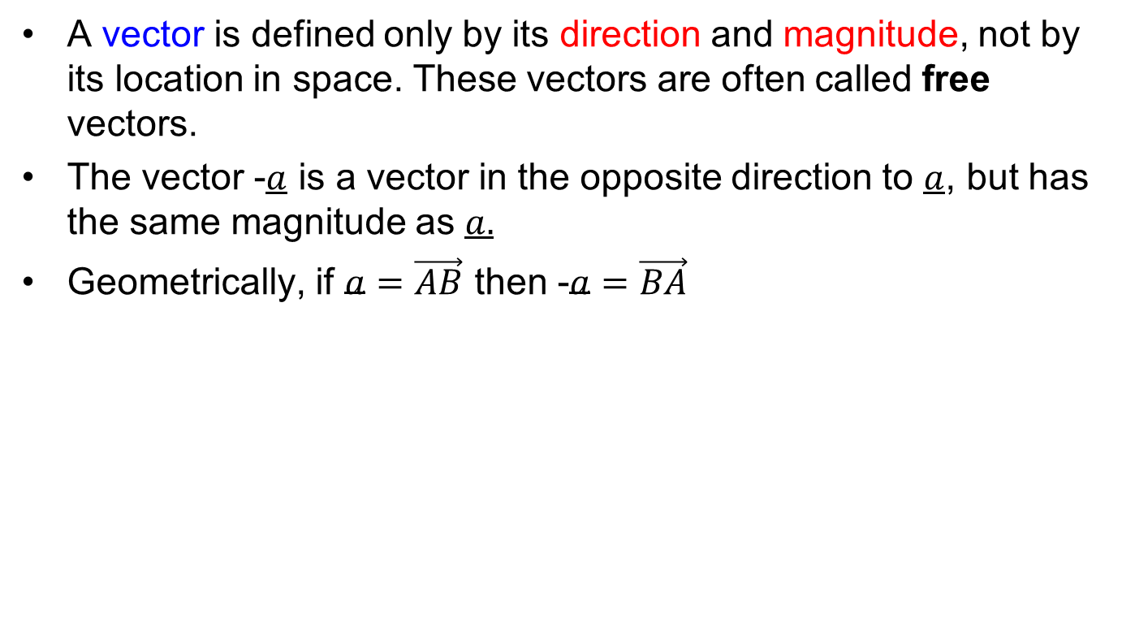
Vector Notation
A vector is defined only by its direction and magnitude, not by its location in space. These vectors are often called free vectors.
The vector -$a$ is a vector in the opposite direction to $a$, but has the same magnitude as $a.$
Geometrically, if $a=\vec{AB}$ then -$a=\vec{BA}$

Slide 11
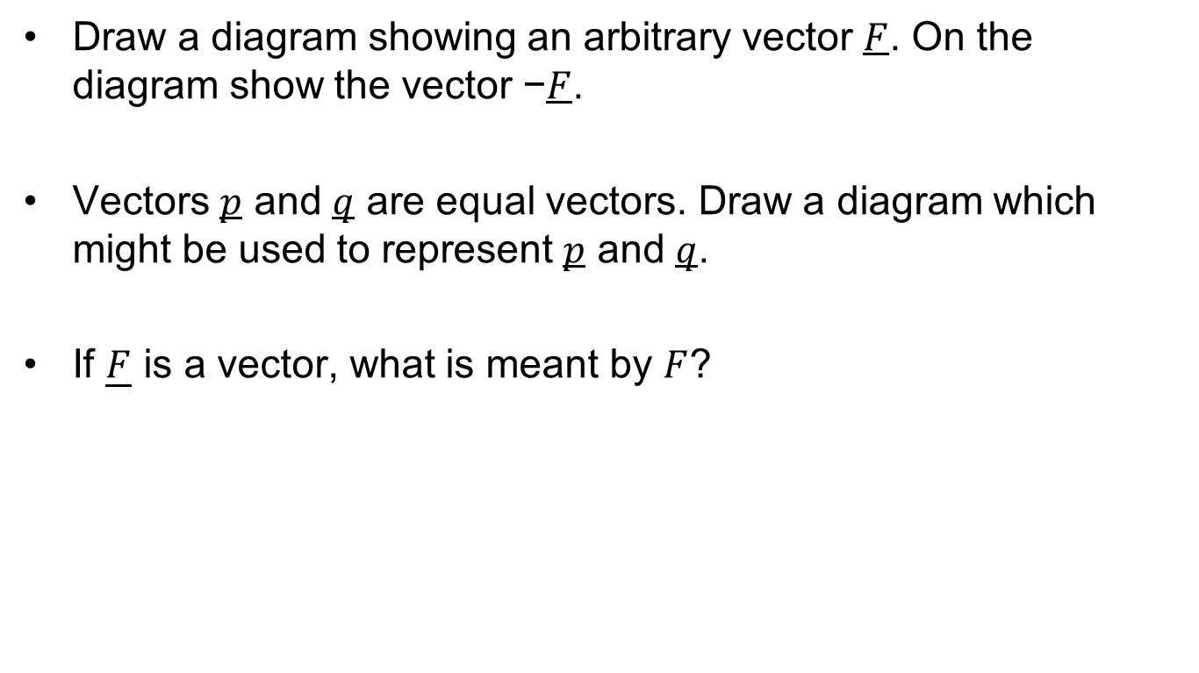
Exercise: Vector Notation
Draw a diagram showing an arbitrary vector $F$. On the diagram show the vector −$F$.
Vectors $p$ and $q$ are equal vectors. Draw a diagram which might be used to represent $p$ and $q$.
If $\underline{F}$ is a vector, what is meant by $F$?

Slide 12
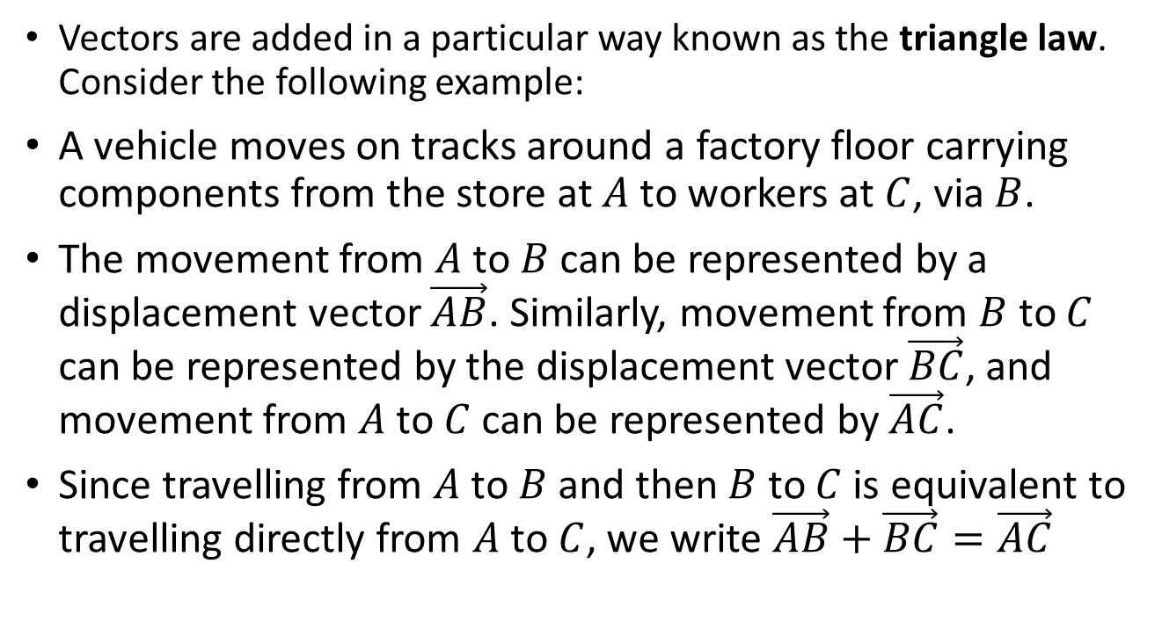
Vector Addition
Vectors are added in a particular way known as the triangle law. Consider the following example:
A vehicle moves on tracks around a factory floor carrying components from the store at $A$ to workers at $C$, via $B$.
The movement from $A$ to $B$ can be represented by a displacement vector $\vec{AB}$. Similarly, movement from $B$ to $C$ can be represented by the displacement vector $\vec{BC}$, and movement from $A$ to $C$ can be represented by $\vec{AC}$.
Since travelling from $A$ to $B$ and then $B$ to $C$ is equivalent to travelling directly from $A$ to $C$, we write $\vec{AB}+\vec{BC}=\vec{AC}$

Slide 13
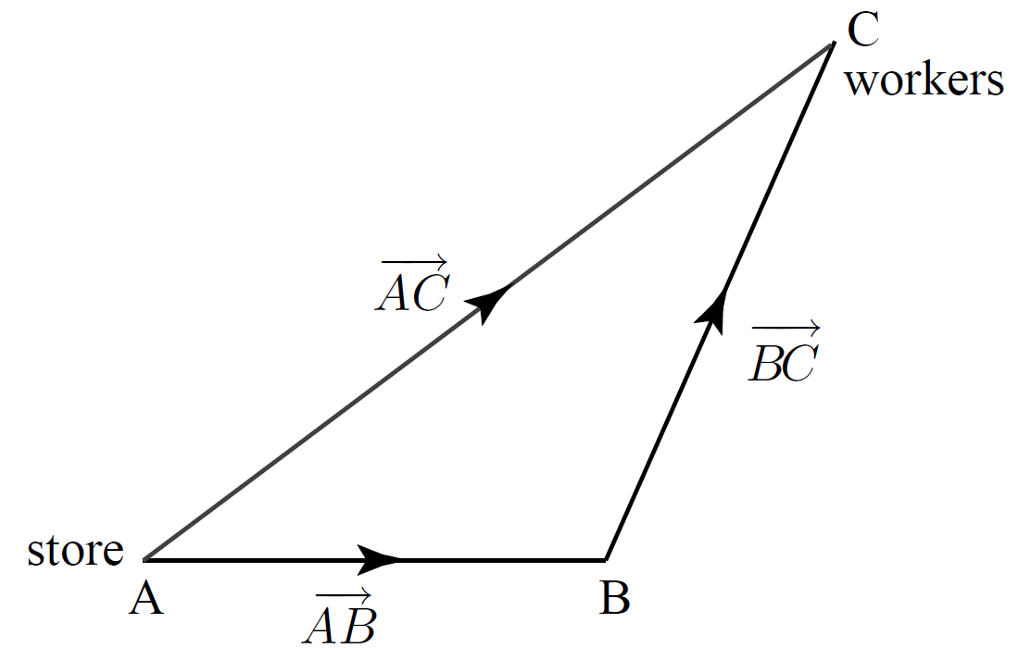
Vector Addition

Slide 14
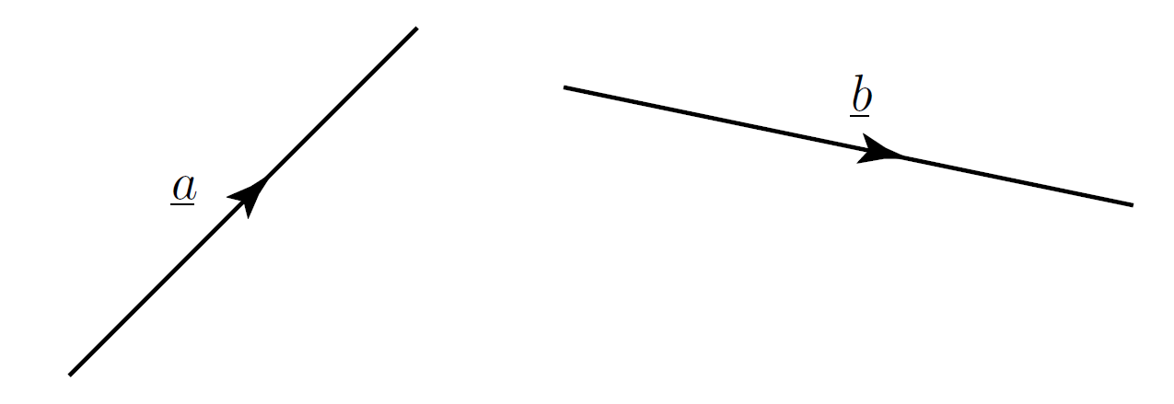
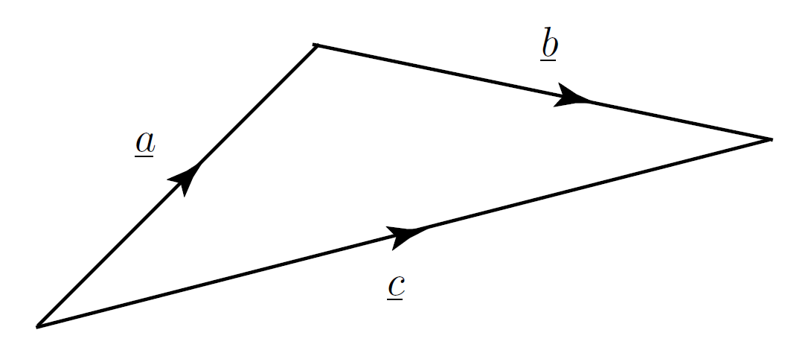
Triangle Law
Note that we can add vectors by placing the tail of the second at the head of the first and completing the third side of the triangle so formed.

Slide 15
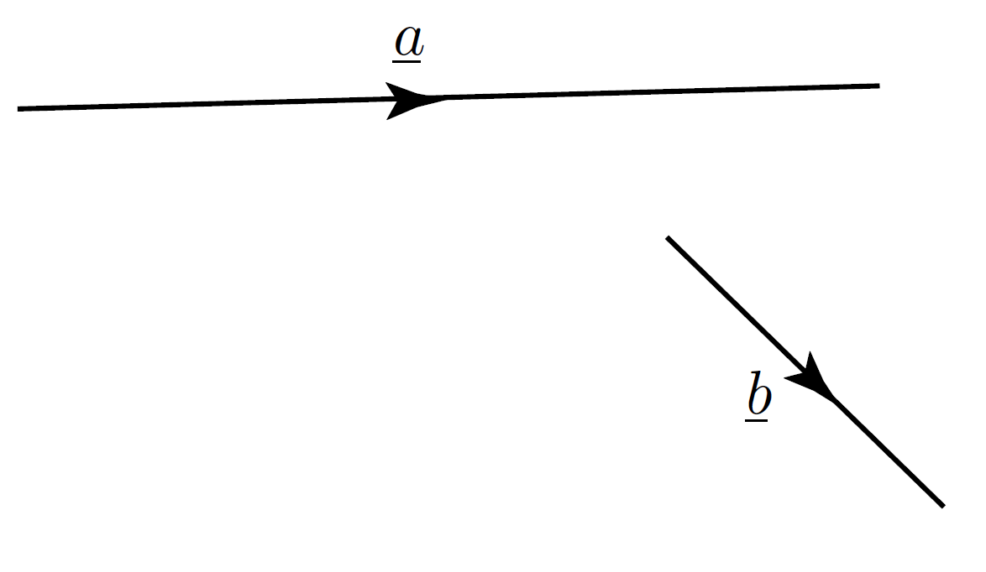
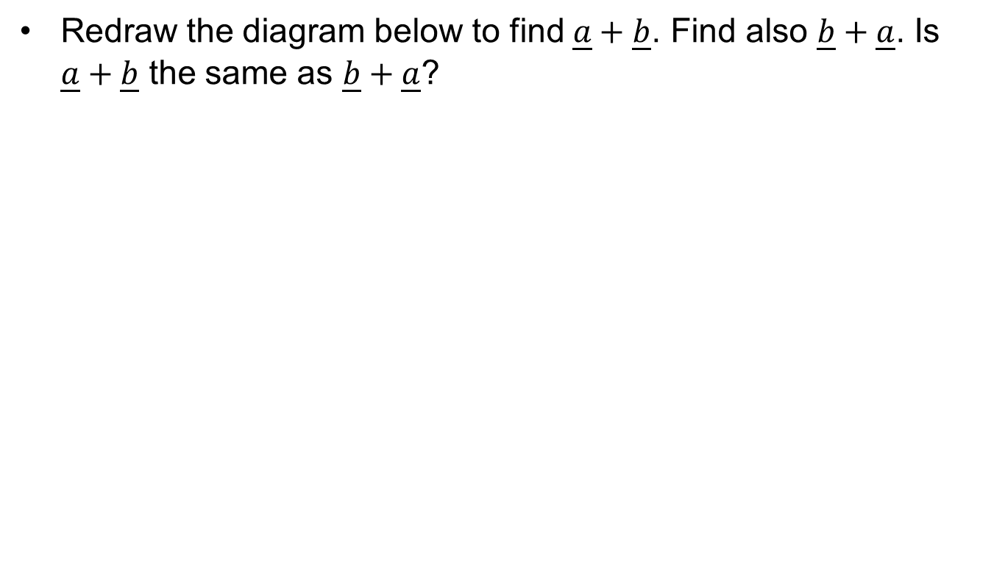
Exercise: Triangle Law
Redraw the diagram below to find $\underline{a}+\underline{b}$. Find also $\underline{b}+\underline{a}$. Is $\underline{a}+\underline{b}$ the same as $\underline{b}+\underline{a}$?

Slide 16
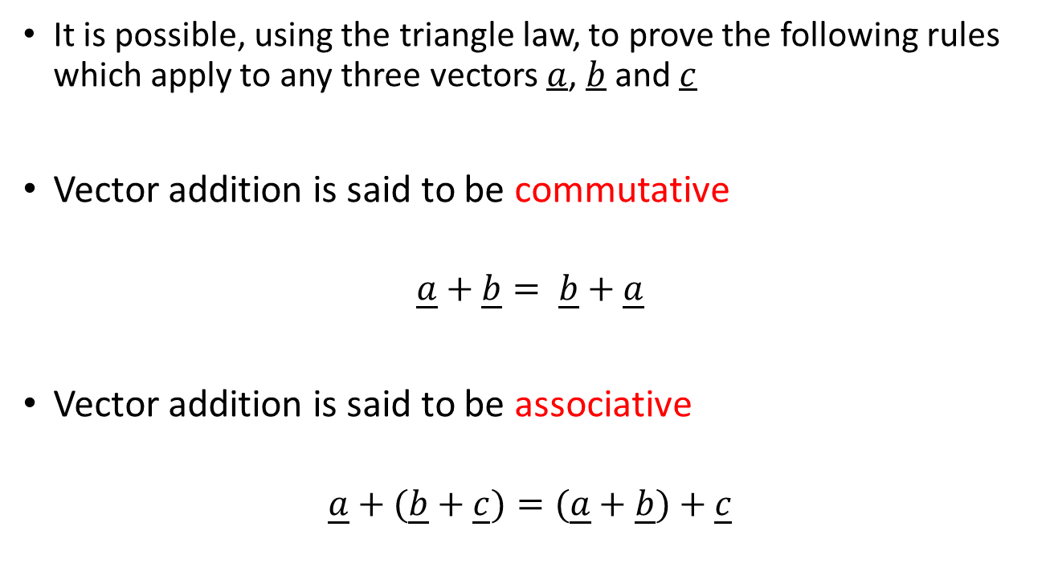
Vector Laws
It is possible, using the triangle law, to prove the following rules which apply to any three vectors $a$, $b$ and $c$
Vector addition is said to be commutative
$$\underline{a}+\underline{b}= \underline{b}+\underline{a}$$
Vector addition is said to be associative
$$\underline{a}+(\underline{b}+\underline{c})=(\underline{a}+\underline{b})+\underline{c}$$

Slide 17
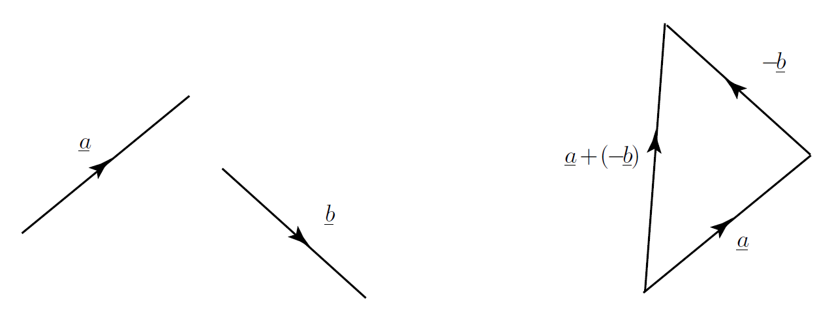
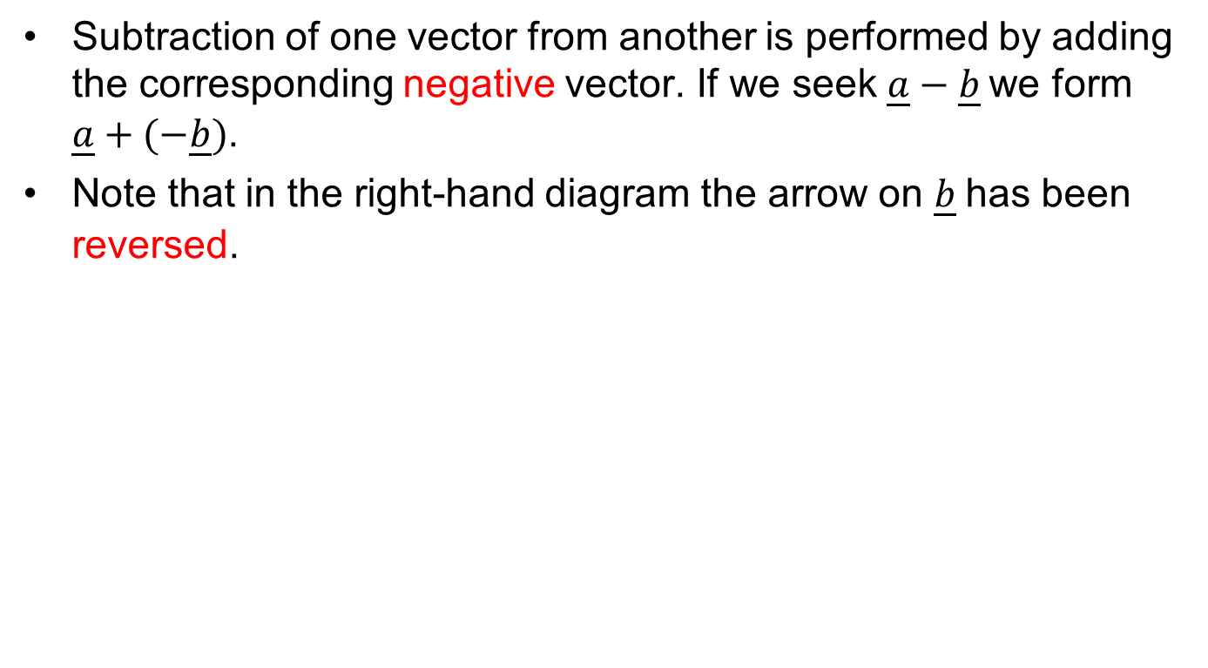
Vector Subtraction
Subtraction of one vector from another is performed by adding the corresponding negative vector. If we seek $\underline{a}−\underline{b}$we form $\underline{a}+(−\underline{b})$.
Note that in the right-hand diagram the arrow on $\underline{b}$has been reversed.

Slide 18
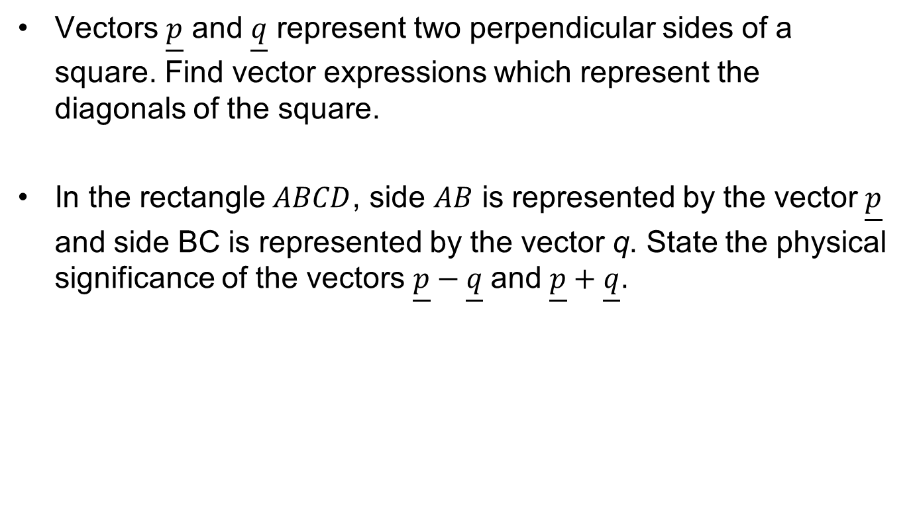
Exercise: Vector Manipulation
Vectors $\underline{p}$ and $\underline{q}$ represent two perpendicular sides of a square. Find vector expressions which represent the diagonals of the square.
In the rectangle $ABCD$, side $AB$ is represented by the vector $\underline{p}$ and side BC is represented by the vector q. State the physical significance of the vectors $\underline{p}−\underline{q}$and $\underline{p}+\underline{q}$.

Slide 19
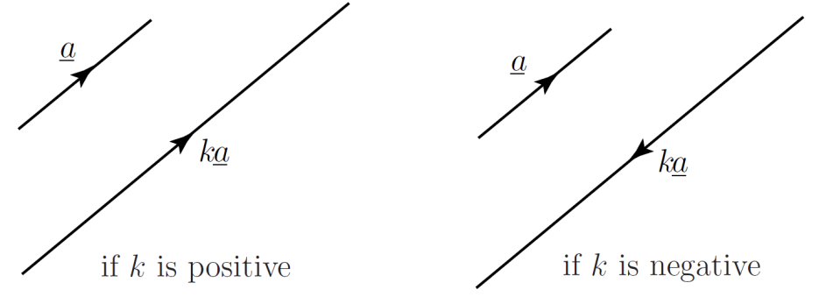
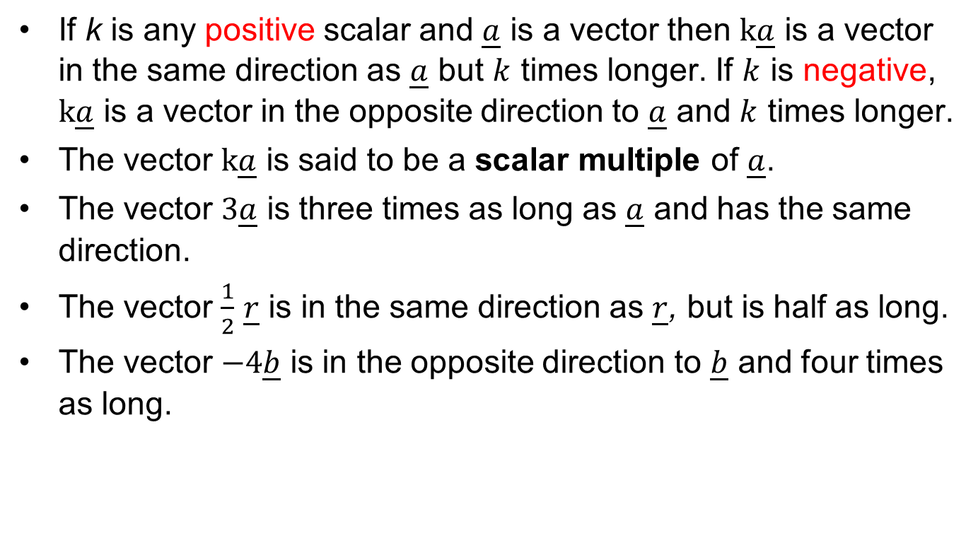
Vector Scalar Multiplication
If k is any positive scalar and $\underline{a}$ is a vector then $k\underline{a}$ is a vector in the same direction as $\underline{a}$ but $k$ times longer. If $k$ is negative, $k\underline{a}$ is a vector in the opposite direction to $\underline{a}$ and $k$ times longer.
The vector $k\underline{a}$ is said to be a scalar multiple of $\underline{a}$.
The vector $3\underline{a}$ is three times as long as $\underline{a}$ and has the same direction.
The vector $\frac{1}{2}$ $\underline{r}$ is in the same direction as $\underline{r}$, but is half as long.
The vector $−4\underline{b}$ is in the opposite direction to $\underline{b}$ and four times as long.

Slide 20
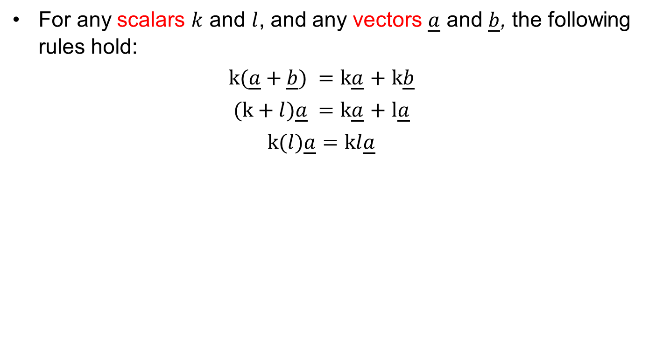
Vector Scalar Multiplication
For any scalars $k$ and $l$, and any vectors $\underline{a}$ and $\underline{b}$, the following rules hold:
$k(\underline{a}+\underline{b}) =$ $k\underline{a}$ $+$ $k\underline{b}$
$(k+l)\underline{a} =$ $k\underline{a}$ $+$ $l\underline{a}$
$k(l)\underline{a}$ $=$ $kl\underline{a}$

Slide 21
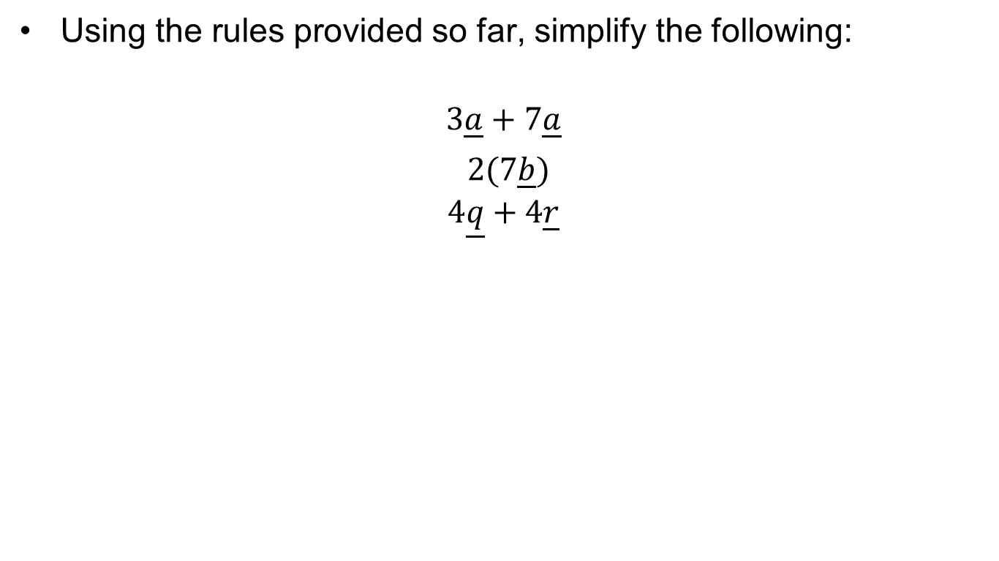
Exercise
Using the rules provided so far, simplify the following:
$$3\underline{a}+7\underline{a}$$
$2(7\underline{b})$
$$4\underline{q}+4\underline{r}$$

Slide 22
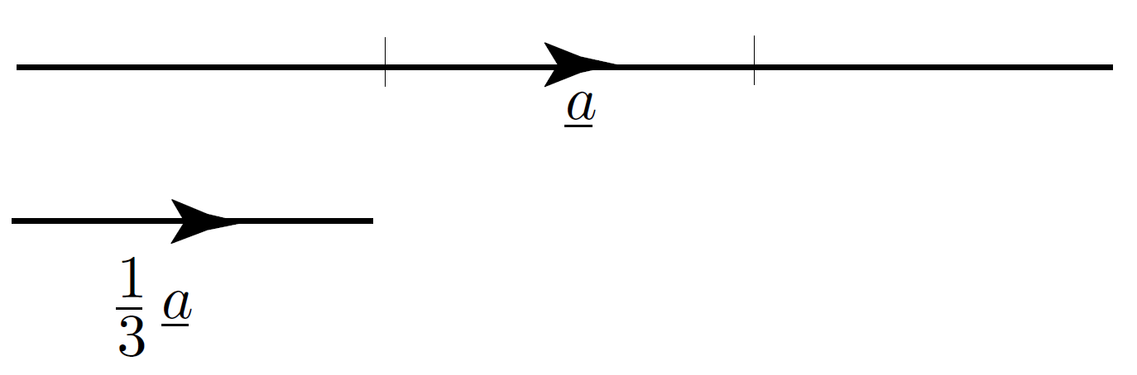
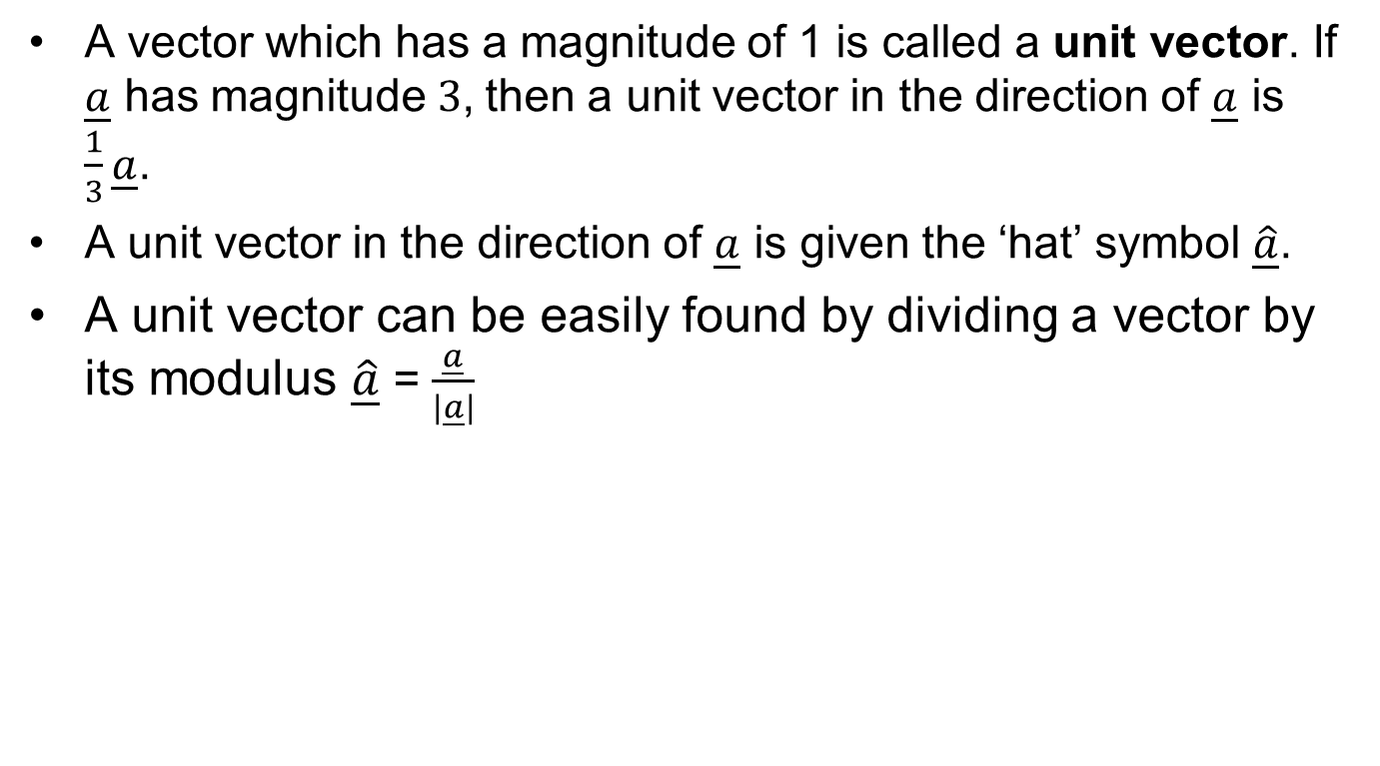
Unit Vectors
A vector which has a magnitude of 1 is called a unit vector. If $\underline{a}$ has magnitude$3$, then a unit vector in the direction of $\underline{a}$ is $\frac{1}{3}\underline{a}$.
A unit vector in the direction of $\underline{a}$ is given the ‘hat’ symbol $\hat{\underline{a}}$.
A unit vector can be easily found by dividing a vector by its modulus $\hat{\underline{a}}$ = $\frac{\underline{a}}{|\underline{a}|}$

Slide 23
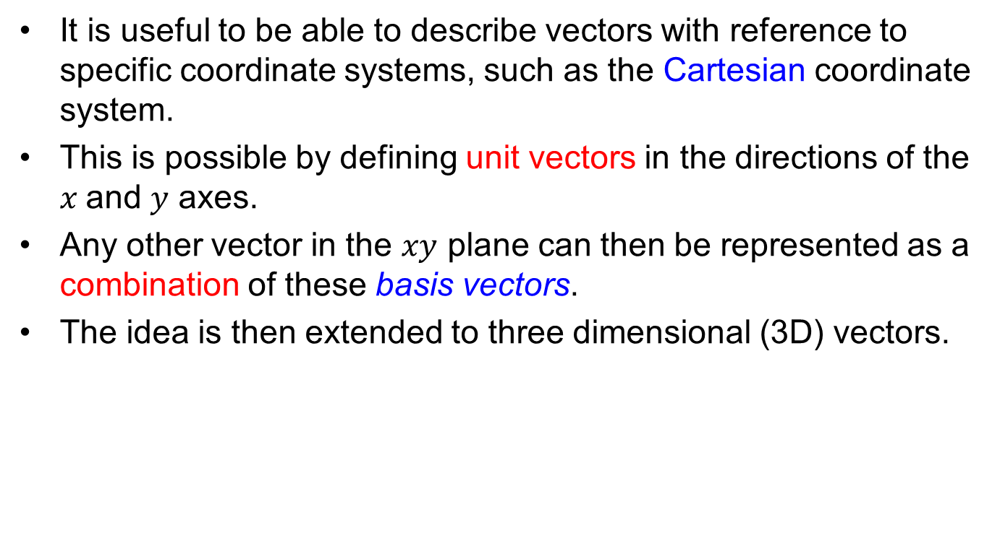
Cartesian Components
It is useful to be able to describe vectors with reference to specific coordinate systems, such as the Cartesian coordinate system.
This is possible by defining unit vectors in the directions of the $x$and $y$ axes.
Any other vector in the $xy$ plane can then be represented as a combination of these basis vectors.
The idea is then extended to three dimensional (3D) vectors.

Slide 24
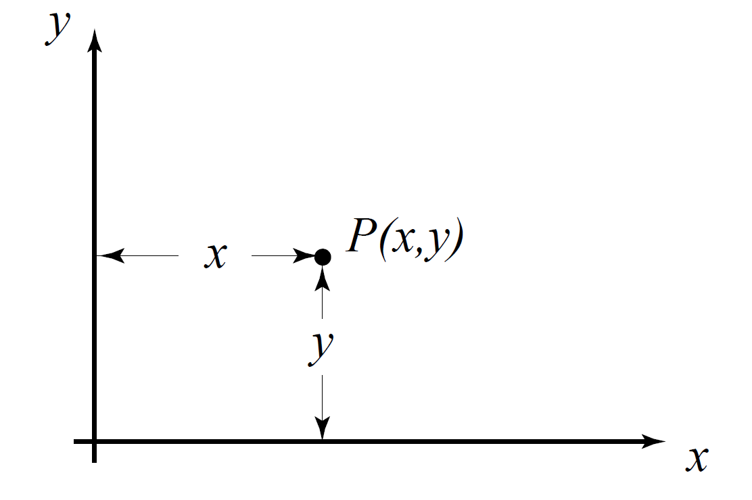
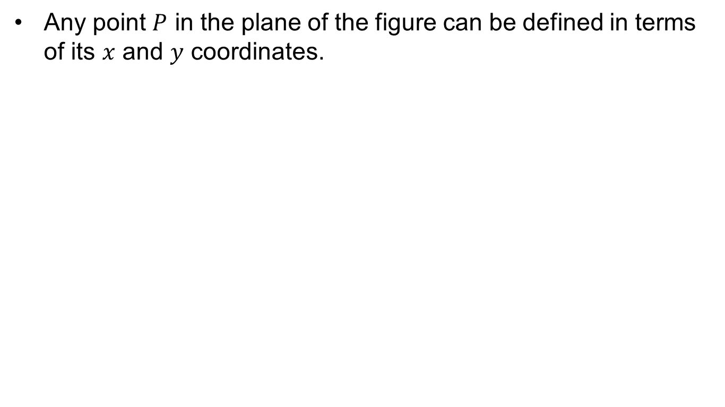
Coordinates
Any point $P$ in the plane of the figure can be defined in terms of its $x$ and $y$ coordinates.

Slide 25
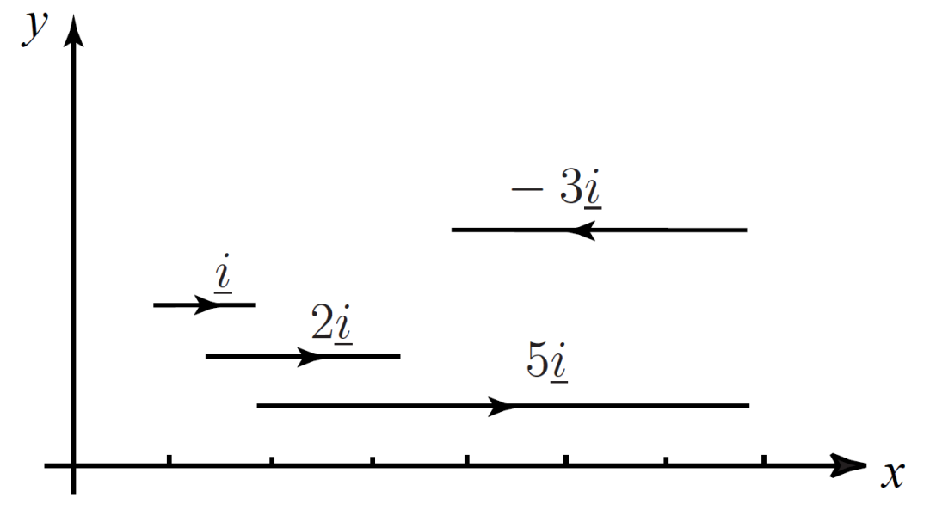
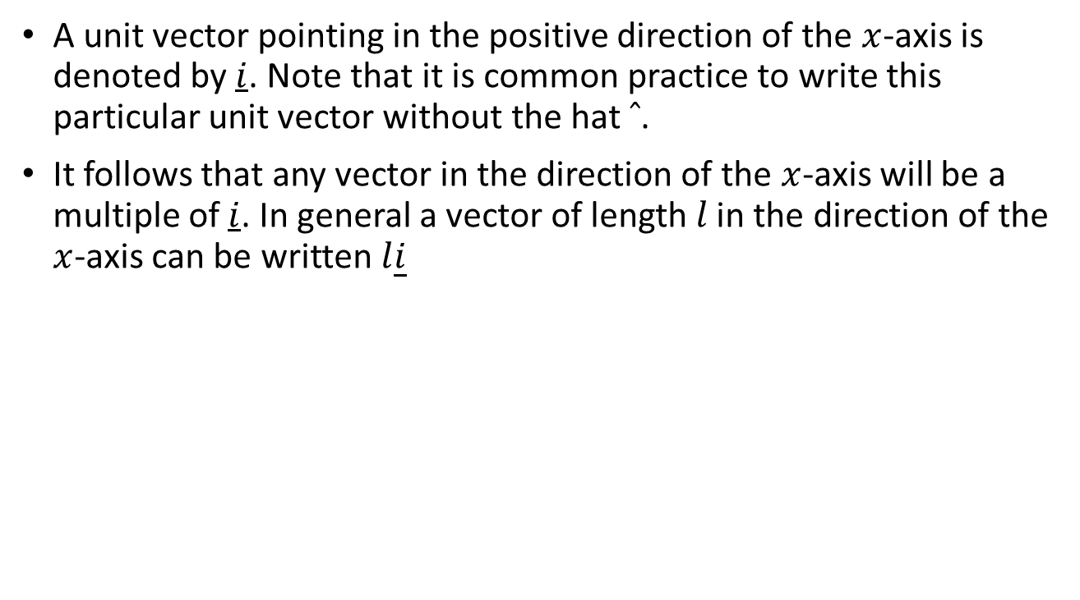
Unit Vector Conventions
A unit vector pointing in the positive direction of the $x$-axis is denoted by $i$. Note that it is common practice to write this particular unit vector without the hat $ˆ$.
It follows that any vector in the direction of the $x$-axis will be a multiple of $i$. In general a vector of length 𝑙 in the direction of the $x$-axis can be written $l\underline{i}$

Slide 26
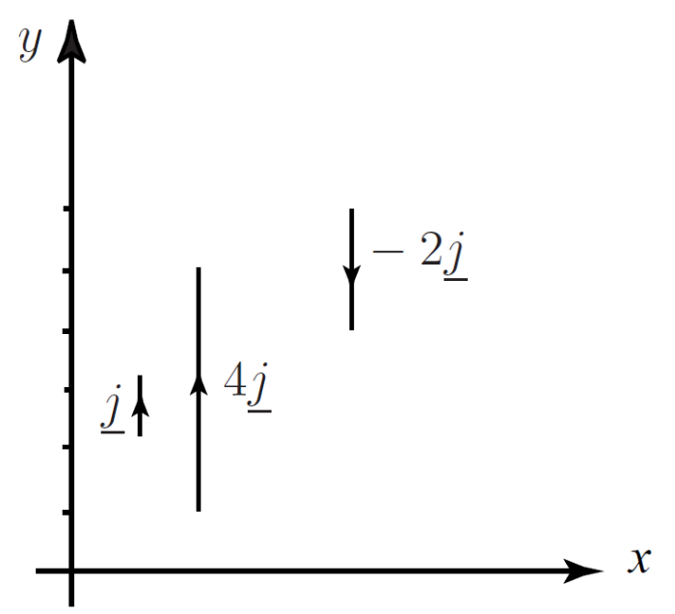
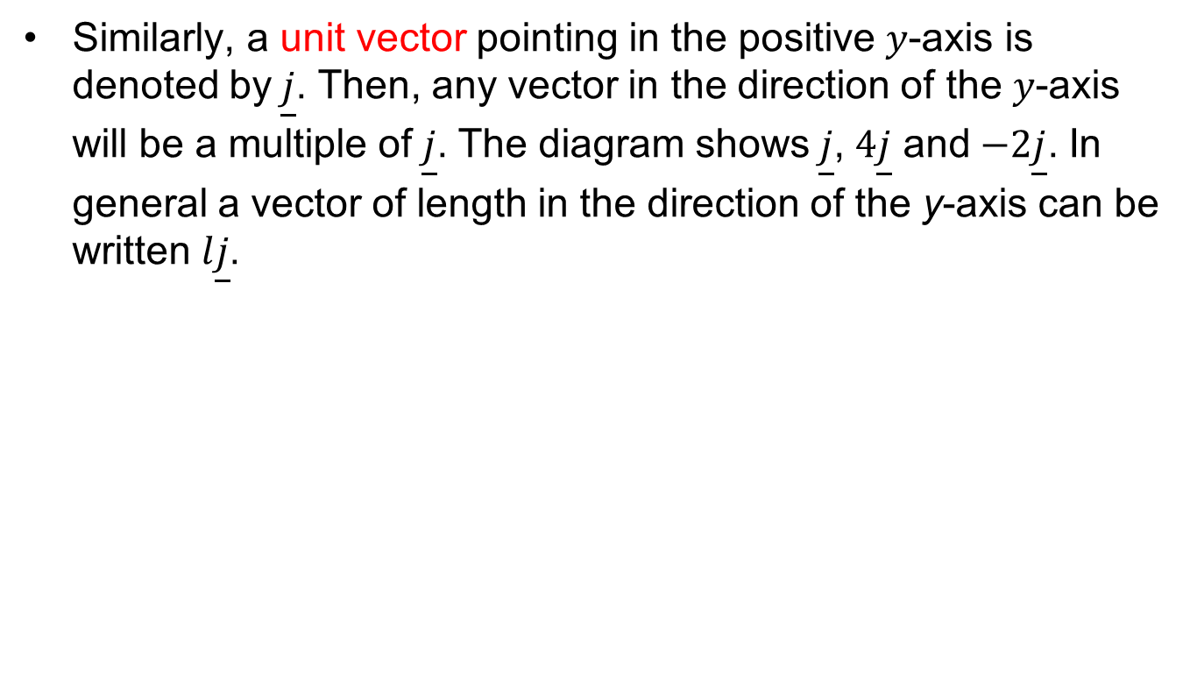
Unit Vector Conventions
Similarly, a unit vector pointing in the positive $y$-axis is denoted by$\underline{j}$. Then, any vector in the direction of the $y$-axis will be a multiple of$\underline{j}$. The diagram shows$\underline{j}$, $4\underline{j}$ and$−2\underline{j}$. In general a vector of length in the direction of the y-axis can be written$l\underline{j}$.

Slide 27
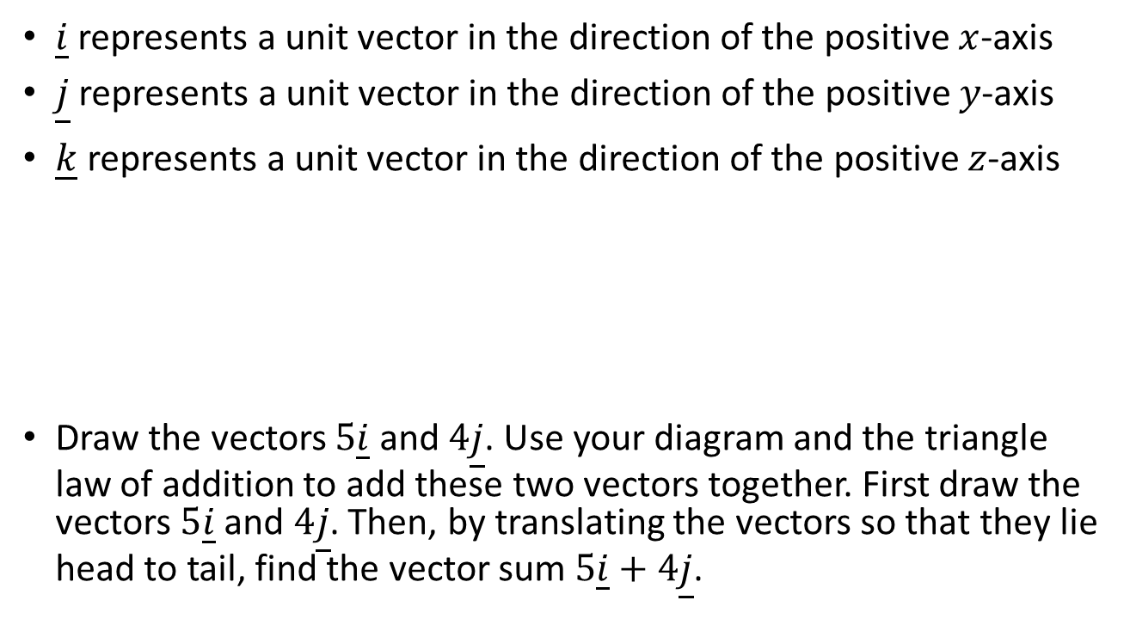
Unit Vectors: Key Points
$\underline{i}$ represents a unit vector in the direction of the positive $x$-axis
$\underline{j}$ represents a unit vector in the direction of the positive $y$-axis
$\underline{k}$ represents a unit vector in the direction of the positive $z$-axis
Draw the vectors $5\underline{i}$ and $4\underline{j}$. Use your diagram and the triangle law of addition to add these two vectors together. First draw the vectors $5\underline{i}$ and $4\underline{j}$. Then, by translating the vectors so that they lie head to tail, find the vector sum $5\underline{i}+4\underline{j}$.

Slide 28
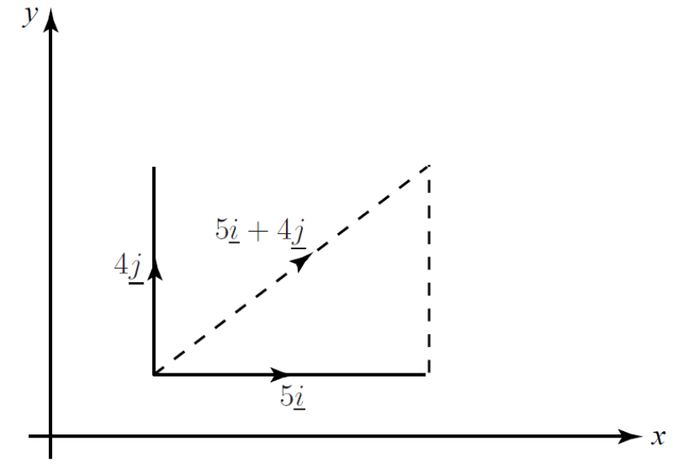
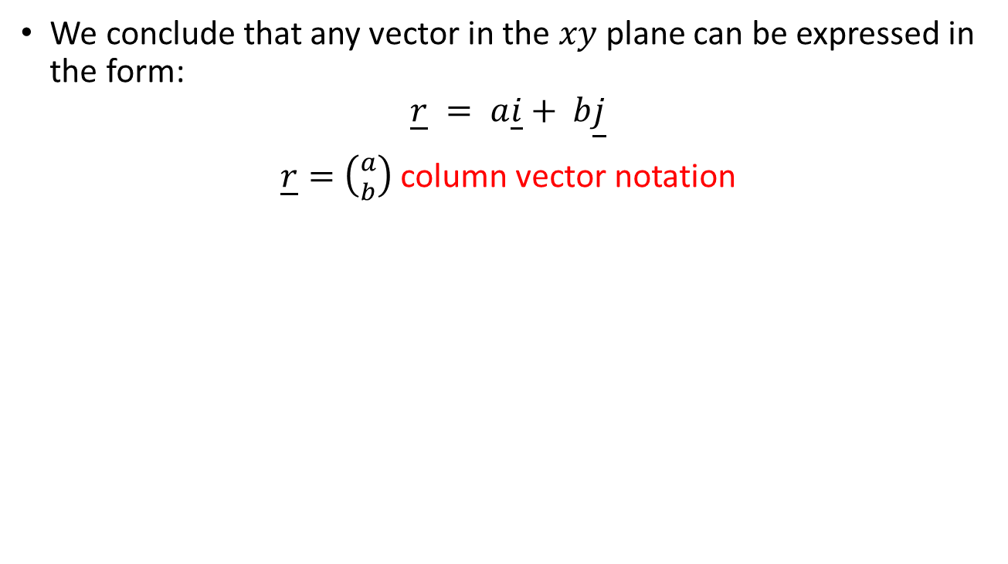
Unit Vectors: Key Points
We conclude that any vector in the $xy$ plane can be expressed in the form:
$$\underline{r} = a\underline{i}+ b\underline{j}$$
$\underline{r}=\left({a \atop b}\right)$ column vector notation

Slide 29
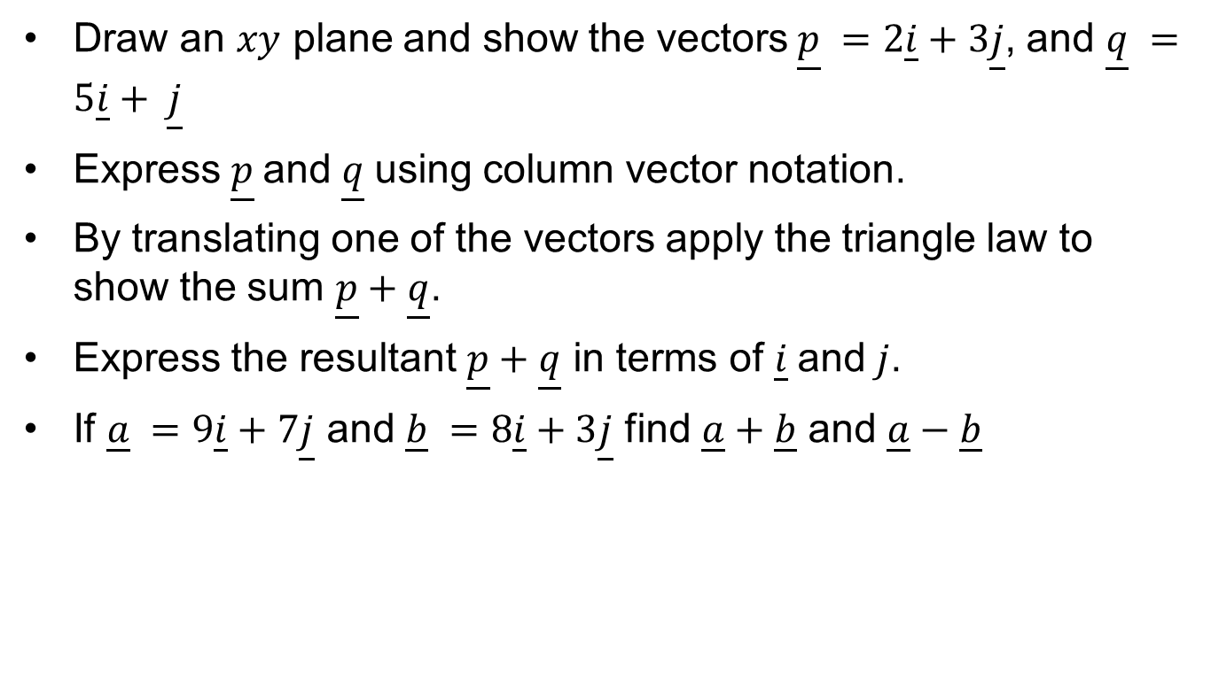
Exercises
Draw an $xy$ plane and show the vectors$\underline{p} =2\underline{i}+3\underline{j}$, and $\underline{q} =5\underline{i}+ \underline{j}$
Express $\underline{p}$and$\underline{q}$ using column vector notation.
By translating one of the vectors apply the triangle law to show the sum $\underline{p}+\underline{q}$.
Express the resultant $\underline{p}+\underline{q}$ in terms of $\underline{i}$and$j$.
If $\underline{a} =9\underline{i}+7\underline{j}$ and $\underline{b} =8\underline{i}+3\underline{j}$ find $\underline{a}+\underline{b}$ and $\underline{a}−\underline{b}$

Slide 30
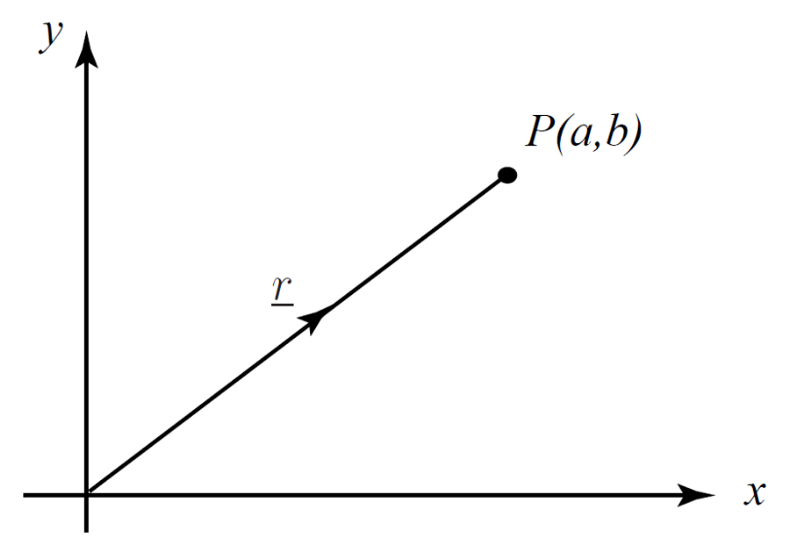
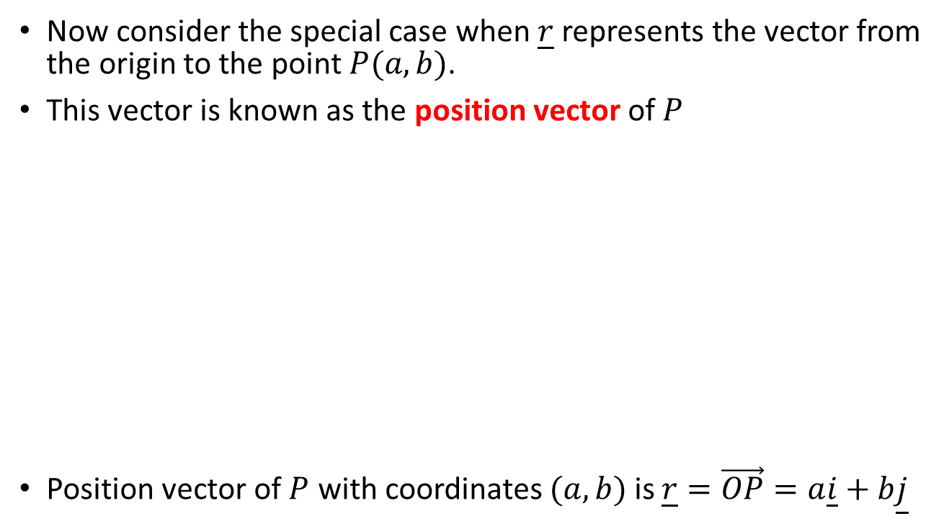
Position Vector
Now consider the special case when $\underline{r}$ represents the vector from the origin to the point $P(a, b)$.
This vector is known as the position vector of $P$
Position vector of $P$ with coordinates $(a, b)$ is $\underline{r}=\vec{OP}=a\underline{i}+b\underline{j}$

Slide 31
Exercise: Position Vector
State the position vectors of the points with coordinates
  P(2, 4)
  Q(−1, 5)
  R(−1,−7)
  S(8,−4)

Slide 32
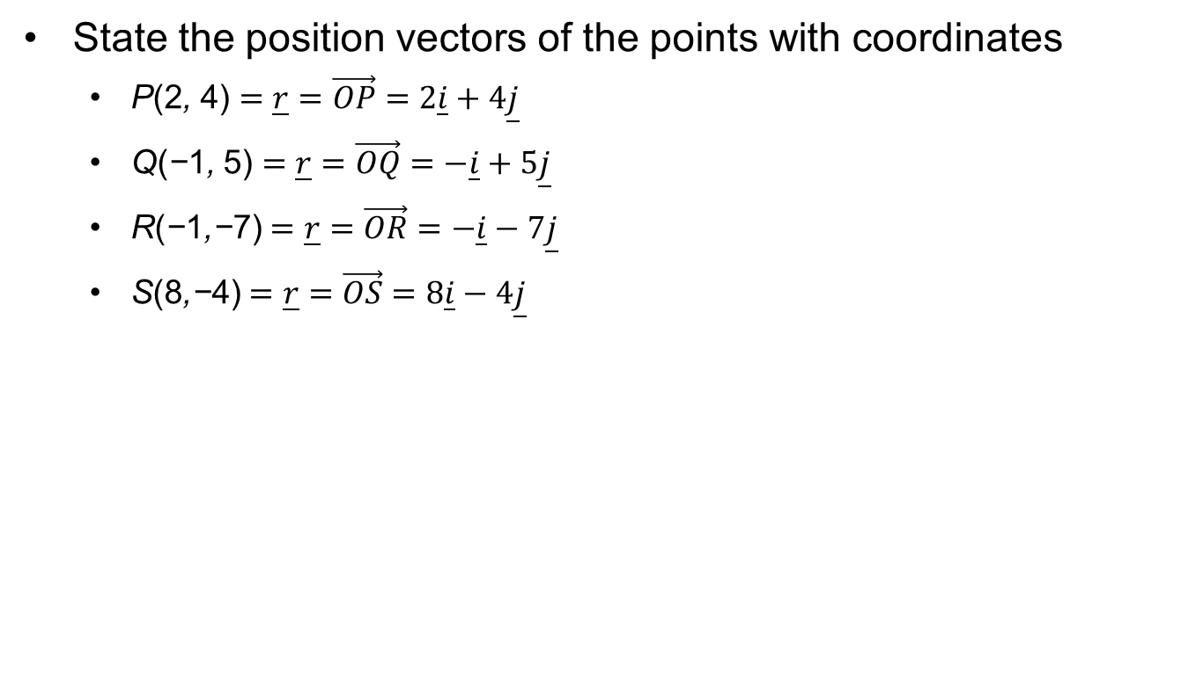
Exercise: Position Vector
State the position vectors of the points with coordinates
  P(2, 4) $=\underline{r}=\vec{OP}=2\underline{i}+4\underline{j}$
  Q(−1, 5) $=\underline{r}=\vec{OQ}=−\underline{i}+5\underline{j}$
  R(−1,−7) $=\underline{r}=\vec{OR}=−\underline{i}−7\underline{j}$
  S(8,−4) $=\underline{r}=\vec{OS}=8\underline{i}−4\underline{j}$

Slide 33
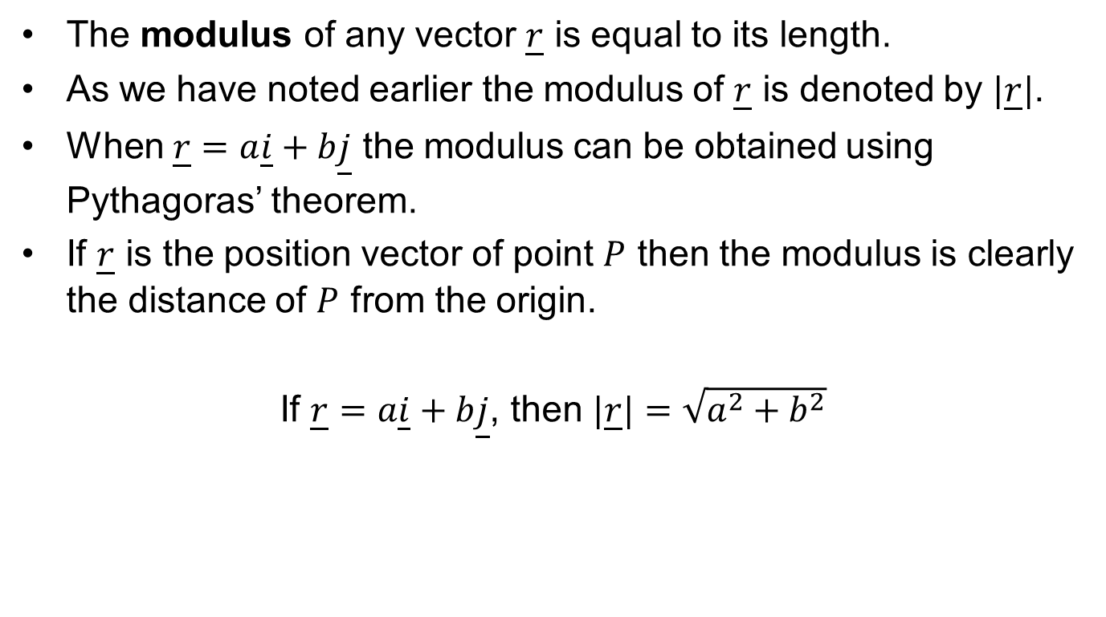
Modulus of a Vector
The modulus of any vector $\underline{r}$ is equal to its length.
As we have noted earlier the modulus of $\underline{r}$ is denoted by $|\underline{r}|$.
When $\underline{r}=a\underline{i}+b\underline{j}$ the modulus can be obtained using Pythagoras’ theorem.
If $\underline{r}$ is the position vector of point $P$ then the modulus is clearly the distance of $P$ from the origin.
If $\underline{r}=a\underline{i}+b\underline{j}$, then $|\underline{r}|=\sqrt{a^{2}+b^{2}}$

Slide 34
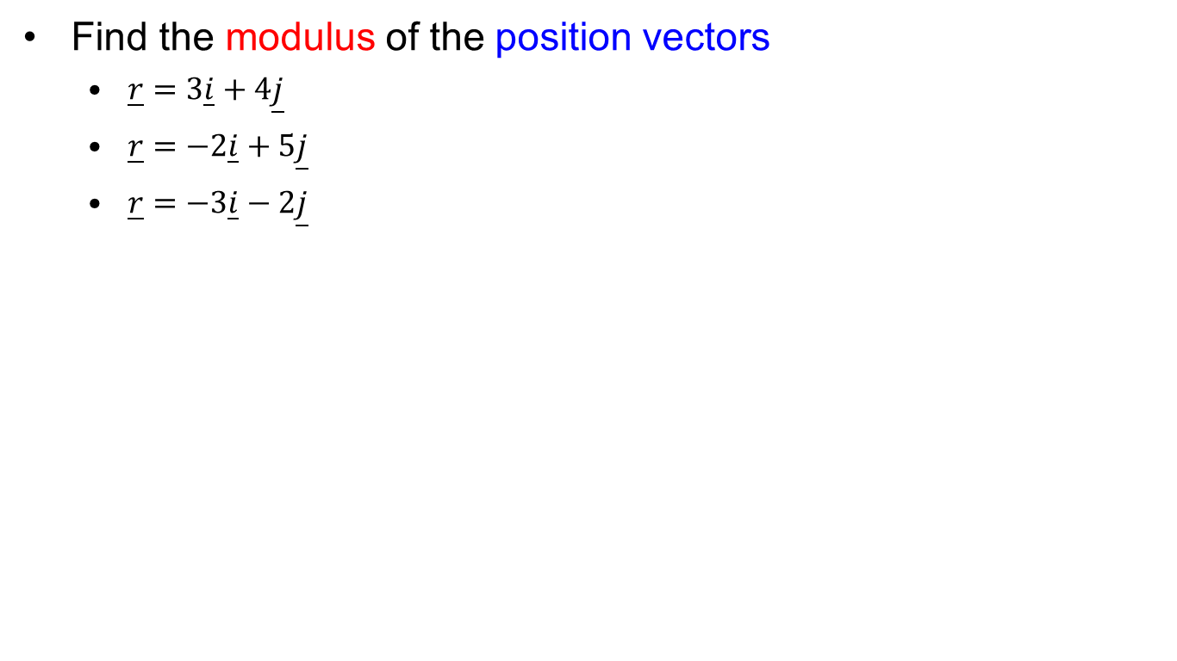
Exercise: Modulus
Find the modulus of the position vectors
  $\underline{r}=3\underline{i}+4\underline{j}$
  $\underline{r}=−2\underline{i}+5\underline{j}$
  $\underline{r}=−3\underline{i}−2\underline{j}$

Slide 35
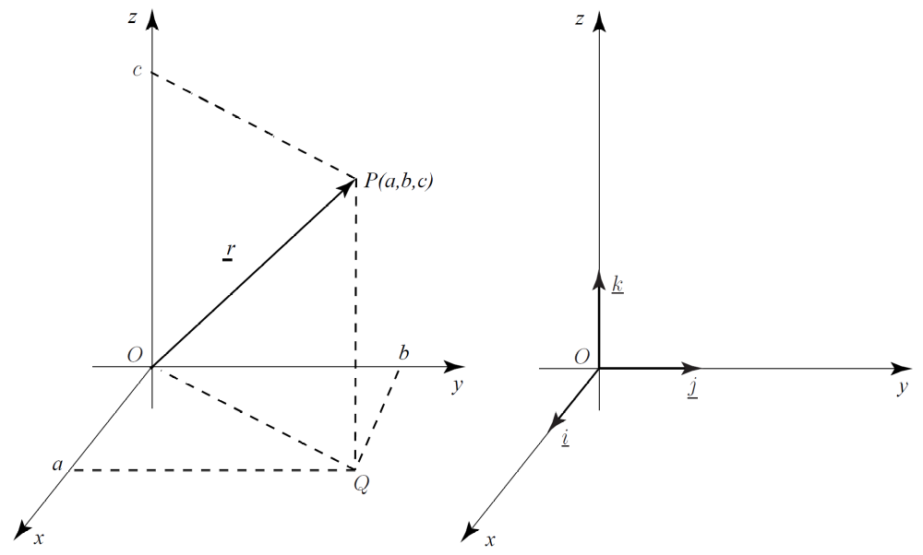
3D Coordinate Frames
Vectors can be used to describe points, lines, and planes in three dimensions. These mathematical foundations underpin much of the technology associated with computer graphics.

Slide 36
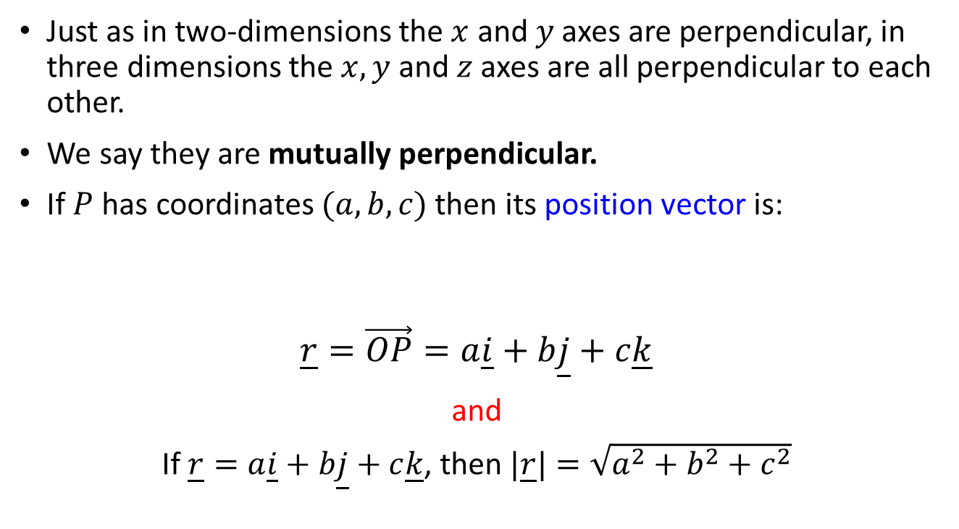
3D Coordinate Frames
Just as in two-dimensions the $x$ and $y$ axes are perpendicular, in three dimensions the $x,y$ and $z$ axes are all perpendicular to each other.
We say they are mutually perpendicular.
If $P$ has coordinates $(a, b, c)$then its position vector is:
$$\underline{r}=\vec{OP}=a\underline{i}+b\underline{j}+c\underline{k}$$
and
If $\underline{r}=a\underline{i}+b\underline{j}+c\underline{k}$, then $|\underline{r}|=\sqrt{a^{2}+b^{2}+c^{2}}$

Slide 37
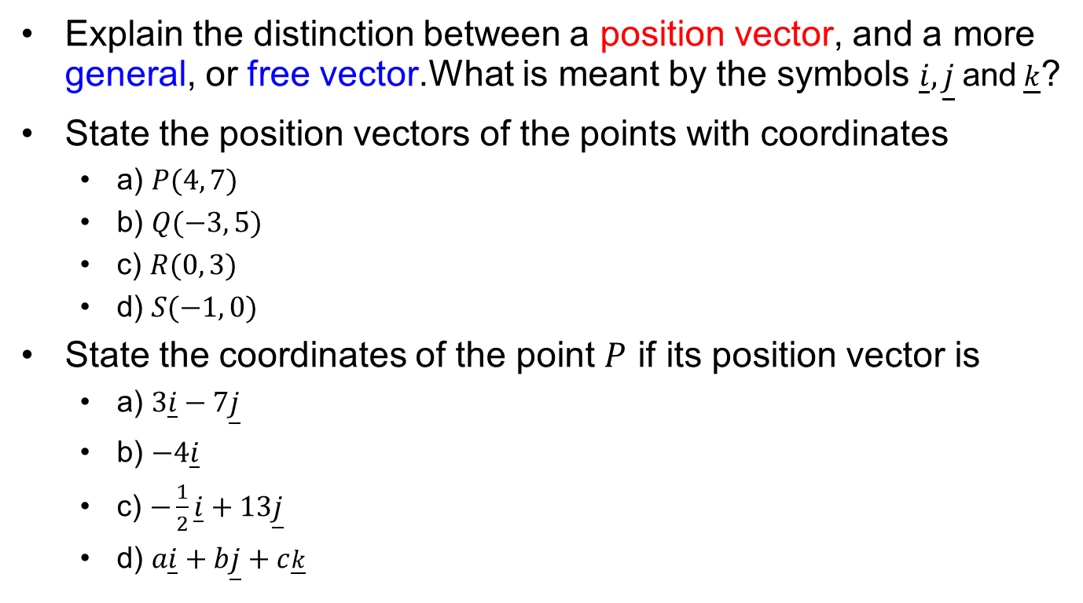
Exercises
Explain the distinction between a position vector, and a more general, or free vector.What is meant by the symbols $\underline{i},\underline{j}$and$\underline{k}$?
State the position vectors of the points with coordinates
  a) $P(4, 7)$
  b) $Q(−3, 5)$
  c) $R(0, 3)$
  d) $S(−1, 0)$
State the coordinates of the point $P$ if its position vector is
  a) $3\underline{i}−7\underline{j}$
  b) $−4\underline{i}$
  c) $−\frac{1}{2}\underline{i}+13\underline{j}$
  d) $a\underline{i}+b\underline{j}+c\underline{k}$

Slide 38
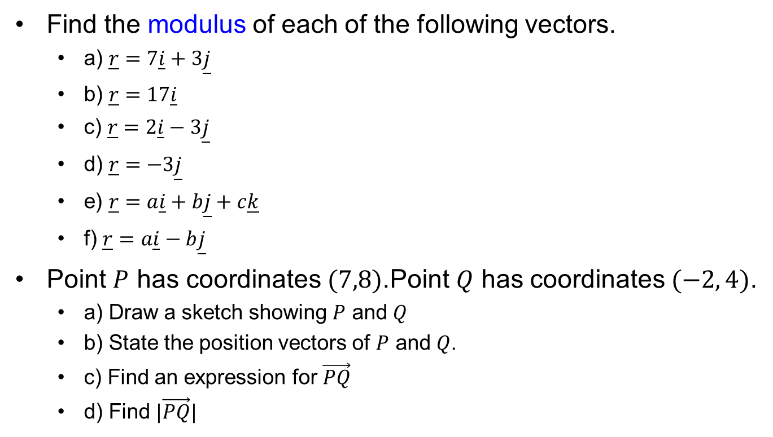
Exercises
Find the modulus of each of the following vectors.
  a) $\underline{r}=7\underline{i}+3\underline{j}$
  b) $\underline{r}=17\underline{i}$
  c) $\underline{r}=2\underline{i}−3\underline{j}$
  d) $\underline{r}=−3\underline{j}$
  e) $\underline{r}=a\underline{i}+b\underline{j}+c\underline{k}$
  f) $\underline{r}=a\underline{i}−b\underline{j}$
Point $P$ has coordinates $(7,8)$.Point $Q$ has coordinates $(−2, 4)$.
  a) Draw a sketch showing $P$ and $Q$
  b) State the position vectors of $P$ and $Q$.
  c) Find an expression for $\vec{PQ}$
  d) Find $|\vec{PQ}|$

Slide 39
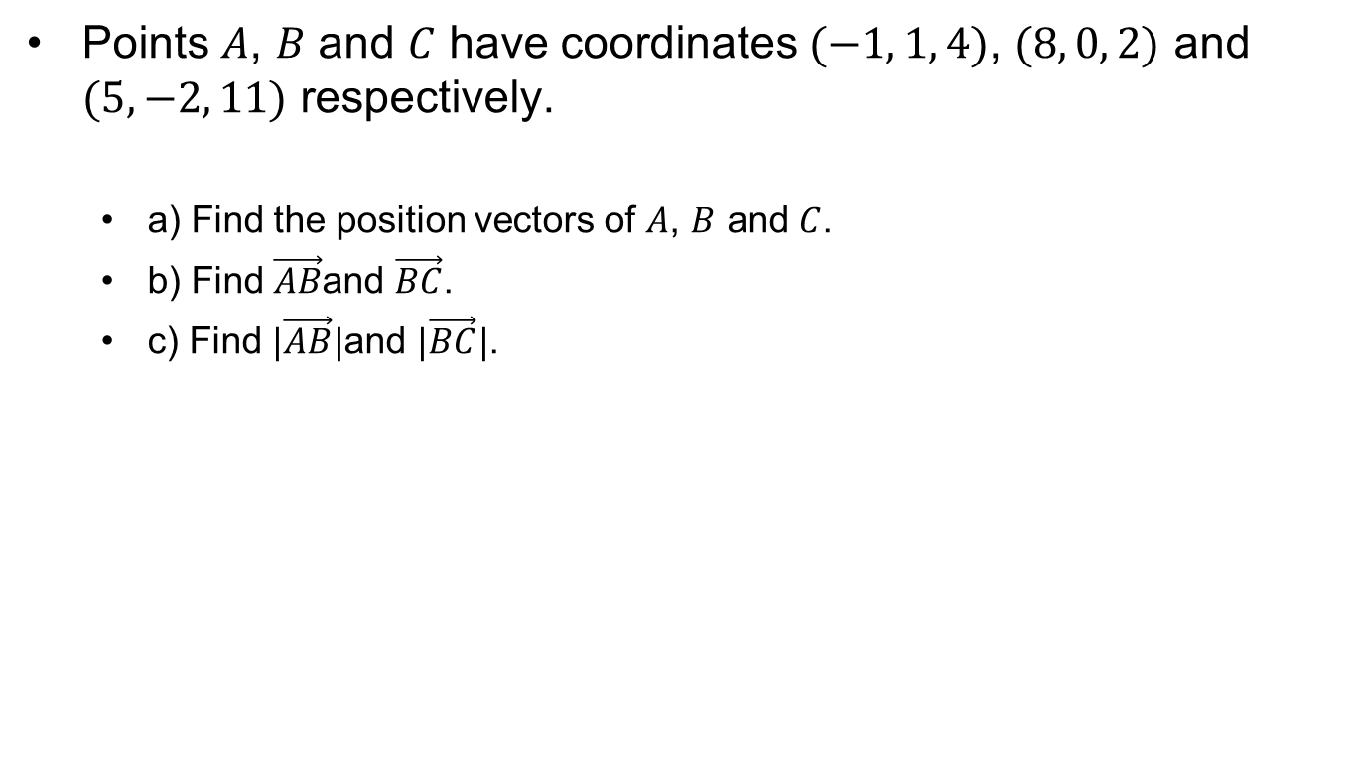
Exercises
Points $A$, $B$ and $C$ have coordinates $(−1, 1, 4)$, $(8, 0, 2)$ and $(5,−2, 11)$ respectively.
  a) Find the position vectors of $A$, $B$ and $C$.
  b) Find $\vec{AB}$and $\vec{BC}$.
  c) Find $|\vec{AB}|$and $|\vec{BC}|$.

Slide 40
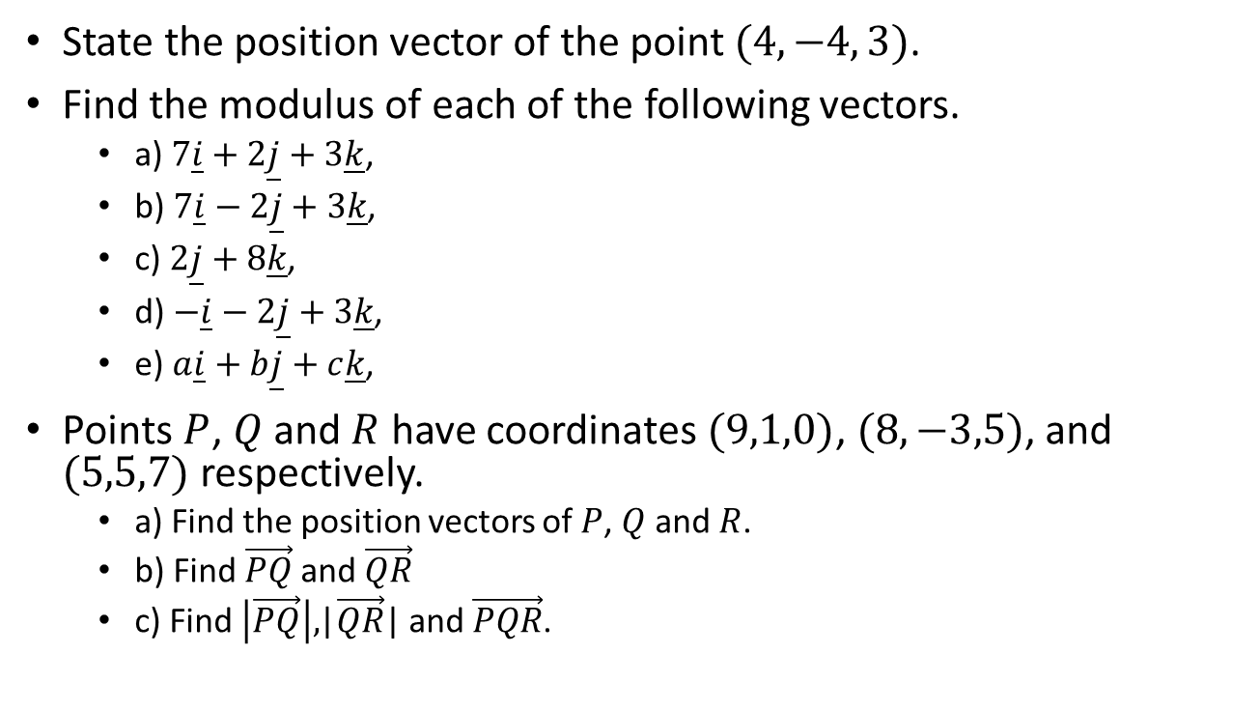
Exercises
State the position vector of the point $(4,−4, 3)$.
Find the modulus of each of the following vectors.
  a) $7\underline{i}+2\underline{j}+3\underline{k}$,
  b) $7\underline{i}−2\underline{j}+3\underline{k}$,
  c) $2\underline{j}+8\underline{k}$,
  d) $−\underline{i}−2\underline{j}+3\underline{k}$,
  e) $a\underline{i}+b\underline{j}+c\underline{k}$,
Points $P$, $Q$ and $R$ have coordinates $(9,1,0)$, $(8,−3,5)$, and $(5,5,7)$ respectively.
  a) Find the position vectors of $P$, $Q$ and $R$.
  b) Find $\vec{PQ}$and $\vec{QR}$
  c) Find $\left|\vec{PQ}\right|,$|$\vec{QR}$| and $\vec{PQR}$.

Slide 41
Artificial Intelligence for Games
CMP6206
Questions?
Maths for AI: Vectors

