Slide 1

Artificial Intelligence for Games
CMP6206
Labs 2
Maths for AI: Dot and Cross Product

Slide 2
Dot and Cross Products
There are two kinds of multiplication involving vectors. The first is known as the scalar product or dot product.
When the scalar/dot product of two vectors is calculated the result is a scalar.
The second product is known as the vector product or cross product. When this is calculated the result is a vector.

Slide 3
What You Should Know
That a vector can be represented as a directed line segment.
How to express a vector in Cartesian form
How to find the modulus of a vector

Slide 4
What You Will Know
Calculate, from its definition, the scalar product of two given vectors
Calculate the scalar product of two vectors given in Cartesian form
Use the scalar product to find the angle between two vectors
Use the scalar product to test whether two vectors are perpendicular
Understand the right-handed screw rule
Calculate the vector product of two given vectors

Slide 5
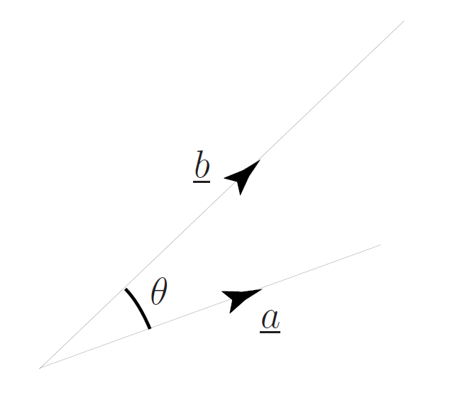
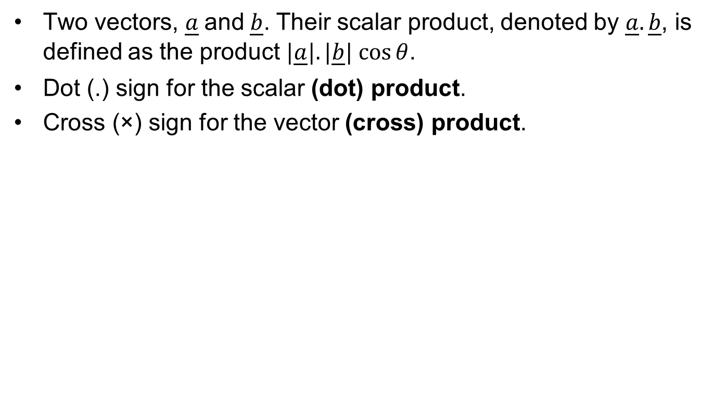
Scalar / Dot Product
Two vectors, $\underline{a}$and$\underline{b}$. Their scalar product, denoted by $\underline{a}.\underline{b}$, is defined as the product $|\underline{a}|.|\underline{b}| cos⁡θ$.
Dot (.) sign for the scalar (dot) product.
Cross (×) sign for the vector (cross) product.

Slide 6
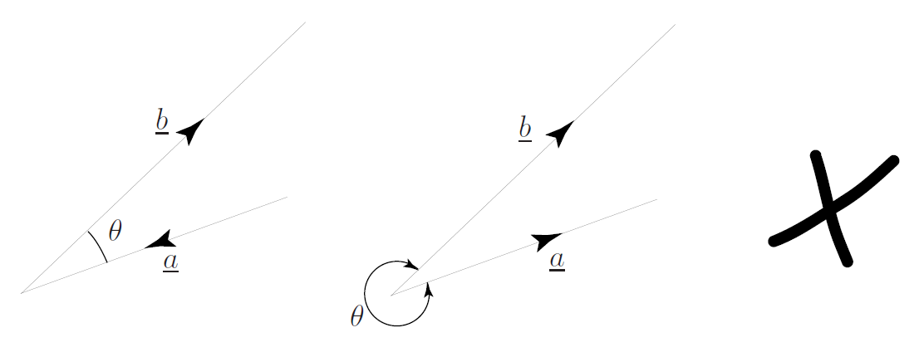
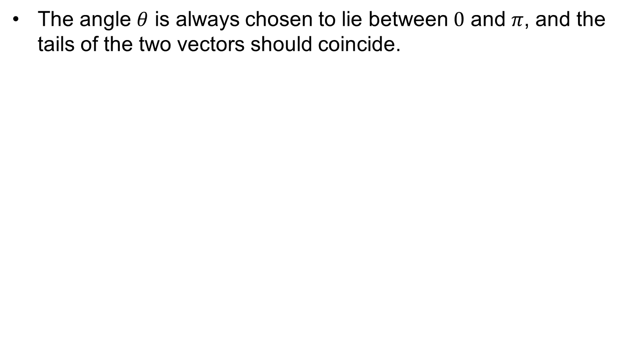
Vector Alignment
The angle $θ$ is always chosen to lie between $0$ and $π$, and the tails of the two vectors should coincide.

Slide 7
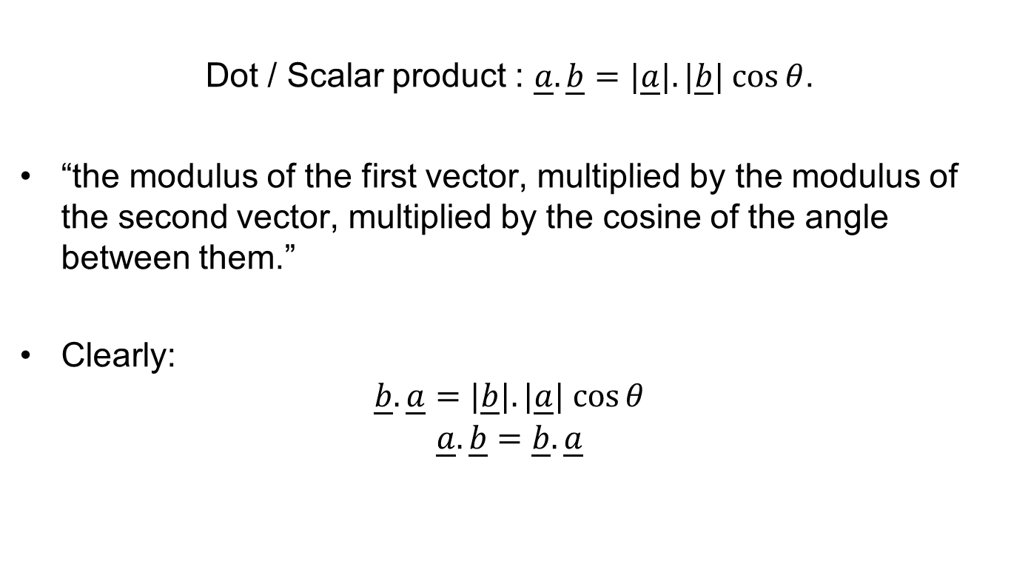
Dot Product Recap
Dot / Scalar product : $\underline{a}.\underline{b}=|\underline{a}|.|\underline{b}| cos⁡θ$.
“the modulus of the first vector, multiplied by the modulus of the second vector, multiplied by the cosine of the angle between them.”
Clearly:
$$\underline{b}.\underline{a}=|\underline{b}|.|\underline{a}| cos⁡θ$$
$$\underline{a}.\underline{b}=\underline{b}.\underline{a}$$

Slide 8
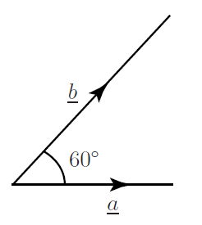
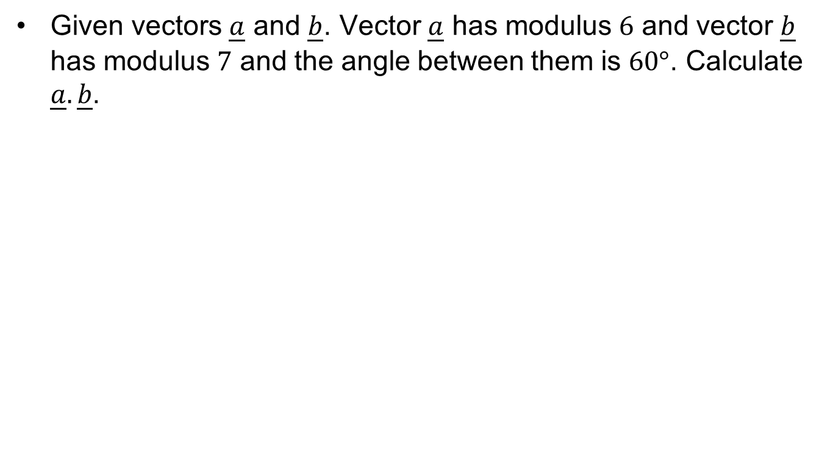
Exercise: Dot Product
Given vectors $\underline{a}$ and $\underline{b}$. Vector $\underline{a}$ has modulus $6$ and vector $\underline{b}$ has modulus $7$ and the angle between them is $60°$. Calculate $\underline{a}.\underline{b}$.

Slide 9
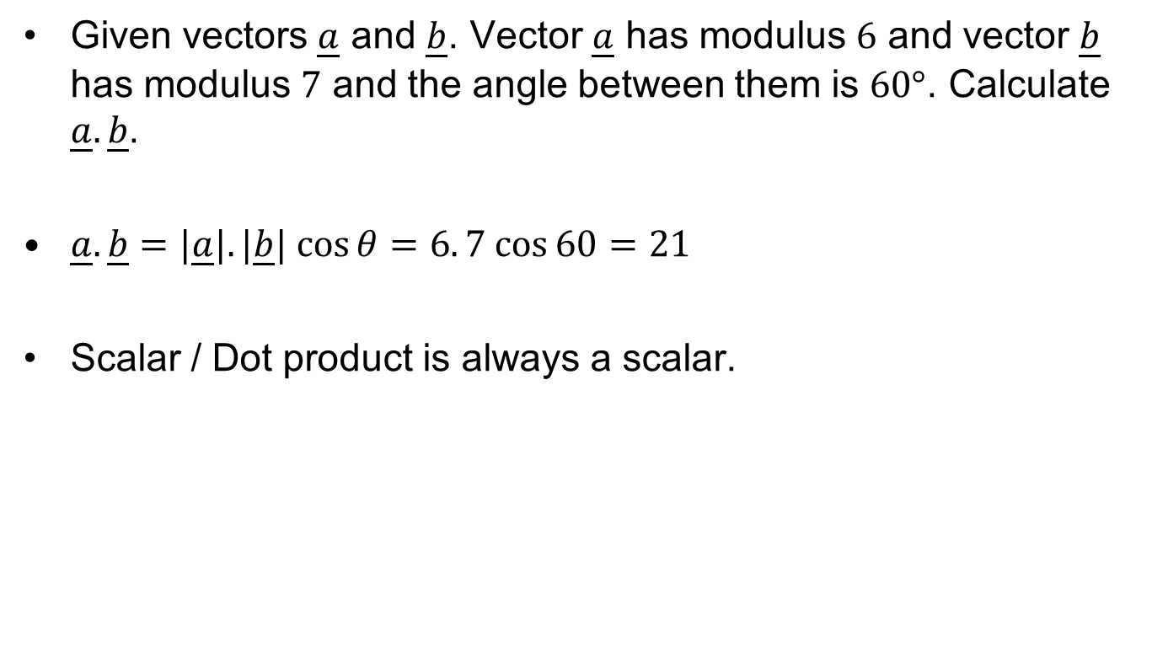
Exercise: Dot Product
Given vectors $\underline{a}$ and $\underline{b}$. Vector $\underline{a}$ has modulus $6$ and vector $\underline{b}$ has modulus $7$ and the angle between them is $60°$. Calculate $\underline{a}.\underline{b}$.
$\underline{a}.\underline{b}=|\underline{a}|.|\underline{b}| cos⁡θ$ $=6. 7 cos⁡60=$ $21$
Scalar / Dot product is always a scalar.

Slide 10
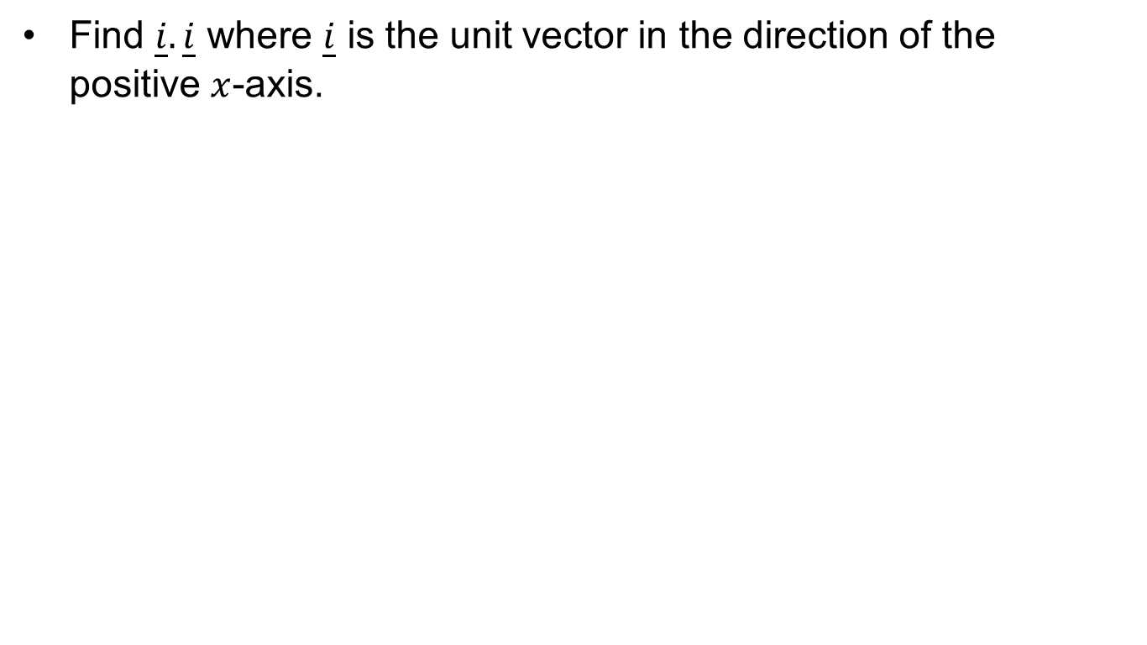
Exercise: Dot Product
Find $\underline{i}.\underline{i}$ where $\underline{i}$ is the unit vector in the direction of the positive $x$-axis.

Slide 11
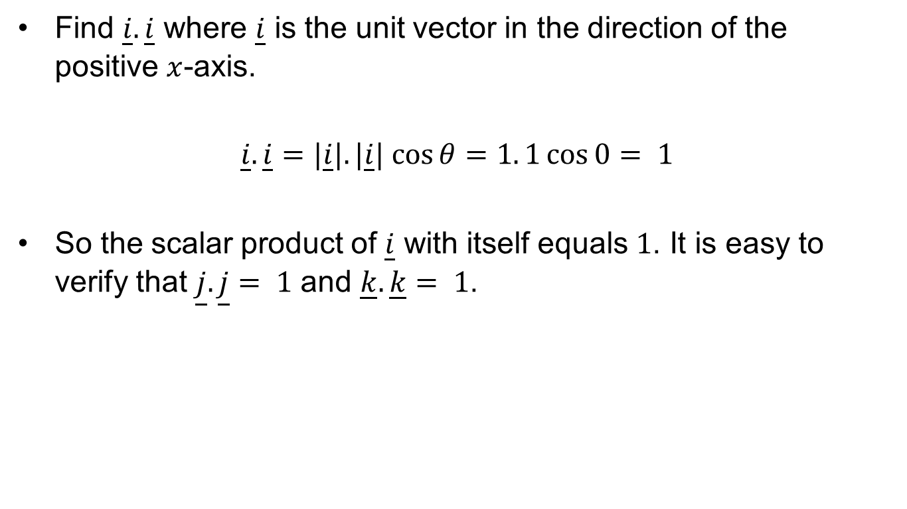
Exercise: Dot Product
Find $\underline{i}.\underline{i}$ where $\underline{i}$ is the unit vector in the direction of the positive $x$-axis.
$\underline{i}.\underline{i}=|\underline{i}|.|\underline{i}| cos⁡θ$ $=1. 1\cos{0}= 1$
So the scalar product of $\underline{i}$ with itself equals $1$. It is easy to verify that $\underline{j}.\underline{j}$ $= 1$ and $\underline{k}.\underline{k}$ $= 1$.

Slide 12
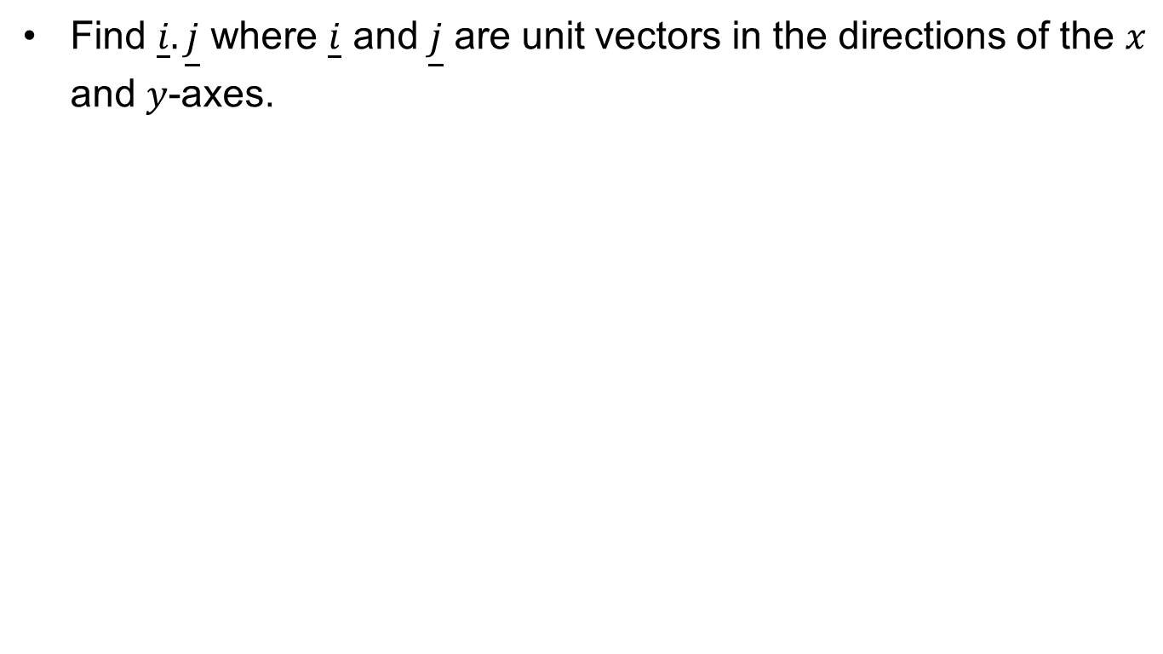
Exercise: Dot Product
Find $\underline{i}.\underline{j}$ where $\underline{i}$ and $\underline{j}$ are unit vectors in the directions of the $x$ and $y$-axes.

Slide 13
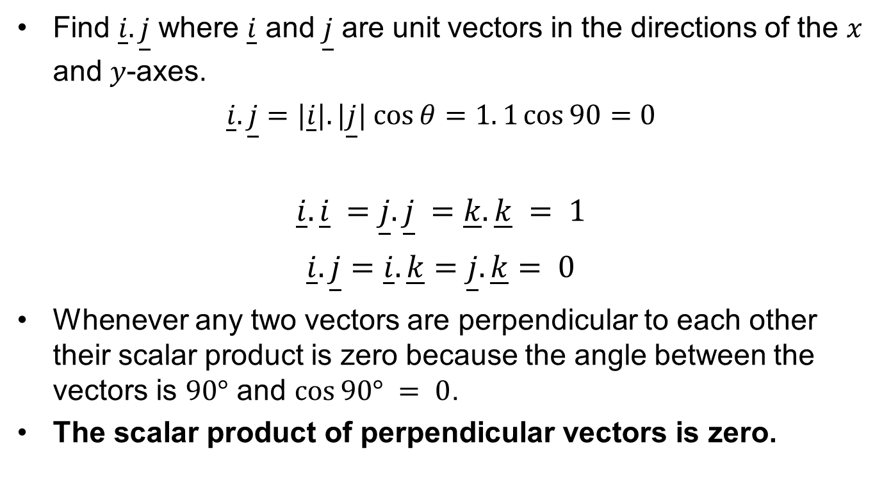
Exercise: Dot Product
Find $\underline{i}.\underline{j}$ where $\underline{i}$ and $\underline{j}$ are unit vectors in the directions of the $x$ and $y$-axes.
$\underline{i}.\underline{j}=|\underline{i}|.|\underline{j}| cos⁡θ$ $=1. 1\cos{90}=0$
$\underline{i}.\underline{i} =$ $\underline{j}.\underline{j} =$ $\underline{k}.\underline{k} = 1$
$\underline{i}.\underline{j}=$ $\underline{i}.\underline{k}=$ $\underline{j}.\underline{k}= 0$
Whenever any two vectors are perpendicular to each other their scalar product is zero because the angle between the vectors is $90°$ and $cos⁡90° = 0$.
The scalar product of perpendicular vectors is zero.

Slide 14
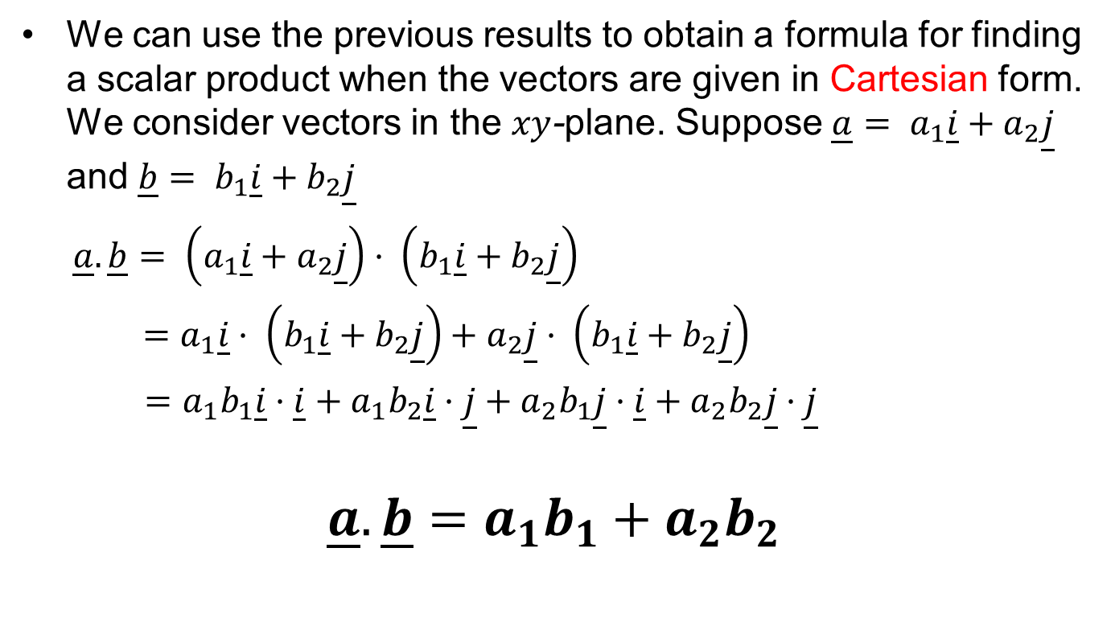
Dot Product Formula
We can use the previous results to obtain a formula for finding a scalar product when the vectors are given in Cartesian form. We consider vectors in the $xy$-plane. Suppose $\underline{a}= a_{1}\underline{i}+a_{2}\underline{j}$ and $\underline{b}= b_{1}\underline{i}+b_{2}\underline{j}$
$\underline{a}.\underline{b}= \left(a_{1}\underline{i}+a_{2}\underline{j}\right)· \left(b_{1}\underline{i}+b_{2}\underline{j}\right)$
$=a_{1}\underline{i}· \left(b_{1}\underline{i}+b_{2}\underline{j}\right)+a_{2}\underline{j}· \left(b_{1}\underline{i}+b_{2}\underline{j}\right)$
$=a_{1}b_{1}\underline{i}·\underline{i}+a_{1}b_{2}\underline{i}·\underline{j}+a_{2}b_{1}\underline{j}·\underline{i}+a_{2}b_{2}\underline{j}·\underline{j}$
$$\underline{a}.\underline{b}=a_{1}b_{1}+a_{2}b_{2}$$

Slide 15
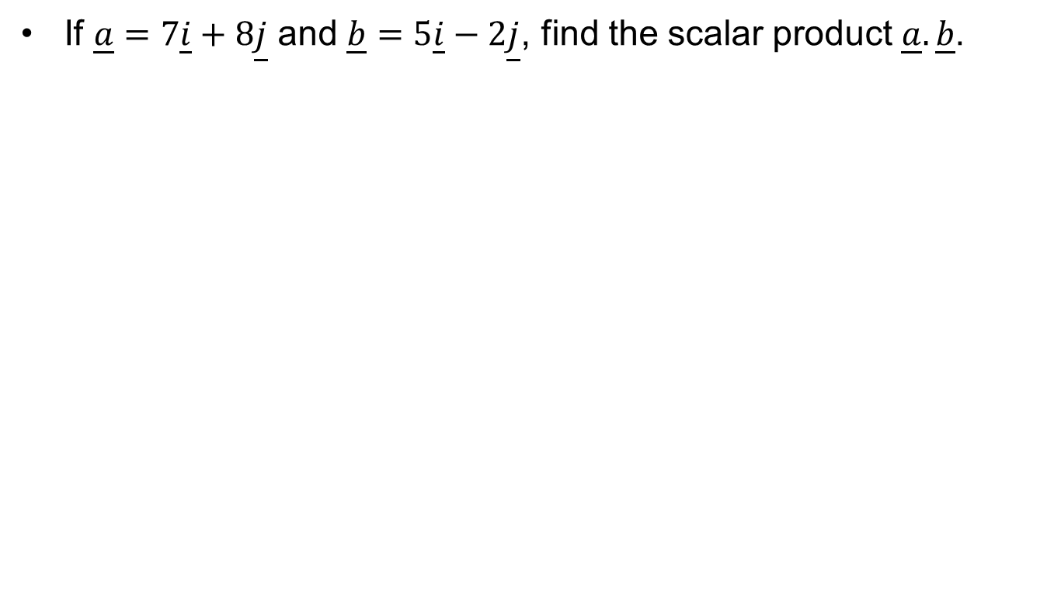
Exercise: Dot Product
If $\underline{a}=7\underline{i}+8\underline{j}$ and $\underline{b}=5\underline{i}−2\underline{j}$, find the scalar product $\underline{a}.\underline{b}$.

Slide 16
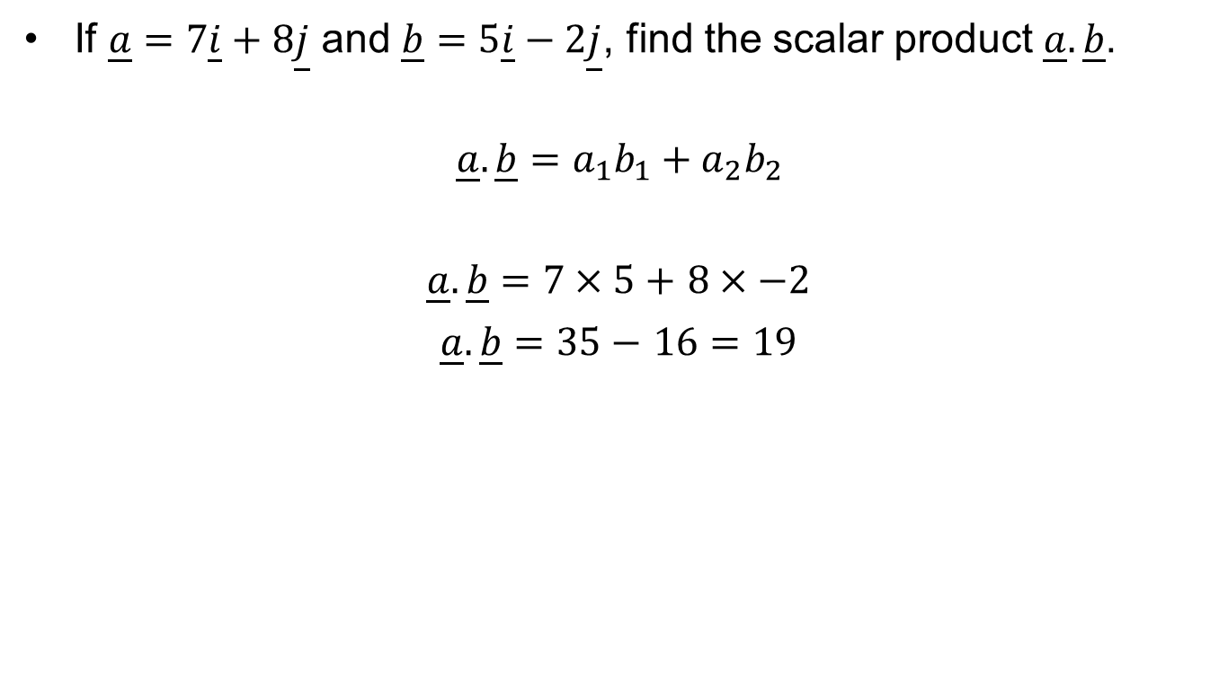
Exercise: Dot Product
If $\underline{a}=7\underline{i}+8\underline{j}$ and $\underline{b}=5\underline{i}−2\underline{j}$, find the scalar product $\underline{a}.\underline{b}$.
$$\underline{a}.\underline{b}=a_{1}b_{1}+a_{2}b_{2}$$
$\underline{a}.\underline{b}=7×5+$ $8×−2$
$\underline{a}.\underline{b}=35−$ $16=19$

Slide 17
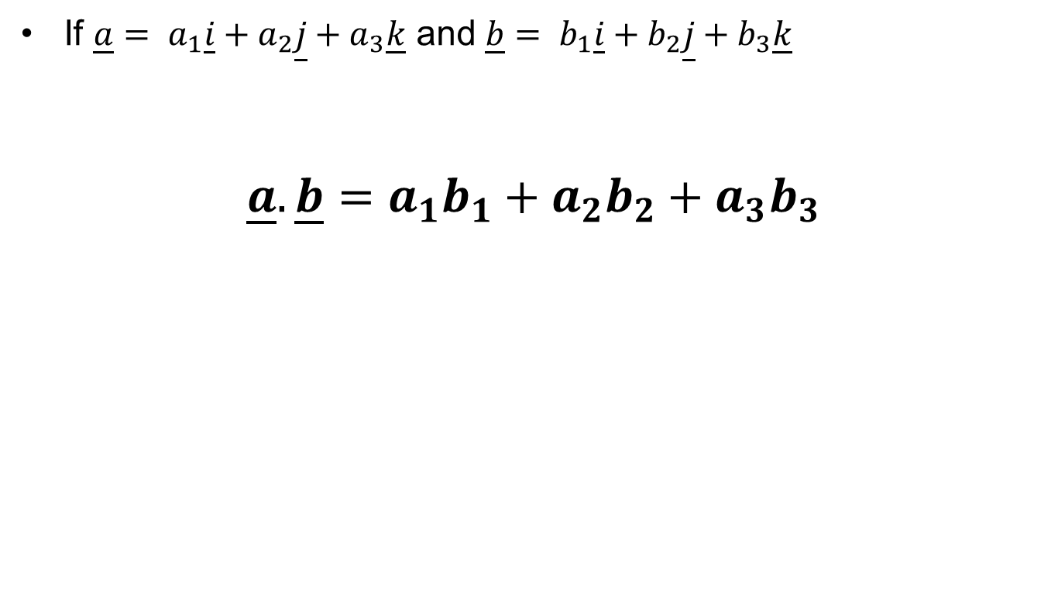
3D Dot Product
If $\underline{a}= a_{1}\underline{i}+a_{2}\underline{j}+a_{3}\underline{k}$ and $\underline{b}= b_{1}\underline{i}+b_{2}\underline{j}+b_{3}\underline{k}$
$$\underline{a}.\underline{b}=a_{1}b_{1}+a_{2}b_{2}+a_{3}b_{3}$$

Slide 18
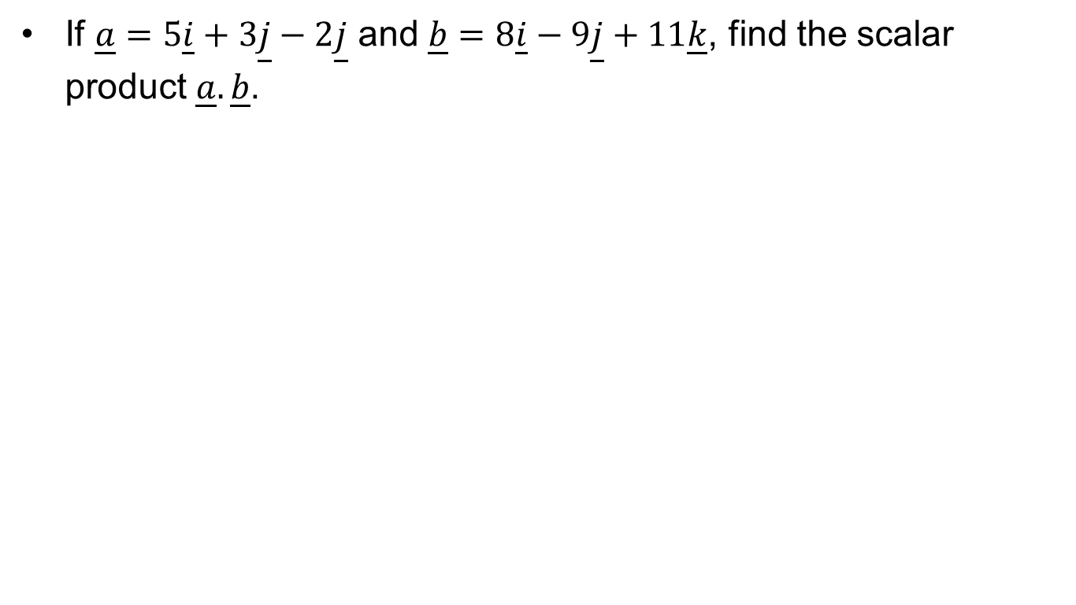
Exercise: Dot Product
If $\underline{a}=5\underline{i}+3\underline{j}−2\underline{j}$ and $\underline{b}=8\underline{i}−9\underline{j}+11\underline{k}$, find the scalar product $\underline{a}.\underline{b}$.

Slide 19
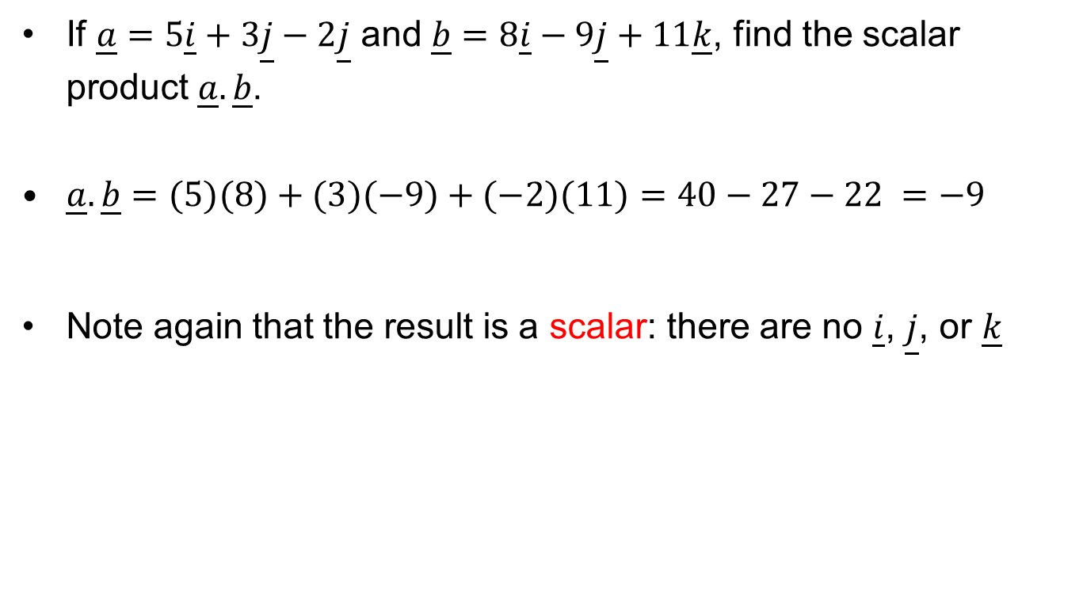
Exercise: Dot Product
If $\underline{a}=5\underline{i}+3\underline{j}−2\underline{j}$ and $\underline{b}=8\underline{i}−9\underline{j}+11\underline{k}$, find the scalar product $\underline{a}.\underline{b}$.
$\underline{a}.\underline{b}=(5)(8)+(3)(−9)+(−2)(11)=40−27−22 =−9$
Note again that the result is a scalar: there are no $\underline{i}$, $\underline{j}$, or $\underline{k}$

Slide 20
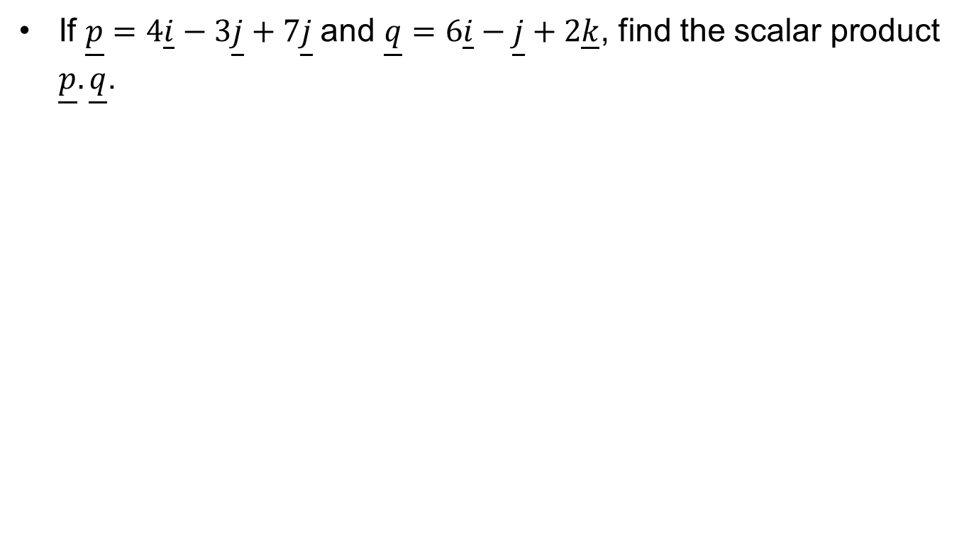
Exercise: Dot Product
If $\underline{p}=4\underline{i}−3\underline{j}+7\underline{j}$and $\underline{q}=6\underline{i}−\underline{j}+2\underline{k}$, find the scalar product $\underline{p}.\underline{q}$.

Slide 21
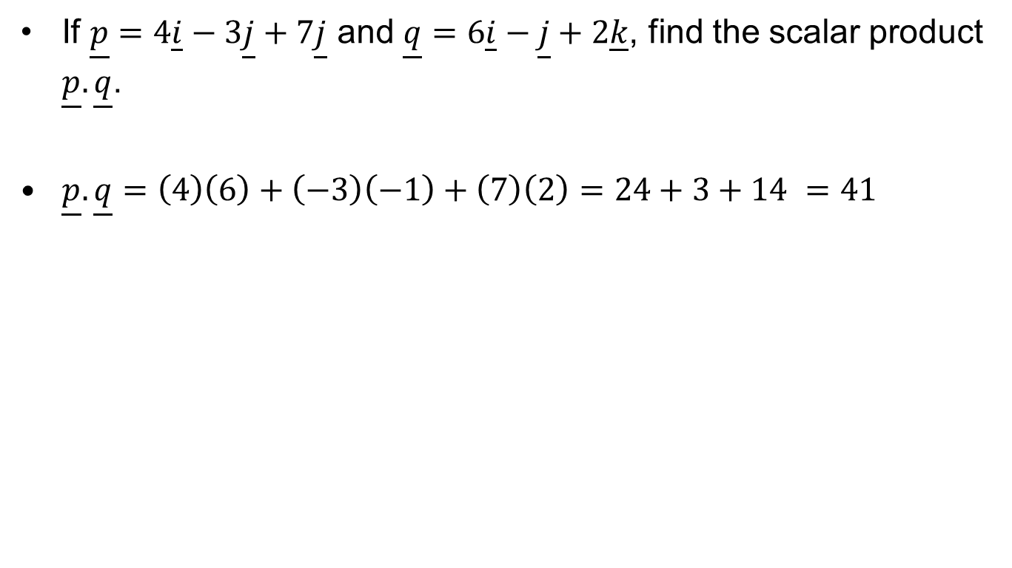
Exercise: Dot Product
If $\underline{p}=4\underline{i}−3\underline{j}+7\underline{j}$ and $\underline{q}=6\underline{i}−\underline{j}+2\underline{k}$, find the scalar product $\underline{p}.\underline{q}$.
$\underline{p}.\underline{q}=\left(4\right)\left(6\right)+\left(−3\right)\left(−1\right)+\left(7\right)\left(2\right)=24+3+14 =41$

Slide 22
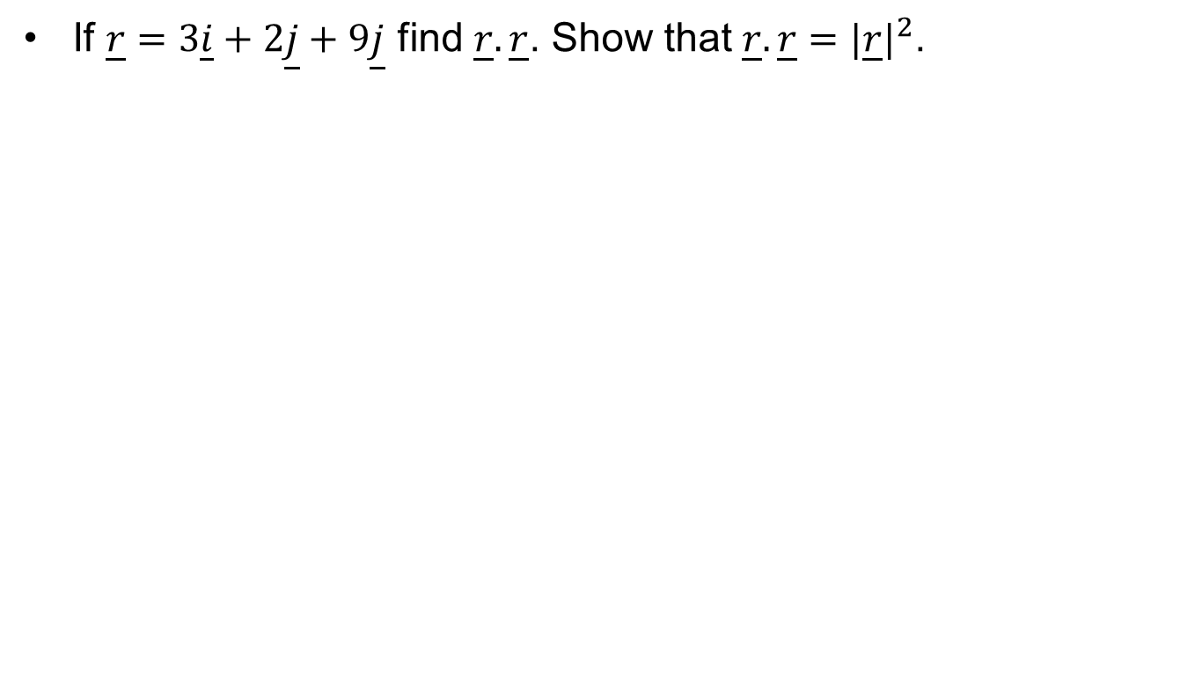
Exercise: Dot Product
If $\underline{r}=3\underline{i}+2\underline{j}+9\underline{j}$ find $\underline{r}.\underline{r}$. Show that $\underline{r}.\underline{r}=|{\underline{r}|}^{2}$.

Slide 23
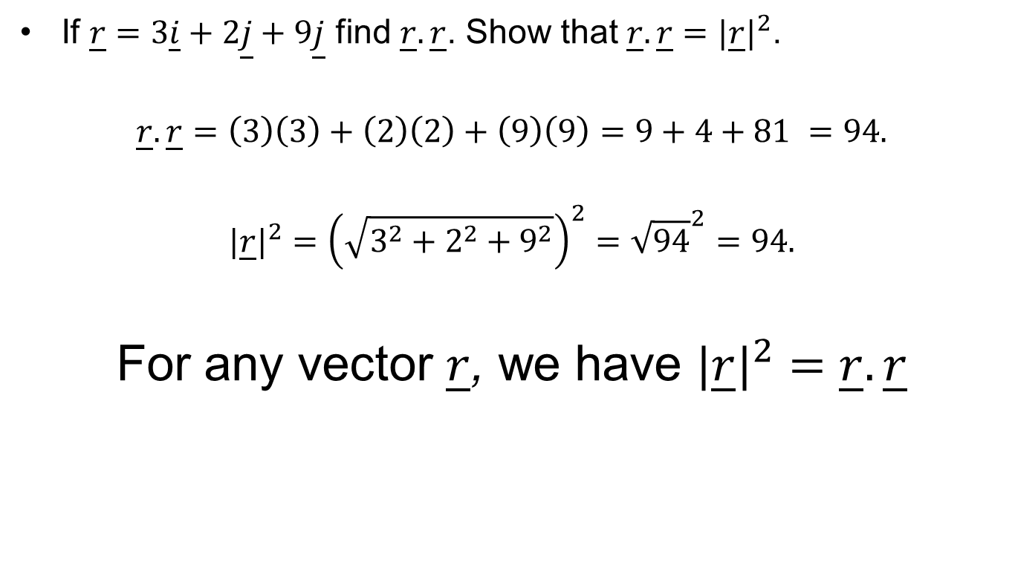
Exercise: Dot Product
If $\underline{r}=3\underline{i}+2\underline{j}+9\underline{j}$ find $\underline{r}.\underline{r}$. Show that $\underline{r}.\underline{r}=|{\underline{r}|}^{2}$.
$$\underline{r}.\underline{r}=\left(3\right)\left(3\right)+\left(2\right)\left(2\right)+\left(9\right)\left(9\right)=9+4+81 =94.$$
$$|{\underline{r}|}^{2}={\left(\sqrt{3^{2}+2^{2}+9^{2}}\right)}^{2}={\sqrt{94}}^{2}=94.$$
For any vector $\underline{r}$, we have $|{\underline{r}|}^{2}=\underline{r}.\underline{r}$

Slide 24
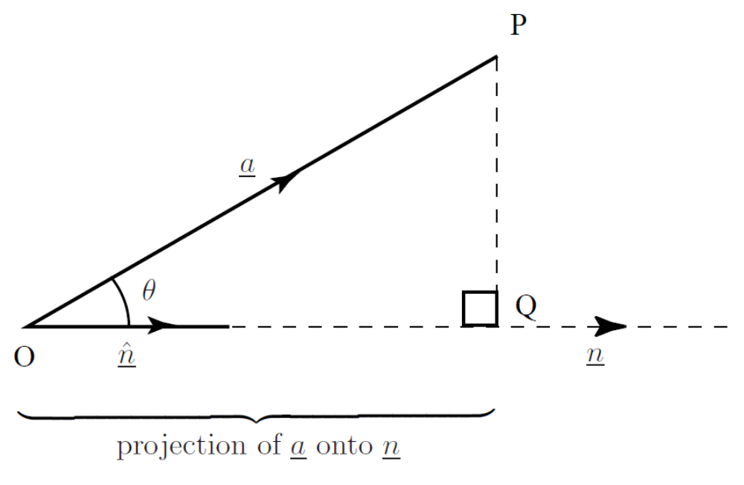
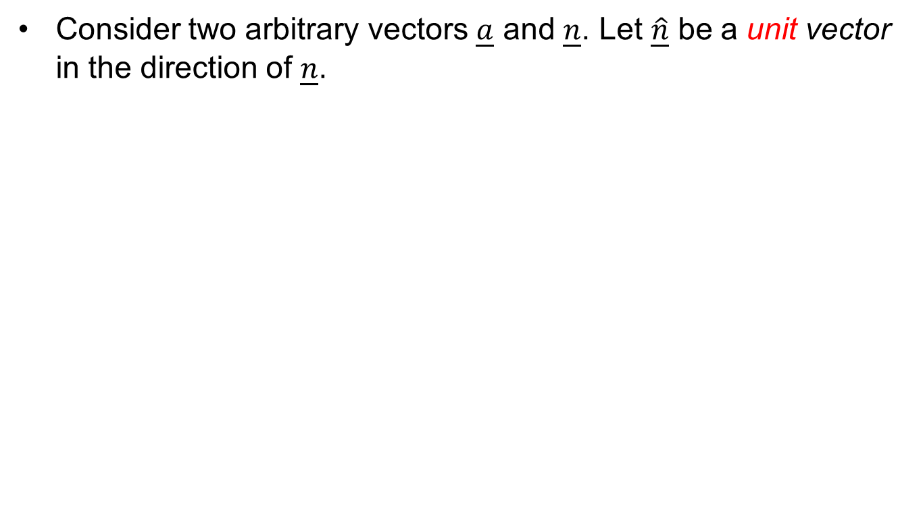
One Vector Along Another
Consider two arbitrary vectors $\underline{a}$ and $\underline{n}$. Let $\underline{\hat{n}}$ be a unit vector in the direction of $\underline{n}$.

Slide 25
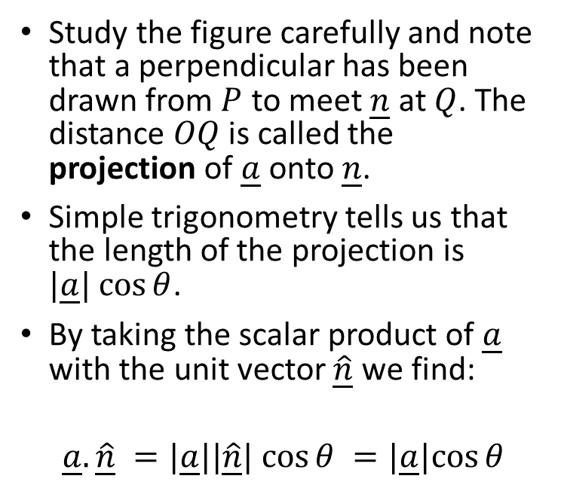
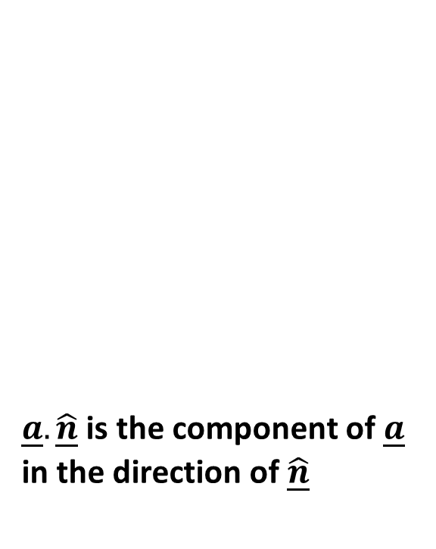
One Vector Along Another
$\underline{a}.\underline{\hat{n}}$ is the component of $\underline{a}$ in the direction of $\underline{\hat{n}}$
Study the figure carefully and note that a perpendicular has been drawn from $P$ to meet $\underline{n}$ at $Q$. The distance $OQ$ is called the projection of $\underline{a}$ onto $\underline{n}$.
Simple trigonometry tells us that the length of the projection is $|\underline{a}| cos⁡θ$.
By taking the scalar product of $\underline{a}$ with the unit vector $\underline{\hat{n}}$ we find:
$$\underline{a}.\underline{\hat{n}} =|\underline{a}||\underline{\hat{n}}| cos⁡θ =|\underline{a}|cos⁡θ$$

Slide 26
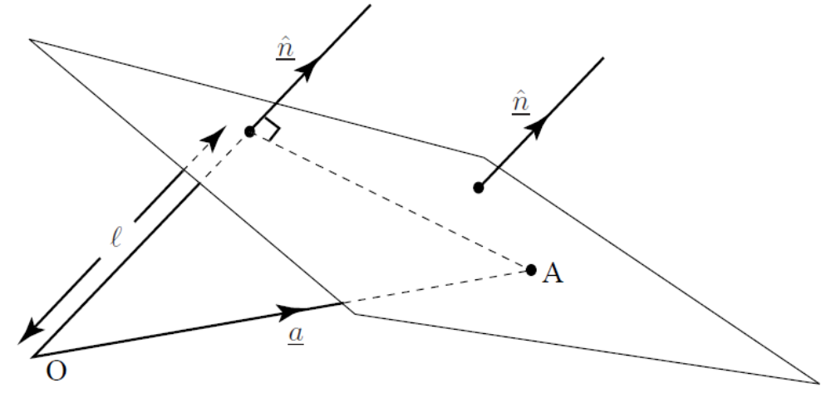
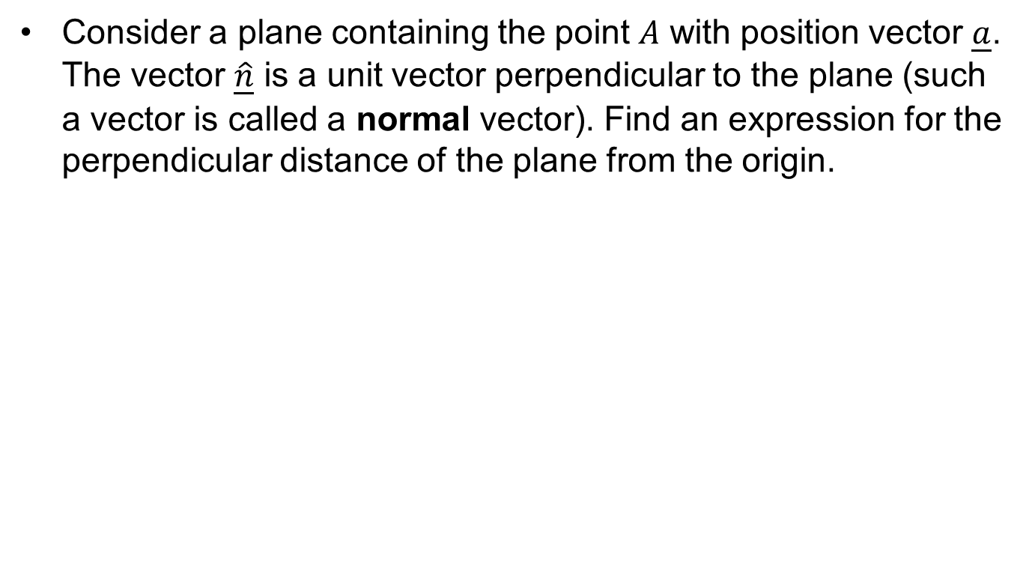
Exercise: Scalar Product
Consider a plane containing the point $A$ with position vector $\underline{a}$. The vector $\underline{\hat{n}}$ is a unit vector perpendicular to the plane (such a vector is called a normal vector). Find an expression for the perpendicular distance of the plane from the origin.

Slide 27
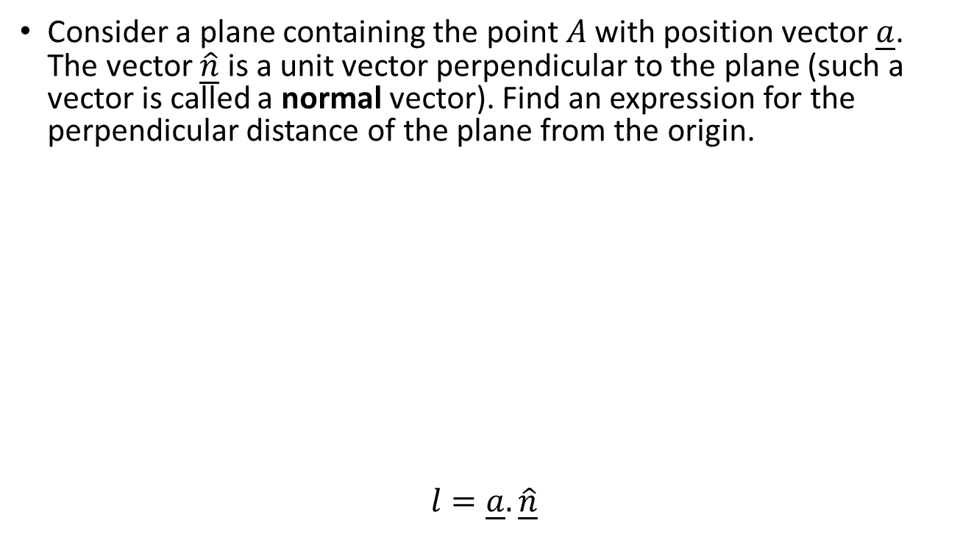
Exercise: Scalar Product
Consider a plane containing the point $A$ with position vector $\underline{a}$. The vector $\underline{\hat{n}}$ is a unit vector perpendicular to the plane (such a vector is called a normal vector). Find an expression for the perpendicular distance of the plane from the origin.
$$l=\underline{a}.\underline{\hat{n}}$$

Slide 28
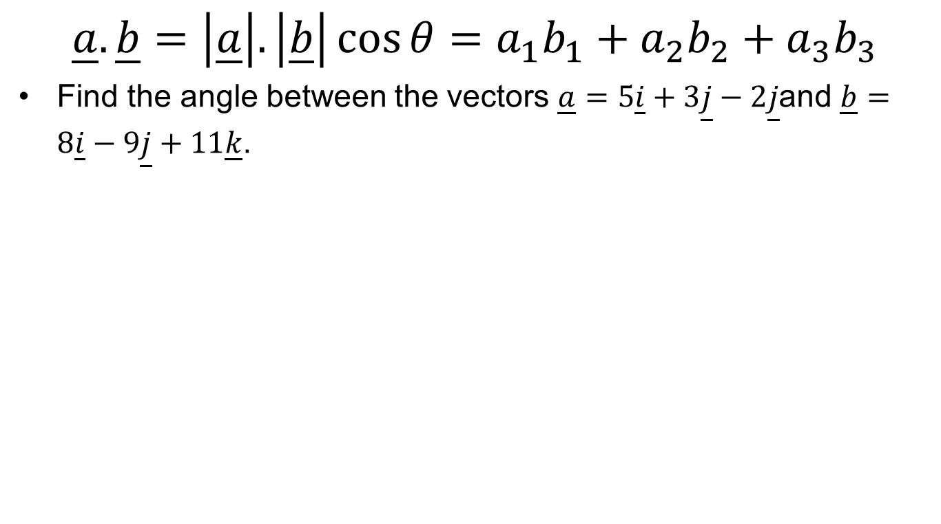
Angle Between Two Vectors
$$\underline{a}.\underline{b}=\left|\underline{a}\right|.\left|\underline{b}\right|\cos{θ}=a_{1}b_{1}+a_{2}b_{2}+a_{3}b_{3}$$
Find the angle between the vectors $\underline{a}=5\underline{i}+3\underline{j}−2\underline{j}$and $\underline{b}=8\underline{i}−9\underline{j}+11\underline{k}$.

Slide 29
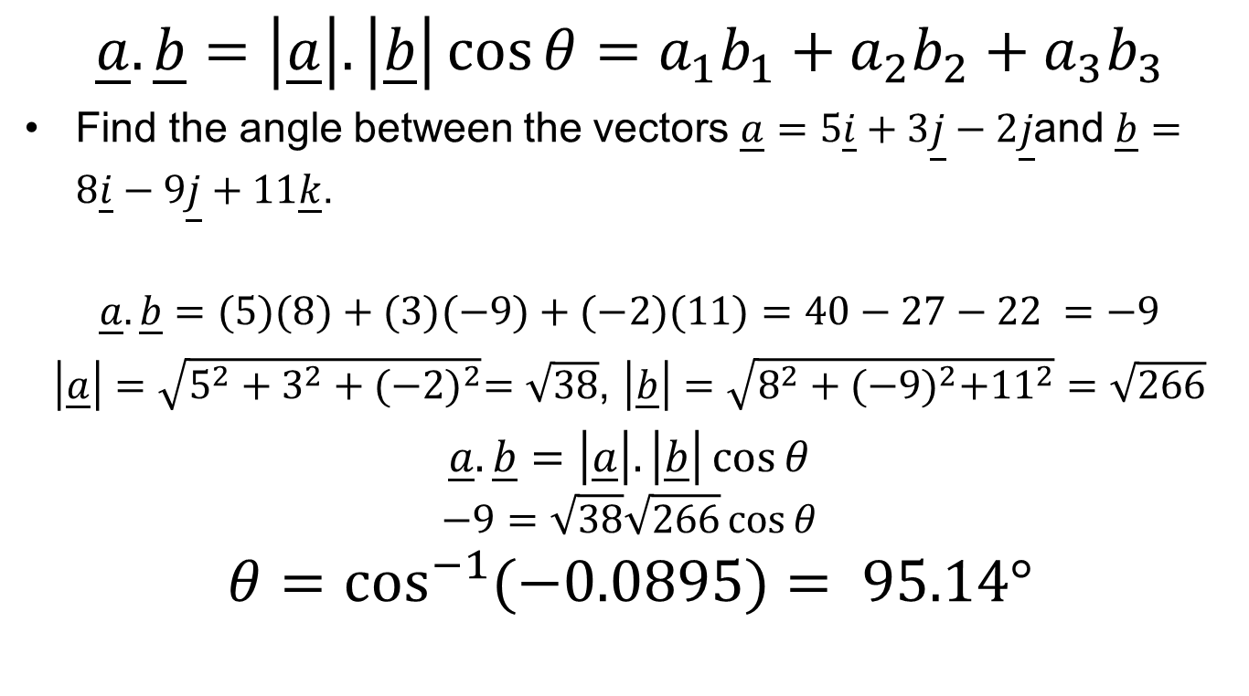
Angle Between Two Vectors
$$\underline{a}.\underline{b}=\left|\underline{a}\right|.\left|\underline{b}\right|\cos{θ}=a_{1}b_{1}+a_{2}b_{2}+a_{3}b_{3}$$
Find the angle between the vectors $\underline{a}=5\underline{i}+3\underline{j}−2\underline{j}$and $\underline{b}=8\underline{i}−9\underline{j}+11\underline{k}$.
$$\underline{a}.\underline{b}=(5)(8)+(3)(−9)+(−2)(11)=40−27−22 =−9$$
$\left|\underline{a}\right|=\sqrt{5^{2}+3^{2}+{(−2)}^{2}}=\sqrt{38}$, $\left|\underline{b}\right|=\sqrt{8^{2}+{(−9)}^{2}+{11}^{2}}=\sqrt{266}$
$\underline{a}.\underline{b}=\left|\underline{a}\right|.\left|\underline{b}\right|\cos{θ}$
$$−9=\sqrt{38}\sqrt{266}\cos{θ}$$
$$θ=\cos^{−1}{(−0.0895)}= 95.14°$$

Slide 30
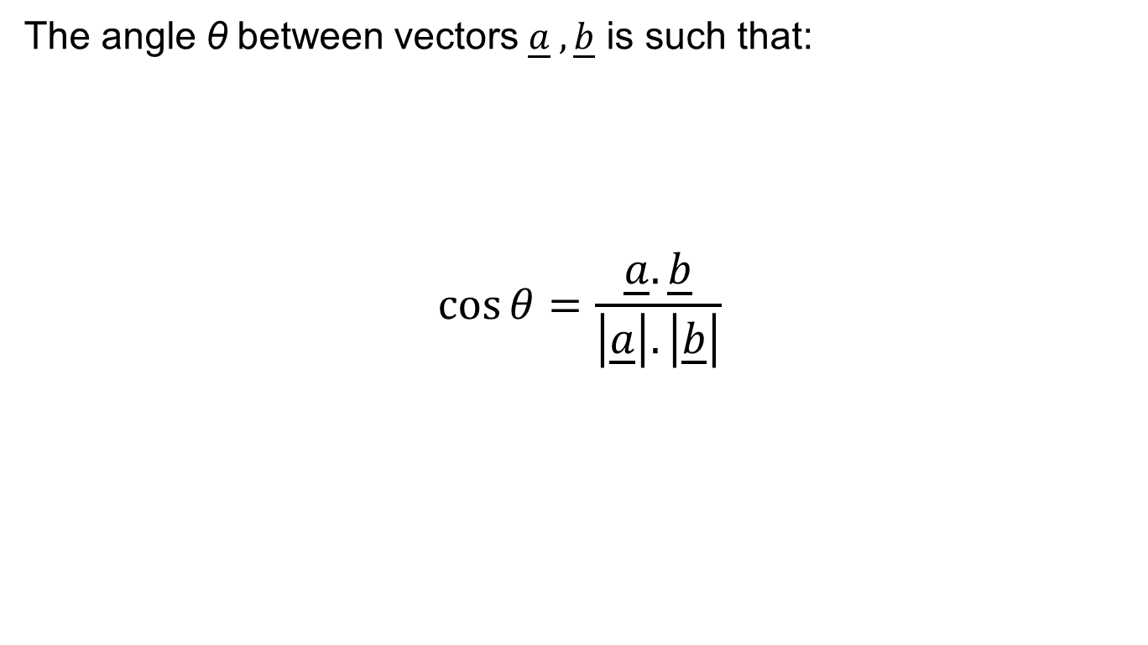
Generalising
The angle θ between vectors $\underline{a} ,\underline{b}$ is such that:
$$\cos{θ}=\frac{\underline{a}.\underline{b}}{\left|\underline{a}\right|.\left|\underline{b}\right|}$$

Slide 31
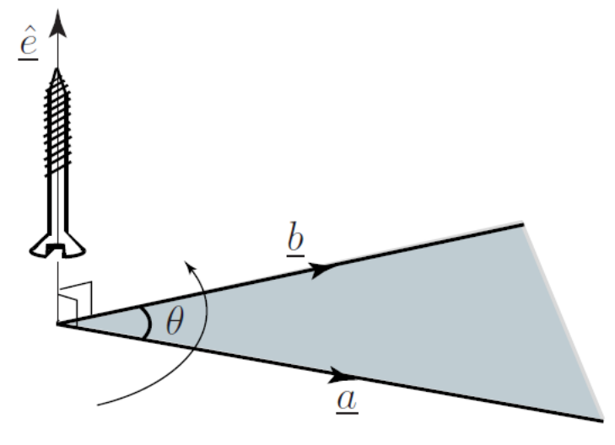
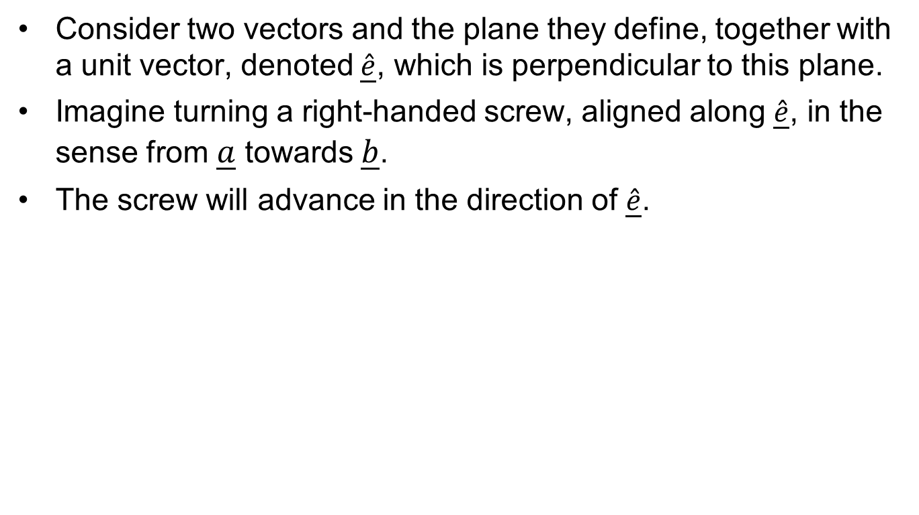
Right Hand Screw Rule
Consider two vectors and the plane they define, together with a unit vector, denoted $\underline{\hat{e}}$, which is perpendicular to this plane.
Imagine turning a right-handed screw, aligned along $\underline{\hat{e}}$, in the sense from $\underline{a}$ towards $\underline{b}$.
The screw will advance in the direction of $\underline{\hat{e}}$.

Slide 32
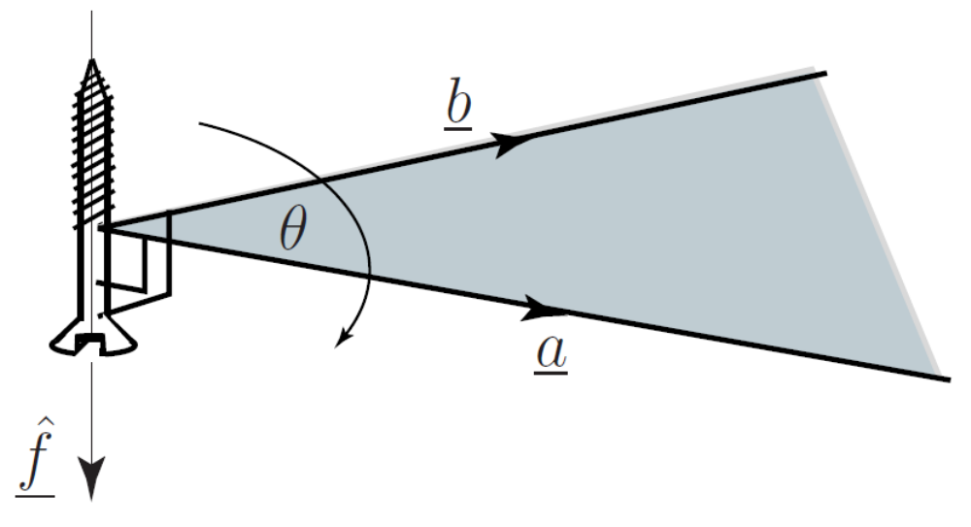
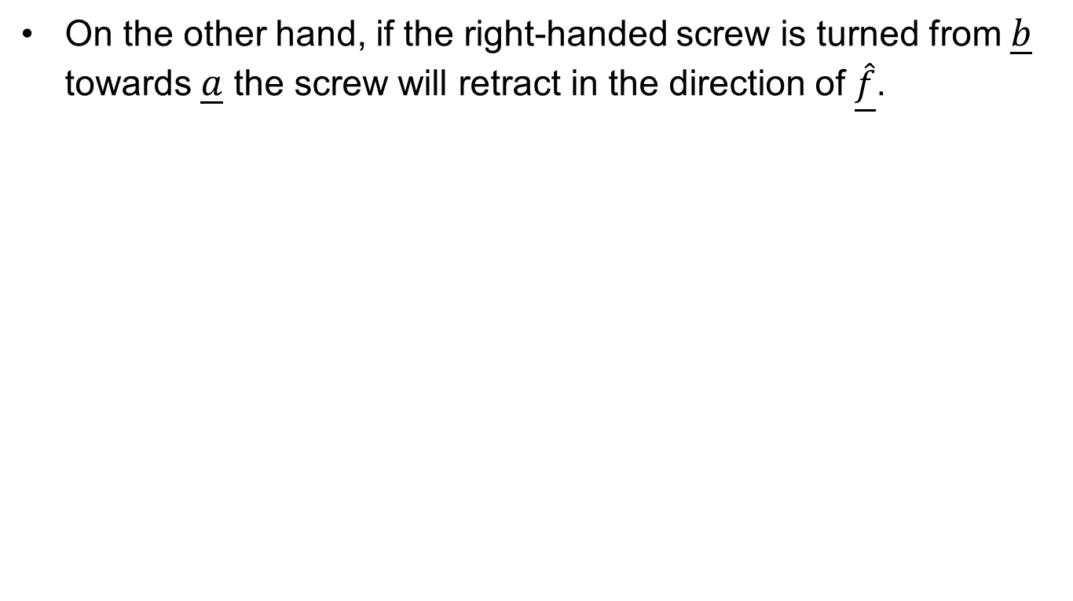
Right Hand Screw Rule
On the other hand, if the right-handed screw is turned from $\underline{b}$ towards $\underline{a}$ the screw will retract in the direction of $\underline{\hat{f}}$.

Slide 33
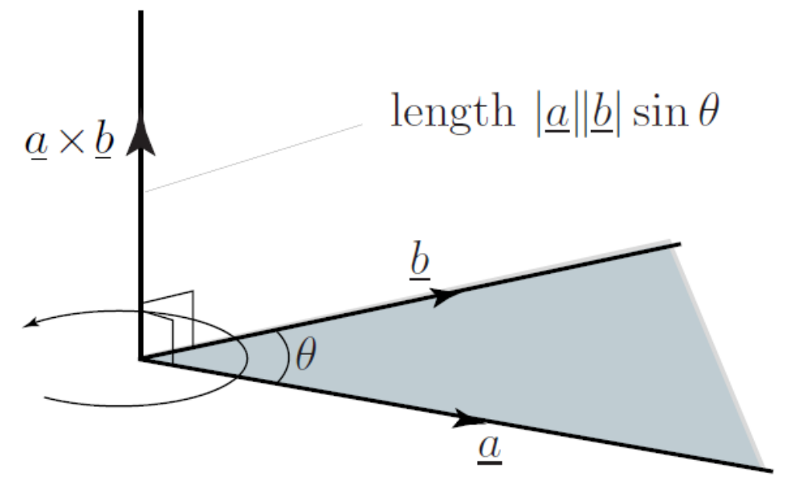
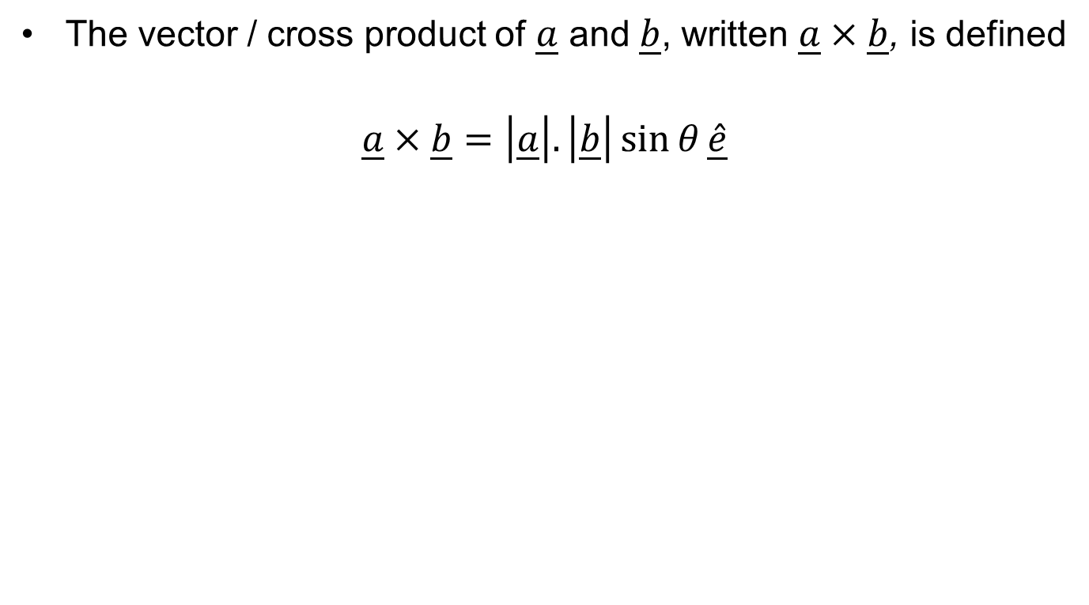
Vector / Cross Product
The vector / cross product of $\underline{a}$ and $\underline{b}$, written $\underline{a}×\underline{b}$, is defined
$$\underline{a}×\underline{b}=\left|\underline{a}\right|.\left|\underline{b}\right|\sin{θ}\underline{\hat{e}}$$

Slide 34
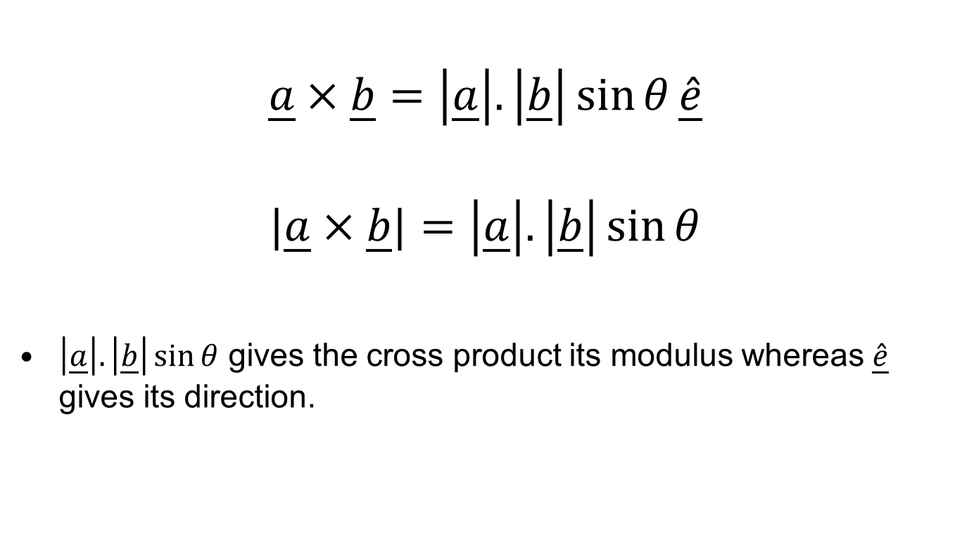
Cross Product: Formulae
$$\underline{a}×\underline{b}=\left|\underline{a}\right|.\left|\underline{b}\right|\sin{θ}\underline{\hat{e}}$$
$$|\underline{a}×\underline{b}|=\left|\underline{a}\right|.\left|\underline{b}\right|\sin{θ}$$
$\left|\underline{a}\right|.\left|\underline{b}\right|\sin{θ}$ gives the cross product its modulus whereas $\underline{\hat{e}}$ gives its direction.

Slide 35
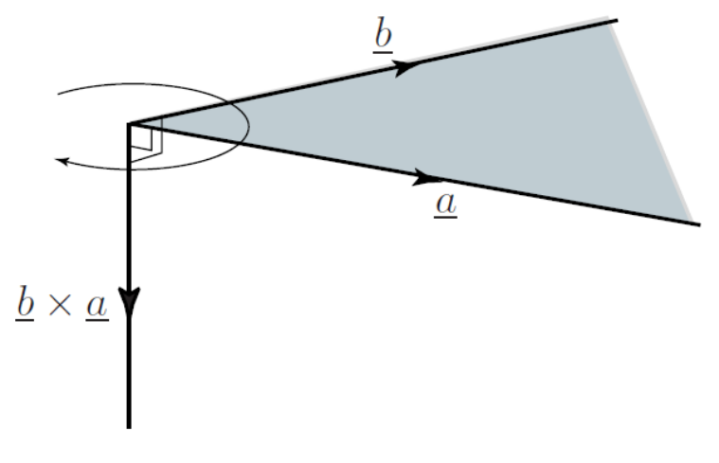
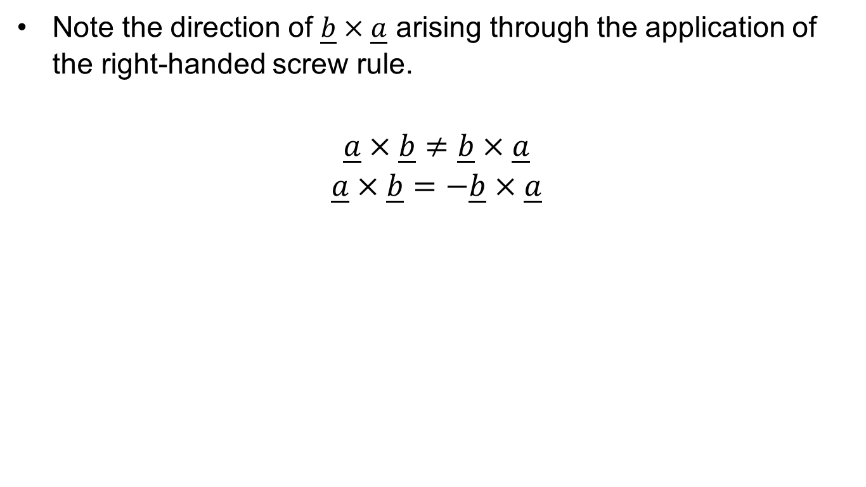
$$\underline{a}×\underline{b}≠\underline{b}×\underline{a}$$
Note the direction of $\underline{b}×\underline{a}$ arising through the application of the right-handed screw rule.
$$\underline{a}×\underline{b}≠\underline{b}×\underline{a}$$
$$\underline{a}×\underline{b}=−\underline{b}×\underline{a}$$

Slide 36
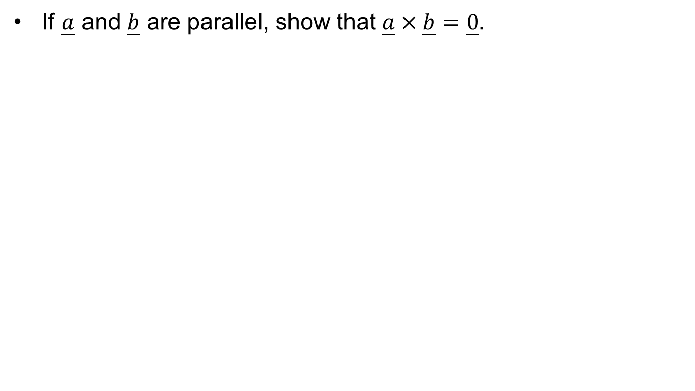
Exercise: Cross Product
If $\underline{a}$ and $\underline{b}$ are parallel, show that $\underline{a}×\underline{b}=\underline{0}$.

Slide 37
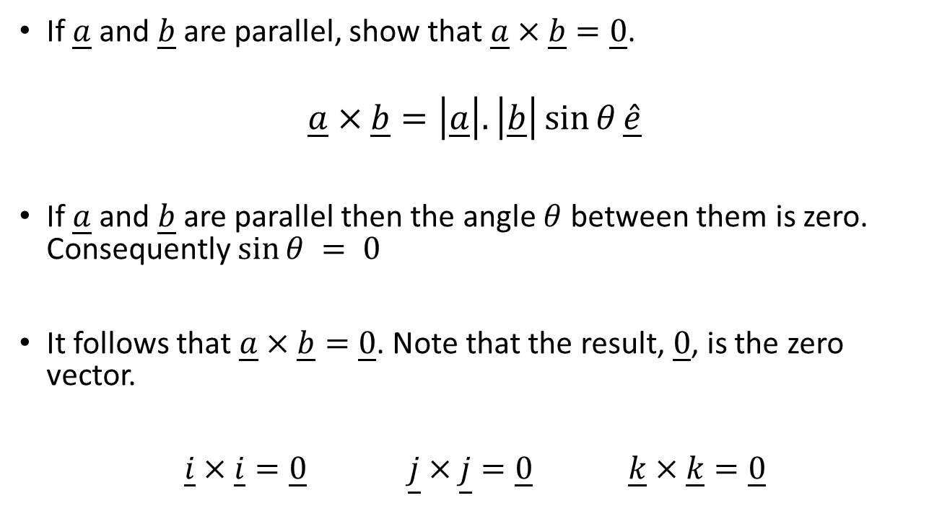
Exercise: Cross Product
If $\underline{a}$ and $\underline{b}$ are parallel, show that $\underline{a}×\underline{b}=\underline{0}$.
$$\underline{a}×\underline{b}=\left|\underline{a}\right|.\left|\underline{b}\right|\sin{θ}\underline{\hat{e}}$$
If $\underline{a}$ and $\underline{b}$ are parallel then the angle $θ$ between them is zero. Consequently $sin⁡θ = 0$
It follows that $\underline{a}×\underline{b}=\underline{0}$. Note that the result, $\underline{0}$, is the zero vector.
$\underline{i}×\underline{i}=\underline{0}$ $\underline{j}×\underline{j}=\underline{0} \underline{k}×\underline{k}=\underline{0}$

Slide 38
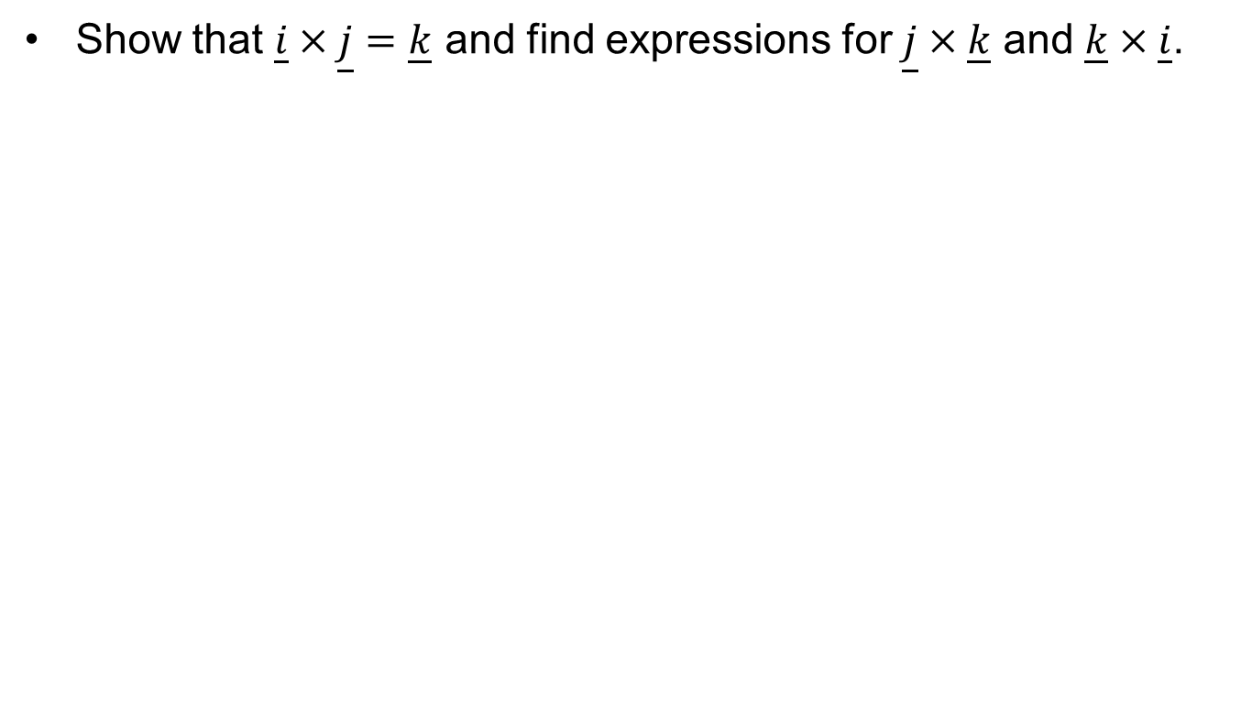
Exercise: Cross Product
Show that $\underline{i}×\underline{j}=\underline{k}$ and find expressions for $\underline{j}×\underline{k}$ and $\underline{k}×\underline{i}$.

Slide 39
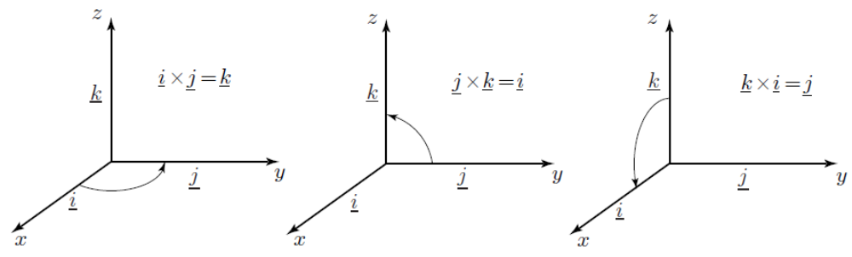
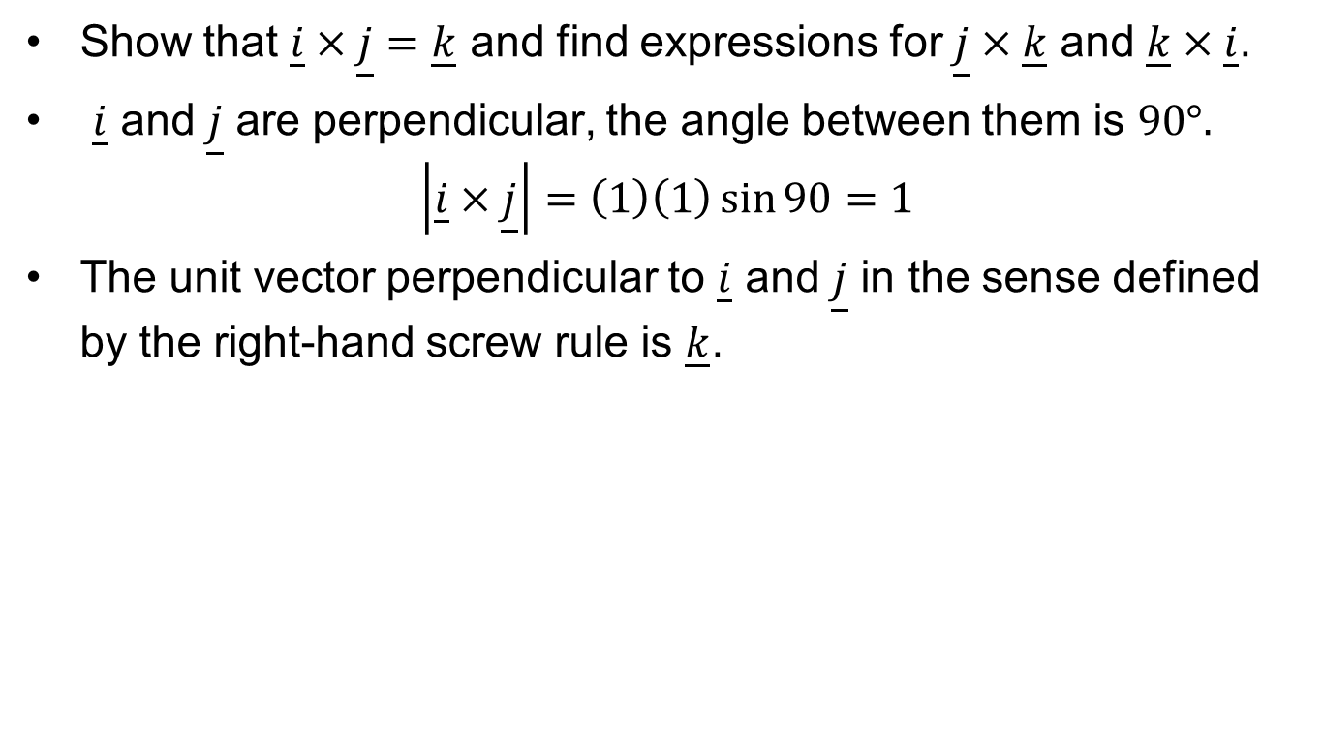
Exercise: Cross Product
Show that $\underline{i}×\underline{j}=\underline{k}$ and find expressions for $\underline{j}×\underline{k}$ and $\underline{k}×\underline{i}$.
$\underline{i}$ and $\underline{j}$ are perpendicular, the angle between them is $90°.$
$$\left|\underline{i}×\underline{j}\right|=\left(1\right)\left(1\right)\sin{90}=1$$
The unit vector perpendicular to $\underline{i}$ and $\underline{j}$ in the sense defined by the right-hand screw rule is $\underline{k}$.

Slide 40
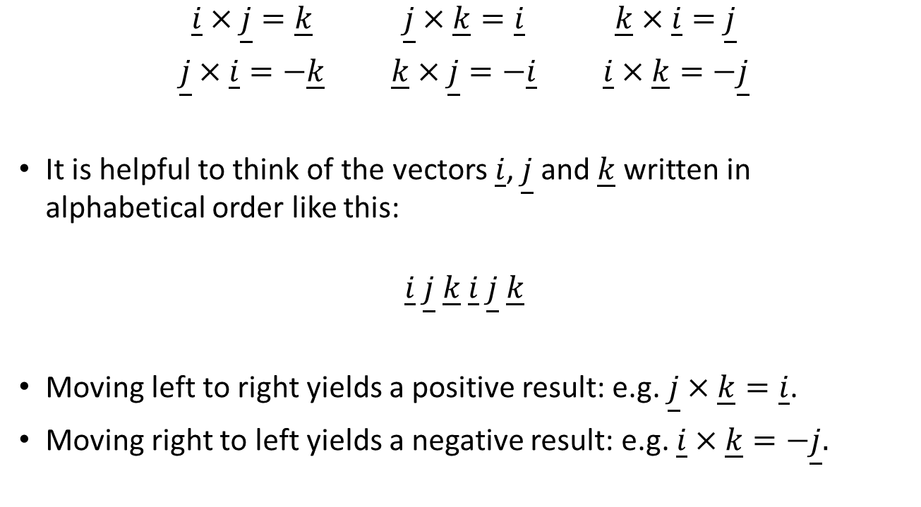
Unit Vector Formulae
$\underline{i}×\underline{j}=\underline{k}$ $\underline{j}×\underline{k}=\underline{i}$ $\underline{k}×\underline{i}=\underline{j}$
$\underline{j}×\underline{i}=−\underline{k}$ $\underline{k}×\underline{j}=−\underline{i}$ $\underline{i}×\underline{k}=−\underline{j}$
It is helpful to think of the vectors $\underline{i}$, $\underline{j}$ and $\underline{k}$ written in alphabetical order like this:
$$\underline{i} \underline{j} \underline{k} \underline{i} \underline{j} \underline{k}$$
Moving left to right yields a positive result: e.g. $\underline{j}×\underline{k}=\underline{i}$.
Moving right to left yields a negative result: e.g. $\underline{i}×\underline{k}=−\underline{j}.$

Slide 41
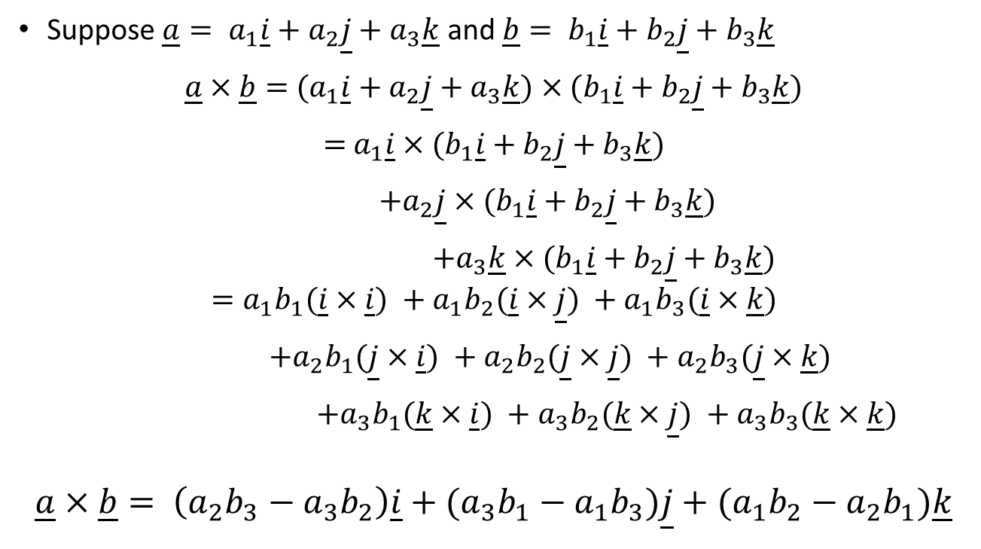
Cross Product Formula
Suppose $\underline{a}= a_{1}\underline{i}+a_{2}\underline{j}+a_{3}\underline{k}$ and $\underline{b}= b_{1}\underline{i}+b_{2}\underline{j}+b_{3}\underline{k}$
$\underline{a}×\underline{b}=$ $(a_{1}\underline{i}+a_{2}\underline{j}+a_{3}\underline{k})×(b_{1}\underline{i}+b_{2}\underline{j}+b_{3}\underline{k})$
$=$ $a_{1}\underline{i}×(b_{1}\underline{i}+b_{2}\underline{j}+b_{3}\underline{k})$
$+a_{2}\underline{j}$ $×(b_{1}\underline{i}+b_{2}\underline{j}+b_{3}\underline{k})$
$+a_{3}\underline{k}×(b_{1}\underline{i}+b_{2}\underline{j}+b_{3}\underline{k})$
$$=a_{1}b_{1}(\underline{i}×\underline{i}) +a_{1}b_{2}(\underline{i}×\underline{j}) +a_{1}b_{3}(\underline{i}×\underline{k})$$
$+a_{2}b_{1}(\underline{j}×\underline{i}) +a_{2}b_{2}(\underline{j}×\underline{j}) +a_{2}b_{3}(\underline{j}×\underline{k})$
$+a_{3}b_{1}(\underline{k}×\underline{i}) +a_{3}b_{2}(\underline{k}×\underline{j}) +a_{3}b_{3}(\underline{k}×\underline{k})$
$$\underline{a}×\underline{b}= \left(a_{2}b_{3}−a_{3}b_{2}\right)\underline{i}+(a_{3}b_{1}−a_{1}b_{3})\underline{j}+(a_{1}b_{2}−a_{2}b_{1})\underline{k}$$

Slide 42
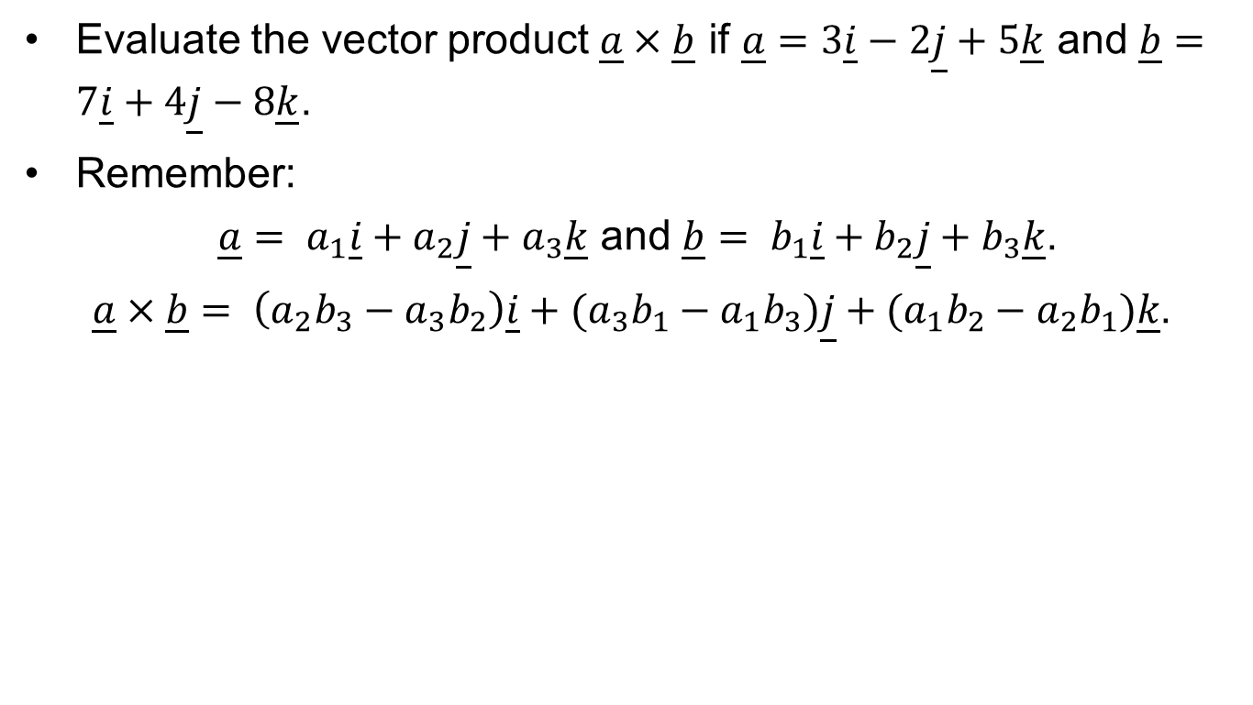
Exercise: Cross Product
Evaluate the vector product $\underline{a}×\underline{b}$ if $\underline{a}=3\underline{i}−2\underline{j}+5\underline{k}$ and $\underline{b}=7\underline{i}+4\underline{j}−8\underline{k}$.
Remember:
$\underline{a}= a_{1}\underline{i}+a_{2}\underline{j}+a_{3}\underline{k}$ and $\underline{b}= b_{1}\underline{i}+b_{2}\underline{j}+b_{3}\underline{k}$.
$\underline{a}×\underline{b}= \left(a_{2}b_{3}−a_{3}b_{2}\right)\underline{i}+(a_{3}b_{1}−a_{1}b_{3})\underline{j}+(a_{1}b_{2}−a_{2}b_{1})\underline{k}$.

Slide 43
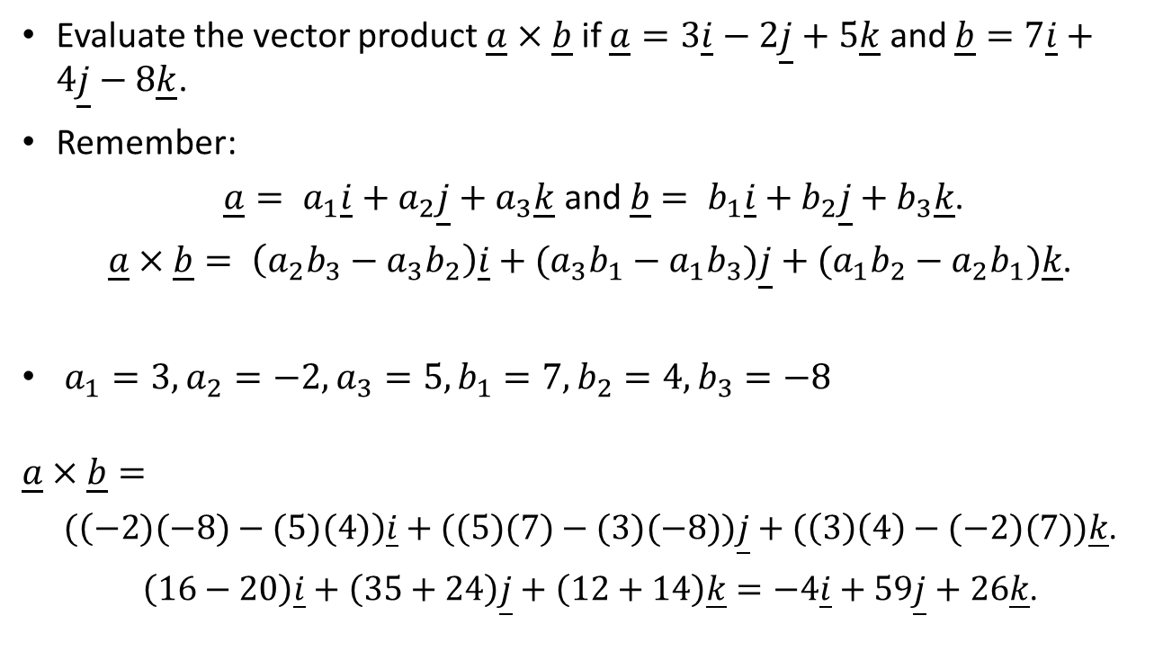
Exercise: Cross Product
Evaluate the vector product $\underline{a}×\underline{b}$ if $\underline{a}=3\underline{i}−2\underline{j}+5\underline{k}$ and $\underline{b}=7\underline{i}+4\underline{j}−8\underline{k}$.
Remember:
$\underline{a}= a_{1}\underline{i}+a_{2}\underline{j}+a_{3}\underline{k}$ and $\underline{b}= b_{1}\underline{i}+b_{2}\underline{j}+b_{3}\underline{k}$.
$\underline{a}×\underline{b}= \left(a_{2}b_{3}−a_{3}b_{2}\right)\underline{i}+(a_{3}b_{1}−a_{1}b_{3})\underline{j}+(a_{1}b_{2}−a_{2}b_{1})\underline{k}$.
$a_{1}=3, a_{2}=−2,a_{3}=5,b_{1}=7,b_{2}=4,b_{3}=−8$
$$\underline{a}×\underline{b}=$$
$(\left(−2)(−8)−(5)(4)\right)\underline{i}+((5)(7)−(3)(−8))\underline{j}+(\left(3\right)\left(4\right)−(−2)(7))\underline{k}$.
$\left(16−20\right)\underline{i}+\left(35+24\right)\underline{j}+\left(12+14\right)\underline{k}=−4\underline{i}+59\underline{j}+26\underline{k}$.

Slide 44

Exercise: Cross Product
Evaluate the vector product $\underline{p}×\underline{q}$ if $\underline{p}=3\underline{i}+5\underline{j}$ and $\underline{q}=2\underline{i}−\underline{j}$.
Remember:
$\underline{a}= a_{1}\underline{i}+a_{2}\underline{j}+a_{3}\underline{k}$ and $\underline{b}= b_{1}\underline{i}+b_{2}\underline{j}+b_{3}\underline{k}$.
$\underline{a}×\underline{b}= \left(a_{2}b_{3}−a_{3}b_{2}\right)\underline{i}+(a_{3}b_{1}−a_{1}b_{3})\underline{j}+(a_{1}b_{2}−a_{2}b_{1})\underline{k}$.

Slide 45

Exercise: Cross Product
Evaluate the vector product $\underline{p}×\underline{q}$ if $\underline{p}=3\underline{i}+5\underline{j}$ and $\underline{q}=2\underline{i}−\underline{j}$.
Remember:
$\underline{a}= a_{1}\underline{i}+a_{2}\underline{j}+a_{3}\underline{k}$ and $\underline{b}= b_{1}\underline{i}+b_{2}\underline{j}+b_{3}\underline{k}$.
$\underline{a}×\underline{b}= \left(a_{2}b_{3}−a_{3}b_{2}\right)\underline{i}+(a_{3}b_{1}−a_{1}b_{3})\underline{j}+(a_{1}b_{2}−a_{2}b_{1})\underline{k}$.
$a_{1}=3, a_{2}=5,a_{3}=0,b_{1}=2,b_{2}=−1,b_{3}=0$
No$\underline{k}$ component, so $a_{3}$ and $b_{3}$ are both zero.
$$\underline{p}×\underline{q}=$$
$\left(\left(3\right)\left(−1\right)−\left(5\right)\left(2\right)\right)\underline{k}=\left(−3−10\right)\underline{k}=−13\underline{k}$.

Slide 46
Artificial Intelligence for Games
CMP6206
Questions?
Maths for AI: Dot and Cross Product

