Slide 1
CMS-DQM + Active learning
https://cmsweb.cern.ch/ dqm/online/jsonfairy/archive/279794/Global/Online/ALL/DT/01-Digi/Wheel1/Sector2/Station3/OccupancyAllHits_perCh_W1_St3_Sec2
(12*3+14) * 5 = 250 request per Run
Processes by neural network
  Removed negatives
  Each row scaled to 1
  Each row resized to 47
  Evaluated with network
Saved to Mongodb
Active learning gui with Flask + JS/HTML/CSS

Slide 2
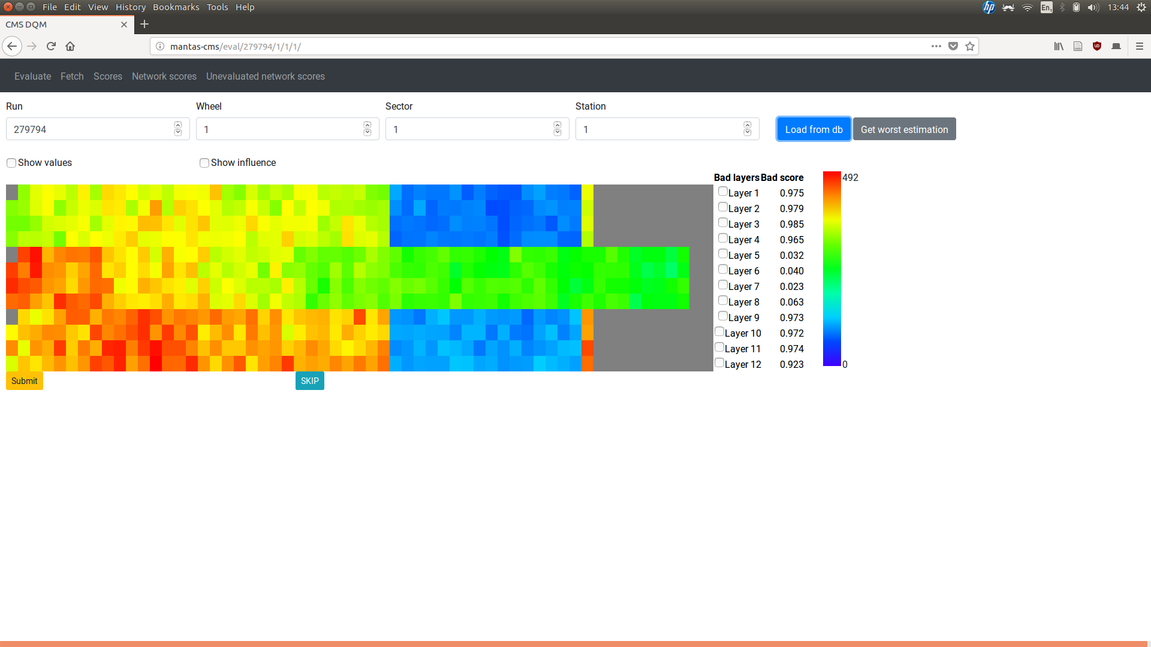
Active learning page

Slide 3
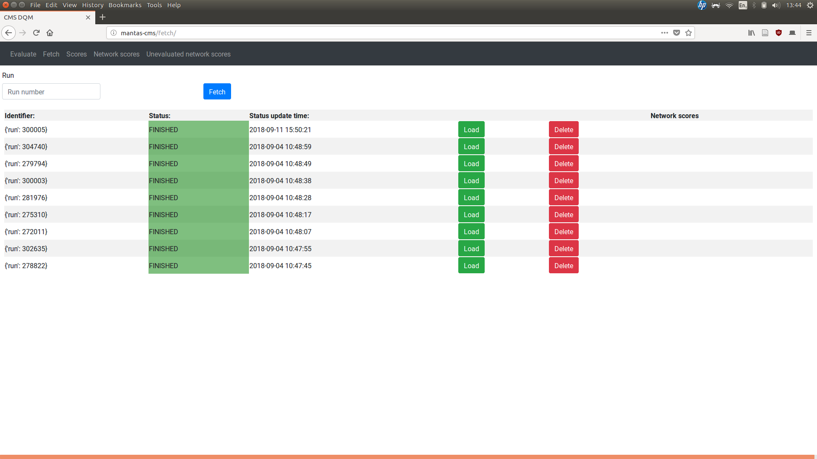
Loading data page

Slide 4
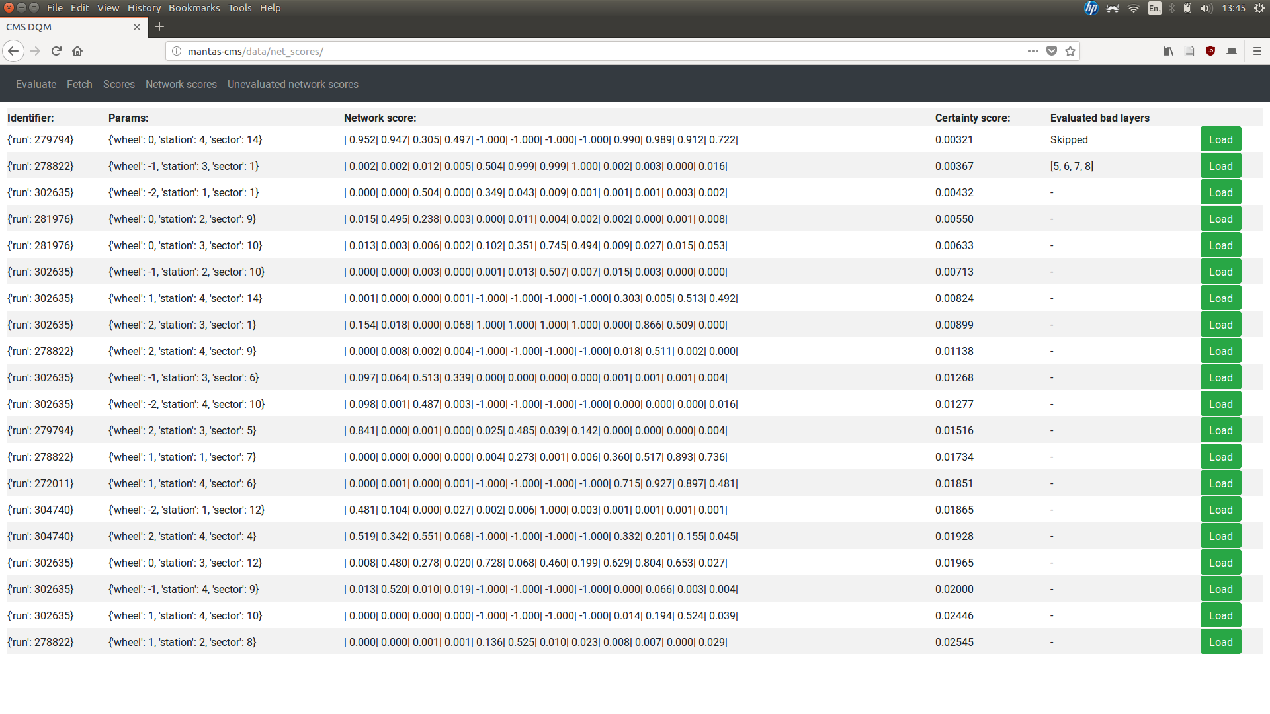
Statistics

Slide 5
Saliency maps [not fully working]
Insight into neural network
Steps:
  After getting the neural network result, get gradients
  Scale them
  Fit into matrix

Slide 6
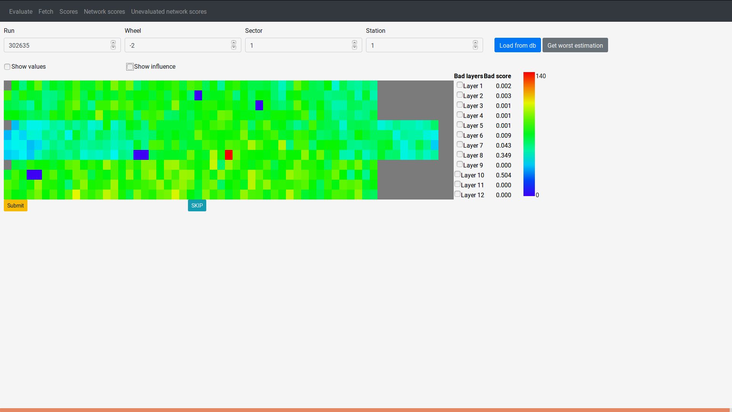
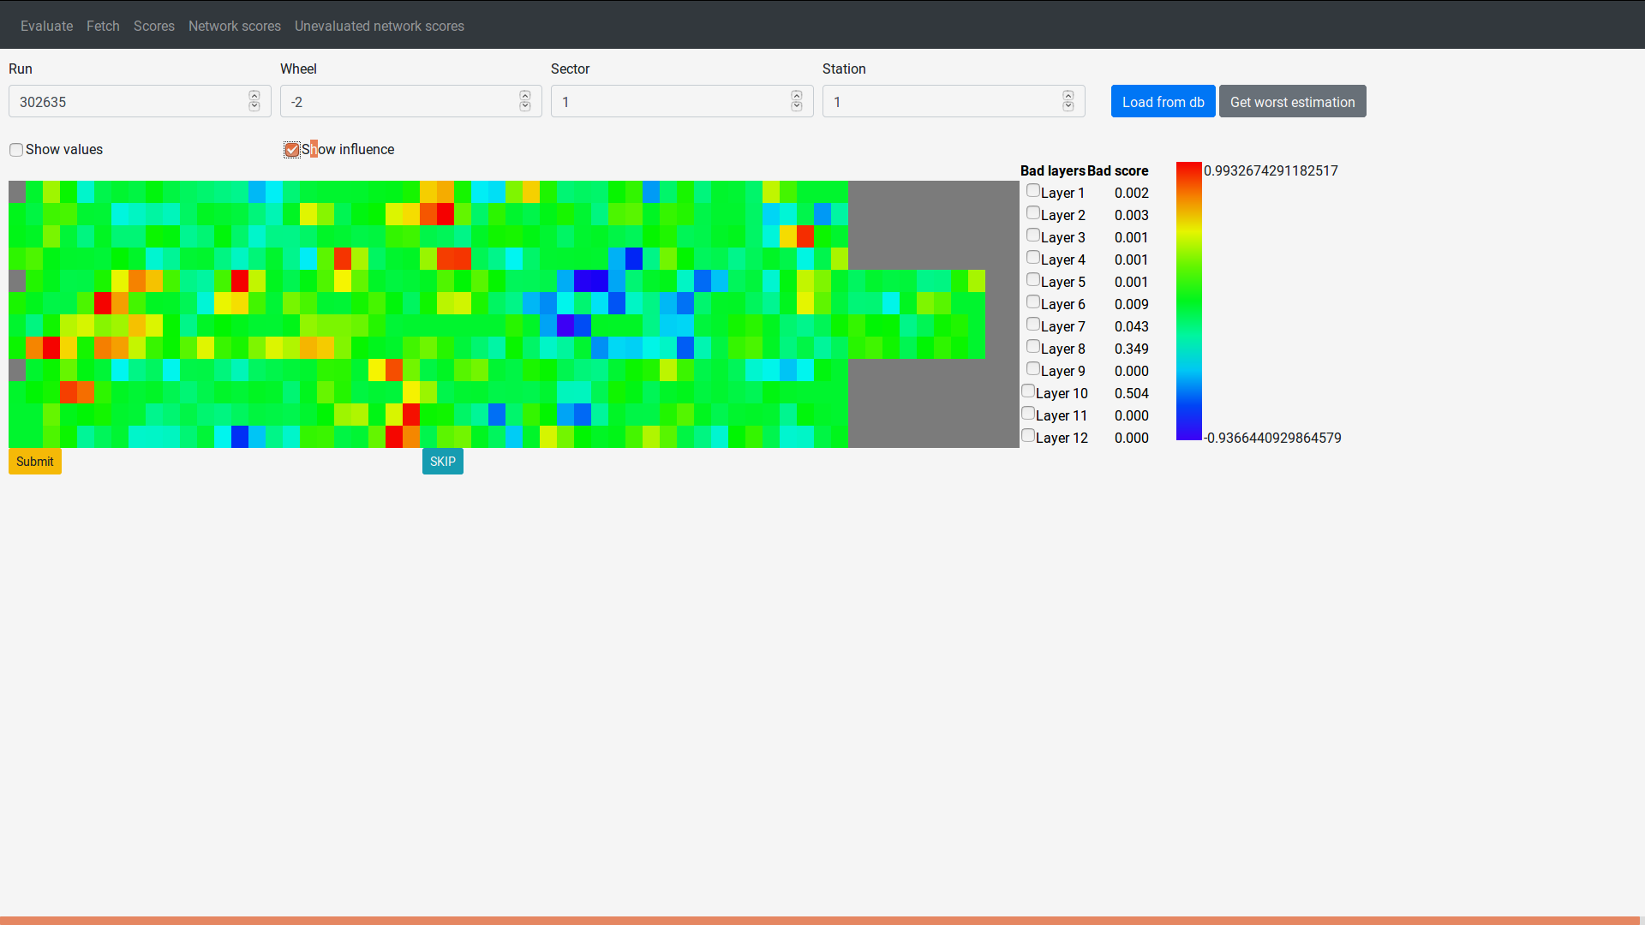

Slide 7
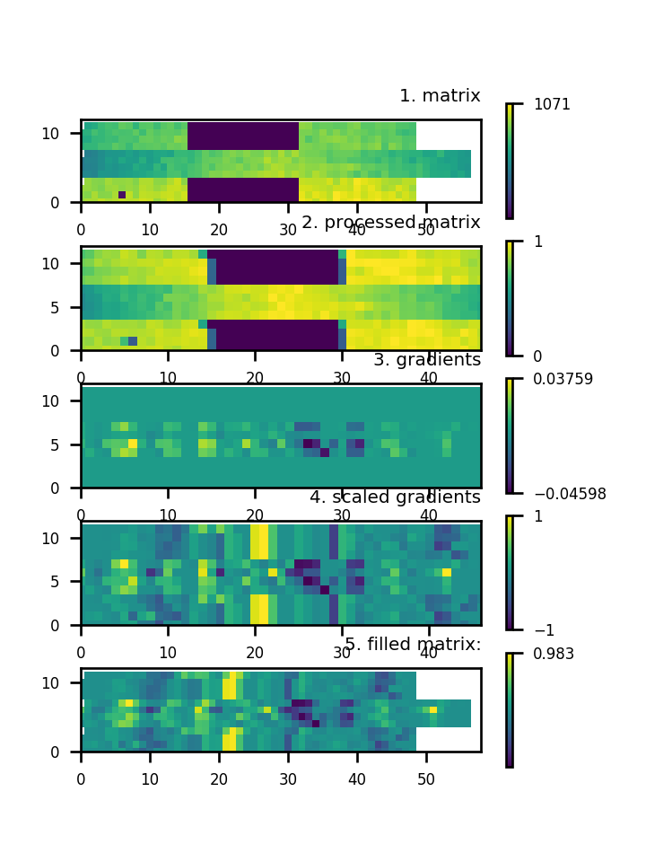
Saliency map steps

Slide 8
Todo
Somehow fix saliency maps
Export / Import
More statistics
Reevaluate button
Paging in statistics pages
Web design / UX fixes
Deploying

