Slide 1
Clustering
Clustering is the process of grouping similar entities together.
K-Means
The algorithm picks centroid locations to minimize the cumulative square of the distances from each example to its closest centroid
 | Advantages Simple and easy to implement Scales to large data sets Disadvantages ✘ It is limited to linear cluster boundaries ✘ The globally optimal result may not be achieved ✘ The number of clusters must be selected beforehand ✘ Not efficient if data contains outliers
 | How to find the optimal number of clusters?
Parameters in K-Means | Elbow Method Sillhouette Coefficient Field/Domain Knowledge
 | How to Apply
 | from sklearn.cluster import KMeans kmeans = KMeans(n_clusters=3).fit_predict(X_scaled) print(kmeans.cluster_centers_) # Get the cluster centroids print(kmeans.labels_) # Get the cluster labels
n_clusters | The number of clusters to form as well as the number of centroids to generate (int, optional, default: 8)
min_samples | Method for initialization (‘k-means++’, ‘random’, default: ‘k-means++’)
max_iter | Maximum number of iterations of the k-means algorithm for a single run (int, default: 300)

Slide 2
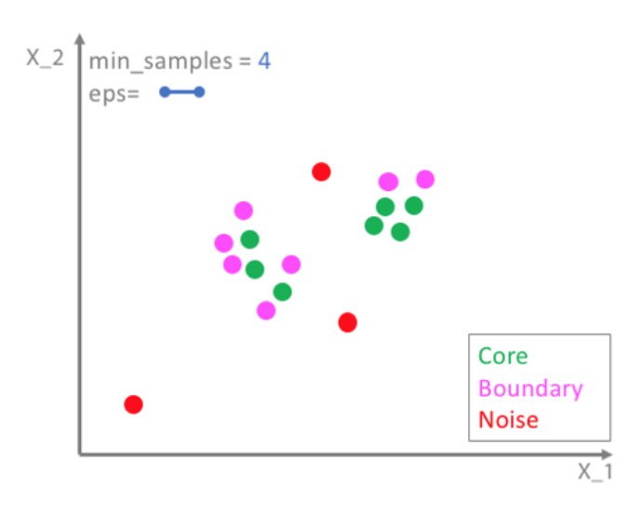
Clustering (Cont’d)
DBSCAN (Density-Based Spatial Clustering of Applications with Noise)
It separate clusters of high density from clusters of low density
 |  | Advantages Great at separating clusters of high density versus clusters of low density within a given dataset. Can handle outliers within the dataset Capable of removing noise points if they fall too far from significant clusters Disadvantages ✘ Does not work well when dealing with clusters of varying densities.
How to Apply | Parameters in DBSCAN
from sklearn.cluster import DBSCAN dbscan = DBSCAN(eps=0.3, min_samples = 2) clusters = dbscan.fit_predict(X_scaled)
DBSCAN assign label to each point using criteria:
eps | The maximum distance between two samples for one to be considered as in the neighborhood of the other. Setting eps implicitly controls how many clusters will be found
min_samples | The number of samples (or total weight) in a neighborhood for a point to be considered as a core point. This includes the point itself.

Slide 3
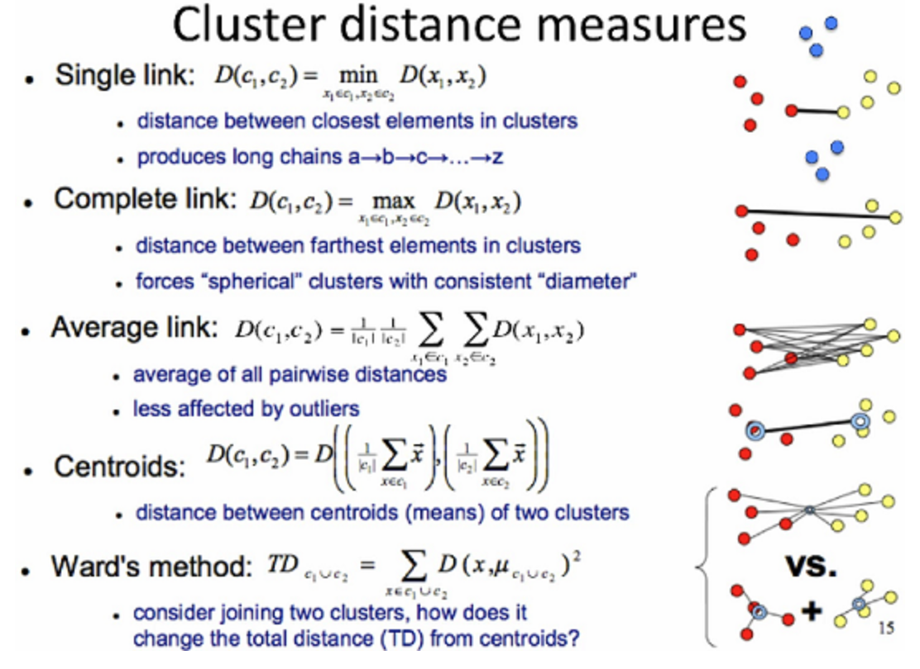
Clustering (Cont’d)
Agglomerative Clustering
In this technique, initially each data point is considered as an individual cluster. At each iteration, the similar clusters merge with other clusters until one cluster or K clusters are formed.
 | Advantages Dendograms provide an interesting and informative way of visualization The resulting hierarchichal representations can be very informative Do not need to specify the number of clusters Disadvantages ✘ They are very sensitive to outliers and, in their presence, the model performance decreases significantly. ✘ They are very expensive, computationally speaking
How to Apply |  | Parameters in Agglomerative Clustering
from sklearn.cluster import AgglomerativeClustering # linkage: {“ward”, “complete”, “average”, “single”} agg = AgglomerativeClustering(n_clusters=2, linkage='complete') assignment = agg.fit_predict(X)
n_clusters | The number of clusters to find (default = 2)
affinity | Metric used to compute the linkage. {‘euclidean’, ‘l1’, ‘l2’, ‘manhattan’, ‘cosine’, or ‘precomputed’} (default = ‘Euclidean’)
linkage | Which linkage criterion to use, {"ward", "complete", "average", "single"} (default="ward")

Slide 4
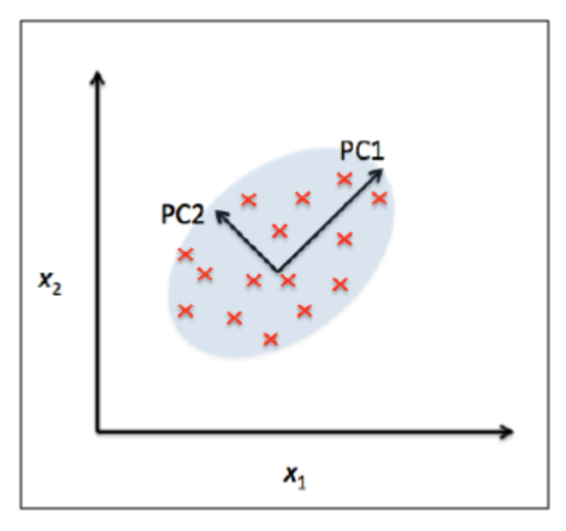
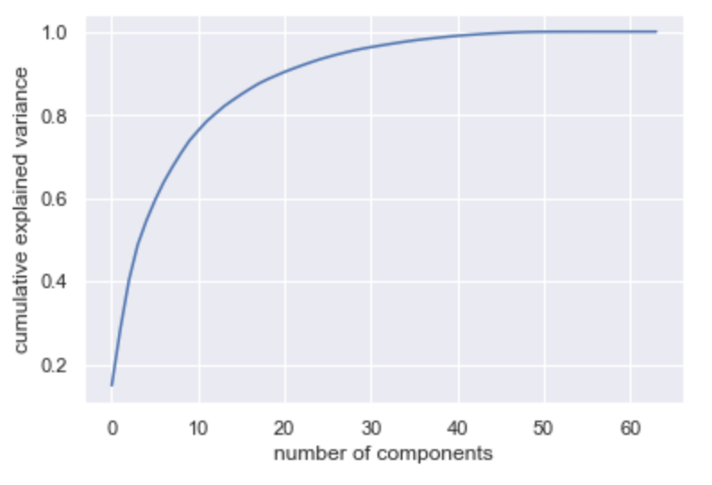
Principal Component Analysis (PCA)
It is a dimension reduction technique, resulting in a lower-dimensional projection of the data that preserves the maximal data variance
 | PCA Applications Visualizing high-dimensional data Noise filtering
 | How to Apply
 | from sklearn.preprocessing import StandardScaler from sklearn.decomposition import PCA scaler = StandardScaler() X_train = sc.fit_transform(X_train) X_test = sc.transform(X_test) pca = PCA(n_components=2) X_train = pca.fit_transform(X_train) X_test = pca.transform(X_test)
How to Select the optimal number of principal components | The optimal number of principal components is determined by looking at the cumulative explained variance ratio as a function of the number of components
1
Scale the data
2
Apply PCA

Slide 5

Evaluation of Clustering (True Label is known)
Adjusted Rand Index (ARI) | V-measure
Measures the similarity between y_true and y_pred | Measures the harmonic mean of homogeneity and completeness
The ARI can get values ranging from -1 to 1 The higher the value, the better it matches the original data
How to Apply | How to Apply
from sklearn.cluster import KMeans from sklearn import metrics digit_km = KMeans(n_clusters=10, random_state=0) clusters = digit_km.fit_predict(digits.data) metrics.adjusted_rand_score(digits.target, clusters) | from sklearn.cluster import KMeans from sklearn import metrics digit_km = KMeans(n_clusters=10, random_state=0) clusters = digit_km.fit_predict(digits.data) metrics.v_measure_score(digits.target, clusters)
Homogeneity: is a measure of the ratio of samples of a single class pertaining to a single cluster
Completeness: measures the ratio of the member of a given class that is assigned to the same cluster
a: is the number of points that are in the same cluster both in C and in K
b: is the number of points that are in the different cluster both in C and in K
n: is the total number of samples

Slide 6
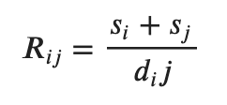

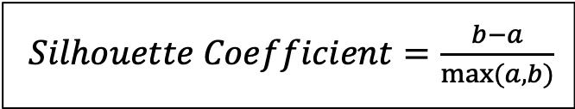
Evaluation of Clustering (True Label is unknown)
Silhouette Coefficient | Davies-Bouldin Index
This measure of evaluates how similar an object is to its own cluster (cohesion) compared to other clusters (separation) | Measures the average similarity between each cluster 𝐶_{𝑖} for 𝑖 = 1,2,…,k and its most similar one 𝐶_{𝑗}
The score is bounded between -1 and +1 The higher the value, the better the K (clusters) selected is | For good clustering, the value is close to 0
How to Apply | How to Apply
from sklearn.cluster import KMeans from sklearn import metrics digit_km = KMeans(n_clusters=10, random_state=0) clusters = digit_km.fit_predict(digits.data) metrics.silhouette_score(digits.data, clusters, metric='euclidean') | from sklearn.cluster import KMeans from sklearn import metrics digit_km = KMeans(n_clusters=10, random_state=0) clusters = digit_km.fit_predict(digits.data) metrics.davies_bouldin_score(digits.data, clusters)
$Silhouette Coefficient=\frac{b−a}{max⁡(a,b)}$
a: The mean distance between a sample and all other points in its cluster
b: The mean distance between a sample and all other points in the next nearest cluster
𝑠_{𝑖} : the average distance between each point of cluster i and the centroid of that cluster – also known as cluster diameter
𝑑_{𝑖𝑗} : the distance between cluster centroids 𝐶_{𝑖} and 𝐶_{𝑗}

