Slide 1
BLOCK 2 · MACHINE LEARNING
Validation, Model Selection & Tuning
Session 6 · 4 hours contact · the conceptual keystone
Notes:
Do not open the notebook yet. Start with the board question.

Slide 2
SESSION 6 · VALIDATION, MODEL SELECTION & TUNING
What you will be able to do
Five objectives. The fifth is the one you will remember.
1 Design a cross-validation strategy that fits the structure of the data, and justify it from measured evidence.
2 Construct a tuning experiment free of both leakage and selection bias.
3 Attach an uncertainty interval to a metric, and decide whether two models genuinely differ.
4 Explain what nested cross-validation is for.
5 Investigate an implausibly strong feature and re-scope a problem in response.

Slide 3
SESSION 6 · VALIDATION, MODEL SELECTION & TUNING
Never report a metric without a spread.
If you take one sentence out of today, take that one. By the end of todqy “R² = 0.606” should read to you like an incomplete sentence.

Slide 4
SESSION 6 · VALIDATION, MODEL SELECTION & TUNING
1
Four words that get confused
Parameter, hyperparameter, validation, test. Most tuning mistakes are a confusion between two of these.

Slide 5
SESSION 6 · VALIDATION, MODEL SELECTION & TUNING
Four words
Word
What it is
Who sets it
Example
Parameter
Learned from the data by fitting
the algorithm
the coefficients β
Hyperparameter
Fixed before fitting; controls how fitting works
you
Ridge α, tree depth
Validation set
Data used to choose between configurations
you
a CV fold
Test set
Data used once, to estimate what you will get
nobody, until the end
our sealed parquet
The test set is the only one of the four you are not allowed to learn anything from.

Slide 6
SESSION 6 · VALIDATION, MODEL SELECTION & TUNING
Three levels, and only one may be touched
1
2
3
The snapshot
The training half
The CV folds
›
›
15,293 listings. Split by host in Session 2. The test half was sealed then.
Every decision you make lives here: cleaning, features, model choice, hyperparameters.
Inside the training half. Four folds fit, one validates, rotate. Grouped by host.

Slide 7
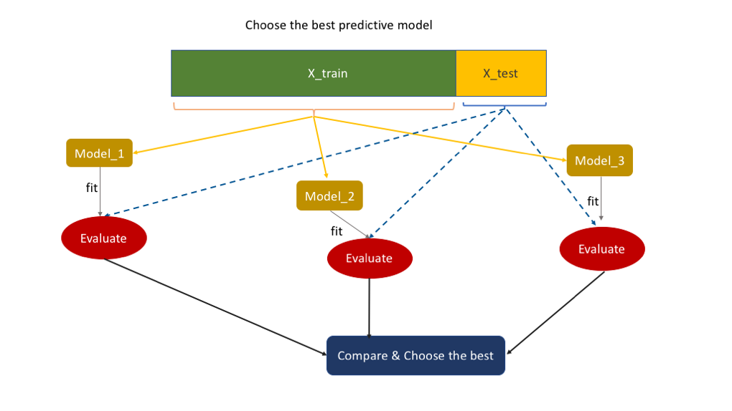
SESSION 6 · VALIDATION, MODEL SELECTION & TUNING
What is wrong with this picture?
Three models are fitted on the training set and then evaluated on X_test to choose the best one. That is selection on the test set: the moment you pick a winner this way, X_test has informed a decision and can no longer tell you what you will get. It is the commonest diagram in the textbooks and it breaks the rule on the next slide.

Slide 8
SESSION 6 · VALIDATION, MODEL SELECTION & TUNING
If a number outside the training half informed a decision, the estimate is already optimistic.
This is the rule the whole session is built on. Everything that follows is a way of measuring how much optimism gets in when you are not careful.

Slide 9
SESSION 6 · VALIDATION, MODEL SELECTION & TUNING
2
Why one split is not enough
Same model, same data, thirty different random splits. The answer moves more than you expect.

Slide 10
SESSION 6 · VALIDATION, MODEL SELECTION & TUNING
The experiment
for seed in range(30):
tr, te = next(GroupShuffleSplit(
n_splits=1, test_size=0.2, random_state=seed)
.split(work, y, groups=groups))
model = Pipeline([("prep", make_preprocessor()),
("model", Ridge())])
model.fit(work.iloc[tr][COLS], y.iloc[tr])
scores.append(model.score(work.iloc[te][COLS], y.iloc[te]))
random_state=seed is the only thing that changes in this loop. A fresh pipeline is built each time, so nothing carries over between splits. Whatever spread comes out is pure luck of the draw.

Slide 11
SESSION 6 · VALIDATION, MODEL SELECTION & TUNING
Thirty splits of one model
Worst: 0.726. Best: 0.843. Mean 0.796, sd 0.030.
0.117
That gap is the size of the result you could report simply by choosing your random seed.
the gap between the best and the worst of thirty 80/20 grouped splits
Any “improvement” smaller than this, measured on a single split, is not evidence of anything.

Slide 12
SESSION 6 · VALIDATION, MODEL SELECTION & TUNING
A single train/test split is a lottery ticket.
It reports one draw from a wide distribution, and reports it as though it were the truth. Cross-validation is what we do instead: draw every ticket, and report the spread as well as the average.

Slide 13
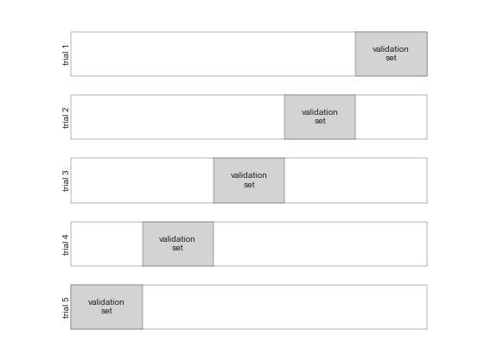
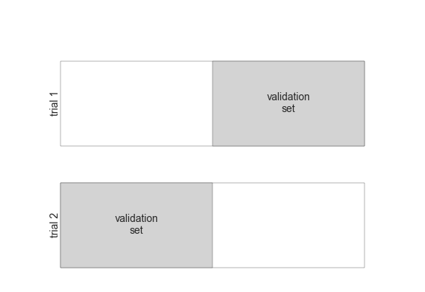
SESSION 6 · VALIDATION, MODEL SELECTION & TUNING
So we draw every ticket
Cross-validation: not one split, but every split in turn.
Five trials, the validation block moving along one place at a time; then the two-fold case, the same idea at its smallest. Every row is a complete refit from scratch - which is why five-fold costs five times a single split, and why nothing may be fitted outside the strip it belongs to.

Slide 14
SESSION 6 · VALIDATION, MODEL SELECTION & TUNING
3
Choosing a splitter
Grouped or random. One of them is wrong here, and it is the one that looks better.

Slide 15
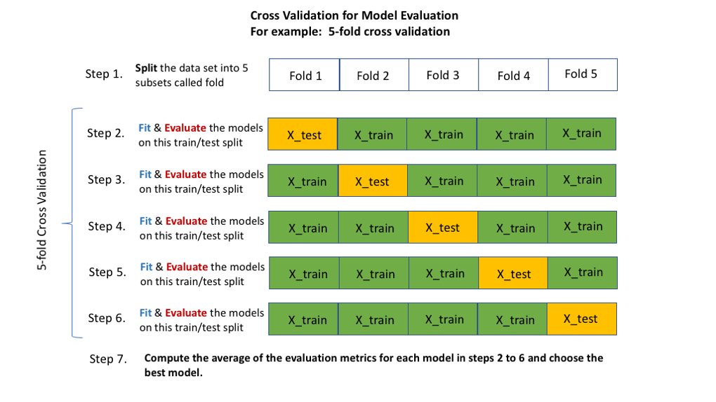
SESSION 6 · VALIDATION, MODEL SELECTION & TUNING
The loop, start to finish
Split into folds, then fit and evaluate five times, then average. Grouping changes nothing in this picture except which rows are allowed to share a strip - that is the entire content of GroupKFold, and the next slide is what it costs to get it wrong.

Slide 16
SESSION 6 · VALIDATION, MODEL SELECTION & TUNING
One model, two ways of building folds
Identical model, identical data. Only the fold construction differs.
Random KFold
GroupKFold on host_id
0.8704 ± 0.0028
0.8249 ± 0.0132
Ignores host entirely. A host's listings land on both sides of every fold boundary.
Every host stays whole. Each fold is a genuinely unseen set of hosts.
The model recognises a neighbour rather than generalising to an unseen host.
80.5% of listings belong to a host with more than one listing, which is why this matters here.
Per fold: 0.871, 0.874, 0.866, 0.873, 0.869
Per fold: 0.830, 0.807, 0.839, 0.811, 0.838

Slide 17
SESSION 6 · VALIDATION, MODEL SELECTION & TUNING
What the wrong splitter buys you
This is not a rounding difference. It is larger than most of the model improvements anyone will report all semester.
+0.0455
And nobody would ever detect it from the random-KFold numbers alone. They look perfectly respectable on their own.
free R², from nothing but letting hosts straddle the fold boundary
You cannot find this by looking at a score. You find it by looking at the data's structure.

Slide 18
SESSION 6 · VALIDATION, MODEL SELECTION & TUNING
The wrong method looked both better and more precise.
Random KFold reported ± 0.0028 against GroupKFold's ± 0.0132 - four times narrower. A tight interval is not evidence of a trustworthy estimate. Grouped folds are more variable because hosts genuinely differ, and that honesty is the point.

Slide 19
SESSION 6 · VALIDATION, MODEL SELECTION & TUNING
4
THE INVESTIGATION
The best-defended number in the course so far is still wrong. Here is how you find that out.

Slide 20
SESSION 6 · VALIDATION, MODEL SELECTION & TUNING
Where we stand
Everything a careful student would have done, has been done.
Cleaned Session 2. Every decision logged.
Leak-audited Session 3. Three leaks found, mechanisms named, removed.
Group-validated Today, §4. Folds respect host structure.
Result R² = 0.8249 ± 0.0132 - and it is still not real.

Slide 21
SESSION 6 · VALIDATION, MODEL SELECTION & TUNING
Permutation importance - drop in R² when a column is shuffled
Measured on held-out data, so it rewards generalisation rather than memorisation.
Feature
ΔR²
minimum_nights
0.7729
accommodates
0.1321
room_type
0.1190
property_type
0.0252
review_scores_rating
0.0126
latitude
0.0110

Slide 22
SESSION 6 · VALIDATION, MODEL SELECTION & TUNING
The number that should stop you
A booking constraint out-predicts capacity and location on a question about what a listing charges per night.
5.9×
Nothing is broken. The protocol is correct, the folds are grouped, the leaks are gone.
minimum_nights against the next most important feature
The correct response to a surprisingly good result is to investigate it, not to report it.

Slide 23
SESSION 6 · VALIDATION, MODEL SELECTION & TUNING
The mechanism
checkin = pd.to_datetime(work["price_quote_checkin_date"])
checkout = pd.to_datetime(work["price_quote_checkout_date"])
quote_nights = (checkout - checkin).dt.days
corr(quote_nights, minimum_nights) -> 0.9801
The scraper asked each listing for a price quote, and the stay it asked for had to satisfy that listing's own minimum. So the two columns are not independent measurements of anything - one was chosen to satisfy the other.

Slide 24
SESSION 6 · VALIDATION, MODEL SELECTION & TUNING
What the price column actually is
minimum_nights
listings
median quoted nights
median price
1 night
3,956
1.0
€259.0
2-3
2,346
2.0
€259.5
4-7
226
5.0
€228.4
8-31
2,342
31.0
€99.9
32+
2,058
32.0
€69.5
Read the price column downwards. These are not the same market. A monthly let at €69 a night and a weekend flat at €259 are different products that happen to share a column.

Slide 25
SESSION 6 · VALIDATION, MODEL SELECTION & TUNING
The model was learning which market a listing belongs to.
Not what a night in it costs. minimum_nights is a near-perfect indicator of long-stay against short-stay, and those two populations have very different prices. The signal was real. The question it answered was not ours.

Slide 26
SESSION 6 · VALIDATION, MODEL SELECTION & TUNING
Is this leakage?
Both columns are correct. That is what makes this hard.
The case against
The case for
It is not
It is
The column is available before any booking is made.
Client B prices short stays. Their question presupposes a population this feature silently mixes.
It would be present at prediction time in production.
The model looks excellent on a question nobody asked.
It passes every mechanical leakage test we built in Session 3.
Deployed as is, it would price a weekend flat using the pattern of monthly lets.
Nothing about it is unavailable, future, or derived from the target.

Slide 27
SESSION 6 · VALIDATION, MODEL SELECTION & TUNING
Only the client's question decides.
This is the lesson of the session, and it does not generalise into a rule you can automate. A feature available at prediction time can still be illegitimate, and no test on the data alone will ever tell you so.

Slide 28
SESSION 6 · VALIDATION, MODEL SELECTION & TUNING
The re-scope, and what it costs
Re-scoping, not deleting a column. The distinction matters.
Decision keep only listings with minimum_nights ≤ 3, and drop the column from the feature set.
Cost 10,929 rows → 6,302. 42% of the data discarded.
Why it is right Client B prices short stays. The population being modelled must be the population being priced.
Why it is uncomfortable You are throwing away data to get a worse number.

Slide 29
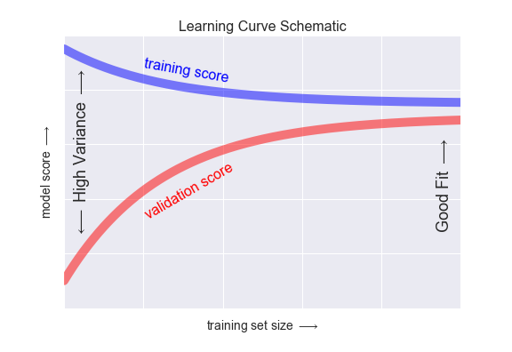
SESSION 6 · VALIDATION, MODEL SELECTION & TUNING
Did losing 42% of the rows hurt?
A learning curve answers it: score against training-set size. If both curves have flattened by the time you reach your row count, more data would not have helped and the re-scope cost you nothing. If the validation curve is still climbing, it did. We do not run this today - it is the check to reach for when somebody objects to the row loss on principle. This is a schematic, not one of our results.

Slide 30
SESSION 6 · VALIDATION, MODEL SELECTION & TUNING
The full descent
Stage
R²
What changed
Session 3, every numeric column
0.999
three leaks
Leaks removed
0.834
still not honest
Random KFold
0.870
hosts straddling folds
GroupKFold
0.825
hosts kept whole
Re-scoped, Ridge
0.606
the honest number
Every step down is a step towards a number you could defend in front of the client.

Slide 31
SESSION 6 · VALIDATION, MODEL SELECTION & TUNING
The honest number
This is the first figure in this course that is genuinely defensible.
0.606
It is also the worst-looking one, and both facts are true at once.
Ridge, short-stay listings only, GroupKFold · ± 0.0997
A lower number that answers the right question beats a higher one that answers a different question.

Slide 32
SESSION 6 · VALIDATION, MODEL SELECTION & TUNING
5
Uncertainty, and whether a difference is real
Three tools: the fold spread, the paired comparison, and the bootstrap.

Slide 33
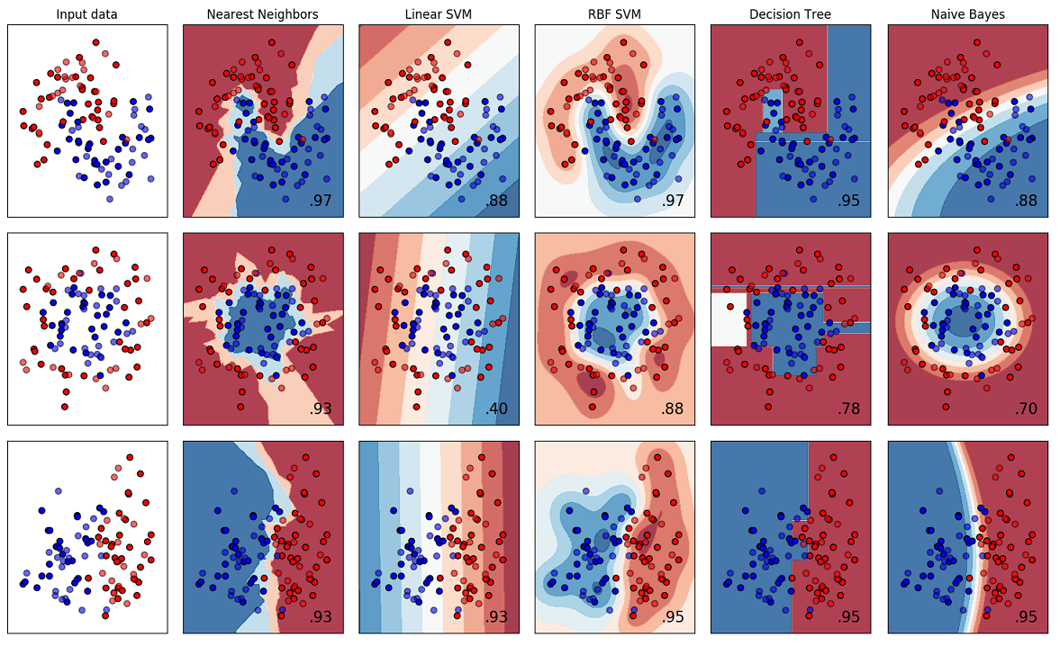
SESSION 6 · VALIDATION, MODEL SELECTION & TUNING
Five models. Five numbers. Which one is best?
Read the bottom row: .93, .93, .95, .95, .95. Five models inside two hundredths of each other, each scored once, on one split, quoted to two decimals with no interval. We measured the spread across seeds in §3 and it was 0.117. Nothing on this figure can distinguish these models, and the figure does not say so. This is the standard comparison plot, and the reason §6 exists.

Slide 34
SESSION 6 · VALIDATION, MODEL SELECTION & TUNING
Two models, one protocol, identical folds
Ridge is ahead by 0.015. Before concluding anything, look at the fold columns.
Model
R²
sd
per-fold
Ridge
0.6056
0.0997
0.743 0.514 0.708 0.552 0.510
HistGB
0.5907
0.0688
0.652 0.555 0.687 0.561 0.498
Each model's own range is far wider than the gap between their means. Ridge spans 0.510 to 0.743.

Slide 35
SESSION 6 · VALIDATION, MODEL SELECTION & TUNING
Why the comparison must be PAIRED
scipy.stats.ttest_rel, not ttest_ind. The folds are not independent samples.
Fold 3 is easier than fold 5 for both models. That difficulty is shared, and it dominates the raw spread.
Subtracting model B from model A within each fold cancels it.
The differences -0.0909, +0.0407, -0.0212, +0.0086, -0.0117
Look at the signs before the p-value they do not even agree on a direction.

Slide 36
SESSION 6 · VALIDATION, MODEL SELECTION & TUNING
The verdict
Mean difference -0.0149, standard deviation 0.0486 - three times the difference itself.
p = 0.531
HistGB wins on 2 folds of 5 and loses on 3.
paired t-test, HistGB against Ridge · t = -0.685
Conclusion: no detectable difference. Not “Ridge is better”. Reporting either as the winner would be unsupported.

Slide 37
SESSION 6 · VALIDATION, MODEL SELECTION & TUNING
Contrast this with Session 5
Same test, same course, opposite conclusions. The signs tell you before the p-value does.
Session 6 · Ridge vs HistGB
Session 5 · the licence models
p = 0.531
p = 0.0017
Signs: - + - + -
Signs: all five the same.
Two wins, three losses, no consistent direction.
Every fold agrees on the direction.
The correct report is “within noise”.
That is what a real difference looks like.

Slide 38
SESSION 6 · VALIDATION, MODEL SELECTION & TUNING
Report the interval, not the point.
“R² = 0.61” is a claim you cannot support. “R² = 0.61, and the fold-to-fold spread is ± 0.10” is a claim a client can act on - including the action of deciding it is not good enough yet.

Slide 39
SESSION 6 · VALIDATION, MODEL SELECTION & TUNING
6
Search, and the last hiding place for optimism
How to look for hyperparameters, and why looking costs you something.

Slide 40
SESSION 6 · VALIDATION, MODEL SELECTION & TUNING
Three ways to search
The choice matters less than what you do with the result.
1
2
3
Grid
Random
Halving
›
›
Every combination. Exhaustive, and the cost explodes with the number of parameters.
Sample combinations. Usually finds as good a point for far less compute.
Start many candidates on little data; keep the survivors and give them more.

Slide 41
SESSION 6 · VALIDATION, MODEL SELECTION & TUNING
If you choose the winner by looking at the folds, the folds can no longer score it honestly.
This is selection optimism. It is the same mistake as the sealed test set, one level down - and it is much easier to make, because nothing about it looks like cheating.

Slide 42
SESSION 6 · VALIDATION, MODEL SELECTION & TUNING
Nested cross-validation, measured
Inner loop picks α. Outer loop measures how well “fit a model and tune α” generalises.
Report the best inner score
Nested CV - the honest estimate
0.6284
0.6103 ± 0.0967
Run GridSearchCV, take best_score_, report it.
The whole search becomes the estimator.
This is what almost everyone does.
An outer loop scores it on folds the search never saw.
α = 10 won, out of only six candidates.
Measures the procedure, not the winner.

Slide 43
SESSION 6 · VALIDATION, MODEL SELECTION & TUNING
The price of having looked
Six candidates. A realistic search has hundreds, and the optimism grows with the size of the grid.
+0.0182
This is why cross-validation does not remove the need for a test set.
optimism from reporting the inner score, on a grid of just six values
It is also small enough to be invisible unless you measure it - which is precisely the problem.

Slide 44
SESSION 6 · VALIDATION, MODEL SELECTION & TUNING
7
Common mistakes, and what to take away
The four beliefs this session exists to break.

Slide 45
SESSION 6 · VALIDATION, MODEL SELECTION & TUNING
Four things
Belief
What today measured
“0.834 beats 0.831, so A is better.”
The fold spread is around ± 0.09. Compare per fold and look at the signs.
“Cross-validation removes the need for a test set.”
Selecting on CV makes CV optimistic. +0.018 from six candidates.
“Random K-fold is the sensible default.”
80.5% of listings share a host. The inflation is +0.0455.
“A feature available at prediction time cannot be leakage.”
minimum_nights is available, passes every test, and is still wrong here.

Slide 46
SESSION 6 · VALIDATION, MODEL SELECTION & TUNING
If one thing survives today:
The student reports “the difference is within noise” instead of picking the higher number - and asks for the per-fold figures before forming an opinion.
M5 · tuned model, CV report with intervals, written methodology defence, and the re-scoping decision.
Notes:
M5 is formative but predicts final quality better than any other milestone. Give it real written feedback.

