Slide 1
BLOCK 2 · MACHINE LEARNING
Ensembles, Interpretation & Error Analysis
Today the models get better and the questions get harder. By the end you will have a champion, and you will know which of its rivals it genuinely beat - and who it fails.
Session 7 · 4 hours contact · deliverable M6, graded

Slide 2
SESSION 7 · ENSEMBLES, INTERPRETATION & ERROR ANALYSIS
Session 5 ended without a winner.
The tree scored higher on AUC and could not produce a usable ranking. The logistic model ranked cleanly and scored lower. We left it there. Today we settle it - and the tie-breaker will not be accuracy.

Slide 3
SESSION 7 · ENSEMBLES, INTERPRETATION & ERROR ANALYSIS
What you will be able to do
Objective 4 is the one that separates a model from a system.
1 Explain why bagging and boosting reduce error differently, and predict which one degrades when you add trees.
2 Benchmark several models under one protocol and say which differences are real.
3 Read permutation importance and partial dependence, and state what neither of them proves.
4 Measure subgroup performance and reason about who a model fails.
5 Write a Model Card that says when the model should not be used.

Slide 4
SESSION 7 · ENSEMBLES, INTERPRETATION & ERROR ANALYSIS
An ensemble is not a better model. It is many worse models, disagreeing usefully.
Hold that sentence through §2. The disagreement is not a defect to be minimised - it is the raw material, and we will measure it.

Slide 5
SESSION 7 · ENSEMBLES, INTERPRETATION & ERROR ANALYSIS
1
Bagging, built by hand
Thirty deliberately overfitted trees, each on its own bootstrap resample. Then we average them.

Slide 6
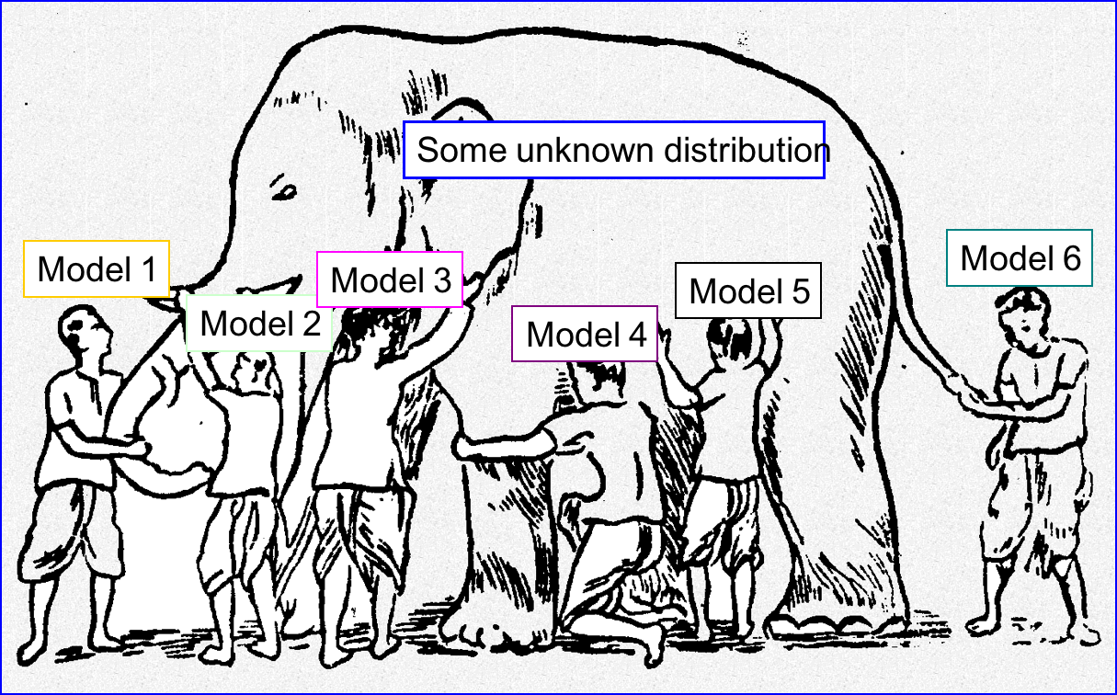
SESSION 7 · ENSEMBLES, INTERPRETATION & ERROR ANALYSIS
Why an ensemble beats its members
Six people each with a hand on a different part of an elephant, each labelled a model; the elephant labelled *some unknown distribution*. No individual is wrong - each is partial, and partial in a different direction. That last clause is the condition under which averaging helps at all: if every model erred in the same direction, averaging would preserve the error exactly.

Slide 7
SESSION 7 · ENSEMBLES, INTERPRETATION & ERROR ANALYSIS
Predict before you run
Collect both in writing before the cell runs.
We fit 30 unbounded decision trees, each on its own bootstrap resample of the training fold.
Unbounded on purpose: each one is deliberately overfitted, so each is high-variance.
Write down two numbers: the mean AUC of the 30 individual trees, and the AUC of their averaged prediction.
Most people put the two within 0.02 of each other.

Slide 8
SESSION 7 · ENSEMBLES, INTERPRETATION & ERROR ANALYSIS
Bagging, in eight lines
for b in range(30):
idx = rng.integers(0, len(X_tr), len(X_tr)) # with replacement
tree = Pipeline([("prep", make_preprocessor()),
("model", DecisionTreeClassifier(random_state=b))])
tree.fit(X_tr.iloc[idx], y_tr.iloc[idx])
tree_preds.append(tree.predict_proba(X_te)[:, 1])
roc_auc_score(y_te, np.array(tree_preds).mean(axis=0))
Two sources of randomness and nothing else: which rows each tree sees, and the tree's own tie-breaking. No tree is better than any other, and none of them sees more data than the original.

Slide 9
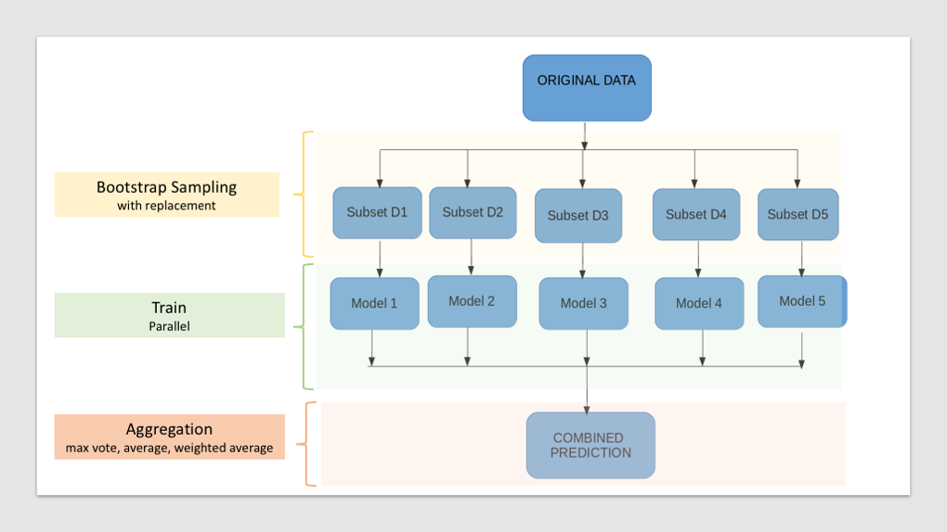
SESSION 7 · ENSEMBLES, INTERPRETATION & ERROR ANALYSIS
The mechanism, before the numbers
Resample the training data with replacement to get several different datasets; fit one model on each, in parallel and in isolation; combine the predictions by averaging or voting. Nothing here sees more data than the original - the only new ingredient is that each model sees a different subset.

Slide 10
SESSION 7 · ENSEMBLES, INTERPRETATION & ERROR ANALYSIS
Thirty trees, then their average
Individual trees: mean AUC 0.7694, sd 0.0100, range 0.7517 to 0.7884. Every one of them is mediocre.
0.897
Averaging them gives 0.8973 - a gain of about 0.13, from no new data, no better trees and no tuning.
AUC of the averaged prediction, against 0.769 for the mean individual tree
The gain is bought entirely with disagreement.

Slide 11
SESSION 7 · ENSEMBLES, INTERPRETATION & ERROR ANALYSIS
Where the gain comes from
Steep at first, then a plateau. More trees never hurt a bagged model - they simply stop helping.
Trees averaged
AUC
1
0.7855
3
0.8425
10
0.8855
30
0.8973
sklearn RandomForest(30)
0.9080
sklearn does slightly better because it also samples features at each split, which decorrelates the trees further. Same idea, applied twice.

Slide 12
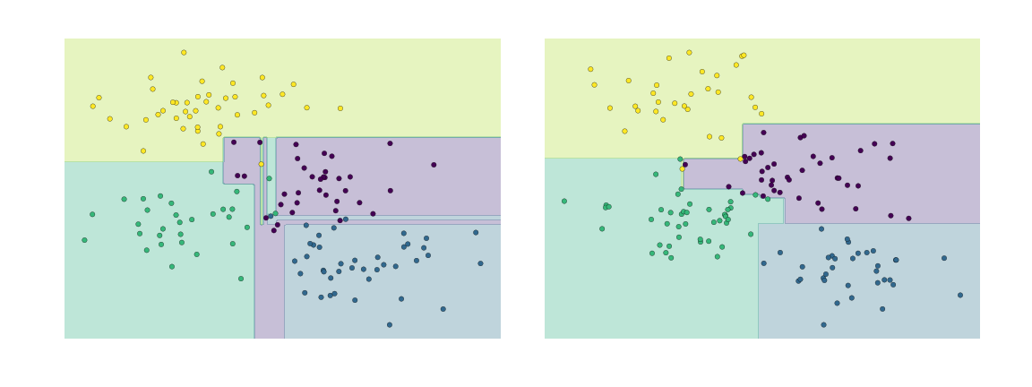
SESSION 7 · ENSEMBLES, INTERPRETATION & ERROR ANALYSIS
Why each tree is deliberately unbounded
An unbounded tree carves the plane into pieces small enough to describe noise. On its own that is a failure - it is the collapse from Session 5. Here it is the point: a high-variance model is one that disagrees with a differently trained copy of itself, and disagreement is what averaging consumes. Try this with thirty depth-2 trees and the gain disappears.

Slide 13
SESSION 7 · ENSEMBLES, INTERPRETATION & ERROR ANALYSIS
The raw material
For a typical listing, the thirty trees disagree by about 0.23 in predicted probability.
0.2283
That disagreement is not noise to be removed. It is what averaging consumes.
mean standard deviation between trees, per listing
If all thirty trees agreed, averaging would change nothing. Try this with thirty depth-2 trees and the gain disappears.

Slide 14
SESSION 7 · ENSEMBLES, INTERPRETATION & ERROR ANALYSIS
2
Boosting, and the opposite failure mode
Same family of weak learners, chained instead of averaged - and the behaviour reverses.

Slide 15
SESSION 7 · ENSEMBLES, INTERPRETATION & ERROR ANALYSIS
Two ways to combine trees
The difference in one word: dependence.
Boosting · sequential
Bagging · parallel
each corrects the last
each is independent
Every tree is fitted to what the previous ones got wrong.
Every tree is fitted to its own resample, in isolation.
The trees are dependent by construction.
The trees are independent by construction.
Past some point the corrections start fitting noise.
More independent estimates to average never hurts.
So n_estimators is a parameter you can overshoot.
So n_estimators is a budget, not a risk.

Slide 16
SESSION 7 · ENSEMBLES, INTERPRETATION & ERROR ANALYSIS
Adding trees: the two families diverge
Identical folds, identical preprocessing. Only the combination rule differs.
n_estimators
RandomForest
Boosting (lr = 0.3)
10
0.9062
0.9204
50
0.9188
0.9163
200
0.9216
0.9141
Read the columns in opposite directions. The forest climbs and settles; the booster peaks at 10 trees and then declines.

Slide 17
SESSION 7 · ENSEMBLES, INTERPRETATION & ERROR ANALYSIS
Boosting at a high learning rate gets worse with more trees.
0.9204 at ten trees, 0.9141 at two hundred. Nothing is broken and nothing needs fixing except the pair of settings that caused it. This is the single most useful thing to know about boosting, and it is invisible if you only ever try one value.

Slide 18
SESSION 7 · ENSEMBLES, INTERPRETATION & ERROR ANALYSIS
Learning rate and tree count are one coupled decision
Read the diagonal. A small rate needs many rounds; a large rate needs few.
learning_rate
20 trees
60 trees
150 trees
0.01
0.9145
0.9182
0.9213
0.30
0.9201
0.9171
0.9141
Tuning either one alone is a category error. They are two ways of spending the same budget.

Slide 19
SESSION 7 · ENSEMBLES, INTERPRETATION & ERROR ANALYSIS
3
The benchmark, done properly
Five models, one protocol, identical folds - then Session 6's machinery applied to the result.

Slide 20
SESSION 7 · ENSEMBLES, INTERPRETATION & ERROR ANALYSIS
Five models, identical folds
Model
AUC
sd
per-fold
LogisticRegression
0.8899
0.0379
0.825 0.914 0.869 0.918 0.924
Tree (depth 5)
0.9075
0.0347
0.856 0.941 0.877 0.924 0.940
RandomForest (200)
0.9216
0.0364
0.862 0.950 0.895 0.946 0.954
HistGB (default)
0.9216
0.0381
0.863 0.955 0.889 0.946 0.954
XGBoost (200)
0.9193
0.0396
0.854 0.953 0.893 0.946 0.951
Before ranking anything: every sd is around 0.037, and the top three means sit inside 0.003 of each other.

Slide 21
SESSION 7 · ENSEMBLES, INTERPRETATION & ERROR ANALYSIS
Which differences are real?
Paired per-fold comparison against the best mean, exactly as in Session 6.
HistGB against
diff
signs
p
verdict
LogisticRegression
+0.0317
+++++
0.0011
REAL
Tree (depth 5)
+0.0141
+++++
0.0034
REAL
RandomForest (200)
+0.0001
++--+
0.9746
within noise
XGBoost (200)
+0.0024
++--+
0.3525
within noise
Look at the signs column before the p column. Five agreeing signs, or a mixture - that is the whole test in one glance.

Slide 22
SESSION 7 · ENSEMBLES, INTERPRETATION & ERROR ANALYSIS
Two real, two illusions
The gap between the top two models is one ten-thousandth, with signs that do not agree on a direction.
+0.0001
Ranked by mean AUC they are 1st and 2nd. Tested properly they are indistinguishable.
HistGB over RandomForest · p = 0.9746
The ensembles genuinely beat logistic regression and the single tree. They do not beat each other.

Slide 23
SESSION 7 · ENSEMBLES, INTERPRETATION & ERROR ANALYSIS
4
Resolving Session 5's cliffhanger
Two models are tied on AUC. Something has to break the tie, and it will not be accuracy.

Slide 24
SESSION 7 · ENSEMBLES, INTERPRETATION & ERROR ANALYSIS
The same four models, judged on usability
The city can inspect 200 listings a month. That is the actual task.
Model
AUC
distinct scores
precision@200
tied at the cut
Tree (depth 5)
0.9075
104
0.985
337
LogisticRegression
0.8899
12,239
0.855
1
RandomForest (200)
0.9216
444
0.990
182
HistGB (default)
0.9216
11,336
0.985
1
A depth-5 tree has at most 32 leaves, so it can emit at most 32 distinct probabilities. A 200-tree forest can emit multiples of 1/200.

Slide 25
SESSION 7 · ENSEMBLES, INTERPRETATION & ERROR ANALYSIS
The tie-breaker
RandomForest and HistGB have identical AUC and p = 0.97. Nothing in the scores separates them.
182
But the forest emits 444 distinct values and leaves 182 listings sharing the cut-off. Which 18 get inspected is settled by row order.
listings tied at the 200th place in the RandomForest ranking
HistGB emits 11,336 and produces a fully ordered, appealable list. That is the reason to ship it.

Slide 26
SESSION 7 · ENSEMBLES, INTERPRETATION & ERROR ANALYSIS
We chose the model that loses no accuracy and can be defended to a host who asks why their address was on the list.
Not the highest score. Not even a different score. A property of the output that no metric in this course measures, and that the client would have discovered on their first month of inspections.

Slide 27
SESSION 7 · ENSEMBLES, INTERPRETATION & ERROR ANALYSIS
5
The industry landscape
What people actually reach for, and the honest reason why.

Slide 28
SESSION 7 · ENSEMBLES, INTERPRETATION & ERROR ANALYSIS
Three things you will meet
The differences between implementations are smaller than the marketing suggests.
1
2
3
XGBoost / LightGBM / CatBoost
“Just use gradient boosting”
Stacking and blending
›
›
Different engineering of the same idea. Our XGBoost scored 0.9193 against HistGB's 0.9216 - p = 0.35, no difference.
Usually right on tabular data, and it is still a claim that has to be measured on your data rather than assumed.
Combine the combinations. Real gains exist and are small; the complexity cost is not.

Slide 29
SESSION 7 · ENSEMBLES, INTERPRETATION & ERROR ANALYSIS
6
Interpretation
A number per feature, and everything that number does not mean.

Slide 30
SESSION 7 · ENSEMBLES, INTERPRETATION & ERROR ANALYSIS
Permutation importance - AUC lost when a column is shuffled
Measured on held-out data, so it rewards generalisation rather than memorisation.
Feature
ΔAUC
minimum_nights
0.1300
room_type
0.0523
number_of_reviews
0.0426
bedrooms
0.0169
calculated_host_listings_count
0.0141
accommodates
0.0037
minimum_nights is top again - and this time it is legitimate. The target is licensing, not price, and a long minimum stay is genuinely informative about how a listing operates.

Slide 31
SESSION 7 · ENSEMBLES, INTERPRETATION & ERROR ANALYSIS
What permutation importance does not tell you
Every one of these belongs in the Model Card, not in a footnote.
Not causal shuffling a column measures this model's dependence on it, not the column's effect on the world.
Correlated features share credit two columns carrying the same information each look half as important as either really is.
Not stable it is itself random. We used n_repeats=5; a single shuffle is one draw.
Not a feature-selection rule dropping the bottom of this list changes the model, so the list no longer applies to it.

Slide 32
SESSION 7 · ENSEMBLES, INTERPRETATION & ERROR ANALYSIS
7
Error analysis: who does this model fail?
One aggregate number hides everything that matters here.

Slide 33
SESSION 7 · ENSEMBLES, INTERPRETATION & ERROR ANALYSIS
Performance by district
Six of the ten districts. The aggregate AUC was 0.9216.
District
n
licensed rate
AUC
recall
Ciutat Vella
2,663
0.597
0.861
0.865
Sarrià-Sant Gervasi
694
0.608
0.919
0.836
Gràcia
1,116
0.656
0.925
0.917
Eixample
4,898
0.732
0.943
0.953
Sants-Montjuïc
1,168
0.720
0.950
0.936
Nou Barris
147
0.537
0.961
0.949
The model is weakest in Ciutat Vella - the historic centre, the second-largest district, and where short-term rental is most contested. Precisely where the city most needs it to work.

Slide 34
SESSION 7 · ENSEMBLES, INTERPRETATION & ERROR ANALYSIS
The spread one number hid
The headline figure was 0.9216 ± 0.0381. Nothing in it says the model works far better in some districts than others.
0.101
A model reported only in aggregate is a model whose failures have not been looked for.
gap between the best and worst district AUC (0.861 to 0.961)
Subgroup performance is not an extra. It is the difference between a model and a system.

Slide 35
SESSION 7 · ENSEMBLES, INTERPRETATION & ERROR ANALYSIS
Where the 200 inspection flags land
District
flags
share of flags
share of listings
over-rep.
Sarrià-Sant Gervasi
33
0.165
0.055
3.00×
Nou Barris
5
0.025
0.012
2.15×
Gràcia
29
0.145
0.088
1.64×
Eixample
75
0.375
0.388
0.97×
Sarrià-Sant Gervasi is the wealthiest district in Barcelona, and it is flagged three times as often as its share of listings.

Slide 36
SESSION 7 · ENSEMBLES, INTERPRETATION & ERROR ANALYSIS
So is the model unfair?
The honest answer is not a verdict. It is a measurement you do not yet have.
Three readings, and the data cannot separate them
What to do about not knowing
we do not know
reserve 20%
Genuine non-compliance is higher there, and the model is correctly finding it.
Keep part of the inspection budget for random selection.
Recording artifact: licences there are less often recorded in the scraped field, whatever the reality.
That preserves an unbiased estimate after deployment, and it is the only thing that can distinguish the three readings.
Model weakness: the model has learned a proxy for wealth rather than for compliance.
It costs enforcement efficiency. Say so, and let the client decide.

Slide 37
SESSION 7 · ENSEMBLES, INTERPRETATION & ERROR ANALYSIS
8
The regression contrast, and Model Card v1
The same session, the same dataset, the opposite conclusion.

Slide 38
SESSION 7 · ENSEMBLES, INTERPRETATION & ERROR ANALYSIS
Ensembles on the price problem
Same folds, same scoping as Session 6.
Model
R²
sd
against Ridge
Ridge
0.6068
0.0988
-
RandomForest (100)
0.6050
0.0700
-0.0018 p = 0.927 within noise
HistGB (Session 6)
0.5904
0.0675
-0.0163 p = 0.469 within noise
On licensing the ensembles beat logistic regression by 0.0317, p = 0.0011. On price they beat nothing at all.

Slide 39
SESSION 7 · ENSEMBLES, INTERPRETATION & ERROR ANALYSIS
Same dataset. Same session. Opposite conclusions.
“Ensembles are better” is not a fact about ensembles. It is a fact about a problem, and it has to be measured for each one. The price target is close to linear in these features; the licensing target is not.

Slide 40
SESSION 7 · ENSEMBLES, INTERPRETATION & ERROR ANALYSIS
Model Card v1 - what M6 has to contain
Graded, 10%. A card that lists only what you kept is a sales document.
1 Intended use, and the client it serves.
2 Performance with uncertainty, and the validation protocol.
3 Top features, with the caveat about what importance does not prove.
4 Subgroup performance, including the district table.
5 Known failure modes, and the conditions under which it should not be used.

Slide 41
SESSION 7 · ENSEMBLES, INTERPRETATION & ERROR ANALYSIS
9
Common mistakes, and what to take away
The four beliefs this session exists to break.

Slide 42
SESSION 7 · ENSEMBLES, INTERPRETATION & ERROR ANALYSIS
Four things
Belief
What today measured
“RandomForest beat HistGB, it is 2nd by mean.”
+0.0001, p = 0.9746, signs ++--+. They are indistinguishable.
“More trees is always safer.”
True for bagging. Boosting at lr = 0.3 fell from 0.9204 to 0.9141.
“Feature importance tells you what causes the outcome.”
It measures this model's dependence on a column. Nothing more.
“The model is 92% accurate, so it is fine.”
District AUC ranges 0.861 to 0.961, and flags concentrate 3.00x in one district.

Slide 43
SESSION 7 · ENSEMBLES, INTERPRETATION & ERROR ANALYSIS
If one thing survives today:
M6 · ensemble champion and Model Card v1 · graded, 10%

