Slide 1
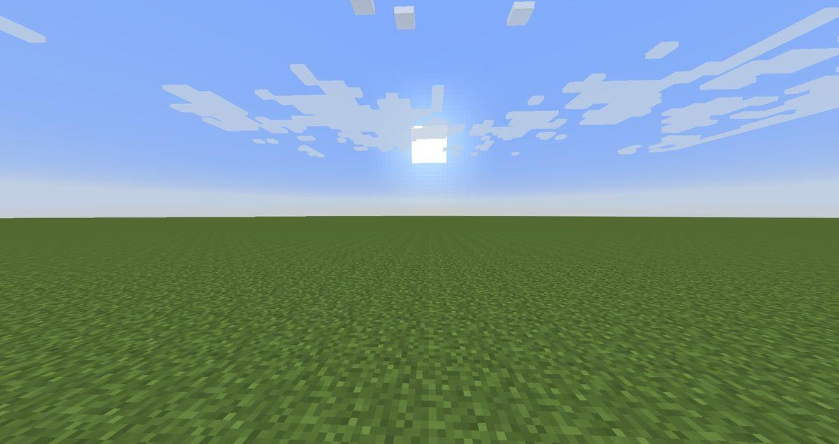



Team
Team Sahay
Member 1 — Role
Member 2 — Role
Member 3 — Role
Member 4 — Role

Slide 2

Problem Statement & Theme
Problem: India runs 3,000+ welfare schemes worth ₹15+ lakh crore — yet under 30% of eligible citizens ever claim them. Discovery is broken: portals are English-first, jargon-heavy, and scattered across 50+ ministry websites.
Impact: ~800 million Bharat citizens — farmers, widows, gig workers, artisans, the elderly — leave entitled benefits on the table every year. A widow in UP doesn't know a ₹6,000/yr pension exists in her name.
Theme Alignment: AI for Social Good × Bharat-first. A multilingual, voice-enabled AI navigator that turns natural Hindi/Hinglish speech into a ranked list of schemes the user actually qualifies for.

Slide 3
Solution Overview: Sahay (सहाय) is an AI Welfare Navigator. The user types or speaks freely in Hindi / Hinglish / English — "58 saal, kisan, 1.5 acre, beti ki padhai" — and Sahay returns the top schemes with eligibility, documents required, and how-to-apply links.
Key Features: (1) Bilingual chat + voice input (2) Signal-extraction engine that catches age, occupation, land-size, life-events from free text (3) 25 real central-govt schemes (PM-KISAN, Ayushman Bharat, MUDRA, Ujjwala, PMAY, Vishwakarma, SSY, NSAP pensions, e-Shram…) (4) One-click demo personas — Ramesh, Lakshmi, Priya, Irfan (5) Animated total-₹-unlocked counter that quantifies the impact live.
Unique Value: Most schemes-search tools are keyword forms in English. Sahay is conversational, vernacular-first, and returns a *reasoned* match — every card explains *why* this scheme fits this person.
Solution

Slide 4
Architecture
Tech Stack: Python + Flask backend • Vanilla JS / HTML / CSS frontend • Claude Haiku 4.5 for AI enrichment • JSON scheme corpus (offline-first, zero-DB).
Data Flow: User speaks/types in Hindi or English → signal extractor pulls age, occupation, land, life-events → scheme scorer ranks 25 schemes → build_why() attaches plain-language reasons → frontend renders cards + ₹-counter.
APIs: Anthropic Claude API (Haiku 4.5) for "why this scheme" copy • Web Speech API for voice input • Internal /api/chat, /api/schemes, /api/personas.

Slide 5
Market Research & Analysis
Target Users: ~800M citizens of Bharat — farmers, widows, senior citizens, gig & platform workers, MSME artisans, students from low-income families. Primary entry point: rural & tier-2/3 smartphones via WhatsApp-style chat or voice.
Market Size: 3,000+ central + state schemes • ₹15+ lakh crore total annual welfare outlay • ~70% leakage / under-claim gap = ₹10+ lakh crore worth of unclaimed benefits sitting on the table every year.
Revenue Model: (1) Govt / state-mission licensing (white-label for Common Service Centres, Panchayats) (2) CSR + foundation grants tied to claim-conversion metrics (3) NBFC / fintech partnerships — qualified-lead handoff for MUDRA, Stand-Up India, KCC loans.
Expected Growth: Pilot in 1 state via CSC network → 10M users in 12 months → scale to all 22 official languages and 250K Common Service Centres → measurable lift in scheme-claim rate is the north-star metric.

Slide 6
Future Scope
WhatsApp & IVR Channels: Meet Bharat where it already is — Sahay over WhatsApp Business API + a toll-free IVR for feature-phone users with no smartphone.
Full 22-Language Coverage: Extend signal-map and scheme copy to all 8th-Schedule languages — Marathi, Tamil, Telugu, Bengali, Punjabi, Odia, Assamese, Kannada, Malayalam, Gujarati, and more.
Document-Auto-Fill & Application Tracking: OCR Aadhaar/ration card → pre-fill scheme forms → submit to UMANG/state portals → track application status end-to-end inside Sahay.
State-Scheme + Private-Welfare Expansion: Grow from 25 central schemes to 3,000+ central + state + corporate-CSR schemes, with eligibility rules versioned per state.
Impact Dashboards for Govt Partners: Live dashboards for Ministries / NITI Aayog showing district-level claim-rate uplift, scheme demand heatmaps, and unmet-need signals.

Slide 7
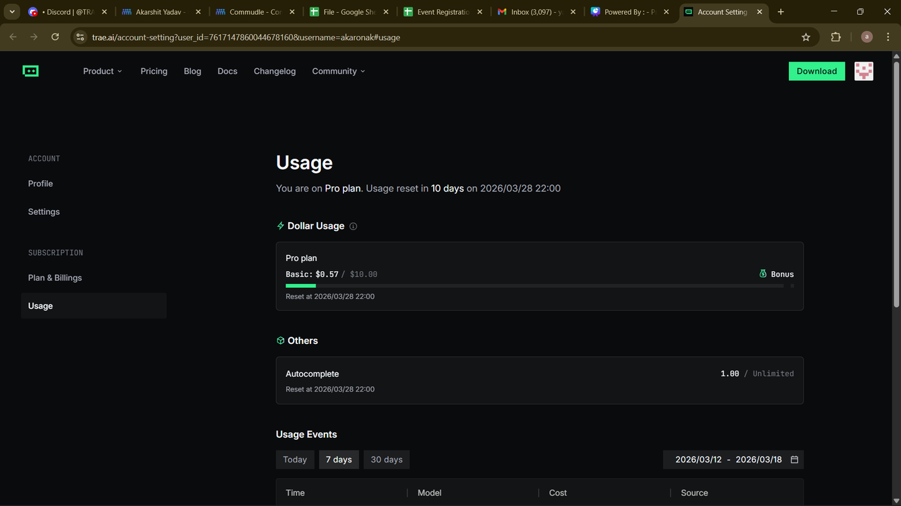
TRAE Account Upholding
Screenshot of TRAE dashboard for each teammate — to be added before submission.
Username visible in every screenshot.
Proof of participation for all teammates attached on this slide.
Placeholder: insert screenshots in the image area below.

Slide 8
Thank
you!

