Slide 1

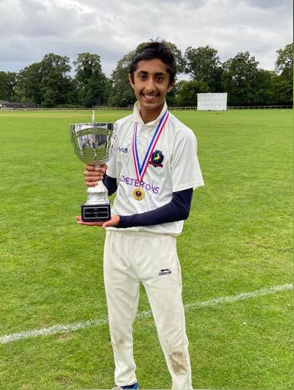
Pranav’s Introduction
Debating
Cricket
Guitar
Biggest learning:
The true nature of Impact and the value of persistence
Favourite Quote:
If your presence doesn’t make an impact, your absence won’t make a difference.
Notes:
Cricket and Guitar as discovering different sides of me.
Perhaps one of the biggest reasons I came here, and everything about what I do is for tangible, real impact on people’s lives. Favourite Quote and idea of impacting other people’s lives drove me to here. But a slightly evolved idea after talking to people and going through experience - impact isn’t the tangible “wow” we see, that’s to make a difference, but true impact is that fulfilled feeling, after constant persistence and touch people’s lives, that is true impact.And this place touches so many people’s lives without them even knowing it. That impact, that true value of persistence, whether it be through 5 hours of troubleshooting, that value of persistence is perhaps my biggest takeaway from the experience.

Slide 2
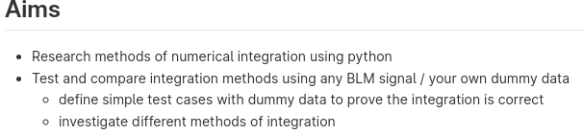
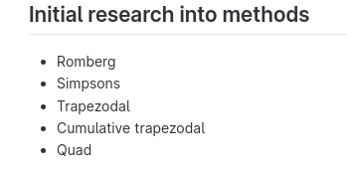
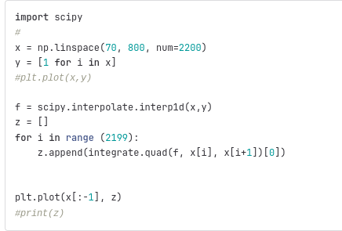
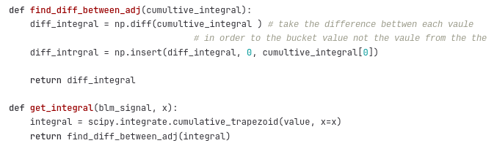
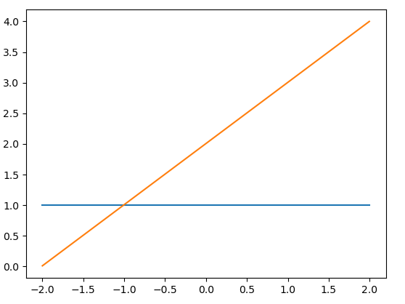
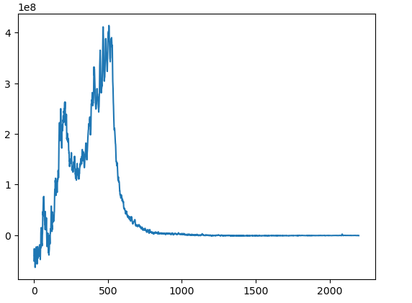
Stage 1 Project - Energy Calibration - Integration and Interpolation of Data using Python

Slide 3
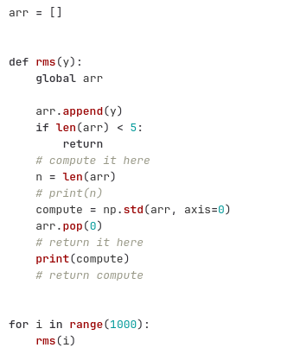
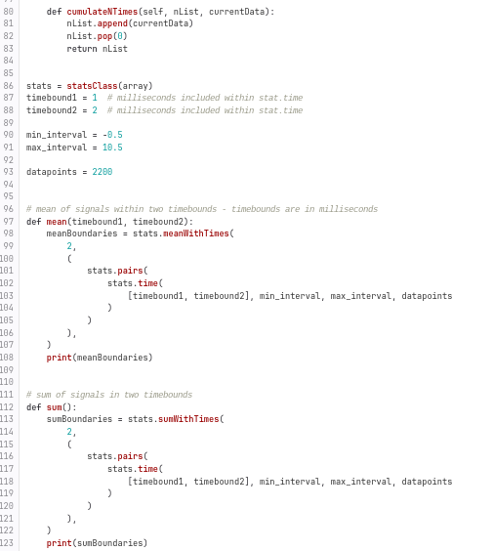
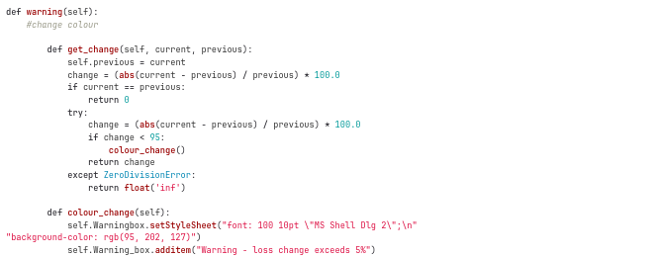
Stage 2 Project - Loss Monitoring
Root, Mean Square Function
Warning dropbox - timestamps and energy loss
Sum and Mean of BLMs

Slide 4
Acknowledgments
We are privileged and grateful to be here and would like to thank those who have put in so much time, effort and energy into facilitating such a fantastic experience:
Haroon Rafique
Esher Bansal
Bill
Public Engagement Team
Thank you!

