Slide 1
ENGI 301 Bubba PCB Proposal
11/14/2021
Mantej Singh

Slide 2
Background Information
What is being proposed?
Hackster Page - link
Github Page - link

Slide 3
Board Functionality
The PCB will be a platform on which the following will be mounted:
Pocket Beagle
4 servo motors
HCSR04 sensor

Slide 4
Fritzing Diagram
Black wires – GND
Red Wires – V_{out}
SG90 (Yellow wires) –
servo1 = "P2_1"
servo2 = "P2_3"
servo3 = "P1_36"
servo4 = "P1_33”
HCSR04
trigger = “P1_6”
echo = “P1_8”

Slide 5
System + Power Block Diagram
[Note] Initial design plan had 8 servo motors but with the limitation of PWM pins on the pocket beagle, the PCB is going to be designed to house 4 servos.

Slide 6
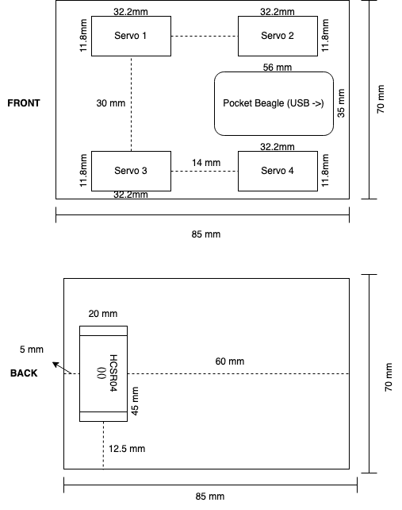
Mechanical Block Diagram

Slide 7
Components Required
1x Pocket beagle
4x SG90 Servo Motors
1x HCSR04 Sensor
4x 3-pin 100-mil servo connector
6x male-to-male jumper wires

