Slide 1
ENGI 301 Bubba PCB Proposal
11/14/2021
Mantej Singh

Slide 2
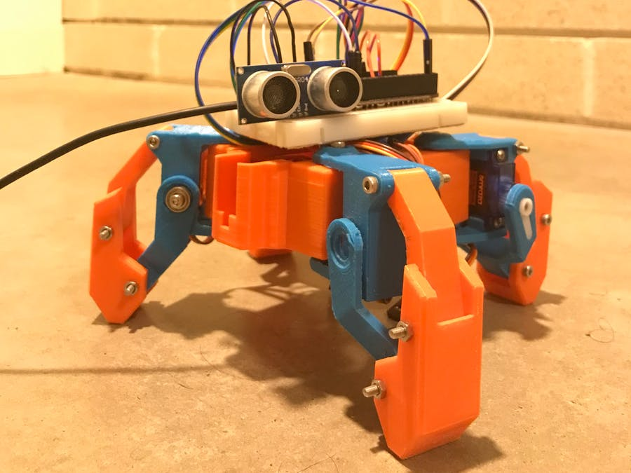
Background Information
What is being proposed?
Hackster Page - link
Github Page - link

Slide 3
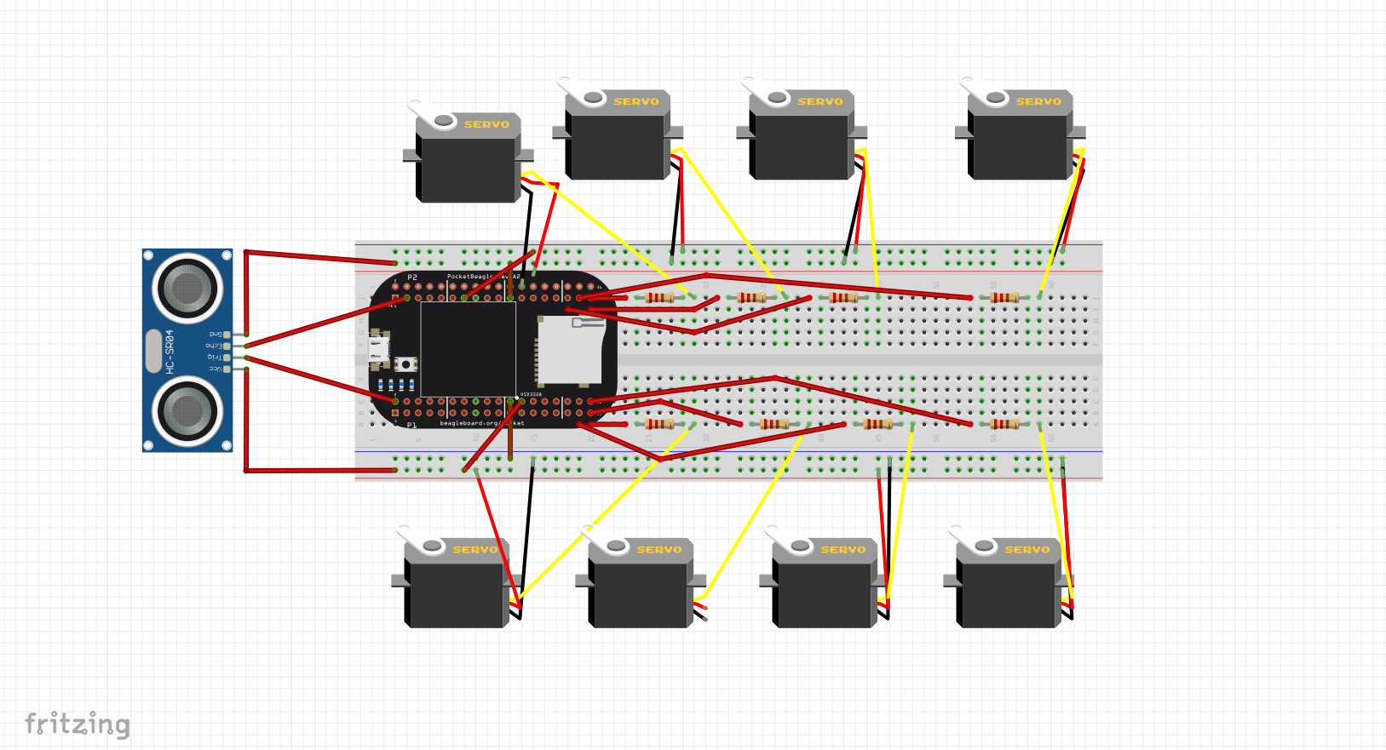
Fritzing Diagram
Black wires – GND
Red Wires – V_{out}
SG90 (Yellow wires) –
servo1 = "P2_1"
servo2 = "P2_3"
servo3 = "P1_36"
servo4 = "P1_33”
HCSR04
trigger = “P1_6”
echo = “P1_8”

Slide 4
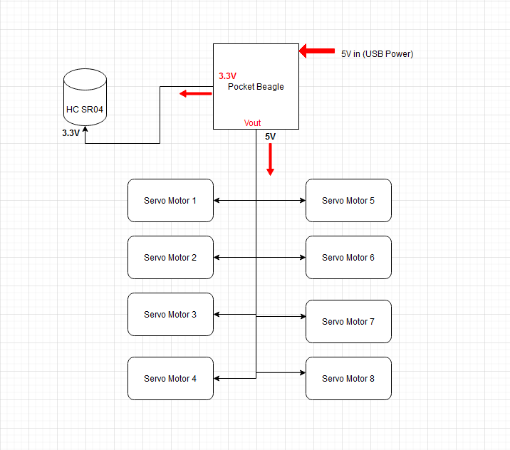
System + Power Block Diagram

Slide 5
System Block Diagram
Create a System Block Diagram
Label interfaces / pins
Components (part numbers if possible)
Can be copied from your previous Project

Slide 6
Mechanical Block Diagram
Create a Mechanical Block Diagram
Use PowerPoint or equivalent to create a rough outline of where all components need to be placed
Need Dimensions and Rough Placement

Slide 7
Components Required
Create a list of all the components that you require for the PCB
Example List:
USB Host connector
TXS0108E Level Shifter
Power connector
Motor screw terminal connector
3-pin 100-mil servo connector
3-pin 100-mil Strip LED connector
LEDs
Buttons
Buzzer
…

Slide 8
Backup

Slide 9
Example Mechanical Drawing (delete from final submission)
3”
.25”
Hex Display
Pocket Beagle
.5”
USB
2”
Button
Buzzer
Pot
Servo
1.5”
FRONT
BACK

