Slide 1
ENGI 301 Bubba The Robot Proposal
10/04/21
Mantej Singh

Slide 2
Background Information
I have a deep research interest in autonomous robots
I did research in robotic motion planning at Kavraki Lab → was very software focused
Now, having learnt about hardware and circuits in ENGI 301, I want to build a robot, named Bubba, that can move around.
Leverage my research in robotic motion planning and incorporate it into an actual physical robot → no more simulations woo!

Slide 3
The Plan:
Leverage the .STL files from Javier (https://github.com/JavierIH/miniKame) to build the chassis for the robot (currently in progress)
Redesign the motion algorithm to run in Python on a PocketBeagle instead of in C++ to run on the ESP8266
Be able to program it to walk forward, turn left and right etc.
Stretch goal: Implement a motion planning algorithm and an HCSR04 ultrasonic sensor to make the robot avoid obstacles and make the robot dance!

Slide 4
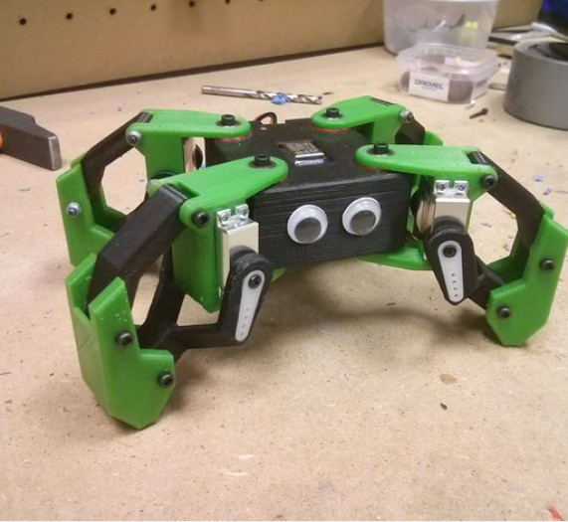
Final Product
https://www.thingiverse.com/thing:1265766
https://github.com/JavierIH/miniKame

Slide 5
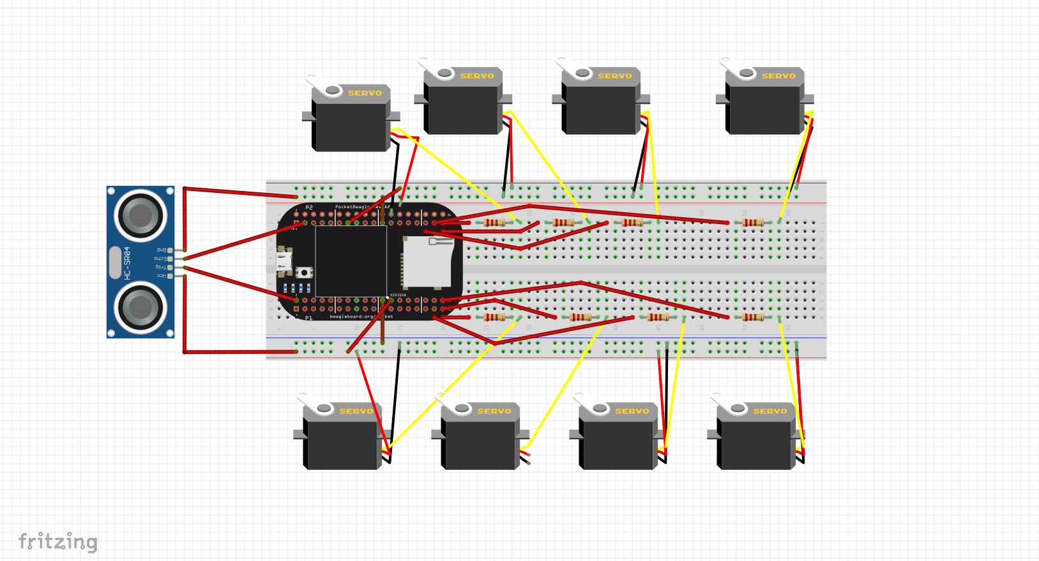
Fritzing Diagram

Slide 6
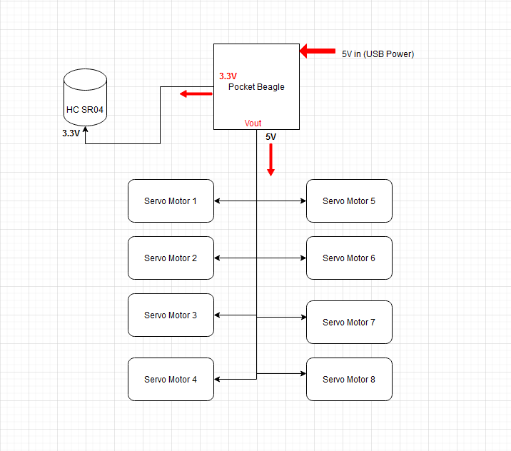
Power Block Diagram

Slide 7
Challenges (after discussion with Prof. Welsh) :
Requires 8 servo motors but only has 4 PWM pins
Solution
Use PRU pins
High degree of synchronization between servo motors required
Solution
Use a data structure that couples the 8 motors together and increase the level of abstraction
Create functions like moveLeftArm() that encapsulate movements of multiple servos together
Interfacing with the servos using BBIO Library
Solution
Build wrappers that allow you to manipulate PRU pins like PWM pins
Concurrency will be required
Solution
Use python multi-threading library to control servos in parallel with each other

Slide 8
Components / Budget
Component | Quantity | Need to Buy | Cost
SG 90 Micro Servo Motor 9G | 8 | No | -
HC SR04 | 1 | OEDK Elec Lab has them? | 3.95
Jumper Cables | 30 | No | -
3D Printed Parts | NA | No | -
Screws/Bolts | 30 | No | -
Battery | 1 | Yes (Need help on this) | -
Need all components to be purchased by instructor listed; additional components may be purchased by student

