Slide 1
AI & Data Science: Data Wrangling, Visualization and EDA
Piyush Luitel

Slide 2
Introduction to AI and Data Science
Artificial Intelligence (AI): Simulation of human intelligence processes by machines, especially computer systems.
Data Science (DS): An interdisciplinary field that uses scientific methods, processes, algorithms, and systems to extract knowledge and insights from structured and unstructured data.
Big Data: Large and complex data sets that traditional data-processing software cannot manage effectively.
Applications: AI and DS are applied in various domains such as healthcare (predictive diagnostics), finance (fraud detection), marketing (customer segmentation), and transportation (autonomous vehicles).

Slide 3
Data Wrangling Overview
Definition: Also known as data munging, it involves cleaning, structuring, and enriching raw data into a desired format for better decision-making in less time.
Importance: Ensures data quality and consistency, making it suitable for analysis.
Primary Goals:
Ensure data quality and consistency.
Transform data into a usable format.
Handle missing values, outliers, and inconsistencies.
Integrate data from multiple sources.
Tools and Technologies:
Python Libraries: Pandas, NumPy, SciPy, scikit-learn
R Packages: dplyr, tidyr, data.table
ETL Tools: Apache NiFi, Talend, Alteryx
Note: This tutorial focuses on Python libraries.
Outcome: A clean, well-structured dataset ready for analysis.

Slide 4
Steps in Data Wrangling
Discovery: Understanding and exploring the data to identify data sources, assess data quality, and gain insights into the structure and format.
Structuring: Organizing and formatting raw data to facilitate efficient analysis, including reshaping data, handling missing values, and converting data types.
Cleaning: Addressing inconsistencies, errors, and outliers by removing or correcting inaccurate data, handling duplicates, and addressing anomalies.
Enriching: Enhancing data with additional information to provide more context or depth, such as merging datasets or incorporating external data sources.
Validation: Ensuring the quality and reliability of processed data by checking for inconsistencies, verifying data integrity, and confirming adherence to predefined standards.
Publishing: Preparing the curated and validated dataset for analysis or dissemination, including documenting data lineage and sharing metadata.

Slide 5
Handling Missing Data
Imputation using Mean, Median, or Mode: Filling missing values with the mean, median, or mode of the available data.
Imputation using Predictive Models: Building a predictive model to estimate missing values based on other features.
Imputation using Group Statistics: Filling missing values using the mean or median of groups sharing similar characteristics.
Dropping Missing Values: Removing rows with missing values, especially if the number of missing values is large.

Slide 6
Handling Categorical and Numerical Values
Categorical Values: Variables representing categories, such as 'Sex', 'Embarked', and 'Pclass' in the Titanic dataset.
Nominal Data: Categories without a specific order (e.g., Gender: male, female).
Ordinal Data: Categories with a meaningful order (e.g., Education Level: High School, Bachelor's, Master's, Doctorate).
Numeric Values: Variables representing numerical values, which can be discrete or continuous (e.g., 'Age', 'Fare').

Slide 7
Encoding Categorical Values:
Label Encoding: Assigning a unique integer to each category, suitable for ordinal data.
One-Hot Encoding: Creating new columns indicating the presence or absence of each possible value, suitable for nominal data

Slide 8
Visualization using Matplotlib
Overview: Matplotlib is a comprehensive library for creating static, animated, and interactive visualizations in Python.
Common Plots:
Line Plot: Used to represent data points in a continuous line.
Bar Chart: Represents categorical data with rectangular bars.
Histogram: Displays the distribution of a dataset.
Scatter Plot: Shows relationships between two variables.
Box Plot: Displays the distribution of data based on five summary statistics.

Slide 9
Matplotlib: Sample Code
# A matplotlib workflow
import matplotlib.pyplot as plt
# 1. Prepare data
x = [1, 2, 3, 4]
y = [11, 22, 33, 44]
# 2. Setup plot (Figure and Axes)
fig, ax = plt.subplots(figsize=(10,10))
# 3. Plot data
ax.plot(x, y)
# 4. Customize plot
ax.set(title="Sample Simple Plot", xlabel="x-axis", ylabel="y-axis")

Slide 10
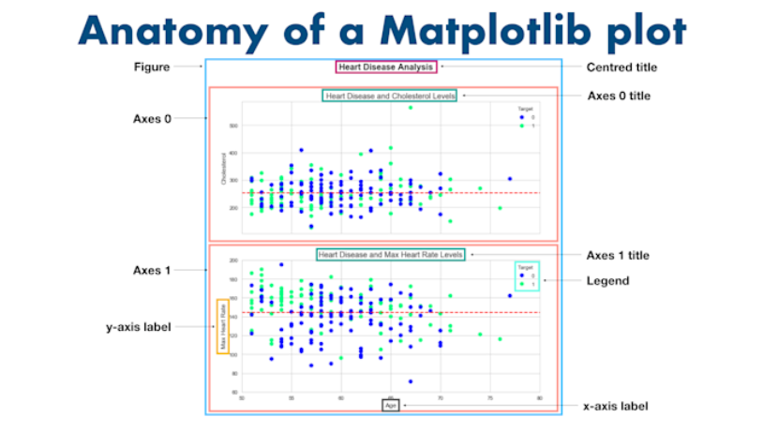

Slide 11
Exploratory Data Analysis (EDA)
Purpose: Discover patterns, relationships, distributions.
Terminologies: Distribution, Outlier.
Univariate Analysis: One feature at a time.
Tools: Histplot (numeric), Countplot (categorical).

Slide 12
Skewed Distributions
Left-Skewed: Long tail on left.
Right-Skewed: Long tail on right.
Transformations: Log
Goal: Skewness between -1 and 1 (normal).

Slide 13
Outlier Detection and Treatment
Removal of Outliers:
Pros: Simple to implement; removes extreme values that could distort analysis.
Cons: Can lead to loss of data, especially if the dataset is small; risk of removing valid data points.
Capping Outliers:
Pros: Keeps all data points; reduces the effect of outliers without losing data.
Cons: The choice of percentile is arbitrary and may not always be optimal.
Transformation:
Pros: Effective for right-skewed distributions; can normalize the data.
Cons: Not suitable for all types of data; log transformation is not defined for zero or negative values.
Imputation:
Pros: Simple to implement; retains all data points.
Cons: Can introduce bias if outliers are numerous; not suitable if outliers contain valuable information.
Z-Score Method:
Pros: Effective for normally distributed data; data-driven approach.
Cons: Not suitable for non-normal distributions

