Slide 1
DATA SCIENCE INTERNSHIP
Internship Completion Report
Submitted in partial fulfillment of the requirements for
B.Tech in Computer Science & Engineering (IBM)
Manthan Arora IILM University, Greater Noida, U.P.
Roll No: 2410031349
Host Organization: Thiranex — Skill Development & Future Tech

Slide 2

Candidate & Program Overview
Student Name
Manthan Arora
University
IILM University, Greater Noida, U.P.
Degree Program
B.Tech — Computer Science & Engineering (IBM)
Internship
Snapshot
Roll Number
2410031349
4 Weeks Intensive Duration Virtual Mode Remote Delivery Verified MSME-Registered Provider
Internship Domain
Data Science
Host Organization
Thiranex (Skill Development & Future Tech)
Duration
10 Aug 2026 – 09 Sept 2026
Certificate ID
THX-AUG1026-364
THIRANEX • DATA SCIENCE INTERNSHIP REPORT
2

Slide 3




Organization Profile: Thiranex
Thiranex is a skill-development and future-tech training organization focused on building industry-relevant, hands-on expertise among students and early-career professionals across emerging technology domains.
MSME Registered
Mentor-Led Training
Future-Tech Focus
Verified Certification
Operates as a recognized entity under India's Ministry of Micro, Small & Medium Enterprises.
Internship programs guided by industry practitioners under the leadership of Founder & CEO Hariharan M.
Core training tracks span Data Science, AI, and emerging technology skill development.
Each completion is issued a verifiable certificate with a unique QR-coded credential ID.
THIRANEX • DATA SCIENCE INTERNSHIP REPORT
3

Slide 4


Problem Statement & Industry Context
The Industry Gap
The Internship's Scope
Academic coursework introduces statistics and machine-learning theory, but most students graduate with limited hands-on exposure to real, messy datasets and end-to-end analytical workflows used in industry.
Sourcing, cleaning, and preparing real-world datasets
Exploratory Data Analysis (EDA) to surface patterns & anomalies
Building and evaluating machine-learning models
Communicating findings through dashboards & visual reports
A model or insight has little business value until it is built on clean data, validated rigorously, and communicated through clear visual storytelling to decision-makers.
THIRANEX • DATA SCIENCE INTERNSHIP REPORT
4

Slide 5




Core Internship Objectives
Data Wrangling
Exploratory Analysis
Machine Learning
Insight Communication
Collect, clean, and structure raw data using Python (Pandas, NumPy) for downstream analysis.
Apply statistical techniques and visualization to uncover trends, correlations, and outliers.
Build and evaluate regression, classification, and clustering models with Scikit-learn.
Translate analytical findings into dashboards and reports for non-technical stakeholders.
THIRANEX • DATA SCIENCE INTERNSHIP REPORT
5

Slide 6




Tools & Technologies Used
Programming & Libraries
Visualization
Python, Pandas, NumPy, Jupyter Notebook
Matplotlib, Seaborn, Power BI
Machine Learning
Data Handling
Scikit-learn — Regression, Classification, Clustering
SQL, Excel, CSV/API data sources
Statistics
Workflow
Descriptive & inferential statistics, hypothesis testing
Data cleaning pipelines, feature engineering
THIRANEX • DATA SCIENCE INTERNSHIP REPORT
6

Slide 7
Data Science Workflow Followed
1
2
3
4
5
Data Collection
Cleaning & Prep
Exploratory Analysis
Model Building
Insight Delivery
Gather raw data from files, APIs & sources
Handle missing values, outliers, formatting
Visualize patterns & test hypotheses
Train, tune & evaluate ML models
Present dashboards & recommendations
This mirrors the standard industry data-science lifecycle — from raw data to a decision-ready insight — applied throughout the internship on practice datasets and assignments.
THIRANEX • DATA SCIENCE INTERNSHIP REPORT
7

Slide 8




Internship Timeline (4 Weeks)
Week 1
Week 2
Week 3
Week 4
Foundations & Data Handling
Exploratory Data Analysis
Machine Learning Modeling
Capstone & Reporting
Python refresher, Pandas/NumPy, data collection, and cleaning fundamentals.
Statistical summaries, correlation analysis, and visualization with Matplotlib/Seaborn.
Regression, classification & clustering with Scikit-learn; model evaluation metrics.
End-to-end mini-project, dashboarding, and final presentation of insights.
THIRANEX • DATA SCIENCE INTERNSHIP REPORT
8

Slide 9
Key Skills Demonstrated
Data Cleaning & Preprocessing
Handled missing values, duplicates, and inconsistent formats across raw datasets to prepare analysis-ready data.
Exploratory Data Analysis
Used descriptive statistics and visual analysis to identify trends, correlations, and outliers in datasets.
Predictive Modeling
Built and compared regression and classification models, evaluating performance using standard metrics.
Data Visualization & Reporting
Designed clear charts and summary dashboards to communicate findings to a non-technical audience.
THIRANEX • DATA SCIENCE INTERNSHIP REPORT
9

Slide 10

Certification & Official Verification
Internship Title | Data Science Internship
Issuing Organization | Thiranex — Skill Development & Future Tech
Certificate ID | THX-AUG1026-364
Duration | 10 Aug 2026 – 09 Sept 2026
Authorized Signatory | Hariharan M, Founder & CEO
Registration Status | MSME Registered
Verified
Credential
This certificate carries a scannable QR verification code confirming authenticity against Thiranex's official records.
THIRANEX • DATA SCIENCE INTERNSHIP REPORT
10

Slide 11
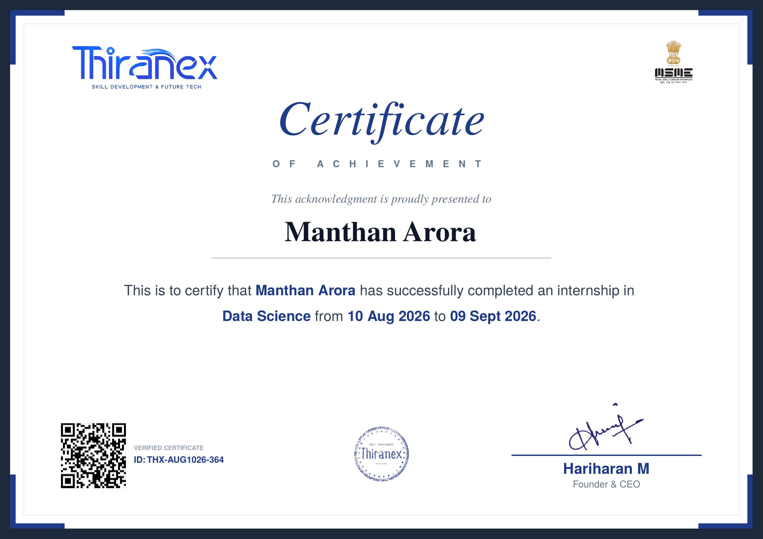
Internship Completion Certificate
THIRANEX • DATA SCIENCE INTERNSHIP REPORT
11

Slide 12
Thank You
Manthan Arora B.Tech CSE (IBM), IILM University, Greater Noida, U.P. Roll No: 2410031349 Data Science Internship — Thiranex
Certificate ID: THX-AUG1026-364

