Slide 1
CSE400 M2 GROUP- 8
NETWORKING
Falak Shah (AU2440014)
Ishani Prajapati (AU2440176)
Manthan Pancholi (AU2440276)
Nikunj Kalariya (AU2440275)
Urvil Chodvadiya (AU2440201)

Slide 2
Project Context and Motivation
Title: Task Offloading in D2D Edge Networks
Domain: Wireless Networking & Edge Computing
Context: High-density mobile networks (5G/6G)
Problem: Mobile CPUs are overwhelmed by latency-sensitive traffic
Intrinsic Uncertainty: Wireless channel fading and random packet arrivals
Stochastic Need: Deterministic routing fails under network jitter

Slide 3
Project Objective and Scope
Objective: Maximize Global Success Expectation: maxₐ ∑ᵢ∈ᴺ E[Yᵢ]
Decision: Optimal offloading target selection in a mesh
Prediction: Outage probability (Probability of missing deadline 𝜏)
Scope: Distributed D2D network with shared compute-resources
Metric: Moving from "Average Delay" to "Bernoulli Success Probability"
(Yi ∼ Bernoulli(pi)).
Modeling Goal: Maximize the expected number of tasks meeting strict deadlines τᵢ.

Slide 4
Project System Overview
Pipeline: Packet Arrival → Offloading Choice → Wireless Link → Remote Buffer
Major Components: Initiator Nodes, Service Peers, and Wireless Channels
Data Flow: Task metadata bits transmitted over a stochastic medium
Interaction: Stochastic Interaction: Aggregate Arrival Rate λⱼ = ∑ₙ aₙ,ⱼ λₙ (Neighbor Load).
System Flow: Offloading Decision → Discrete Summation → M/M/1 Sojourn Time → Binary Outcome.

Slide 5
Sources of Uncertainty
Channel Uncertainty: Small-scale fading and shadowing in wireless links
Traffic Uncertainty: Burstiness of packet arrival times (Poisson jitter)
Processing Uncertainty: Variable CPU cycles required for network protocols
Load Uncertainty: Hidden states of peer device queues

Slide 6
Key Random Variables
Xproc : Task Processing Time (Continuous Random Variable).
Tinter : Inter-arrival Time ∼ Exponential(λ).
Wq : Buffer Delay (Derived Random Variable).
Lq : Queue Length ∼ Geometric Distribution (Networking Metric).
B / H : Bandwidth Demand / Channel Link Quality.
Tsojourn : Total Delay (Aggregate Random Variable: Wq + Xproc + ttrans).
Yi : Completion Indicator (Success = 1, Fail = 0).

Slide 7
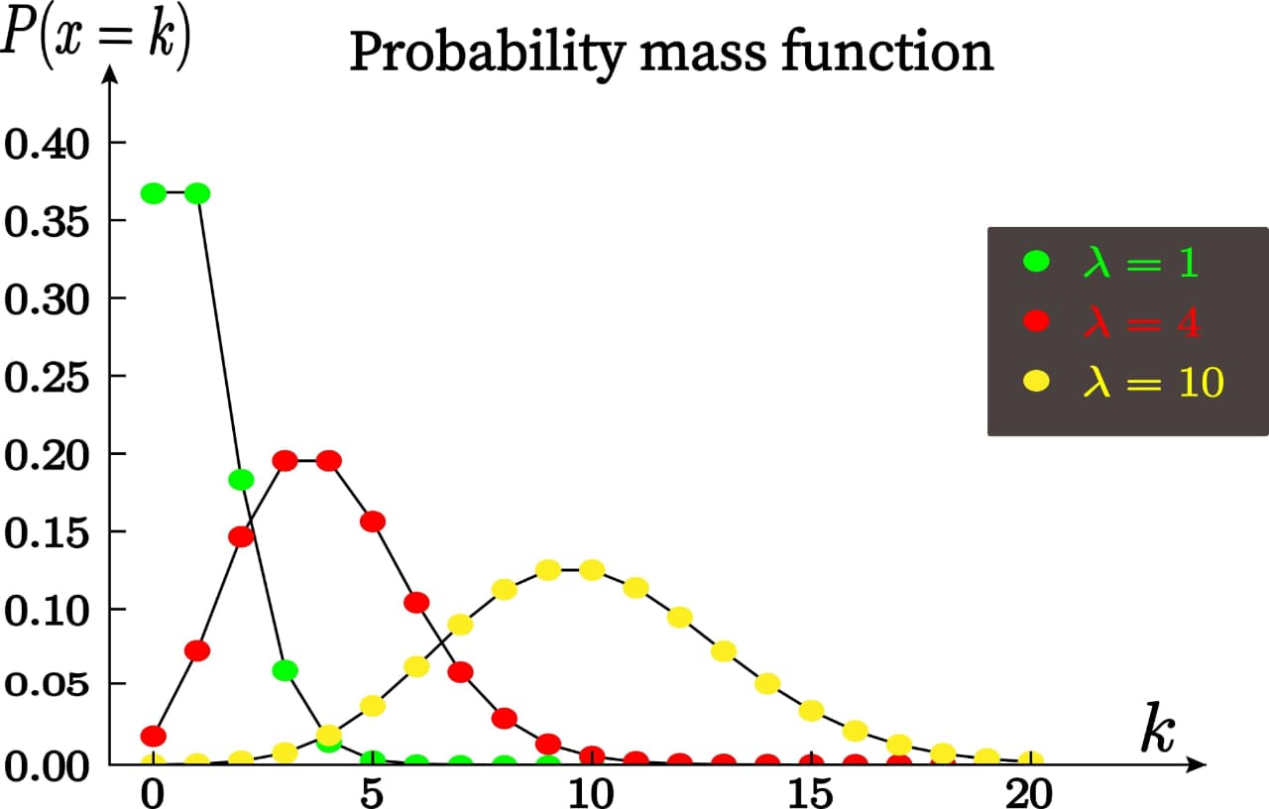
Probabilistic Models and Assumptions
Arrival Model: Poisson Process with rate 𝜆
Service Model: Exponential Service times with rate 𝜇
Fading Assumption: Rayleigh Fading (Exponential power gains) influencing ttrans.
Independence: i.i.d. (Independent and Identically Distributed) links
Justification: Urban D2D environments follow stochastic multipath patterns

Slide 8
Probabilistic Reasoning and Inference Logic
Logic: Link quality 𝛾 determines the stochastic transmission rate R
Conditional Prob: P(Success∣Neighbor Load)
Inference: Using Load 𝜆 to calculate the CDF of Sojourn time
Formula: F(t ≤ τ) = 1 − exp( − (μ − λ) · τₑff )

Slide 9
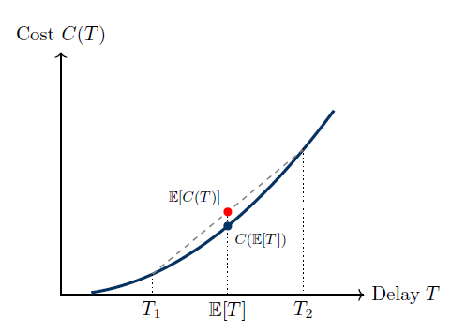
Operationalizing Probabilistic Reasoning
Simulation: Monte Carlo realizations of random packet streams
Jensen’s Inequality: E[C(T)] ≥ C(E[T]).
Decision Logic: Offload if P(Success remote) > P(Success local).
Metrics: Percentage of packets meeting the Hard Deadline 𝜏

Slide 10
Current Limitations and Conceptual Gaps
Mobility Gap: Model assumes static nodes; ignores Doppler fading
Feedback Delay: Uncertainty in "Stale" channel state information
Ambiguity: Handling highly correlated traffic bursts (Non-Poisson)
Feasibility: High computational overhead of calculating Nash Equilibrium

Slide 11
Planned Refinements and Role Coordination
Evolution: Upgrading 𝑀 / 𝑀 / 1 → 𝑀 / 𝐺 / 1 for heavy-tailed risks
Refinement: Upgrading to M/G/1 queueing using Laplace–Stieltjes transforms for non-exponential heavy-tailed tasks.
Ambiguity Resolution: Solving the Stale Information problem
Project Manager (M3): Falak Shah
Scribe Team (M3): Ishani Prajapati, Nikunj Kalariya
Simulation/Video (M3): Manthan Pancholi, Urvil Chodvadiya
Test Goal: Injecting bursty traffic to stress-test Poisson assumptions

Slide 12
Summary of Group-Level Understanding
Replaced deterministic fixed delays with stochastic random variables
Established M/M/1 queueing model as the baseline system model
Identified variance as a major risk factor, not just mean delay
Modeled user offloading decisions as a stochastic game
Showed system converges to a stable Nash equilibrium
Used probability to quantitatively manage network congestion

