Slide 1
InstitutePLUSE
Platform for Learning, Utility, Sustainability & Engagement
Subject Code: 1BPRJ258
Interdisciplinary Project-Based Learning | Week 15–16
TEAM MEMBERS
UNDER THE GUIDANCE OF
Mallikarjun B Chikkabasur — CS
Prof. Somashekar T M
Manoj G Raikar — CS
Assistant Professor
Manthan T Patel — CS
Department of ME
Bheemappa Talawar — AIML
Kasirayagouda Umannavar — E&C
Jain College of Engineering, Belagavi
Premkumar S Koppal — ME
1/13

Slide 2
Brand Identity & Vision
InstitutePLUSE: Building Smarter, Greener & More Connected Campuses.
P
L
U
S
E
Platform
Learning
Utility
Sustainability
Engagement
A unified SaaS-grade portal connecting all students, faculty, and administrators.
Promoting educational growth with Focus Timers, Study Alarms, and Resource Hubs.
Simplifying campus life with QR Attendance, digital Canteen, and interactive maps.
Log carbon footprints, track campus green covers, and earn eco-points.
Motivating communities through team challenges, events, and live leaderboards.
2/13

Slide 3
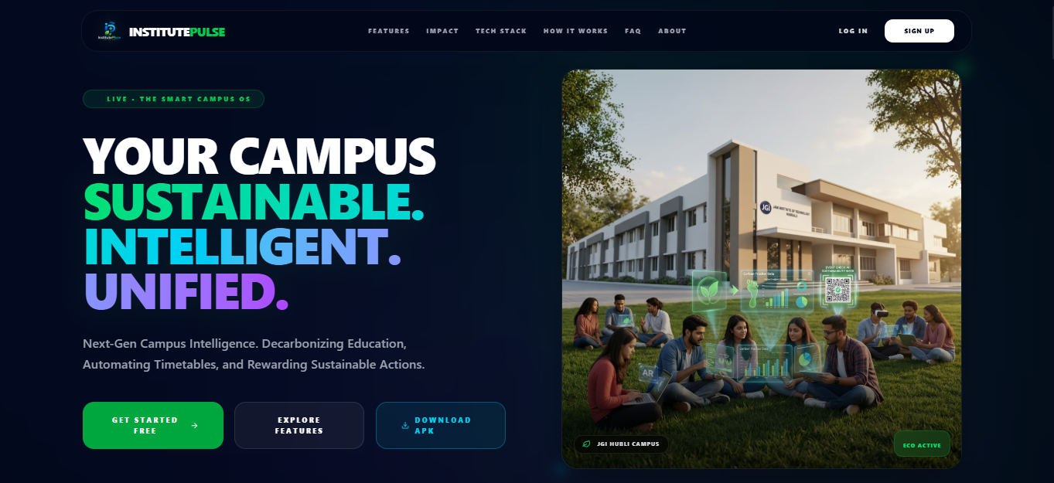
Landing Page
The first impression — a premium, responsive web experience
Dark futuristic design with gradient accents
App download (Android APK) with one click
Feature showcase with animated sections
Role-based login: Student, Faculty, Admin, Owner
Real-time campus statistics counter
Interactive navigation with smooth scrolling
UN SDG alignment badges displayed
Fully responsive — mobile & desktop
3/13

Slide 4
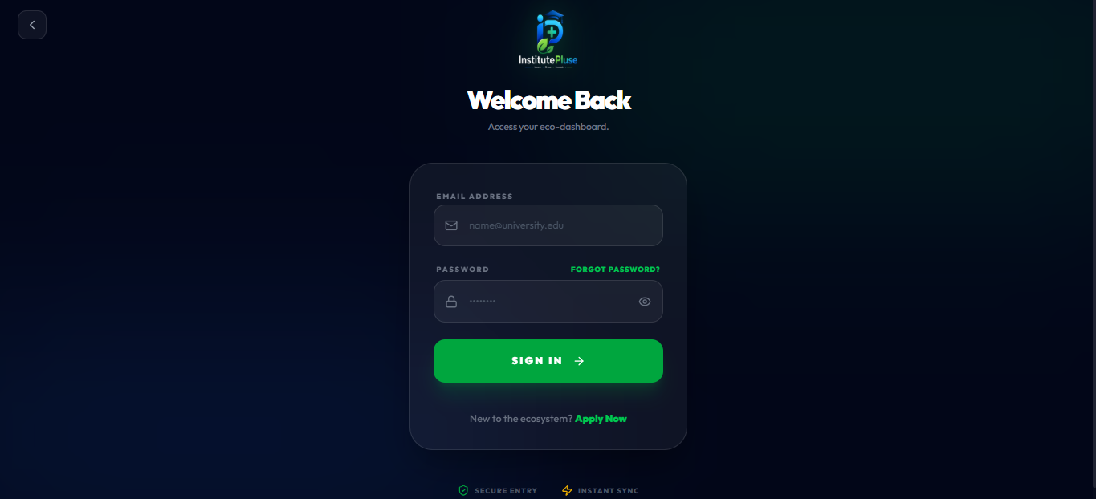
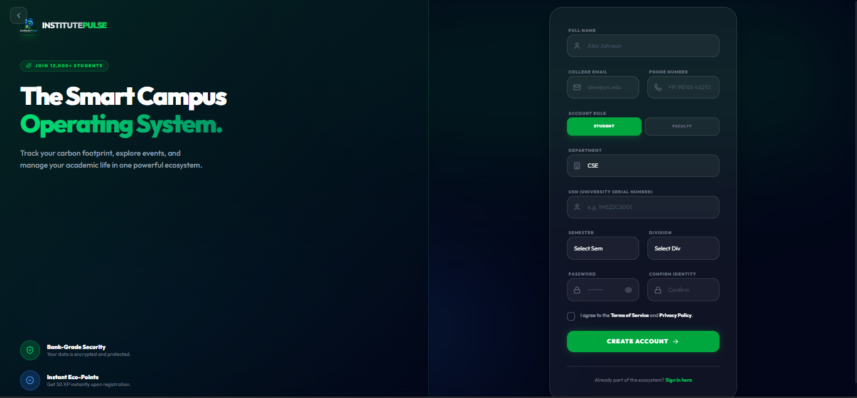
Authentication System
Secure role-based sign-in & sign-up with brute-force protection
Role-based routing: Student / Faculty / Admin / Owner
Supabase Auth with PostgreSQL RLS security
Brute-force lockout — 3 attempts → 60s block
Hidden admin URL path for extra security
Batch & department selection on sign-up
Profile avatar upload with real-time preview
Email validation & password strength check
Auto-redirect based on authenticated role
4/13

Slide 5
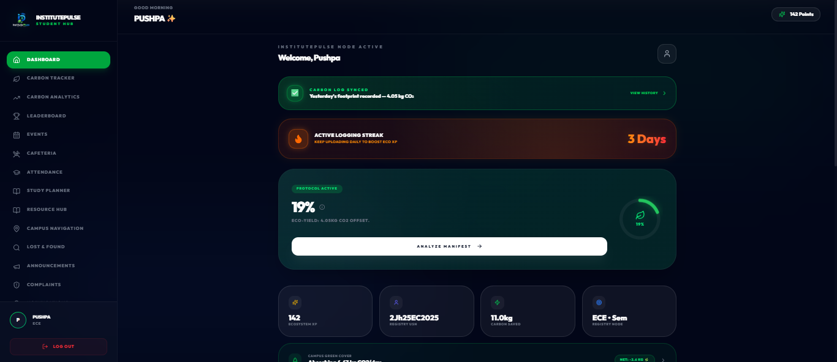
Student Dashboard
A personalized command center for every student
Real-time XP level & progress bar
Eco Score gauge with daily insights
Attendance percentage tracker
Quick-action cards: Log Carbon, Scan QR, Events
Streak counter & badge showcase
Upcoming classes & assignment reminders
Campus broadcast alert banners
Leaderboard ranking preview
5/13

Slide 6
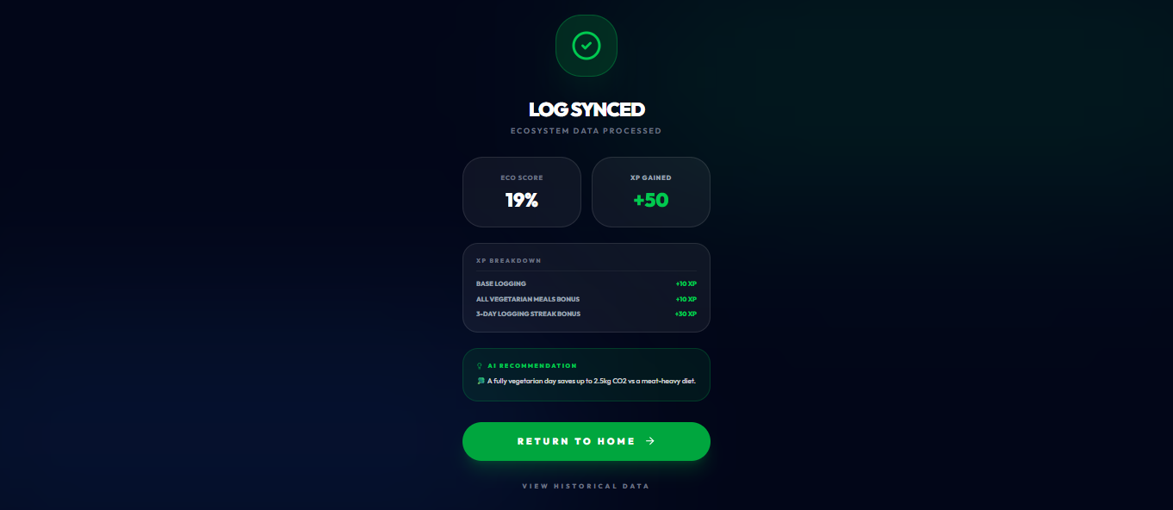
Carbon Footprint Tracker
IPCC-standard daily carbon logging with gamified rewards
Log travel: Car, Bike, Bus, Walk (per-km CO₂ factors)
Electricity: Indian Grid factor 0.82 kg CO₂/kWh
Meals: Veg / Vegan / Non-Veg carbon values
Water usage & waste generation tracking
Eco Score = max(0, 100 − (Emissions/5.0) × 100)
XP rewards: +10 base, +60 perfect, +15 walk/vegan
Streaks: 3-day (+30), 7-day (+75), 30-day (+200 XP)
Anti-cheat: yesterday-only, hard limits, cross-check
6/13

Slide 7
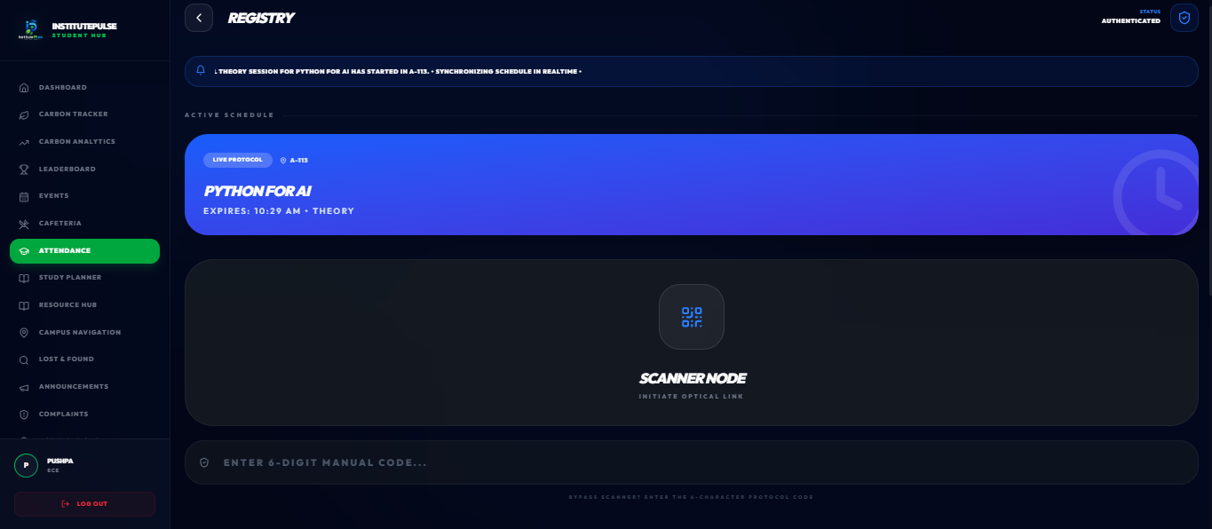
Timed QR Attendance
Anti-proxy attendance with GPS verification & real-time tracking
Batch-specific QR codes tied to class timetable
QR codes cycle every 10 seconds
GPS geolocation verification — campus fence
One scan per device — prevents proxy sharing
Faculty: real-time present/absent list
Extend timers, assign substitutes, cancel classes
Attendance analytics with date-range filtering
Export to Excel/PDF with verification QR codes
7/13

Slide 8
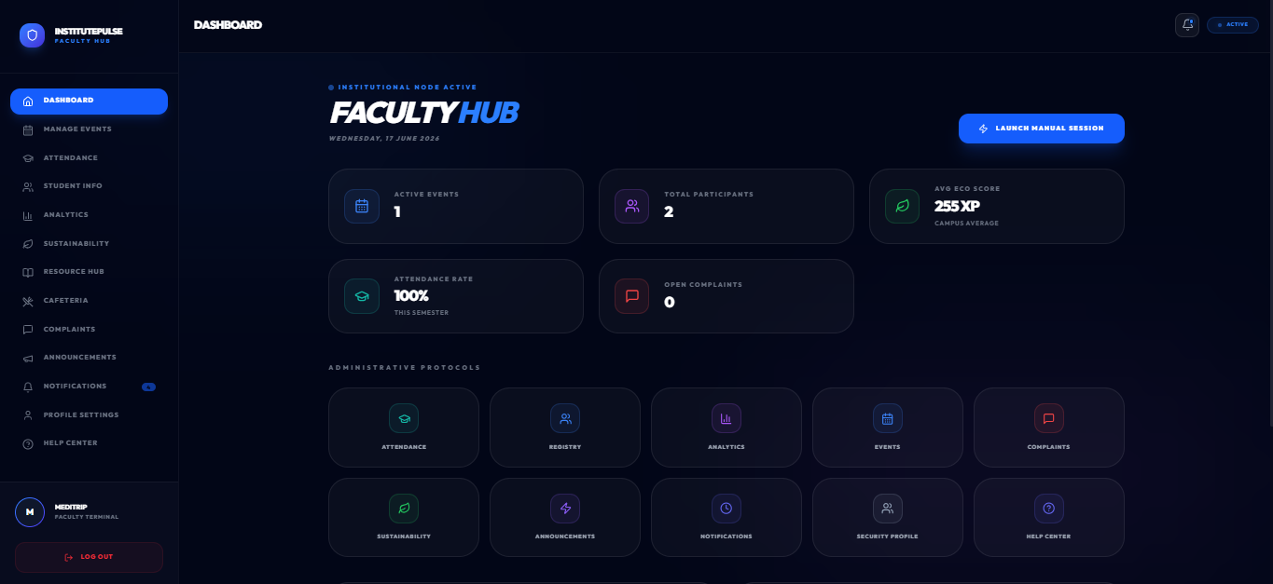
Faculty Dashboard
Complete class management & academic resource hub
Manage classes: cancel, reschedule, swap rooms
Assign substitute faculty with one click
Academic Resource Hub: upload PDFs, links, videos
Subject-wise resource organization
Award XP trophies directly to students
Push notifications to student devices
Attendance history & analytics per batch
Quick actions for day-to-day operations
8/13

Slide 9
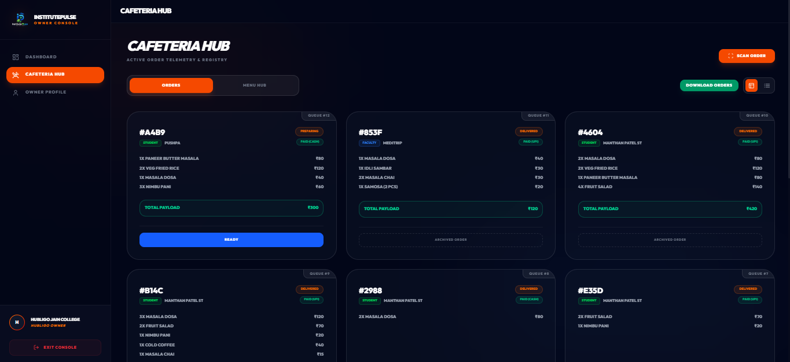
Eco-Cafeteria Hub
Digital canteen ordering with carbon labels per menu item
Full digital menu with pricing & carbon weight
Carbon labels: Idli (0.3 kg), Egg Rice (1.0 kg CO₂)
Cart shows cumulative price + CO₂ impact
QR receipt generation for pickup
Real-time order status: Pending → Ready → Done
Canteen owner scanner for instant fulfillment
Anti-cheat cross-reference with carbon logs
Category-wise filtering & search
9/13

Slide 10
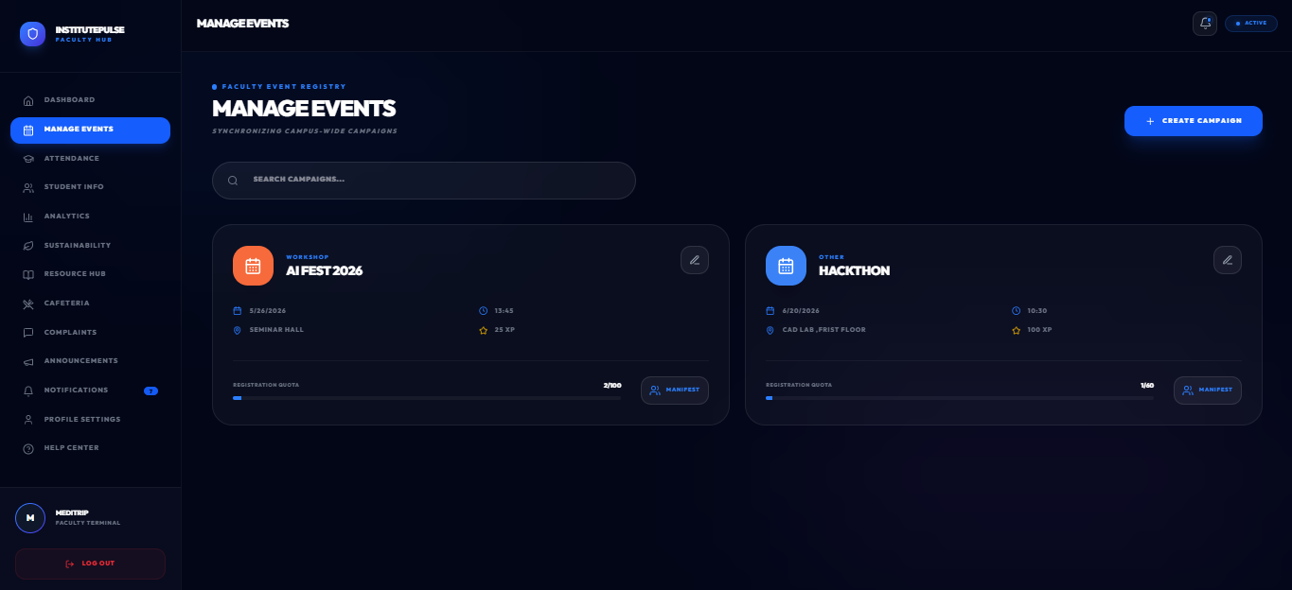
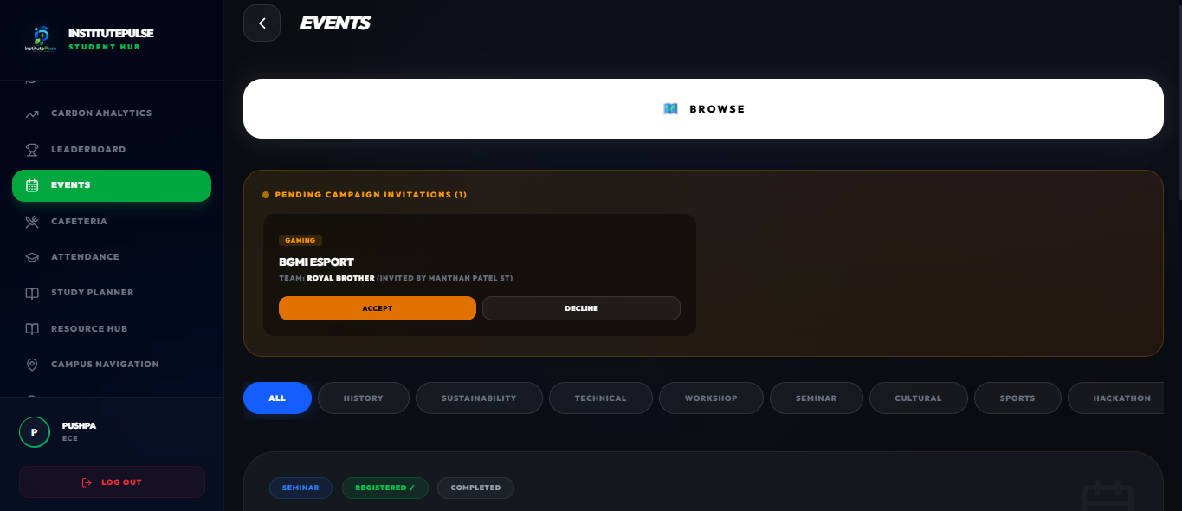
Events & Team Registration
Solo / Duo / Trio / Squad event registration with invite system
Multiple team formats: Solo, Duo, Trio, Squad
Classmate search & invite system
Leader-only chat rooms for coordination
Full-width responsive roster tables
Excel & PDF export with verification QR codes
Event countdown timers & reminders
Registration status tracking dashboard
Admin event creation & management panel
10/13

Slide 11
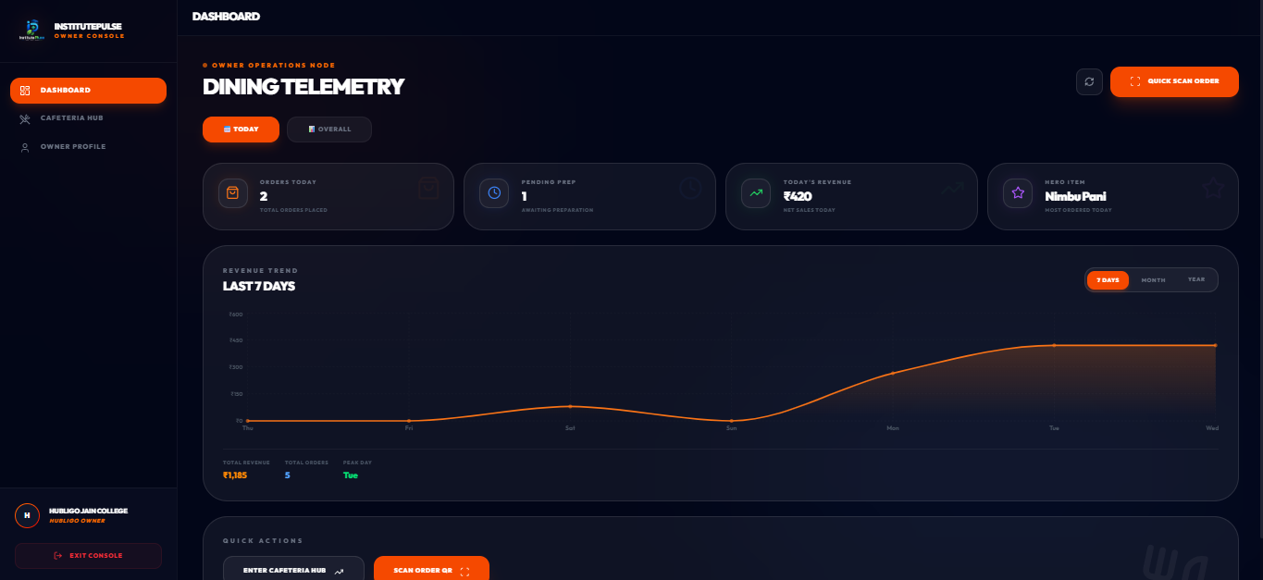
Canteen Owner Dashboard
Real-time order management & menu control panel
Live order queue with status management
QR code scanner for order verification
Menu item CRUD: add, edit, price, carbon label
Daily sales analytics & revenue tracking
Order history with date-range filter
Inventory & availability toggle per item
Push notifications for new orders
Carbon impact summary across all orders
11/13

Slide 12
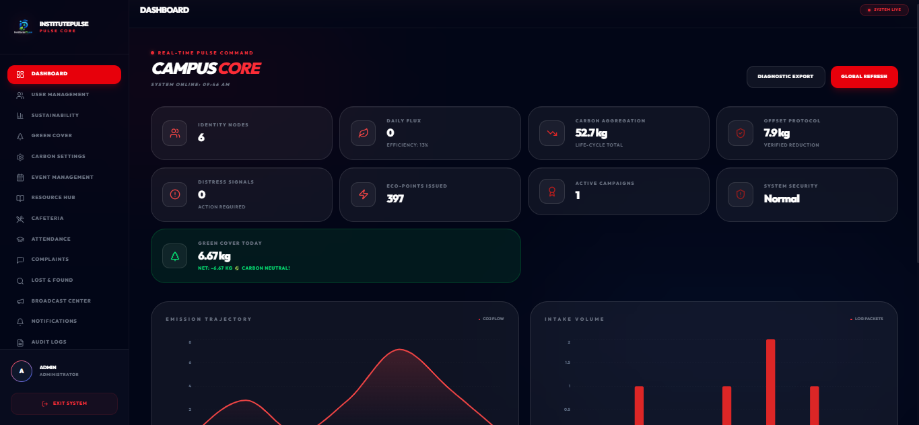
Admin Dashboard
Campus-wide control center with real-time metrics & CMS
Real-time campus sustainability metrics
Landing page CMS editor — live updates
Student & faculty user management
Anti-cheat quarantine panel — ban cheaters
Green Cover inventory: trees, grass, absorption
Sustainability audit logs with export
Broadcast system: urgent/warning/info alerts
Lost & Found + complaint moderation
12/13

Slide 13
Thank You!
InstitutePLUSE — Building Smarter, Greener & More Connected Campuses.
React + Vite • Tailwind CSS v4 • Supabase • Capacitor • Framer Motion
🎯 UN SDG: Goal 4 (Education) • Goal 11 (Sustainable Cities) • Goal 12 (Responsible Consumption) • Goal 13 (Climate Action)
Subject: 1BPRJ258 — Interdisciplinary Project-Based Learning
Guide: Prof. Somashekar T M | Dept. of ME
Jain College of Engineering, Belagavi
Week 15–16 | 2025–26
13/13

