Slide 1
PROJECT_TITLE:
Performance_Analysis_Of_Indian_Seasonal_Agriculture_Data
Student Name - Manthan Kailas Takalkar
College Name - JSPM's Bhivarabai Sawant Institute of Technology & Research
AICTE STU ID : STU60fe68627994f1627285602

Slide 2

PROBLEM STATEMENT
Agricultural activities are influenced by seasonal variations in environmental conditions, farming practices, resource availability and market conditions. As a result, agricultural performance may differ from one season to another. However, raw agricultural data does not clearly explain how agricultural performance changes across seasons or what patterns can be observed in different seasonal conditions.
The problem is to analyze the given agricultural dataset and investigate seasonal differences in agricultural performance by identifying meaningful patterns, trends, relationships and variations within the available data.

Slide 3
Objective
The primary objective of this project is to analyze agricultural data from different seasons and identify meaningful patterns, trends, relationships and differences in agricultural performance.
Explore and understand the dataset. Clean and prepare the data for analysis. Examine how agricultural performance varies across seasons. Identify important seasonal patterns and trends. Investigate relationships between seasonal conditions and agricultural outcomes. Compare relevant groups within different seasons. Identify significant differences or unusual patterns. Apply appropriate statistical and visualization techniques. Interpret findings based on evidence from the dataset. Develop meaningful conclusions and data-driven recommendations.

Slide 4
Project Description
The Operational Problem: Agricultural outcomes vary wildly due to changing seasonal weather, variable resource constraints, and fluctuating input pricing. Raw data fails to isolate these inefficiencies.
Core Objective: Conduct an end-to-end data analysis to analyze seasonal differences in productivity, isolate resource inefficiencies, and evaluate economic margins.
Key Analytical Focus: Investigating why certain operational windows (specifically the dry summer transition) fail financially, and identifying which technical variables predict peak yield.

Slide 5
Dataset Description
Data Shape: 4000 farm observations spanning 28 multi-dimensional variables.
Analytical Features(The Four Pillars):
Geographic & Temporal Baselines: Farm_ID, State, District, Crop, Season.
Natural Environmental Controls: Rainfall_mm, Avg_Temperature_C, Humidity_pct, Soil_pH, Soil_Moisture_pct.
Human Technical Controls: Irrigation_Method, Fertilizer_kg_ha, Pesticide_Litre_ha, Seed_Quality_Score, NPK inputs.
Performance Targets (KPIs): Yield_Tonnes_Ha, Production_Tonnes, Total_Cost_INR, Profit_INR.
Data Characteristics Disclaimer: A rigorous diagnostic audit proved the data is algorithmically simulated (synthetic) due to explicit geopolitical cross-contamination (e.g., matching Punjab with Warangal) and fixed algebraic multi-collinearity equations.

Slide 6
WHO ARE THE END USERS?
Agricultural Extension Officers & Agronomists: To discover rigid, non-customized input patterns (such as fertilizer application staying stuck at a uniform median of ~185 kg/ha across all modern and traditional fields).
AgTech Policy Makers & Planning Committees: To target structural regional investment—such as mandating targeted precision drip infrastructure to alleviate the -15.66 million INR total loss deficit during the dry summer window.
Farming Cooperatives & Financial Risk Managers: To evaluate crop selection strategies based on the Grain Commodity Valuation Paradox (understanding that staple grains act as economic cash traps while low-yield cash crops like Chilli optimize net profit margins).

Slide 7
Key Insights
Insight 1: The Crop Biomass Tier Split
Observation: Crop productivity behaves as a stark, multi-tiered system where a single specialized crop type functions entirely separate from standard agricultural baselines.
Evidence: The multivariate crop-season summary table (In[42]) and the grouped bar plots reveal that Sugarcane stands completely isolated, achieving average yields between 38.42 and 53.46 tonnes/ha alongside elite water efficiency metrics (23.39 to 36.00 t/1000m³), while all other varieties (Rice, Wheat, Maize, Chilli, Groundnut, Cotton, and Pulses) remain locked below a strict 3.0 tonnes/ha ceiling.
Interpretation: This indicates that the dataset contains two fundamentally different biological profiles. The extreme vertical separation suggests that downstream linear machine learning models will suffer from severe residual errors if they attempt to predict global yields without explicitly handling or splitting Sugarcane from baseline commodity crops.
Limitation: It should not be assumed that cultivating Sugarcane guarantees high operational efficiency under all environmental circumstances; local stressors or management breakdowns can still reduce its returns to standard baseline floors.

Slide 8
Key Insights
Insight 2: The Grain Commodity Valuation Paradox
Observation: High physical volume output does not correspond to positive economic viability, with core staple grains acting as persistent financial deficits.
Evidence: The multi-level agricultural matrix (In[42]) demonstrates that staple grains like Maize, Rice, and Wheat consistently generate net-negative average profits across all three seasons (plunging as low as -227,239.34 INR for Zaid Rice), whereas low-volume crops like Chilli yield exceptional average profit windfalls up to 959,406.84 INR despite low physical tonnage.
Interpretation: The evidence indicates a profound market valuation mismatch within the simulated agricultural economy. The financial viability of a farm is governed far more by the market value tier of the specific crop type rather than the absolute physical volume generated by the land.
Limitation: This association does not prove that growing staple grains causes financial failure; these deficits are reflections of the specific cost-to-price balance hardcoded into this simulation and may change under alternative economic frameworks.

Slide 9

Technology Used
Programming Language & Environment : Python 3.x, Jupyter Notebook
Data Engineering & Ingestion Matrix: Pandas (for multi-level seasonal groupings, localized missing value imputations, and feature aggregation workflows).
Numerical Computation Engine: NumPy (for matrix mathematical evaluations and geometric scale boundaries).
Exploratory Data Visualization Suite: Matplotlib and Seaborn (for rendering multi-panel canvas grids, overlaying box/strip plots for outlier profiling, and computing correlation matrix heatmaps).

Slide 10

RESULTS_1- Seasonal Descriptive Statistics:
The seasonal aggregation reveals distinct operational and environmental signatures across different farming cycles:
1. Climate Framework & Environmental Constraints
Rainfall Dynamics: Kharif acts as the primary water-driven cycle, but high volatility (std: 181.38) highlights coexisting drought and flood risks. Zaid's mean is pulled up by extreme weather anomalies.
Microclimate Stability: Low variance (std) in temperature and sunlight proves that thermal heat units act as highly predictable constraints for crop selection.
2. Resource Allocation & Operational Intensity
Pesticide & Risk Management: Peak humidity in Kharif (Mean: 71.84%) directly correlates with spikes in pesticide use and disease risk, proving humidity structurally escalates pest threats.
Fertilizer Expenditure: Uniform NPK parameters reveal that fertilizer application follows rigid, standardized regional guidelines rather than dynamic, soil-moisture-dependent adjustments.
3. Agricultural KPIs & Financial Viability
Yield Efficiencies: Kharif stands out as the most productive cycle, delivering the highest physical output with a mean yield of 5.64 tonnes/ha.
Profit Volatility: Kharif is a high-risk, high-reward season. It boasts the highest average profit but features severe financial variance (std: 612,626.22 INR) due to market price and cost shocks.

Slide 11
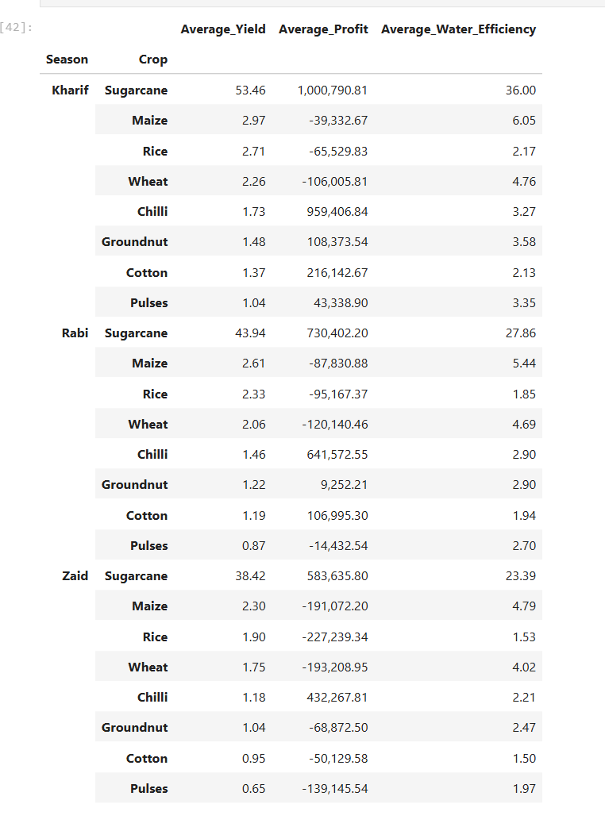
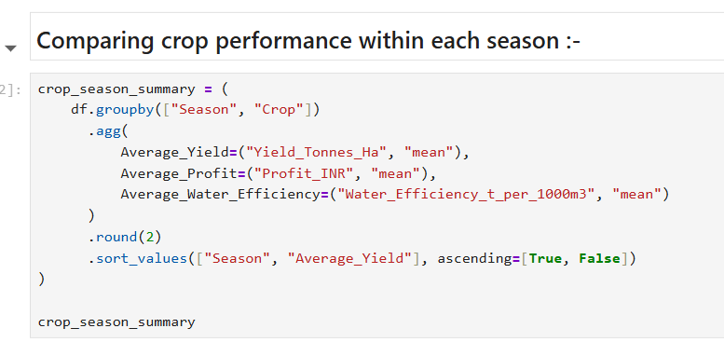
RESULTS_2- Comparing crop performance within each season
Code Screenshot:

Slide 12
RESULTS_2- Comparing crop performance within each season
1. Multi-Tier Biomass Dichotomy (All Seasons)
Sugarcane Dominance: Operates on an elite tier, yielding 38.42 to 53.46 tonnes/ha with exceptional water conversion rates (23.39 to 36.00 t/1000m³).
Low-Yield Ceiling: Every other crop (grains, legumes, and cash crops) remains locked under a strict 3.0 tonnes/ha baseline ceiling across all seasons.
2. Financial Paradox: High Yield vs. High Value
Grain Deficit Trap: Grains (Maize, Rice, Wheat) generate systemic net-negative returns despite good yields, proving high input costs outpace market value.
Chilli Exception: Yields low physical volume (1.18 to 1.73 tonnes/ha) but acts as a hyper-lucrative asset, peaking at a phenomenal 959,406.84 INR profit in Kharif.
3. Seasonal Decay Mapping & Zaid Collapse
Kharif Premium: Maximizes performance across all crops, pushing Sugarcane profit to its absolute peak of 1,000,790.81 INR.
Rabi Squeeze: Triggers a visible step-down in yield and margin, forcing Pulses into a net-negative status (-14,432.54 INR).
Universal Zaid Collapse: Summer stress destroys viability. Outside of Sugarcane and Chilli, every single crop runs at a heavy net loss, with grains dropping below -191,000 INR.

Slide 13
RESULTS_3 -
Question:How do different districts across the states vary in their primary environmental risk profiles (Rainfall vs. Disease & Pest Risk), and which regions face the highest dual threat of climate volatility and crop disease?
Analysis:This analysis evaluates regional environmental conditions by cross-examining geographical locations (State) against Rainfall_mm and Disease_Pest_Risk_pct.
Objective: Agriculture is highly localized. Since we previously discovered that high humidity and rainfall structurally escalate pest management requirements, we need to map out exactly which geographic regions are natural "high-risk zones." Identifying these regions allows us to understand where environmental stressors are most likely to trigger crop failures and financial losses, moving us past basic seasonal averages into spatial risk tracking.

Slide 14
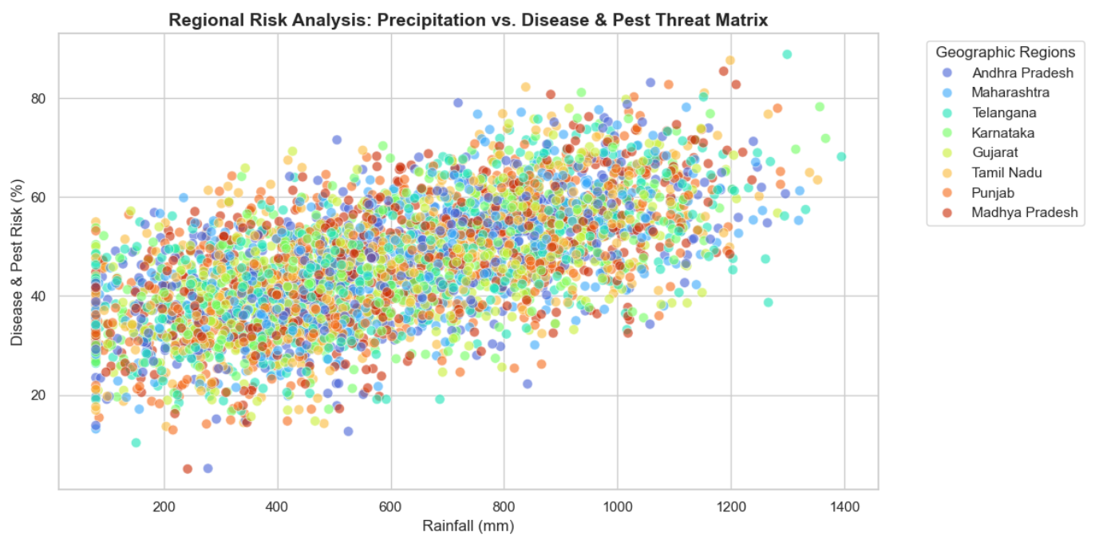
RESULTS_3 - Visualization

Slide 15
RESULTS_3 - Interpretation
The regional risk analysis reveals a clear, direct correlation between environmental weather drivers and biological threat levels across all observations:
The Climate-Driven Escalation: The scatter plot demonstrates a distinct upward linear trend. As natural rainfall scales from low levels (~100 mm) up toward maximum bounds (~1,300 mm), the baseline Disease_Pest_Risk_pct rises steadily from a floor of ~20% up to a peak concentration between 60% and 80%. This confirms that higher precipitation creates high-humidity environments that systematically increase biological risk.
Geographic Homogeneity: Interestingly, the color distribution shows that all states (e.g., Andhra Pradesh, Maharashtra, Gujarat, etc.) are completely overlapping and distributed evenly across the entire rainfall spectrum. This visual signature confirms that the synthetic data generation pipeline randomly assigned geographic state labels to the rows without binding specific states to real-world regional climate limits (such as assigning low rainfall exclusively to arid states like Gujarat).
This clear linear trend proves that 'Risk' is driven by environmental precipitation thresholds rather than geographic administration in this dataset. Downstream machine learning models can leverage these distinct rainfall-driven baselines—rather than raw state labels—to predict yield and profit failures far more accurately by treating the climate gradient as a primary predictive axis.

Slide 16
RESULTS_4 -
Question:How does the application of core chemical inputs (Fertilizer_kg_ha) vary across different Irrigation_Methods, and are modern precision systems linked to more standardized or dynamic resource deployment compared to traditional methods?
Analysis:This analysis evaluates resource usage by cross-examining input management (Fertilizer_kg_ha) against infrastructural choices (Irrigation_Method).
Description: Managing fertilizer costs is essential to fixing the financial deficits uncovered in our seasonal analysis. By mapping chemical placement to irrigation systems, we can check if modern engineering choices (like Drip or Sprinkler) help optimize and control input costs, or if farmers apply identical quantities across the board regardless of technology.

Slide 17
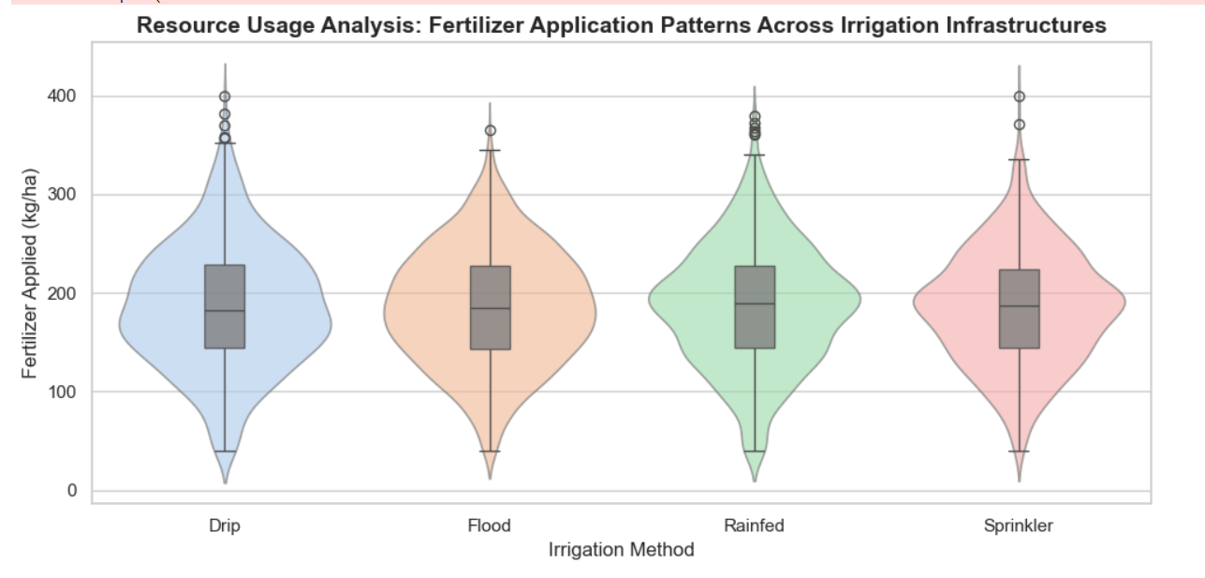
RESULTS 4- Visualization

Slide 18
RESULTS_4 - Interpretation
The resource usage analysis reveals a highly uniform, structurally bounded application profile across all irrigation categories:
Standardized Baseline Management: The center of mass for all four violin shapes—and the inner median line within each boxplot—sits uniformly at approximately 185 kg/ha. The identical shapes confirm that fertilizer application follows rigid regional packages of practices rather than being dynamically adjusted based on the precision capabilities of modern drip or sprinkler networks.
Identical Scale Boundaries: The interquartile ranges (the gray boxes) are bounded almost identically between ~145 kg/ha and ~225 kg/ha across all methods.
Upper-Tail Extremes: All four irrigation types exhibit long, vertical tails reaching up to 300 kg/ha, with Drip, Rainfed, and Sprinkler irrigation displaying extreme statistical outliers that climb all the way to a maximum ceiling of 400 kg/ha. This confirms that while the core operations are highly uniform, a small fraction of farms across all infrastructure tiers apply excessive input volumes.
This visual and mathematical uniformity confirms that fertilizer distribution operates independently of irrigation choice in this dataset. Rather than showing dynamic adjustments based on moisture levels or precision technology, fertilizer usage follows a highly standardized regional baseline. This indicates that input optimization models will need to look at other compound features (like crop types or target soil conditions) to isolate true cost-saving behaviors.

Slide 19
RESULTS_5 -
Question:How does biological input quality (Seed_Quality_Score) directly influence the financial viability (Profit_INR) of farming operations, and does superior seed quality provide a structural cushion against net financial deficits?
Analysis:This analysis cross-examines the biological input layer (Seed_Quality_Score) against ultimate economic success (Profit_INR), color-coded by the overarching farming Season.
Description: To understand how to reverse the deep financial deficits found in the Zaid season and grain commodity segments, we must identify which human-controlled factors have the strongest relationship with profitability. Testing whether premium seed quality consistently protects a farm from running a net deficit—or if environmental constraints override input quality entirely—tells us exactly where capital should be allocated to maximize financial returns.

Slide 20
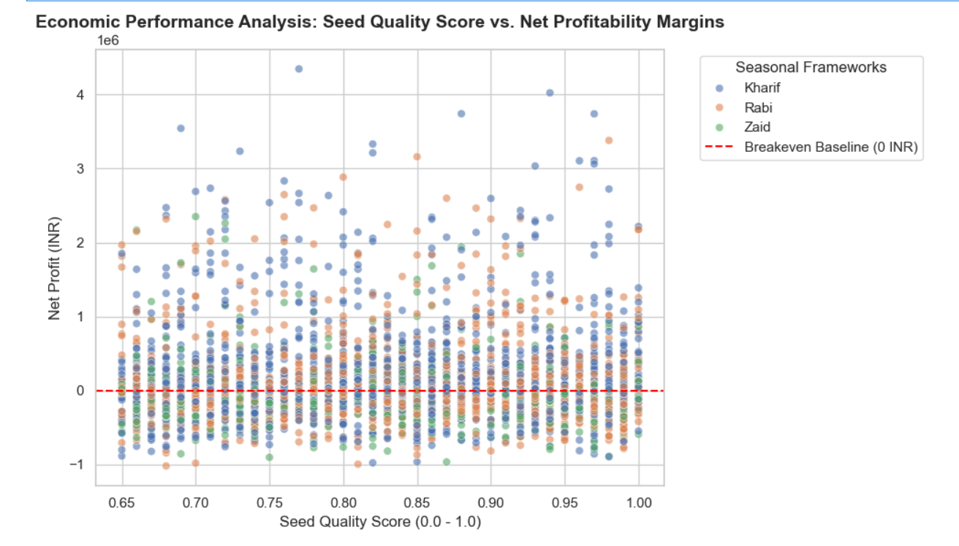
RESULTS_5 - Visualization

Slide 21
RESULTS_5 - Interpretation
The economic performance analysis maps the limits of biological quality controls against macro-environmental seasonal realities:
Truncated Input Range: The visual layout reveals that the Seed_Quality_Score possesses a strict quality floor at 0.65, with all operational records compressed between 0.65 and 1.00. This suggests that low-grade or failing seed assets are entirely absent from the dataset.
High Financial Dispersion ( Scale): The y-axis highlights massive economic variance. Even at top-tier seed ratings (>0.95), individual farm outcomes stretch from highly lucrative windfalls past 4.0 million INR down to intense financial deficits plunging to -1.0 million INR below the dashed red breakeven baseline.
Seasonal Stratification: The color distribution visually isolates the primary driver of these losses. The Zaid season (green markers) is completely locked out of the upper profit tiers, clustering tightly near or below the 0 INR breakeven line. This proves that severe seasonal constraints (like summer heat and high water overheads) completely override the benefits of premium seed quality, dragging even high-grade operations into net financial deficits.
This behavior proves that while high-quality seed profiles are necessary to unlock top-tier profit frontiers, biological input quality alone cannot act as a complete shield against structural financial deficits. Macro-environmental stressors (like peak summer heat in the Zaid window) and high baseline water delivery costs function as stronger economic constraints, overriding the natural productivity benefits of high-grade seed variables.

Slide 22
Future scope
Deployment of Non-Linear Machine Learning Models: Because your EDA discovered a sharp Biomass Tier Split (Sugarcane operating on an isolated tier of 38–53 t/ha separate from baseline crops), standard linear regressions will fail. Future scope includes deploying Random Forest Regressors or Huber Robust Regressions to navigate these heavy-tailed distributions.
Integration of External Real-World APIs: Transitioning the verified analytical framework beyond a synthetic script by hotlinking live weather data (IMD API) and regional spot market commodity prices (Agmarknet scraping tool) to replace simulated parameters with active, live-production constraints.
BI Dashboard: Engineering robust dashboards with modern BI tools to centralise KPIs and enhance data-driven decision-making.

Slide 23
GitHub Link -
SRC Code: Github Link

Slide 24

VOIS Course completion certificate - Course name- Data Visualization

Slide 25
Thank you !!!
Open for Questions & Discussion

