Slide 1

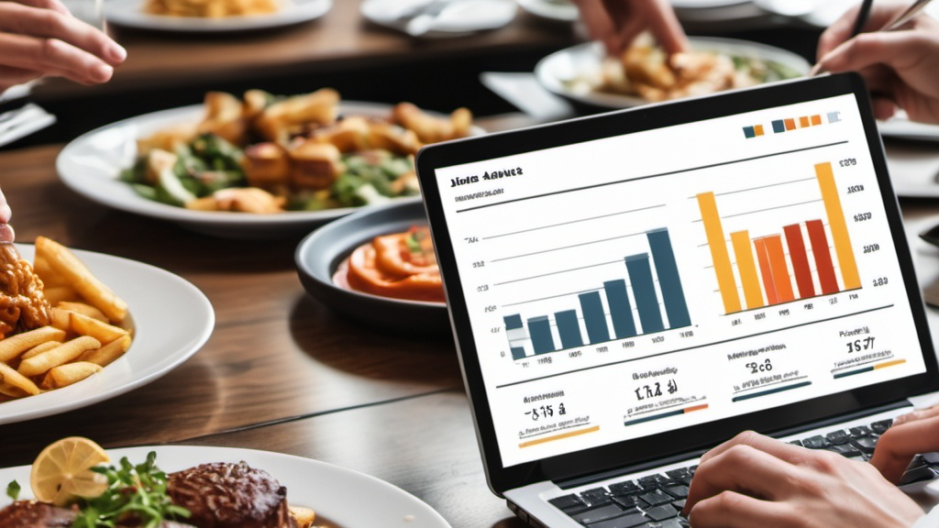
Restaurant Order Analysis
Insights Derived from Maven Analytics Dataset

Slide 2

Project Description
Overview
Analysis of a quarter's restaurant order data focusing on trends in customer preferences, item popularity, spending patterns, and order timing.
Dataset includes order details (date, time, items) and menu information (item names, categories, prices).
Objectives
Leverage data-driven insights to:
Improve menu offerings.
Optimize operations.
Cater to customer preferences.
Key Analyses
Item Popularity: Least and most ordered items by category.
High-Spend Orders: Insights into highest spend orders and total amounts.
Order Timing: Peak and low traffic periods.
Cuisine Development: Recommendations for new menu items.
Impact
Enhanced menu focusing on popular cuisines.
Removal or marketing of low-popularity items.
Efficient operations during peak hours.
Improved customer satisfaction and revenue growth.
For Dataset Click here

Slide 3

Approach
Data Transformation: Utilized SQL to convert raw data into a structured database for seamless analysis.
Data Cleaning: Considered 137 rows (1% of the total dataset) with NULL values in item_id, as order canceled. Added item_id = 0 as canceled order item in menu item table and replaced null with 0 in orders table
Understanding the Data: Began by thoroughly analyzing the available tables to comprehend their structure, relationships, and relevance to the analysis objectives.

Slide 4
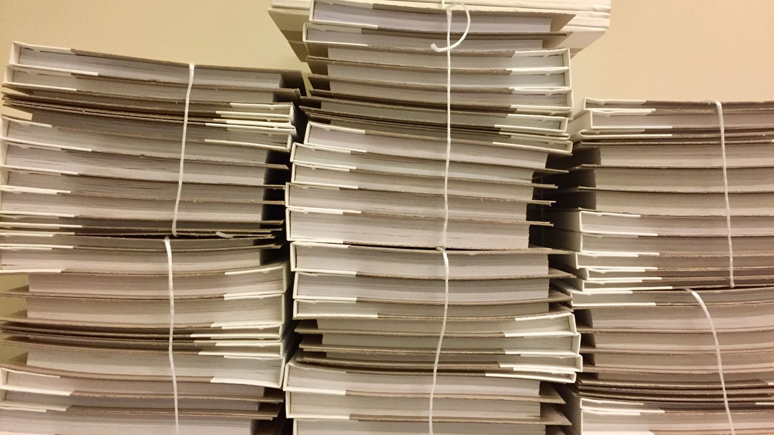

Tech Stack Used – MySQL Workbench 8.0 CE

Slide 5

Insights (From Next Page)

Slide 6


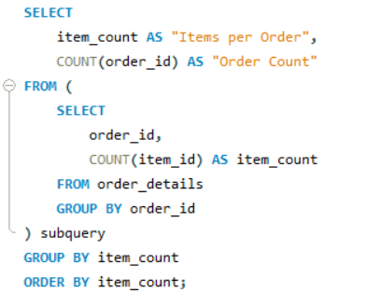
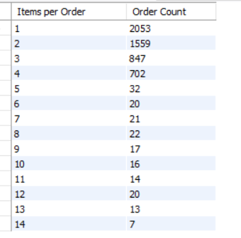
1.Total Orders
Overview of the Order Details Table
SQL Query :
Result:
There are total 12234 orders
2.Total Unique Orders
There are total 5370 unique orders
3. Items Ordered by one order

Slide 7

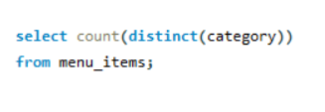
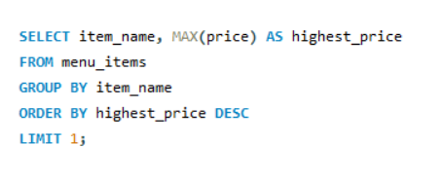
Overview of the Menu Items Table
SQL Query :
Result:
There are total 32 Menu items
1.Total Menu Items
There are total 4 Categories
2.Total Category
Shrimp Scampi is Costliest Product costs 19.95 $
3.Costliest Product
Note: just change Max to Min to find out Product with lowest price

Slide 8

Recommended Questions by Maven Analytics (Next Page)

Slide 9
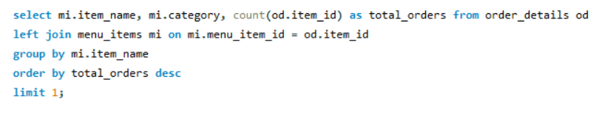


1. What were the least and most ordered items? What categories were they in?
SQL Query :
Result:
Note: for least sold item replace desc with asc
Least Sold item
Most sold item

Slide 10
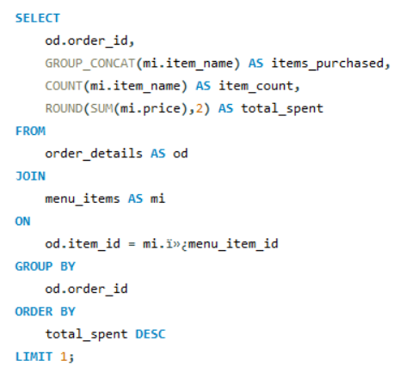
2. What do the highest spend orders look like? Which items did they buy and how much did they spend?
SQL Query :
Result:
Order ID : 440 Total orders : 14 Items Purchased: Steak Tacos,Hot Dog,Spaghetti,Spaghetti & Meatballs,Spaghetti & Meatballs,Fettuccine Alfredo,Fettuccine Alfredo,Korean Beef Bowl,Meat Lasagna,Edamame,Chips & Salsa,Chicken Parmesan,French Fries,Eggplant Parmesan Total Cost : 192.15 $

Slide 11
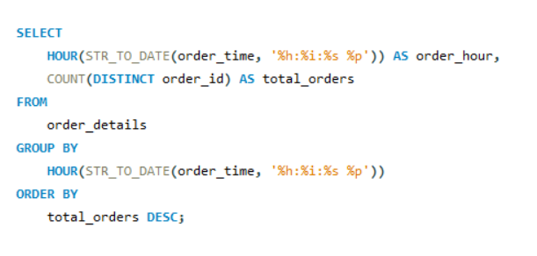
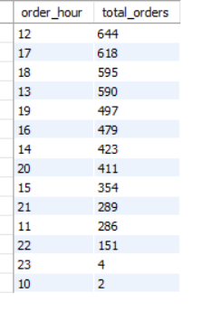
3. Were there certain times that had more or less orders?
Result:
SQL Query :

Slide 12
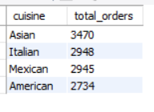
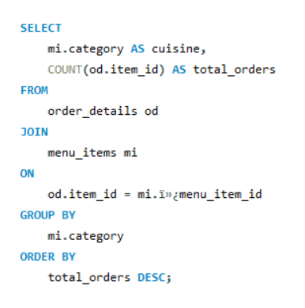
4. Which cuisines should we focus on developing more menu items for based on the data?
SQL Query :
Result:
Recommendations :
Prioritize expanding the Asian menu, followed by Italian and Mexican, while keeping an eye on customer feedback and trends.

Slide 13
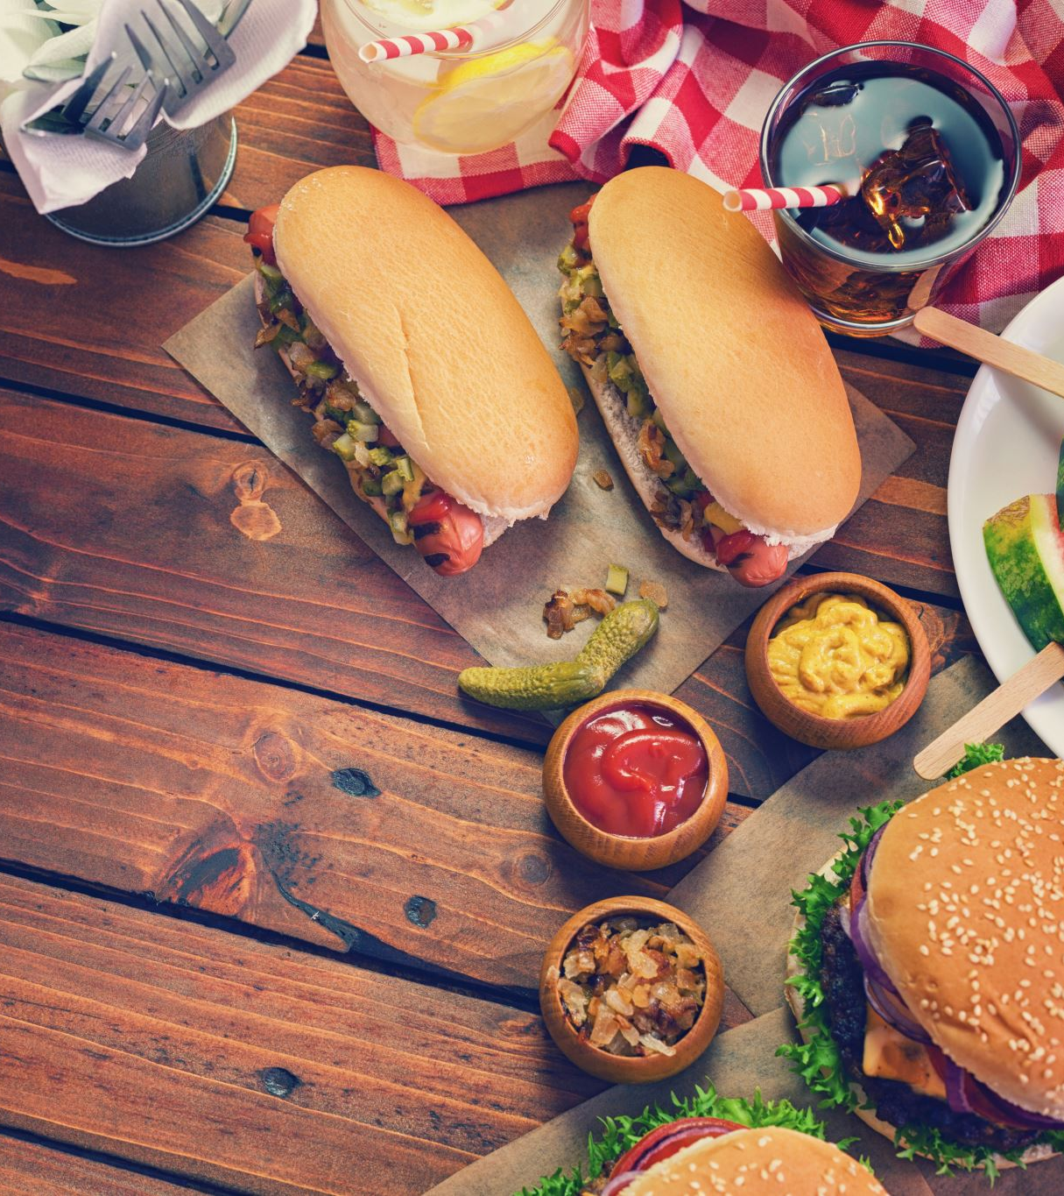
Results found
The data covers the date range from January 1, 2023, to March 31, 2023.
Hamburger is the most popular dish, while Chicken Tacos is the least preferred.
The maximum number of items ordered in a single order is 14.
The highest order volume is observed during Lunch and Evening Breakfast hours, indicating peak customer activity during that period.
Total 137 Orders get canceled.

Slide 14
Thank You
Connect with me on:
LinkedIn
Instagram
YouTube
Github

