Slide 1
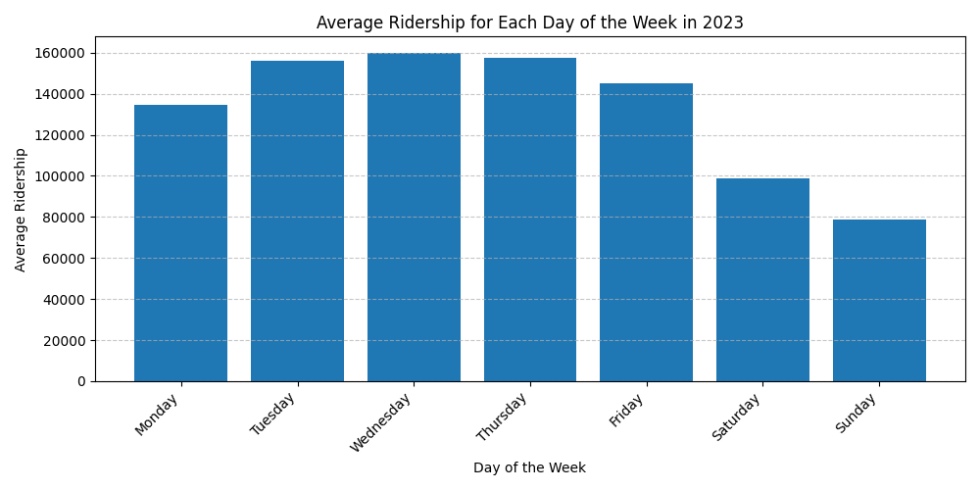
Average Ridership for Each Day of the Week (2023)

