Slide 1
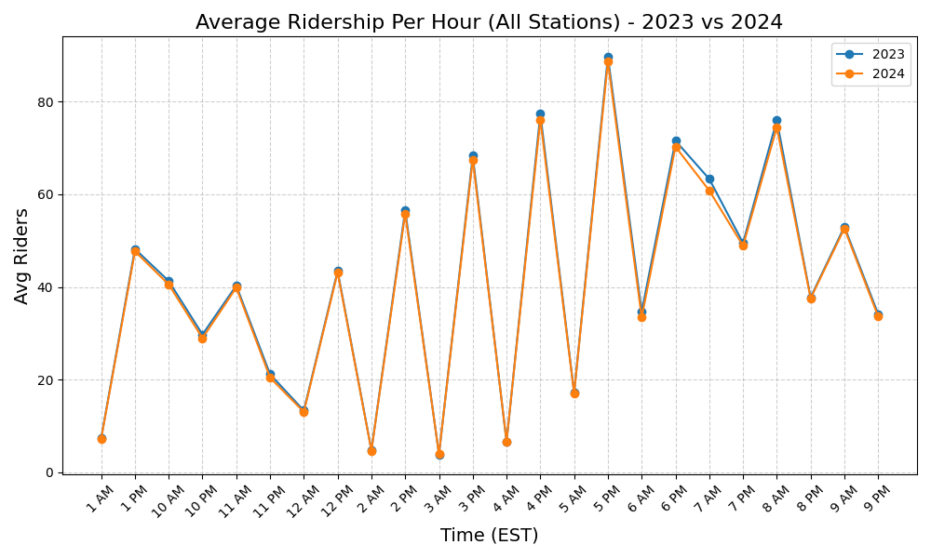
Average Ridership Per Hour (2023 vs 2024)

