Slide 1
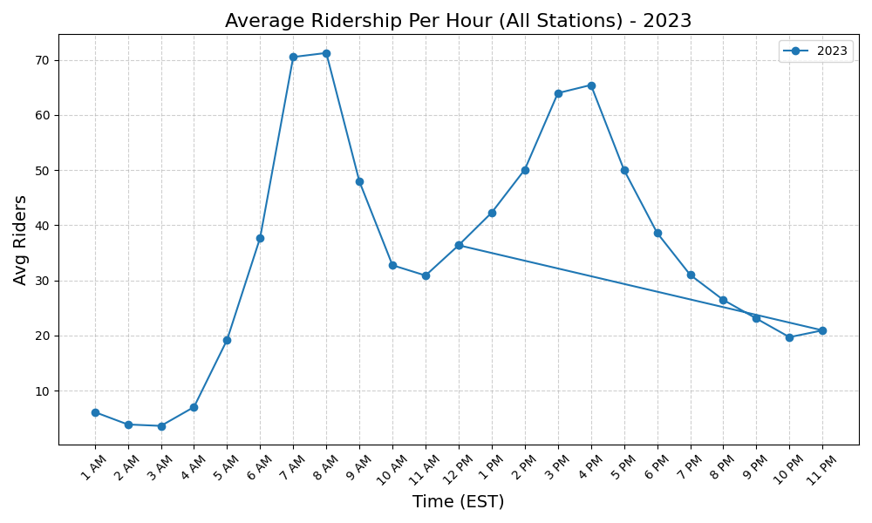
Average Ridership Per Hour - 2023

Slide 2
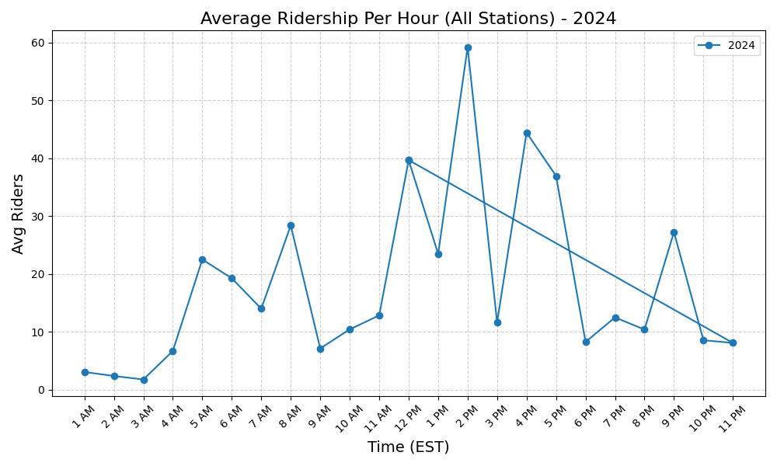
Average Ridership Per Hour - 2024

