Slide 1
अ
SANGAM
Simhastha Kumbh 2027
Kumbh Mela Ops · Cross-site reunification
The camps already exist. They just can't search each other.
Two sacred sites, 30 km apart. A pilgrim lost at Trimbakeshwar and found at Nashik can sit uncatalogued for days — because no single help desk sees both ends.
30 km
200–300
hours–week
between Ramkund & Kushavarta
separations a day, at peak
to reunite a family today
Notes:
SANGAM means confluence. Two sacred sites, 30 km apart. Today a person lost at one and found at the other can sit uncatalogued for days, because the camps don't cross-search. Mostly elderly, rural, phoneless. That gap is what we close.

Slide 2
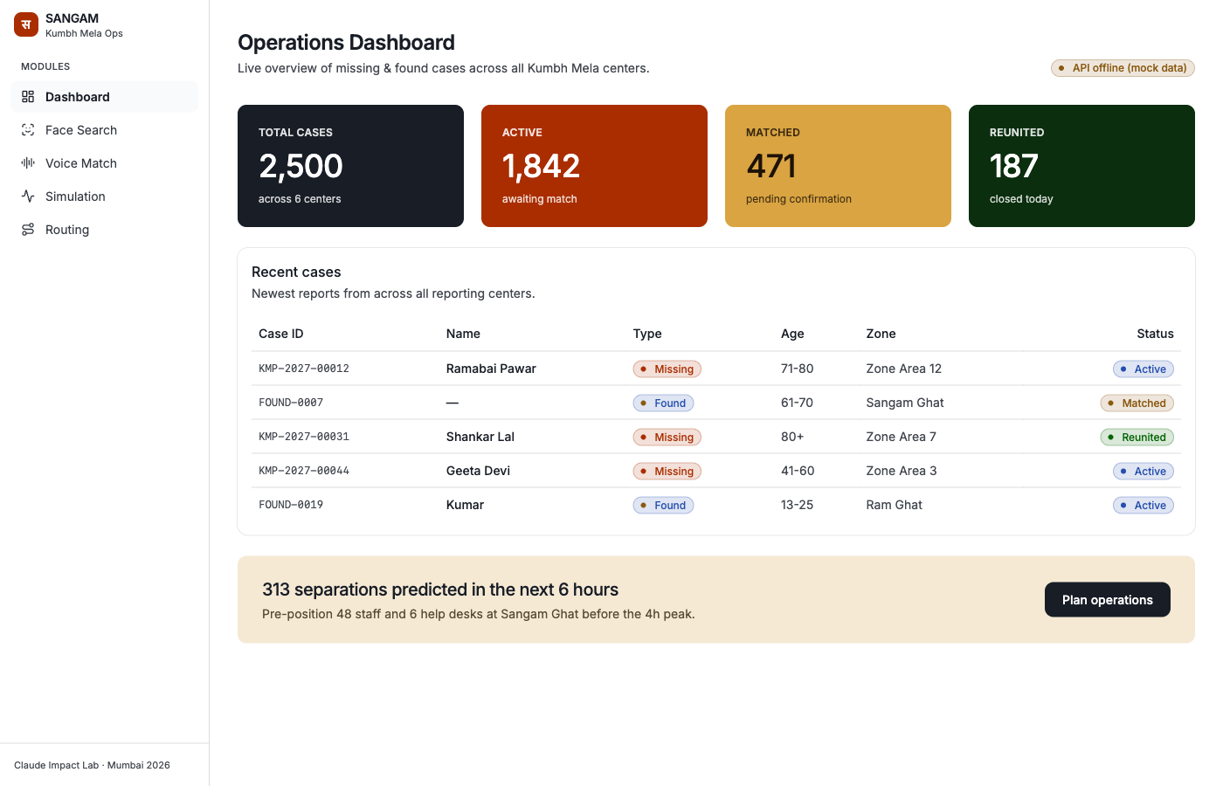
One console, five modules
— every Kumbh center on one screen, online or off
SANGAM — Operations Dashboard
▦
Dashboard
Every center, live — total, active, matched, reunited.
◉
Face Search
A finder's photo, matched to open reports. No Aadhaar, no CCTV.
⊪
Voice Match
Audio in any language → a matchable record. For phoneless pilgrims.
◬
Simulation
Separation surges forecast from 2,500 real cases — pre-position staff.
⤳
Routing
A multilingual BOLO + priority zones, pushed to police posts & LED boards.
API offline · mock data
The screen above is running with the network down — the deterministic core keeps reuniting on snan days.
Notes:
One operator console, five modules feeding one operation. Dashboard sees every center at once. Face Search matches a finder's photo to open reports — no Aadhaar, no CCTV. Voice Match takes audio in any language for phoneless pilgrims. Simulation predicts separation surges from 2,500 real cases. Routing fires a multilingual BOLO to police posts. Note the badge: it's running API-offline on mock data — it works when the network doesn't.

Slide 3
Match across sites, verify before handover
— the gap nothing else closes
CROSS-SITE MATCH
confidence
0.91
VERIFY BEFORE HANDOVER
CLAIMANT
● SEEKER · TRIMBAK
● PERSON · NASHIK
Claims to be the son · cannot name her companion · relation unconfirmed
Kamala-bai
Found elder
71–80 · green saree, ear studs · Maithili last seen 14:20, Kushavarta
71–80 · green saree, ear studs registered 15:50, Ramkund
⦸
Handover blocked
Attire + ear studs + Maithili + age band align; found ~90 min after last-seen — consistent with a shuttle transfer across the 30 km.
Your child-handover SOP, enforced at scale — flagging what a volunteer at hour fourteen would miss. The operator alone confirms; never auto.
From hours-to-a-week to 90 seconds across 30 km — and when the wrong person came to claim her, it said no.
The ask
Pilot it at one camp at Ramkund.
one camp → both sites → all camps
Notes:
The IP is the cross-site match plus verify-before-handover. Kamala-bai, filed at Trimbak, matched to a found elder at Nashik at 0.91 with a plain rationale. Then a claimant arrives whose story almost lines up — Verify catches the mismatch and blocks the handover. Two lines that land: hours-to-a-week became 90 seconds across 30 km, and when the wrong person came to claim her, it said no. The ask: pilot it at one camp at Ramkund.

