Slide 1


SDC Hackathon 2026
Xeno Force
2026
ArcTalent
Xeno Force
Domain 1 - AIVERSECITY
Presented By:
Emmanuel Heng
Nicholas Chuah
Dihom Chan
Ghessweynne
Skills that travel with you.
Helping working adults and SMEs plan their next learning step in an uncertain AI future.

Slide 2
01
PROBLEM STATEMENT
2026
39% of workers’ existing skills are expected to change or become outdated by 2030.
63% of surveyed employers identify skills gaps as a major barrier to business transformation.
Xeno Force
OUR PROBLEM STATEMENT
Working adults with limited learning time, money and information need a practical way to acquire these needed skills and which skills to learn first as job requirements change.
SMEs face the same decision across an entire workforce.
SDC Hackathon

Slide 3

02
SDC Hackathon
Xeno Force
2026
MEET AINA: EXPERIENCE WORTH BUILDING ON
01
Her starting point
Existing workplace experience and transferable skills.
AINA · ADMINISTRATIVE ASSISTANT
02
Her constraints
An illustrative worker persona—not a customer testimonial.
Limited weekly learning time and a small training budget.
03
Her decision
Which next role can I work towards—and what should I learn first?

Slide 4
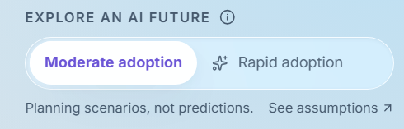

SDC Hackathon
Xeno Force
2026
START WITH SKILLS USEFUL ACROSS MULTIPLE POSSIBLE FUTURES.
Compare two scenarios
Explore moderate and rapid AI adoption assumptions.
LEARN SHARED FOUNDATIONS FIRSt
Prioritise skills needed across the leading career options.
ADAPT THE LATER Steps
03
Recalculate recommendations as goals, constraints or evidence change.

Slide 5
04
TELL US ABOUT YOURSelf
COMPARE YOUR OPtions
01
Enter your skills and goals, or import a CV with consent and review suggested skills.
02
Inspect role matches, transferable skills and remaining gaps.
2026
BUILD YOUR LEARNING ROUte
REVIEW AND ADApt
03
04
Track progress, revisit evidence and update your plan.
Get an ordered plan with course links, learning hours and budget constraints.
Xeno Force
SDC Hackathon
FROM EXPERIENCE TO AN ACTIONABLE NEXT STEP

Slide 6
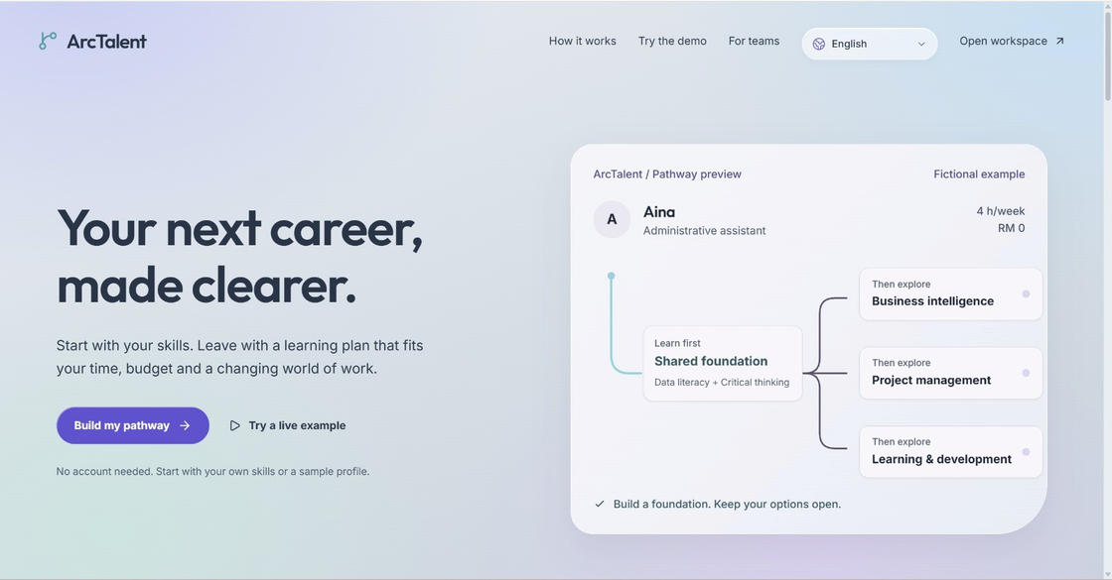

LIVE DEMO
ONE WORKER. TWO POSSIBLE FUTURES. A PRACTICAL NEXT STEP.
SDC Hackathon 2026
Xeno Force
05

Slide 7
06
Prioritise shared foundations
Learn first.
Keep your options open.
A
D
Start with skills useful across several leading career options.
Build on existing experience
What makes ArcTalent different?
B
Identify transferable skills instead of treating a career change as starting over.
Compare possible futures
Understand the changes
C
F
Explore how recommendations respond to different AI adoption assumptions.
See why a recommendation changes when new evidence is introduced.
SDC Hackathon
Xeno Force
2026

Slide 8
WHAT SUCCESS WOULD MEAN FOR PEOPLE
A useful plan should lead to meaningful action.
For a working adult
Understand their transferable skills and choose a realistic next learning step.
For an SME manager
Identify shared training needs and explore internal career moves.
For our pilot
Measure plan understanding, course completion and demonstrated skill gains.
SDC Hackathon
Xeno Force
07
SDG ALIGNMENT
SDG 4 · RELEVANT SKILLS
SDG 8 · WORKFORCE DEVELOPMENT
SDG 10 · MORE ACCESSIBLE LEARNING PATHWAYS
2026

Slide 9
08
SDC Hackathon
Xeno Force
2026
TRANSPARENT GUIDANCE
KEEP PEOPLE IN CONTROL
Users review suggested skills and choose their destination.
TRUST IS PART OF THE PRODUCT
MAKE UNCERTAINTY VISIBLE
Label simulations and distinguish planning estimates from actual outcomes.
SEPARATE ASSISTANCE FROM CALCULATION
AI helps interpret and explain; the planning engine calculates scores and schedules.

Slide 10


THANK YOU
Xeno Force
SDC Hackathon 2026

