Slide 1
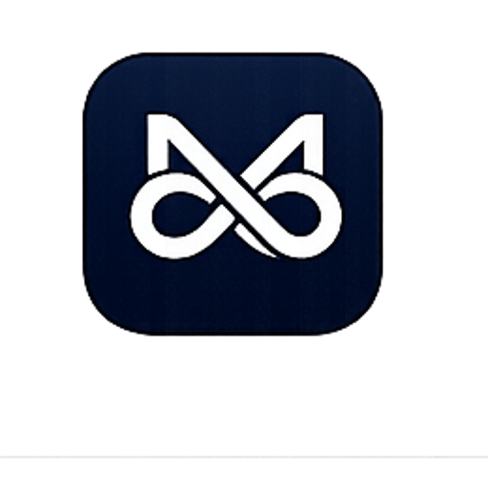
AI NextGen Industry Readiness Internship Program
Company Background & Vision
Transforming Students into Industry-Ready Professionals
• 13+ years of IT industry experience — founded our startup to bridge academic learning and real-world expectations
• Deep technical expertise serving clients across the United States
• We understand the skills and competencies organizations seek in today's workforce
• Mission: Industry-partnered programs that transform students into job-ready professionals
Our Impact
Working with students, colleges, and industry partners to build technical, problem-solving, and workplace skills — a talent pipeline that contributes confidently from day one.
Program Highlights
24/7 AI Tutor · Weekly Live Mentorship · Lifetime Course Access · Mini Project + Capstone + Hackathon · Top 5% Paid Internship · Top 5% Placement Assurity
Academia
Industry Program
Job-Ready Talent
Day-One Impact

Slide 2
The Problem We Identified
Through industry engagements and hiring, we observed a significant disconnect: graduates have theoretical knowledge but lack hands-on experience, industry exposure, and professional readiness for competitive work environments.
Student Challenges
Strong theory, limited practical exposure
No real-world project experience
Limited industry workflow understanding
Communication & interview readiness gaps
Hard transition from classroom to workplace
College Challenges
Rising placement expectations from management
Rapidly changing technology landscape
Industry–academia skill mismatch
Need for measurable employability outcomes
Faculty bandwidth for 500+ students
College Education ←—— GAP ——→ Industry Expectations

Slide 3
What We Do
Industry-partnered internship program: real-world projects, mentorship from experienced IT professionals, practical technical training, and industry best practices.
1
2
3
Technical Skill Development
Python · Full Stack · AI tracks 200+ lessons · live coding labs
Hands-on Project Experience
Mini projects · capstone · GitHub portfolio
Industry Mentorship
Weekly live sessions · recorded Q&A · mentor feedback
4
5
6
Career Readiness Training
Interview prep · HR modules · mock dialogues
Assessment & Tracking
50-Q weekly quizzes · XP · leaderboard · analytics
Placement Preparation
Aptitude · coding · resume · employer connect
Our Impact
Industry-ready graduates with practical knowledge, portfolio proof, and confidence — prepared to thrive in modern organizations from day one.

Slide 4
Learn by Building, Not Just Learning
Phase 1: Foundation Skills
Programming · Databases · APIs · Git · Linux · Debugging
Phase 2: Project Development
Team projects · Agile · Code reviews · Real-world use cases
Phase 3: Industry Simulation
Professional workflows · Documentation · Collaboration
Phase 4: Performance Evaluation
Weekly assessments · Feedback · Progress dashboards
Three Live Internship Tracks (8 Weeks Each)
• Python Engineering Foundations — Linux, Git, DSA, REST APIs, backend readiness
• Full Stack Product Engineering — React, Next.js, NestJS, PostgreSQL, Docker, DevOps
• AI Engineering & Intelligent Systems (Advanced) — LLMs, RAG, agents, FastAPI, vector DBs, AI UX

Slide 5
Real-World Experience That Matters
• Live project environments with browser-based coding sandbox
• Industry-standard tools: Git, Docker, REST APIs, cloud-ready stacks
• Mentor-guided assignments with weekly live sessions + recordings
• Professional development: documentation, presentations, teamwork
• Client-centric problem solving through capstone & hackathon
• 24/7 lesson-scoped AI tutor for continuous learning support
Student Deliverables
✓ Project Portfolio (GitHub repos)
✓ Technical Documentation
✓ Presentation & Demo Skills
✓ QR-Verified Completion Certificate
✓ Internship LoR (merit-based)
✓ Hackathon participation certificate
End of Program: Mini Project → Capstone Project → Industry Hackathon → Top Performer Selection

Slide 6
Preparing Students for Career Success
Technical Preparation
• Aptitude training
• Coding practice & output prediction
• Problem solving drills
• Mock technical interviews
Professional Skills
• Communication workshops
• Resume building
• LinkedIn optimization
• Group discussions
• HR interview preparation
Career Readiness
• Personal branding
• Workplace etiquette
• Corporate communication
• Weekly interview prep modules (8 Q&A per week)
Career Readiness Funnel: Learn → Practice → Assess → Interview → Place

Slide 7
Driving Employment Opportunities
Employer Engagement
Hiring partner network
Recruitment drives
Industry referrals
Talent showcases at hackathon
Student Benefits
Increased placement opportunities
Industry visibility
Strong professional profile
Job readiness confidence
Top Performers
Top 5% → Paid internship (performance-based stipend)
Top 5% → Placement assurity pathway
Hackathon winners prioritized
Students Trained | Projects Completed | Hiring Partners | Placement Success Rate
[___]+ | [___]+ | [___]+ | [___]%
Student Year | Course Fee
2nd Year | ₹3,999
3rd Year | ₹7,999
4th Year | ₹11,999
Placement Ecosystem
Students → Skills + Portfolio → Hackathon → Employers → Internship / Placement

Slide 8
Let's Build Industry-Ready Talent Together
Thank You · Questions & Discussion
"Empowering students with the skills, experience, and confidence required to thrive in today's competitive job market."
Contact
Praveen Manoharan — Program Lead
+91 8760 8760 62
AI NextGen Industry Readiness Internship Program

