Slide 1

Generating State-Based Syntax Highlighters from Rascal’s context-free grammars
By Edser Apperloo
Supervisors:
Tijs van der Storm
&
Mircea Lungu

Slide 2
State-based syntax highlighters
CFGs are too complex
Similar to state machines
Contexts
Matches
Scopes

Slide 3
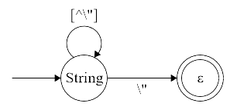
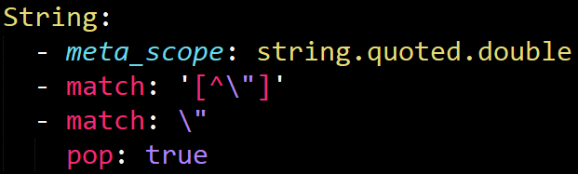
State-based syntax highlighters
Contexts -> States
Matches -> Transitions
Scopes -> Colouring

Slide 4
The designed algorithm in Rascal
How to embed highlighter information?
Simplify grammars
Transform to strongly regular grammars
To component machines
Translation to a syntax highlighter

Slide 5
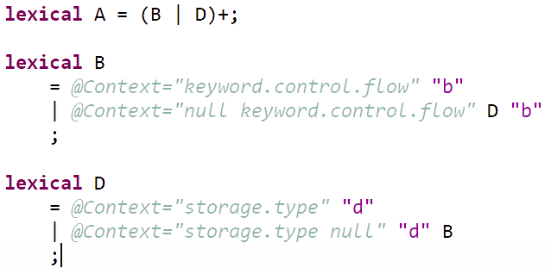
The original grammar
Example sentences:
“bbddbdb”
“bdbdbd”
@Context=“storage.type”
@Context=“null storage.type”

Slide 6
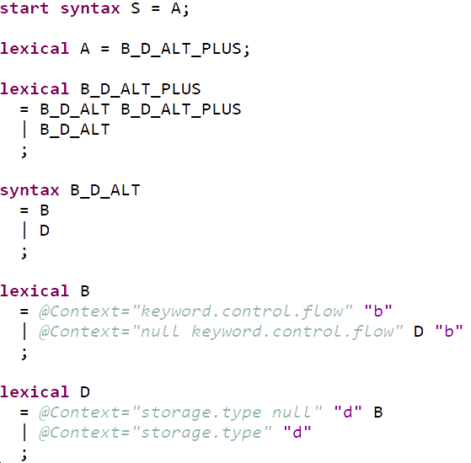
The plain version
Rewritten regular tokens
Reduce to (S,N,T,P)

Slide 7
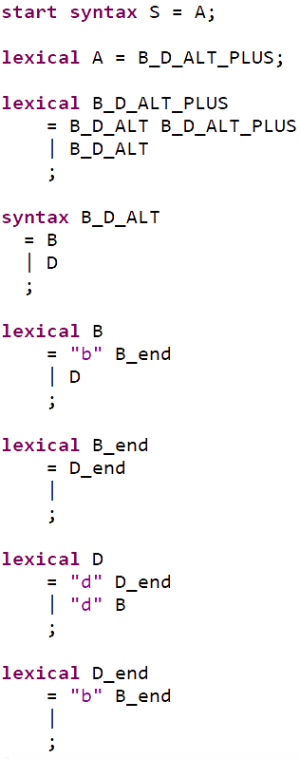
Strongly regular version
Mohri and Nederhof
Transforms any CFG into a strongly regular approximation

Slide 9
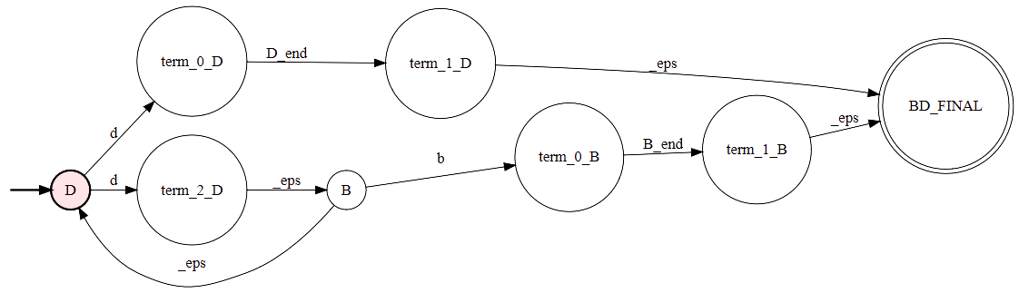
Component machines
Compact representation
NFA for “lexical D”

Slide 10
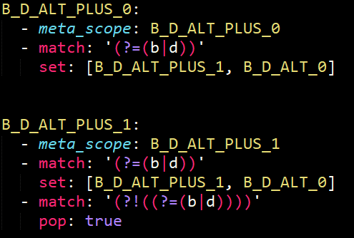
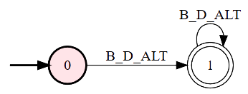
Mapping to Highlighter
Almost direct mapping

Slide 11
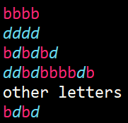
Results & Evaluation
Performance and resulting highlighter
11 Contexts
~100 SLOC
Reasons for errors:
End-of-line characters ($)
Parser like behavior

Slide 12
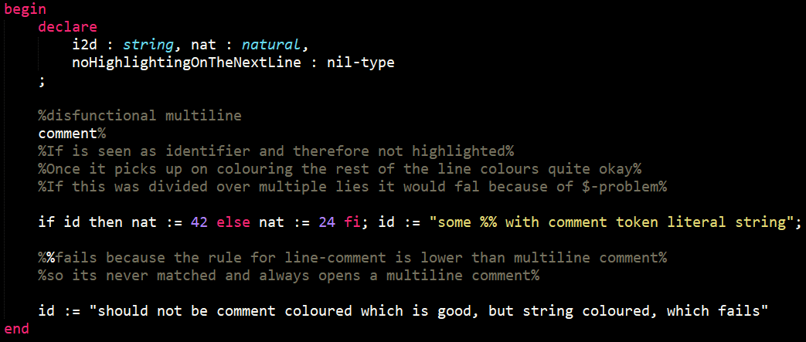
Results & Evaluation

Slide 13
Conclusion
Promising at first
Severity of errors
Wrong approach
Future
Retain less of the structure

