Slide 1

B.M.S. College of
Engineering
Project work – Phase II
23DS7PWPP2 | Review 2
MandiSense AI: Where and When to Sell, with Verified Revenue Floors
Srijan C Vachadmath (1BM23CD060)
Manohara Salmani (1BM23CD035)
Shreejith Shah (1BM23CD057)
Dr. Kalyan N
Assistant Professor
Department of CSE(Data Science)
BMSCE, Bengaluru
Notes:
Review 2 of Project Work Phase 2. MandiSense AI recommends where and when a Kolar-belt farmer should sell, and states a revenue floor it has been tested to respect.

Slide 2

Table of Contents
INTRODUCTION AND OBJECTIVES
METHODOLOGY AND SYSTEM ARCHITECTURE
IMPLEMENTATION AND CODE QUALITY
RESULTS, VALIDATION AND BENCHMARKING
NOVELTY AND OPTIMIZATION
PROJECT PLANNING AND RISK MANAGEMENT
REPORT, DOCUMENTATION AND SDG MAPPING
RESEARCH PAPER STATUS
CONCLUSION AND FUTURE WORK
REFERENCES
Department of Computer Science & Engineering(Data Science)

Slide 3
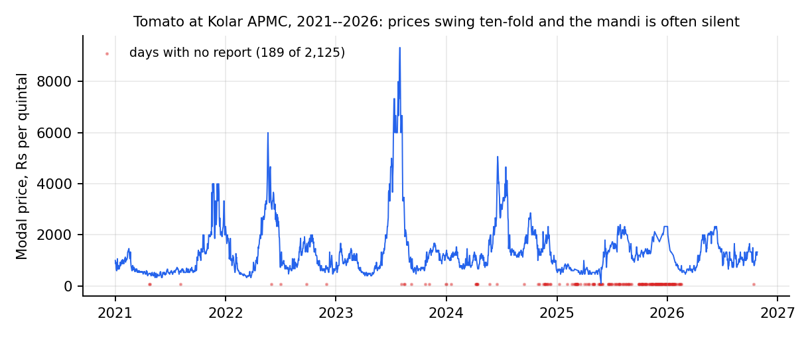
Introduction and Problem Statement
Context: farmers in the Bengaluru–Kolar belt choose a mandi and a day with only yesterday's price. Kolar tomato ranged Rs 100–9,330 per quintal and was silent on 189 of 2,125 days.
Problem: choose (mandi, hold 0–3 days) or the farm gate to maximise net revenue, and state a floor that holds.
Gap: models are judged on forecast error, not decisions; reporting gaps are ignored; decompose-then-forecast gains are unaudited [1]–[6].
Scope: tomato, onion, potato, ginger; Agmarknet only; offline evaluation. Garlic refused (one eligible mandi).
63,524
36,821
4 crops
real Agmarknet records
mandi-days in the panel
plus garlic refused
Why it matters: a farmer who gambles a harvest needs a minimum expected revenue, not just a forecast. Information frictions of exactly this kind measurably hurt small sellers [7], [8].
Department of Computer Science & Engineering(Data Science)
Notes:
Recap of Review 1, kept short. The key idea: the question is a decision under uncertainty with missing data, not a forecasting question.

Slide 4
Objectives
Status: 6 of 8 objectives met, 1 partly met (floors, 2 of 4 crops), 1 built with a null result (spillover).
# | Objective (approved scope) | Status | Evidence
1 | Real-data panel, ≥30,000 mandi-days, exclusions recorded | Met | 36,821 mandi-days; 63,524 records
2 | Revenue formulation + market-choice model; ≥500 held-out days per crop | Met | 511–963 scored days per crop
3 | Test label and loss effects with paired tests | Met | Realised labels: −87 to −157 Rs/q; SPO+ no gain
4 | Floor violation within 2 points of nominal 10% | Partly | Tomato 9.0%, ginger 10.5%; onion 6.3%, potato 6.9%
5 | FastAPI + trilingual app, tests, reproducible pipeline | Met | 650 passing tests; one-command pipeline
6 | Audit decompose-then-forecast leakage; foundation-model baseline | Met | +27…62% skill → −15…−1% when causal
7 | LLM decision intelligence, grounded and verified | Met | Judge caught 9/9 corrupted; 30 unit tests
8 | Cross-commodity spillover with FDR control | Null result | 0 of 40 edges published: no shock episodes
Department of Computer Science & Engineering(Data Science)
Notes:
Each objective is mapped to the result that demonstrates it. Objective 4 is only partly met because onion and potato floors were more cautious than needed. Objective 8 is met as engineering; it publishes no transmission result.

Slide 5
Proposed Methodology and System Architecture
Idea: train on what the farmer would actually receive (price net of transport, shrinkage and silent markets), not on the posted price.
Action: (mandi, hold 0–3 days) or farm gate; recommendation = best guaranteed revenue, with an adaptive conformal floor.
Rejected: predict-then-optimise on posted prices and decompose-then-forecast hybrids (they never see a silent market, and leak the future).
Market-choice engines
+ conformal floors
Agmarknet
exports
Clean + audit
loader, checks
Market panel,
observation store
FastAPI service
farmer · trader · chat
Next.js app
EN · KN · HI
Forecasters
+ specialist council
Shock study
+ spillover
Language layer: decision-intelligence briefs,
explanation writer + independent judge
Data layer → model layer → service layer → language layer → presentation layer. All results use real portal records; no synthetic data enter any result.
Department of Computer Science & Engineering(Data Science)
Notes:
Five layers. The distinctive choices: label = realised revenue, and the language model is a writer whose output is verified and may be discarded.

Slide 6
Key Formulation: Revenue, Loss and Verified Floor
Net revenue of action (m, k) from origin ℓ
Sym. | Meaning | Default
f | market fee + commission | 4 %
c₀ | handling per trip | Rs 20
τ | transport, Rs per quintal-km | 0.35
ρ | road / great-circle distance | 1.3
δ | daily spoilage (tomato / onion / potato) | 3 / 0.8 / 0.4 %
φ | price discount if mandi silent | 0.85
φ_g | farm-gate discount | 0.80
α, γ | floor level, ACI step | 0.10, 0.01
R(m,k | ℓ) = (1 − f)(1 − δ)ᵏ · P̃(m, t+k) − τ·ρ·d(ℓ,m) − c₀
P̃ = P if market m reported on day t+k, else φ · P̄(t+k) (wasted trip); farm gate pays φ_g · P̄(t)
Decision-focused loss (SPO+)
L(r̂, r) = max_a (2r̂ₐ − rₐ) − 2r̂ₐ* + rₐ*
non-negative, zero at the truth, upper-bounds regret; tested against squared error
Guaranteed floor and adaptive level
Parameters are scenario assumptions, not estimates. τ, δ and φ are swept at evaluation time; conclusions hold across all 10 settings per crop.
L = r̂ − q·σ̂ ; αₜ₊₁ = αₜ + γ (α − 1[R < L])
q = (1 − αₜ) quantile of past normalised scores; outcomes of a k-day hold are released only after the sale date
Department of Computer Science & Engineering(Data Science)
Notes:
Revenue is affine in the price vector, so SPO+ is exact for this problem. The floor is the best guaranteed revenue; outcomes feed the calibrator only after the sale date has passed.

Slide 7
Decision Intelligence and Cross-Commodity Spillover
Objective 7: grounded decision briefs
Objective 8: spillover between crops
1. Evidence bundle: flat map of dotted keys (forecast.h5.point, market-choice, arrivals, spillover) + what was unavailable
2. Provider fills a fixed schema: action BUY/SELL/HOLD/WAIT, confidence (may be INSUFFICIENT_EVIDENCE), factors that each cite an evidence key
3. Grounding check: every figure within 1% of an evidence value, every key exists, no market named outside the evidence
4. Never fails silently: failing provider → deterministic fallback; ungrounded brief served as grounded:false with issues listed
Policy: a HOLD is overridden when spoilage outruns the expected gain
Panel: weekly returns of 5 crops, 232 weeks, one reference market each
Clean: remove first common factor (24.5% of variance) and calendar-month means so shared shocks are not read as transmission
Episodes: source crop in squeeze or glut; onsets <4 weeks apart merged
Effect: mean response of target over h = 1–4 weeks minus its unconditional baseline
Inference: bootstrap over whole episodes (2,000 draws, 90%); Benjamini–Hochberg FDR 10% across 40 edges
Gates: ≥8 episodes, CI excludes 0, |effect| ≥ 1%; otherwise INSUFFICIENT_EVIDENCE
Department of Computer Science & Engineering(Data Science)
Notes:
Both services share one principle: publish a claim only when the evidence supports it, otherwise say so.

Slide 8
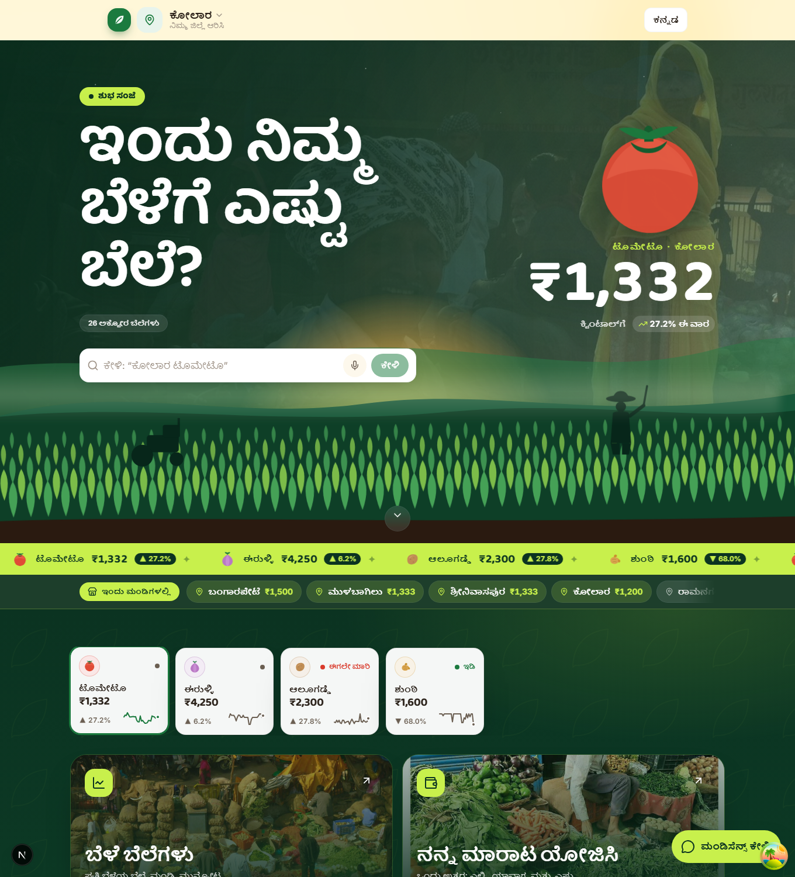
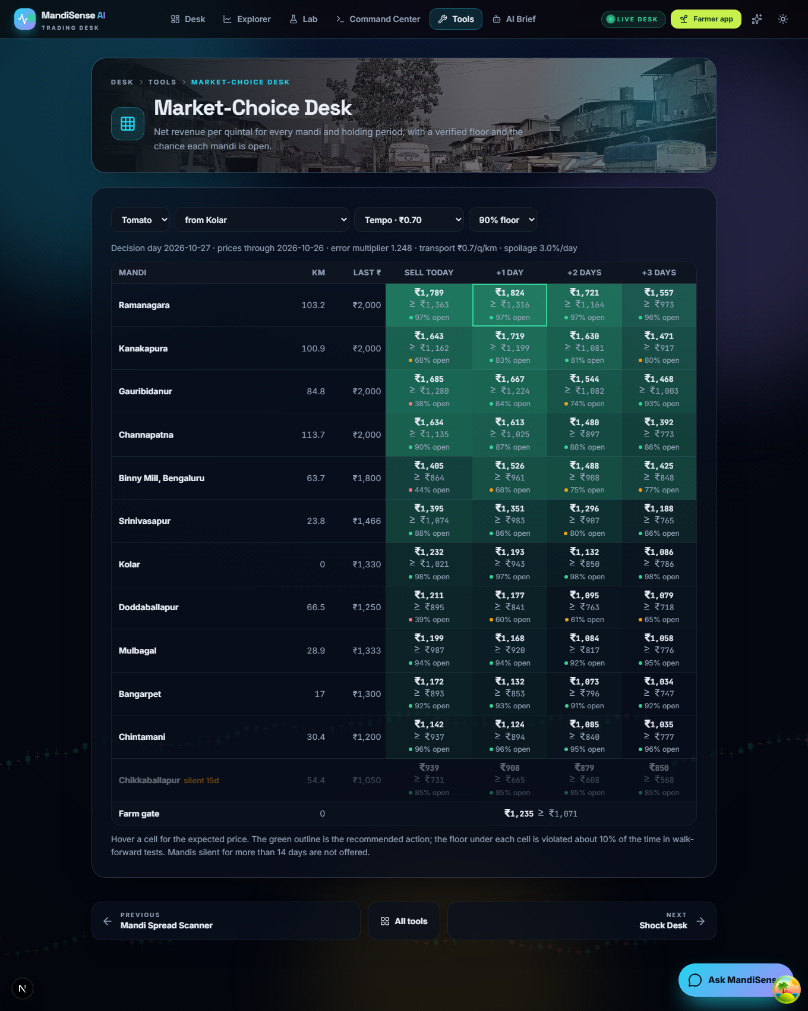
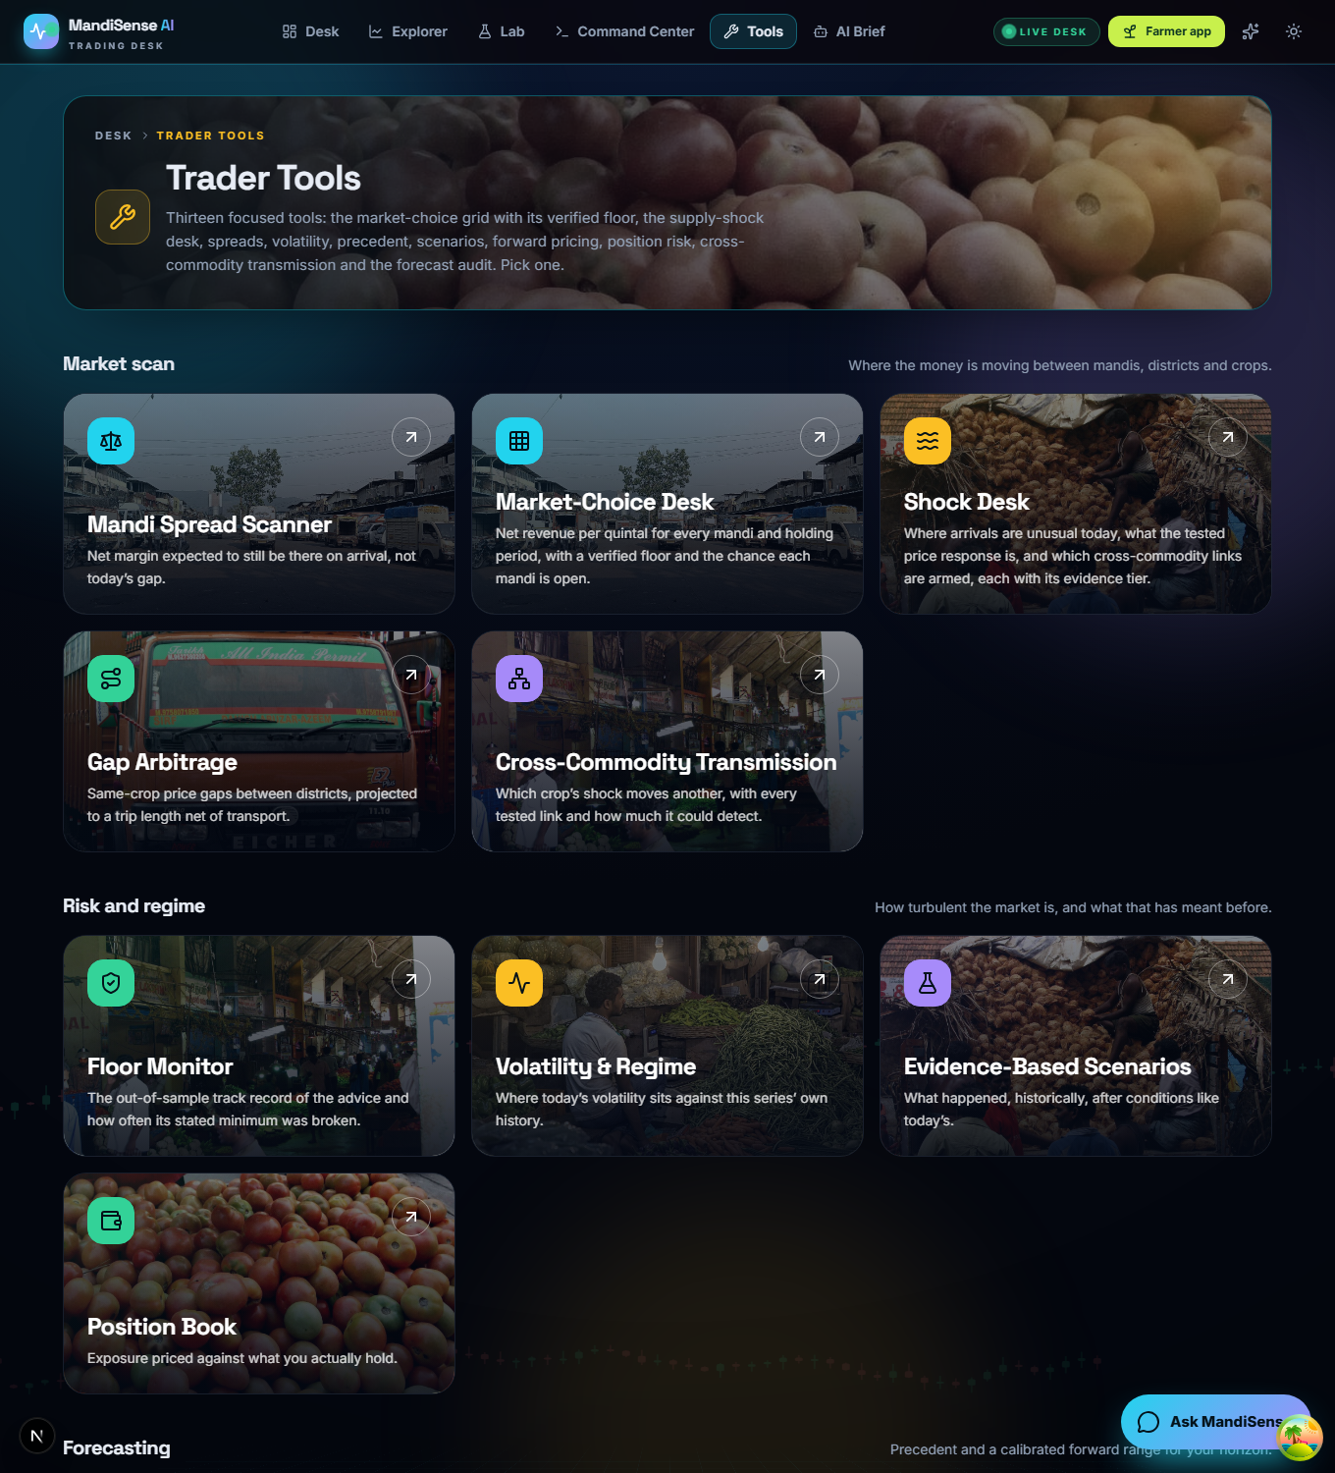
Implementation and System Integration
Integrated: one pipeline command runs 12 stages from raw exports to tests; API, web app, engines and language layer share one data store.
Manual: refreshing Agmarknet exports (download by hand); public deployment config exists but is not verified live.
Defects fixed: NumPy 2 broke pandas; fresh clone missed the observation store; hard deletion emptied trader pages; council weights summed above 1.
world
forecasts
market
choice
transmission
shock
spillover
council
research
evidence
results
doc
tests
scripts/pipeline.py: each stage has declared outputs; run alone, skipped, or dry-run (--list, --only, --skip, --dry-run)
Endpoints: /v1/market-choice, /v1/farmer, /v1/trader, /v1/shock, /v1/council, /v1/spillover, /v1/intelligence, /v1/chat
Department of Computer Science & Engineering(Data Science)
Notes:
End-to-end flow. The live demonstration follows on the next slide; the screenshots here only show what the screens contain.

Slide 9
Live Demonstration Plan
1
Start the stack
uvicorn api.main:app and npm run dev; open the farmer home in Kannada
2
Farmer: best place to sell
recommendation with reasons, verified floor and evidence level
3
Trader: Market-Choice Desk
per-crop engines, floor monitor, back-test gain over the heuristics
4
AI brief and chat
grounded brief with cited factors; ask a question in Hindi
5
Shock desk and council
evidence tiers shown honestly (suggestive, not robust)
6
Show the refusal
garlic: the engine declines instead of guessing
This is a live demonstration. Everything shown runs from the repository; no recording is used. If the network is down, the language layer falls back to rule-based text and the demonstration continues unchanged.
Department of Computer Science & Engineering(Data Science)
Notes:
Run the six steps live. Step 6 is deliberate: it shows the system refusing a crop with no market choice.

Slide 10
Tools, Technology Stack and Code Quality
Repository: Git, 69 commits; README, requirements.lock, docs for architecture, tool choices, shock study, council and LLM evaluation; CI workflow.
Reproducible: pipeline.py regenerates all artefacts; the thesis tables are generated from them, not typed.
Tested: 650 tests passing (engines, API, trader/farmer, council, shock, spillover, chat); vitest for the web app; headless UI smoke test; fresh-clone check.
Layer | Tool (version) | Why chosen
Data / stats | NumPy 1.26.4, pandas 2.1.4, SciPy 1.11.4, statsmodels 0.14.1 | tested, pinned stack
Learning | LightGBM 4.6.0, XGBoost 2.0.3, scikit-learn 1.3.2, Optuna, PyTorch (research env) | trees win on tabular [19]; Optuna TPE [20]
Backend | FastAPI 0.136.1, Uvicorn 0.46.0, Pydantic 2.13.3 | typed requests, auto API docs
Frontend | Next.js 16.2.4, React 19.2.4, TypeScript 5, Tailwind 4 | fast pages on weak connections
Language layer | gpt-oss-120b writer, Qwen judge (Groq); Claude provider optional | two model families; deterministic fallback
Quality | pytest 9.0.3, vitest 3.2, GitHub Actions, Docker, Render file | automated checks on every push
Department of Computer Science & Engineering(Data Science)
Notes:
Choices and rejected alternatives are recorded in docs/TOOL_CHOICES.md. Research tests need a separate PyTorch environment by design.

Slide 11
Experimental Setup and Evaluation Metrics
Split: nested walk-forward, 5 outer blocks (2024-H1 → 2026-10); inner validation by Optuna (20 neural / 25 boosting trials); K+2-day gap before every block.
Setup: Core i9-13900HX, 31.7 GB, RTX 4060; fixed seeds recorded in configuration; same tuning budget for every method.
Metrics: realised revenue, regret to hindsight oracle, share of oracle gap closed, silent-market trips, floor violation, forecast skill.
Baselines (all retrained): random walk, LightGBM/XGBoost on observed prices, nearest mandi, highest price yesterday, best 7-day mean, farm gate.
Crop | Mandi-days | Mandis | Eligible | Test days | Studied
Tomato | 17,582 | 14 | 12 | 963 | yes
Onion | 5,343 | 11 | 4 | 511 | yes
Potato | 5,000 | 12 | 3 | 569 | yes
Ginger | 6,423 | 10 | 3 | 776 | yes
Garlic | 2,473 | 7 | 1 | — | refused
Total | 36,821
Inference: moving-block bootstrap (block 14); Newey–West Diebold–Mariano; Holm across all pre-specified comparisons; model confidence set [24]–[27].
Pre-specified: model ladder, 12 paired comparisons, silence tests and leakage protocol were fixed before tuned results were seen.
Department of Computer Science & Engineering(Data Science)
Notes:
Dataset: two Agmarknet exports that agree on 3,307 overlapping tomato market-days (r = 0.99996). Eligible = markets with at least 700 reported days.

Slide 12
Results and Validation: Decision Quality
Result: models trained on realised revenue earn the most in every crop; the oracle bounds what is possible.
Why: observed-price models send 12–43% of trips to a silent market; realised-label models cut that to 5–21%.
Rs 2,156
tomato, realised-label model (oracle 2,570)
+Rs 556
over nearest mandi, tomato (1,600 → 2,156)
Holm p < 0.002
labels effect in all four crops
Department of Computer Science & Engineering(Data Science)
Notes:
Test set: 963/511/569/776 held-out decision days. Intervals are in the report (Table 6.1). The ordering is the same in every crop.

Slide 13
Statistical Validation: What Actually Improved Decisions
Crop | Labels: realised vs observed (Δ regret, Rs/q) | 95% CI | Holm p | SPO+ vs squared error (Δ regret, Rs/q) | Holm p
Tomato | −140 | [−181, −102] | < 0.0001 | −25 [−53, +3] | 0.51
Onion | −157 | [−224, −89] | < 0.0001 | −23 [−62, +11] | 0.21
Potato | −87 | [−142, −39] | 0.002 | +1 [−27, +32] | 0.95
Ginger | −149 | [−232, −80] | < 0.0001 | −66 [−180, +30] | 0.17
Finding
Model confidence set
Limits
Better labels, not a fancier loss: realised-outcome supervision cuts regret in all four crops; SPO+ adds nothing reliable.
Only realised-label models survive in every crop; no observed-price model does. Tomato keeps 7 specifications; the others 3.
One region, one source, 5.8 years; revenue parameters are scenarios; silent day treated as no sale; offline only.
Department of Computer Science & Engineering(Data Science)
Notes:
Paired daily regret differences, moving-block bootstrap, Newey-West Diebold-Mariano, Holm correction across all pre-specified comparisons.

Slide 14
Verified Floors and Served-Engine Back-test
Floor violation (%) target 10% | Adaptive 5% | Adaptive 10% | Adaptive 20% | Static 10% | Naive Gaussian
Tomato | 3.0 | 9.0 | 21.3 | 6.0 | 27.4
Onion | 1.6 | 6.3 | 15.5 | 4.0 | 34.5
Potato | 2.5 | 6.9 | 17.7 | 6.2 | 25.8
Ginger | 4.3 | 10.5 | 20.4 | 8.9 | 11.9
Back-test, last 330 days | Gain vs highest yesterday (Rs/q) | vs nearest | Gap closed | Evidence
Tomato | +170 [+104, +255] | +571 | 62% | strong
Onion | +60 [+16, +119] | +300 | 46% | strong
Potato | +15 [−38, +60] | +69 | 11% | limited
Ginger | +202 [+25, +429] | +1,595 | 67% | strong
Adaptive floors track the nominal level; the static quantile is cautious; a naive Gaussian floor is breached on 26–35% of days in three crops.
Department of Computer Science & Engineering(Data Science)
Notes:
Floors are calibrated online with delayed feedback. Back-test gains are significant for tomato, onion and ginger; potato's gain over the best heuristic (Rs 15, CI −38 to +60) is not distinguishable from zero, so the app labels it limited evidence. Garlic is refused.

Slide 15
Look-Ahead Audit of Decompose-then-Forecast Models
+27 … +62%
skill under the published protocol
−15 … −1%
the same models, causal decomposition
Why: STL and VMD are two-sided smoothers, so the component at day t already contains later prices. Zero-shot Chronos-Bolt [17] scores −9.4% at 1 day: no model here beats the random walk on the daily tomato series.
Department of Computer Science & Engineering(Data Science)
Notes:
Identical forecasters, lags and origins under two protocols. The claim is about the protocol the hybrid papers describe; we did not audit those specific papers.

Slide 16
Council, Shocks, Spillover and Language Layer
Study | What was tested | Result | Verdict
Specialist council | 4 feature-family agents, weights ≤ 1, 4 folds | council +0.2…+0.4% vs single +0.6…+0.8% skill; wins 0–1 of 4 folds | Not promoted
Supply-shock event study | 30 crop–horizon tests, placebo shifts, Holm | 0 robust, 5 suggestive; effects as large as the detectable minimum | Not served
Cross-commodity spillover | 5 crops, 40 edges, FDR 10%, ≥8 episodes | 0 shock episodes in all 10 source cells; 40/40 insufficient evidence | Withheld
District forecasts | 3-, 5-, 7-day vs no change, 90% band | skill +3.0…+4.0%, coverage 89.8%; 1-day not distinguishable | Served 3/5/7 d
Explanation layer | 24 texts, 120 sentences, EN/KN/HI, independent judge | kept: EN 0.83–0.99, KN 0.62–0.88, HI 0.68–0.91; judge caught 9/9 corrupted, 0/3 false alarms | Verified, small n
Zero spillover episodes is also a finding about the pipeline: the detector depends on supply-regime labels that the real panel does not yet supply. Listed under future work.
Department of Computer Science & Engineering(Data Science)
Notes:
These are reported as null results on purpose: a result that did not clear its evidence floor is not served.

Slide 17
Comparative Benchmarking
Same split, same metric, all retrained: no published study scores mandi choice by regret on real reporting-gap data, so baselines are the heuristics farmers use and the standard predict-then-optimise models.
Where we win: all four crops vs every heuristic and every observed-price model. Where we do not:
potato back-test gain is not distinguishable from the best heuristic, and SPO+ ties the squared-error loss.
Gap closed (nearest → oracle) / silent-market trips | Tomato | Onion | Potato | Ginger
Nearest mandi, sell today | 0.00 / 34% | 0.00 / 34% | 0.00 / 34% | 0.00 / 24%
Highest price yesterday | 0.43 / 28% | 0.26 / 43% | 0.17 / 35% | 0.69 / 11%
LightGBM, observed prices | 0.43 / 29% | 0.24 / 43% | 0.12 / 34% | 0.69 / 12%
LightGBM, realised outcomes (ours) | 0.57 / 12% | 0.48 / 18% | 0.31 / 21% | 0.76 / 5%
Neural SPO+, realised outcomes (ours) | 0.58 / 12% | 0.50 / 20% | 0.28 / 17% | 0.76 / 5%
Department of Computer Science & Engineering(Data Science)
Notes:
Gap closed is the share of the gap between the nearest-mandi rule and the hindsight oracle. Published decompose-then-forecast results are compared under their own protocol and the causal one on the previous slide.

Slide 18
Novelty and Research Contribution
In one sentence: supervise market choice on realised, silence-aware revenue, certify it with delayed-feedback conformal floors, and audit the leakage in published hybrids.
Already exists
New here
Ours vs adapted
Forecasters of agricultural prices [9]–[14]
SPO+ and decision-focused learning [21], [22]
Adaptive conformal inference [25]–[28]
Revenue labels that include silent markets, on real mandi data
Floors for selected actions whose outcome resolves k days later
Measured size of look-ahead leakage in STL/VMD hybrids
Verified language briefs and a withheld-by-default spillover engine
Ours: formulation, pipeline, leakage protocol, grounding verifier, engines, app
Adapted: SPO+ [21], ACI [26], DeepSets [29], Optuna [20], Chronos [17]
Honest scope: the positive contribution that survived testing is the label effect, the floor validity and the audit; the loss, reporting head, silence features, council and spillover are bounded negative results.
Department of Computer Science & Engineering(Data Science)
Notes:
Claims limited to what held on held-out data. Negative results are part of the contribution.

Slide 19
Optimization and Ablation Study
Tuning: Optuna TPE per fold on each method's native criterion; same budget for all. Tuning on forecast loss instead of regret: no reliable change.
Cost: served boosting model chosen over the neural one: equal decisions, far cheaper to train, run and explain.
One change at a time | Δ regret, Rs/q (95% CI) | Holm p | Verdict
SPO+ loss instead of squared error | −25 [−53, +3] | 0.505 | no reliable difference
Add reporting head (SPO+) | +23 [+8, +36] | 0.012 | worse
Add network-silence features (GBM) | −12 [−31, +3] | 0.695 | no reliable difference
Tried and did not work: reporting head (worse, p = 0.012), silence features, decision-regret tuning, unconstrained council weights (summed 2.4–3.1, significantly worse), SPO+ over squared error. Ablations shown for tomato; the other crops agree.
Department of Computer Science & Engineering(Data Science)
Notes:
Each row changes one thing. Failures are documented, not hidden.

Slide 20
Project Planning: WBS and Critical Path
WBS package | Hours | Primary owner
1 Management & documentation | 130 h | Shreejith
2 Data | 100 h | Manohara
3 Models & research | 290 h | Manohara
4 Application | 300 h | Srijan
5 Verification | 90 h | Shreejith / Manohara
Total | 910 h
A
Requirements
2 wk
B
Data
3 wk
C
Market choice
4 wk
F
Forecasters
3 wk
G
Experiments
4 wk
K
Report
3 wk
J
Integration
2 wk
I
Testing
3 wk
D
Backend
4 wk
E
Web app
5 wk
H
LLM layer
3 wk
Critical path (red):
A→B→C→F→G→I→J→K
2+3+4+3+4+3+2+3 = 24 weeks
D, E, H have slack
Hours are team estimates, not logged time. Each leaf task has one owner; children sum to parents.
Worked slack, activity E: LF(E) = LS(I) = 16 weeks, so LS(E) = 16 − 5 = 11; ES(E) = 6; slack = 11 − 6 = 5 weeks. For H: LS = 16 − 3 = 13, ES = 6, slack = 7. For D: LF = min(LS(E), LS(H)) = 11, LS = 7, ES = 2, slack = 5.
RAM: every work package has one primary owner (R) and the guide is accountable (A); Manohara 430 h, Srijan 300 h, Shreejith 180 h.
Department of Computer Science & Engineering(Data Science)
Notes:
Planned 24 weeks from 27 April 2026. The baseline was reconstructed from the Phase-1 roadmap. Owners follow the team's split; the commit history does not corroborate work of the second and third members and the report says so.

Slide 21
Schedule Tracking and Risk Management
0
4
8
12
16
20
24
28
Risk | P×I | Response | Status
R1 Source data synthetic | 15 | Re-acquired Agmarknet exports, integrity check, removed synthetic | Occurred
R2 Look-ahead leakage | 20 | Leakage unit tests; caught 2 whole-series-centred features | Occurred
R3 Hard deletion broke trader pages | 9 | Soft delete, re-seeding, id aliasing | Occurred
R4 NumPy 2 broke pandas | 9 | Pinned 1.26.4; lock file | Occurred
R5 LLM rate limit 8k tokens/min | 8 | Throttling, small evaluation set | Occurred
R6 Uneven team contribution | 12 | Contribution record; owner split | Open
R7 Deployment unverified | 9 | Docker + Render files; to verify | Open
R8 No field trial | 12 | Stated limitation; survey ready | Open
A Requirements
B Data
C Market choice
D Backend API
E Web application
F Forecasters
G Experiments
H LLM layer
I Testing
J Integration
K Report
baseline
actual
Slip: 24 weeks planned, about 27 actual (+3.3 weeks, 14%). Data (B) was reopened after the first dataset proved synthetic, which pushed C and G on the critical path; D, E and H sat on slack and absorbed their delay.
Milestones: M1 requirements (wk 3), M2 first deployed prototype 9 Jun, M3 farmer suite 30 Sep, M4 research results 29 Oct, M5 report (wk 27).
Materialised: R1. Trigger: results that looked too clean. Action: discard, rebuild from portal exports, re-run every experiment (see report Ch. 4).
Department of Computer Science & Engineering(Data Science)
Notes:
Baseline reconstructed; actual spans from commit dates (first commit 28 April, last 29 October). There is no repository activity between 10 June and 28 September.

Slide 22
Project Report and Documentation Status
Report: BMSCE thesis template, 68 pages, compiled in LaTeX; Chapters 1–7 written; every table generated from experiment artefacts.
Appendices: A code (read from source), B survey instrument, C per-fold evaluation, D dataset, E PO and SDG mapping, F similarity record.
Remaining: official Drillbit report, CO–PO matrix from the course file, declaration date, supervisor corrections.
Item | State
Chapters 1–7 | complete
Appendices A–E | complete (E: CO–PO table to be inserted)
Appendix F similarity record | pending: Drillbit not yet run
Figures and tables | numbered, captioned, referenced
Citations | 40 IEEE-style entries, all cited
Similarity: target ≤ 20% with Drillbit, references excluded. The official check has not been run yet; no percentage is claimed. A self-check of the conference draft found no verbatim web matches, which is not a substitute.
Department of Computer Science & Engineering(Data Science)
Notes:
Be explicit: the Drillbit percentage and date will be entered in Appendix F once the official report exists.

Slide 23
SDG Mapping and Societal Impact
Stakeholders: smallholder farmers (need a plain answer and a floor), traders (need evidence tiers and arrivals), mandi officials and policy makers (need transparent data use).
SDG / target | Link | Support in our results | Status
2 / 2.3 | income of small-scale producers through market information | back-test gains Rs 60–202 per quintal over the best simple rule in 3 of 4 crops | Measured offline
1 / 1.4 | access to economic services | free trilingual tool for small sellers | Not measured
12 / 12.3 | reduce food loss along supply chains | spoilage built into advice; kg avoided not measured | Potential
9 / 9.c | access to information technology | open pipeline on a public data feed | Engineering
Impact is claimed only where held-out numbers support it; the benefit to farmers' real income needs a field trial.
Department of Computer Science & Engineering(Data Science)
Notes:
Numbered targets, not only goal numbers. The offline gains are not real income.

Slide 24
Research Paper Status
Primary target: IEEE Access, a broad applied-engineering journal that accepts long empirical papers with negative results.
Status: manuscripts drafted; none submitted yet, so there is no acknowledgement, review or acceptance to show.
Manuscript | Venue | Pages | Status
Where and When to Sell: Outcome-Supervised Market Choice with Conformal Revenue Floors, and a Look-Ahead Audit of Decomposition Forecasters | IEEE Access | 14 | Drafted, not submitted
Fusing Specialist Agents and Market Signals into Calibrated Price Ranges: A Pre-Registered Evaluation on Indian Agricultural Mandis | CICPS 2027 (Springer LNNS) | 12 | Drafted, not submitted
MandiSense project proposal | KSCST SPP 50th series | 14 | Proposal drafted
Similarity: only a self-conducted check exists for the conference draft (no verbatim web matches). Official Drillbit percentages will be added at submission.
Department of Computer Science & Engineering(Data Science)
Notes:
Do not claim submission. The next step is to submit the IEEE Access manuscript and attach the acknowledgement mail.

Slide 25
Conclusion and Future Work
Key outcome: advice trained on realised revenue beats the best simple rule by Rs 170 per quintal for tomato and Rs 202 for ginger, with floors that hold their level.
Against objectives: 6 met, 1 partly met, 1 null result; negative results reported.
Limitations
Future work (from those limits)
One region, one source, 5.8 years
Offline only; no farmer acted on the advice
Revenue parameters are scenarios
Briefs checked for traceability, not user-tested
Spillover found no episodes; deployment unverified
Field pilot with farmers and the survey
Estimate transport, spoilage and silence from data
Diagnose the spillover labelling; define episodes from arrivals
User test of briefs; native-speaker review of KN/HI
Verify deployment and monitor live floor violations
Department of Computer Science & Engineering(Data Science)
Notes:
Everything under future work follows from a stated limitation.

Slide 26
References
[1] P. Birthal et al., J. Agribusiness Develop. Emerg. Econ., 2019
[2] AGMARKNET, Directorate of Marketing and Inspection, Govt. of India
[3] R. Jensen, Quart. J. Econ., 122(3), 2007
[4] J. Aker, AEJ: Appl. Econ., 2(3), 2010
[5] S. Ray et al., Appl. Soft Comput., 149, 2023
[6] K. Meena, B. Chaitra, IEEE Access, 12, 2024
[7] G. Jha, K. Sinha, Neural Comput. Appl., 24, 2014
[8] Wu et al., Expert Syst., 2026
[9] R. Cleveland et al., J. Official Statist., 6(1), 1990
[10] Hyndman, Athanasopoulos, Forecasting: Principles and Practice, 3e, 2021
[11] A. Sathe et al., Results Eng., 27, 2025
[12] B. Celik, S. Celik, Borsa Istanbul Rev., 2025
[13] K. Dragomiretskiy, D. Zosso, IEEE TSP, 62(3), 2014
[14] Bergmeir, Benítez, Inf. Sci., 191, 2012
[15] Cerqueira et al., Mach. Learn., 109, 2020
[16] Bundak et al., IEEE Access, 13, 2025
[17] Ansari et al., Chronos, TMLR, 2024
[18] Wang, Zhang, arXiv:2601.06371, 2026
[19] Grinsztajn et al., NeurIPS D&B, 2022
[20] Akiba et al., Optuna, KDD, 2019
[21] Elmachtoub, Grigas, Manage. Sci., 68(1), 2022
[22] Mandi et al., J. Artif. Intell. Res., 80, 2024
[23] Chen, Guestrin, XGBoost, KDD, 2016; Ke et al., LightGBM, NeurIPS, 2017
[24] Diebold, Mariano, JBES, 13(3), 1995
[25] Newey, West, Econometrica, 55(3), 1987
[26] Gibbs, Candès, NeurIPS, 2021
[27] Hansen, Lunde, Nason, Econometrica, 79(2), 2011
[28] Vovk et al., Algorithmic Learning in a Random World, 2005; Angelopoulos, Bates, 2023
[29] Zaheer et al., Deep Sets, NeurIPS, 2017
[30] Holm, Scand. J. Statist., 6(2), 1979
[31] Künsch, Ann. Statist., 17(3), 1989
[32] Romano et al., CQR, NeurIPS, 2019
[33] Rubin, Biometrika, 63(3), 1976
[34] Che et al., Sci. Rep., 8, 2018
Full 40-entry list with all details is in the thesis bibliography.
Department of Computer Science & Engineering(Data Science)
Notes:
IEEE style, numbered. Full vetted list of 40 entries is in the thesis.

Slide 27
THANK YOU
Department of Computer Science & Engineering(Data Science)

