Slide 1

B.M.S. College of
Engineering
Project work – Phase II
23DS7PWPP2 | Review 2
MandiSense AI: Where and When to Sell, with Verified Revenue Floors
Srijan C Vachadmath (1BM23CD060)
Manohara Salmani (1BM23CD035)
Shreejith Shah (1BM23CD057)
Dr. Kalyan N
Assistant Professor
Department of CSE(Data Science)
BMSCE, Bengaluru
Notes:
[CORE · about 0.5 min]
SAY
Good morning, respected panel. We are Srijan, Manohara and Shreejith, and our guide is Dr. Kalyan N.
Our project is MandiSense AI. It answers one question for a farmer in the Bengaluru and Kolar belt: where should I sell this load, and should I wait. It also states a minimum amount the farmer can count on, and we have tested that minimum.
In the next twenty-odd minutes we will show the method, the results including what did not work, a live demonstration, and our plan and status.
SHOW / CLICK
Title slide. Stand still; do not read the title aloud, say the project name once.
TRANSITION
Move to contents.

Slide 2

Table of Contents
INTRODUCTION AND OBJECTIVES
METHODOLOGY AND SYSTEM ARCHITECTURE
IMPLEMENTATION AND CODE QUALITY
RESULTS, VALIDATION AND BENCHMARKING
NOVELTY AND OPTIMIZATION
PROJECT PLANNING AND RISK MANAGEMENT
REPORT, DOCUMENTATION AND SDG MAPPING
RESEARCH PAPER STATUS
CONCLUSION AND FUTURE WORK
REFERENCES
Department of Computer Science & Engineering(Data Science)
Notes:
[CORE · about 0.3 min]
SAY
The deck follows the review rubric: introduction and objectives, method, implementation with the live demonstration, results and benchmarking, novelty and optimisation, planning and risk, report and SDGs, paper status, and conclusion.
SHOW / CLICK
Contents. Do not linger.

Slide 3
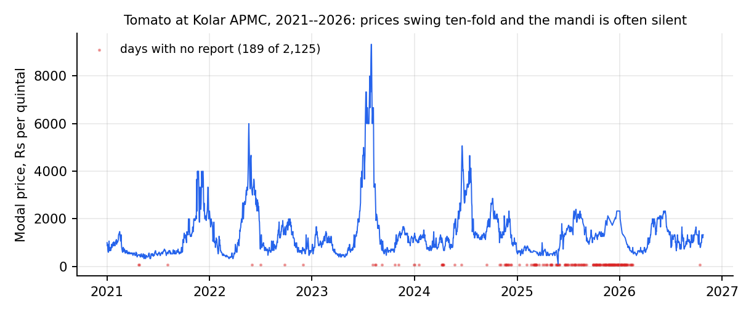
Introduction and Problem Statement
Context: farmers in the Bengaluru–Kolar belt choose a mandi and a day with only yesterday's price. Kolar tomato ranged Rs 100–9,330 per quintal and was silent on 189 of 2,125 days.
Problem: choose (mandi, hold 0–3 days) or the farm gate to maximise net revenue, and state a floor that holds.
Gap: models are judged on forecast error, not decisions; reporting gaps are ignored; decompose-then-forecast gains are unaudited [1]–[6].
Scope: tomato, onion, potato, ginger; Agmarknet only; offline evaluation. Garlic refused (one eligible mandi).
63,524
36,821
4 crops
real Agmarknet records
mandi-days in the panel
plus garlic refused
Why it matters: a farmer who gambles a harvest needs a minimum expected revenue, not just a forecast. Information frictions of exactly this kind measurably hurt small sellers [7], [8].
Department of Computer Science & Engineering(Data Science)
Notes:
[CORE · about 1.5 min]
SAY
A farmer in Kolar chooses a mandi and a day using only yesterday's price. That is a poor guide. This chart is tomato at Kolar APMC over five years: the modal price ranged from one hundred rupees to more than nine thousand per quintal, and on one hundred and eighty-nine of two thousand one hundred and twenty-five calendar days the mandi posted no price at all. The red marks are those silent days.
So the problem is a decision, not a forecast: choose a mandi and a holding period, zero to three days, or the farm gate, to maximise what the farmer actually keeps after transport, fees and spoilage, and state a minimum that holds.
The gap in the literature is that price models are judged on forecast error, they ignore that mandis go silent, and the large gains reported by decompose-then-forecast models were never audited.
We used sixty-three thousand real Agmarknet records, thirty-six thousand eight hundred mandi-days, for tomato, onion, potato and ginger. Garlic is refused by design because only one mandi has enough reports, so there is no choice to make.
SHOW / CLICK
Point at the red marks on the chart, then at the three stat boxes.
NUMBERS TO QUOTE
- 63,524 records; 36,821 mandi-days
- Tomato Kolar: Rs 100 to Rs 9,330 per quintal
- 189 silent days of 2,125
- Garlic refused: one eligible mandi
IF ASKED
Q: Why not just forecast the price?
A: Because a forecast is only useful through the decision it supports. We train on what the farmer would have received, including the cost of a silent mandi, and we show that this matters more than the forecasting model.
Q: Is the data real?
A: Yes. Two Agmarknet exports that agree on 3,307 overlapping tomato market-days (correlation 0.99996). There is no synthetic data in any result. An early synthetic dataset was found and removed; it is in our risk register.
TRANSITION
Now the objectives and where each one stands.

Slide 4
Objectives
Status: 7 met · 1 partly met (floors) · 1 null result (spillover) · 1 built and tested (digest, shown live today).
# | Objective (approved scope) | Status | Evidence
1 | Real-data panel, ≥30,000 mandi-days, exclusions recorded | Met | 36,821 mandi-days; 63,524 records
2 | Revenue formulation + market-choice model; ≥500 held-out days per crop | Met | 511–963 scored days per crop
3 | Test label and loss effects with paired tests | Met | Realised labels: −87 to −157 Rs/q; SPO+ no gain
4 | Floor violation within 2 points of nominal 10% | Partly | Tomato 9.0%, ginger 10.5%; onion 6.3%, potato 6.9%
5 | FastAPI + trilingual app, tests, reproducible pipeline | Met | 669 backend + 11 web tests; one-command pipeline
6 | Audit decompose-then-forecast leakage; foundation-model baseline | Met | +27…62% skill → −15…−1% when causal
7 | LLM decision intelligence, grounded and verified | Met | Judge caught 9/9 corrupted; 30 unit tests
8 | Cross-commodity spillover with FDR control | Null result | 0 of 40 edges published: no shock episodes
9 | Inspectable advice: breakdown, what-if, track record, silence tax, crowd | Met | Parts add up to net; replay 165 days; 11 tests
10 | Dated morning digest on a free channel (Telegram), EN/KN/HI | Built, tested | 8 tests; live demo today; no farmer pilot
Department of Computer Science & Engineering(Data Science)
Notes:
[CORE · about 1.5 min]
SAY
We set ten objectives and the status of each is on the slide, including the ones that did not fully succeed.
Seven are met: the data panel, the revenue model, the label and loss tests, the application and pipeline, the leakage audit, the grounded language briefs, and the five insight features.
One is partly met: the floor. We aimed for the violation rate to be within two points of ten percent; tomato and ginger meet that, onion and potato were more cautious than needed.
One is a null result: spillover between crops. The engine ran on all forty combinations and published none, because no shock episode reached the evidence floor. We report that rather than force a number.
The last, the morning digest, is built and tested and you will see it live in a few minutes.
SHOW / CLICK
Run a finger down the Status column: green, one orange, one red, then the last row.
NUMBERS TO QUOTE
- 7 met · 1 partly · 1 null result · 1 built and tested
- 650 tests then; 669 backend tests and 11 web tests now
IF ASKED
Q: Why report a null result?
A: Because publishing an unsupported number is worse. The engine's rule is to publish an edge only with at least eight shock episodes. It found zero. We also state that this points to a gap in the shock-labelling step, which is in future work.
Q: Is objective 4 really failed?
A: Partly met. At the 10 percent level tomato violated 9.0 percent and ginger 10.5, onion 6.3 and potato 6.9. The cautious side is the safe side, but it misses the stated two-point band.
TRANSITION
Next, the method in plain language.

Slide 5
Proposed Methodology and System Architecture
Idea: train on what the farmer would actually receive (price net of transport, shrinkage and silent markets), not on the posted price.
Action: (mandi, hold 0–3 days) or farm gate; recommendation = best guaranteed revenue, with an adaptive conformal floor.
Rejected: predict-then-optimise on posted prices and decompose-then-forecast hybrids (they never see a silent market, and leak the future).
Market-choice engines
+ conformal floors
Agmarknet
exports
Clean + audit
loader, checks
Market panel,
observation store
FastAPI service
farmer · trader · chat
Next.js app
EN · KN · HI
Forecasters
+ specialist council
Shock study
+ spillover
Language layer: decision-intelligence briefs,
explanation writer + independent judge
Data layer → model layer → service layer (engines + five insight features) → language layer → presentation. All results use real portal records; no synthetic data enter any result.
Telegram bot · 7 am digest
Department of Computer Science & Engineering(Data Science)
Notes:
[CORE · about 2 min]
SAY
The idea is simple. A conventional model predicts the posted price and picks the best predicted market. But it never sees a silent market, so it cannot learn that a mandi may be closed. We instead train on what the farmer would actually receive: price after the fee, after spoilage while waiting, after transport, and a penalty if the mandi turns out silent.
The action is a mandi and a holding period, or the farm gate. The recommendation is the action with the best guaranteed revenue, using an adaptive conformal floor.
We rejected two alternatives: predict-then-optimise on posted prices, and decompose-then-forecast hybrids, because they never see silent markets and, as our audit shows, they leak the future.
The architecture: Agmarknet exports are cleaned and audited into a market panel; engines, forecasters and the shock study feed one FastAPI service; a language layer, the insight features and a Telegram bot sit on top; the Next.js app serves English, Kannada and Hindi.
SHOW / CLICK
Trace the arrows left to right: exports, clean, panel, three engines, FastAPI, Next.js. Point at the orange language box and the Telegram bot box.
NUMBERS TO QUOTE
- Five layers: data, model, service, language, presentation
- No synthetic data in any result
IF ASKED
Q: Why conformal and not a normal-distribution floor?
A: A normal floor assumes normal errors; on our data it was breached on 26 to 35 percent of days in three crops when the target was 10 percent. Conformal inference gives a coverage guarantee under shift, and we calibrate it online with delayed feedback.
TRANSITION
Now the formulation, with every symbol defined.

Slide 6
Key Formulation: Revenue, Loss and Verified Floor
Net revenue of action (m, k) from origin ℓ
Sym. | Meaning | Default
f | market fee + commission | 4 %
c₀ | handling per trip | Rs 20
τ | transport, Rs per quintal-km | 0.35
ρ | road / great-circle distance | 1.3
δ | daily spoilage (tomato / onion / potato) | 3 / 0.8 / 0.4 %
φ | price discount if mandi silent | 0.85
φ_g | farm-gate discount | 0.80
α, γ | floor level, ACI step | 0.10, 0.01
R(m,k | ℓ) = (1 − f)(1 − δ)ᵏ · P̃(m, t+k) − τ·ρ·d(ℓ,m) − c₀
P̃ = P if market m reported on day t+k, else φ · P̄(t+k) (wasted trip); farm gate pays φ_g · P̄(t)
Decision-focused loss (SPO+)
L(r̂, r) = max_a (2r̂ₐ − rₐ) − 2r̂ₐ* + rₐ*
non-negative, zero at the truth, upper-bounds regret; tested against squared error
Guaranteed floor and adaptive level
Parameters are scenario assumptions, not estimates. τ, δ and φ are swept at evaluation time; conclusions hold across all 10 settings per crop.
L = r̂ − q·σ̂ ; αₜ₊₁ = αₜ + γ (α − 1[R < L])
q = (1 − αₜ) quantile of past normalised scores; outcomes of a k-day hold are released only after the sale date
Department of Computer Science & Engineering(Data Science)
Notes:
[SKIP IF SHORT · about 1.5 min]
SAY
Three formulas. The first is the revenue of an action: the price after the fee, after spoilage for each day of waiting, minus transport and handling. If the mandi is silent the farmer gets a fraction of the day's mean price instead.
The second is the decision-focused loss, SPO-plus, which trains the model on the regret of the decision. It is exact here because revenue is linear in prices.
The third is the floor: the predicted revenue minus a multiple of the recent error, and the confidence level updates after each outcome, but only once the sale date has passed, because a three-day hold resolves three days later.
The cost parameters are scenario assumptions, not estimates. We sweep them and the conclusions hold across ten settings per crop.
SHOW / CLICK
Do not read symbols. Point at the three boxes and the parameter table on the right.
NUMBERS TO QUOTE
- Fee 4 percent; handling Rs 20; transport Rs 0.35 per quintal-km; spoilage 3, 0.8, 0.4 percent a day
IF ASKED
Q: Where do the parameters come from?
A: They are scenario assumptions and the app shows them. The farmer can change them in the what-if panel, and we report sensitivity across ten settings per crop.
TRANSITION
Two supporting services: grounded briefs and spillover.

Slide 7
Decision Intelligence and Cross-Commodity Spillover
Objective 7: grounded decision briefs
Objective 8: spillover between crops
1. Evidence bundle: flat map of dotted keys (forecast.h5.point, market-choice, arrivals, spillover) + what was unavailable
2. Provider fills a fixed schema: action BUY/SELL/HOLD/WAIT, confidence (may be INSUFFICIENT_EVIDENCE), factors that each cite an evidence key
3. Grounding check: every figure within 1% of an evidence value, every key exists, no market named outside the evidence
4. Never fails silently: failing provider → deterministic fallback; ungrounded brief served as grounded:false with issues listed
Policy: a HOLD is overridden when spoilage outruns the expected gain
Panel: weekly returns of 5 crops, 232 weeks, one reference market each
Clean: remove first common factor (24.5% of variance) and calendar-month means so shared shocks are not read as transmission
Episodes: source crop in squeeze or glut; onsets <4 weeks apart merged
Effect: mean response of target over h = 1–4 weeks minus its unconditional baseline
Inference: bootstrap over whole episodes (2,000 draws, 90%); Benjamini–Hochberg FDR 10% across 40 edges
Gates: ≥8 episodes, CI excludes 0, |effect| ≥ 1%; otherwise INSUFFICIENT_EVIDENCE
Department of Computer Science & Engineering(Data Science)
Notes:
[SKIP IF SHORT · about 1.5 min]
SAY
Two supporting components, each with the same rule: publish a claim only when the evidence supports it.
On the left, the decision-intelligence service. It gathers an evidence bundle, asks a language model to fill a fixed schema, and a verifier checks every figure against the evidence within one percent and every cited key. A brief that fails is shown as ungrounded with the issues listed; a failing provider falls back to rules. An independent judge model caught all nine deliberately corrupted explanations and rejected none of three faithful ones; the sample is small and we say so.
On the right, the spillover engine: weekly returns of five crops, the common market factor and seasonality removed, shock episodes, a bootstrap over episodes and false-discovery control. It needs eight episodes per edge. It found none, so it published none.
SHOW / CLICK
Left card then right card.
NUMBERS TO QUOTE
- Judge: 9 of 9 corrupted caught, 0 of 3 faithful rejected
- Spillover: 40 edges, 0 published, 0 shock episodes
IF ASKED
Q: Does the language model decide the advice?
A: No. The engines decide. The model only words a sentence that code has already computed, and a validator rejects any change to a number.
TRANSITION
Now the five insight features that make the advice inspectable.

Slide 8
Insight Features: Method
1 Breakdown: why this mandi
4 Silence tax
R = P − fP − (1−f)·P·[1 − (1−δ)ᵏ] − τρd − c₀
Tₘ = sₘ · max( P̄ₘ − φ·P̄day , 0 )
the parts add up to the served net revenue; the code asserts it
s = surprise silence on open days; weekdays silent ≥ 90% are known closed days
2 What if: break-even cost
5 Crowd simulator
x* = min { x on grid : a*(x) ≠ a*(x₀) }
Pₘ(x) = Pₘ · (1 + x / Aₘ)^(−b)
re-price every action under the farmer's costs; report where the best action flips
Aₘ = median daily arrivals; b = 0.115 is an association (SE 0.023): a scenario
3 Track record
None of these fits a model at request time. Each reads the served engine and the ingested panel, and every assumption is returned with the answer.
win: gain > ₹1 · tie: |gain| ≤ ₹1 · loss: gain < −₹1
only days after the floor multiplier was fitted; floor held if R ≥ L
Department of Computer Science & Engineering(Data Science)
Notes:
[CORE · about 1.5 min]
SAY
Advice has to be inspectable. We built five features, all from the served engine and the ingested panel, none fitting a model at request time.
The breakdown writes the net revenue as its parts, and the code asserts that the parts add up to the served figure.
The what-if re-prices every action under the farmer's own costs and finds the exact cost at which the advice flips.
The track record replays the back-test day by day on days the floor was not fitted on.
The silence tax is the expected rupees lost per quintal on a trip to a mandi because it reports no price, after ignoring weekdays that are known closed days.
The crowd simulator asks what happens to a mandi's price if many farmers follow the same advice. The price flexibility, 0.115, is an association in past data, not a causal estimate, so it is a scenario with a slider.
SHOW / CLICK
Point at the four formulas: breakdown identity, silence tax, crowd price impact, track-record definition.
NUMBERS TO QUOTE
- Flexibility b = 0.115, standard error 0.023
- Closed day = silent on 90 percent or more of that weekday
IF ASKED
Q: Is the crowd result a measured effect?
A: No, and we say so on the screen. It is a scenario. At b equal to zero every policy is equal; the conclusion strengthens as b rises. A field pilot would be needed to measure the real response.
TRANSITION
Now the implementation and the live demonstration.

Slide 9
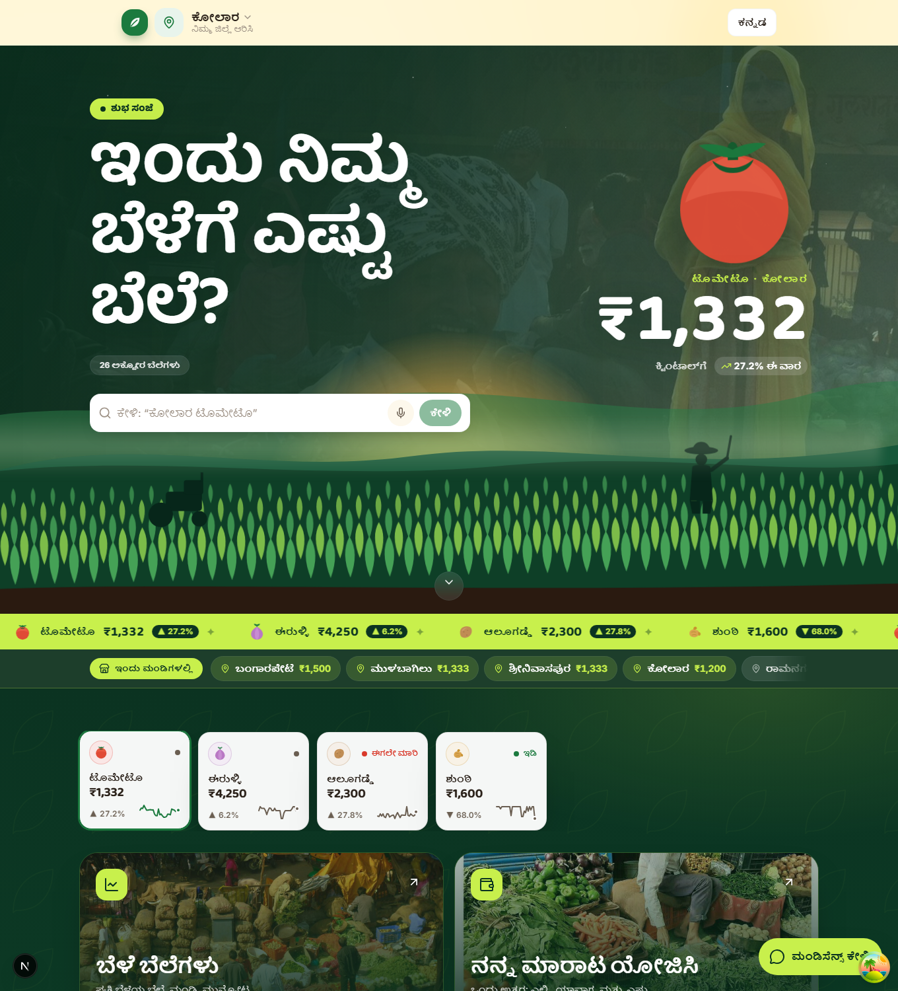
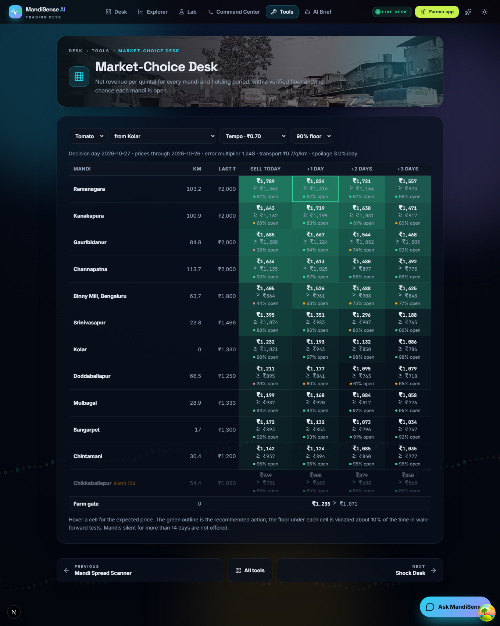
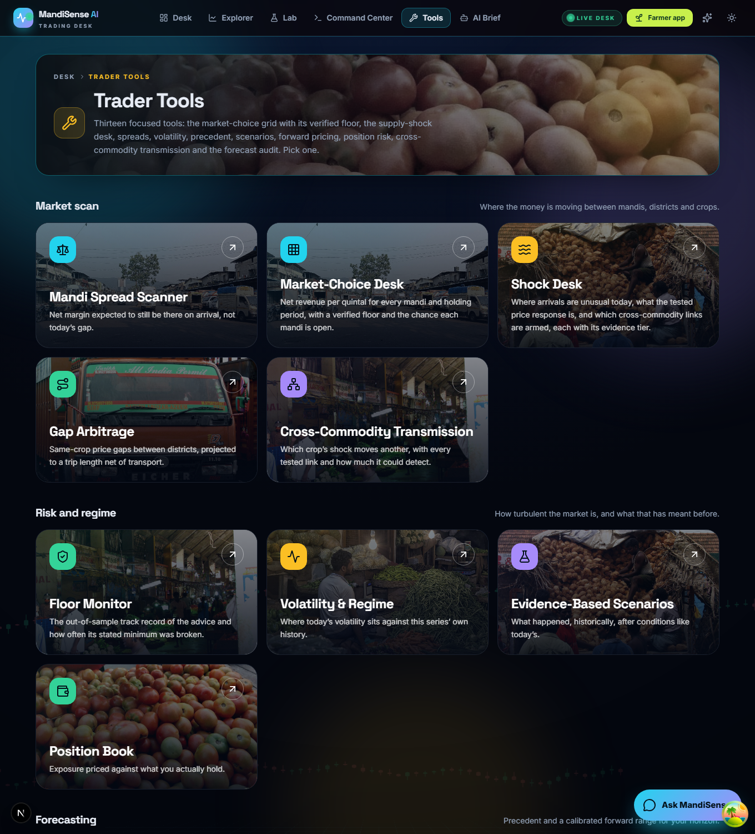
Implementation and System Integration
Integrated: one pipeline command runs 13 stages from raw exports to tests; API, web app, engines and language layer share one data store.
Manual: refreshing Agmarknet exports (download by hand); public deployment config exists but is not verified live.
Defects fixed: NumPy 2 broke pandas; fresh clone missed the observation store; hard deletion emptied trader pages; council weights summed above 1.
world
forecasts
market
choice
track
record
transmission
shock
spillover
council
research
evidence
results
doc
tests
scripts/pipeline.py: each stage has declared outputs; run alone, skipped, or dry-run (--list, --only, --skip, --dry-run)
Endpoints: /v1/market-choice (+5 insight routes), /v1/farmer, /v1/trader, /v1/shock, /v1/council, /v1/spillover, /v1/intelligence, /v1/chat, /v1/notify
Department of Computer Science & Engineering(Data Science)
Notes:
[CORE · about 1.5 min]
SAY
The system is integrated end to end. One command, pipeline dot py, runs the stages in dependency order, from the farmer world and forecasts to the engines, the track record, shocks, spillover, council, evidence, results and the tests. Each stage declares its inputs and outputs and can be run alone.
What is manual: refreshing the Agmarknet exports, which we download by hand, and verifying the public deployment, whose configuration exists but which we have not tested live.
Defects found during integration, and fixed: a NumPy upgrade broke pandas, a fresh clone was missing the observation store, a hard delete emptied the trader pages, the council weights summed above one, and a stale server answered new endpoints with not-found during testing.
The next two slides are the demonstration. It is live.
SHOW / CLICK
Point along the pipeline boxes. The screenshots are only a reminder of the three screens.
NUMBERS TO QUOTE
- Pipeline stages with declared outputs; 669 backend tests; 11 web tests; 60-check smoke test
TRANSITION
Overview of what you will see, then the demo.

Slide 10
What You Will See: Five Features and a Digest
1 Why this mandi?
2 What if my costs differ?
3 Has this advice worked?
Per-quintal arithmetic of the advice: price − fee − spoilage − transport − handling = net.
Farmer app · /breakdown
Sliders for transport, spoilage and longest wait; the advice updates and says where it flips.
Farmer app · /simulate
The advice replayed on 165 days it had not seen: wins, ties, losses; floor score.
Farmer app · /track-record
4 Silence Tax
5 Crowd Simulator
6 Daily digest
Rupees lost per quintal on a trip because a mandi reports no price; weekday strip.
Trader desk · /reporting-value
What happens to a mandi's price when 200 farmers follow the same advice; coordinated split.
Trader desk · /crowd
A dated morning message with advice only where evidence is strong.
Telegram bot · /v1/notify
Department of Computer Science & Engineering(Data Science)
Notes:
[CORE · about 1 min]
SAY
Before we switch to the browser, here is what you will see. Five features plus the digest, each answering one question: why this mandi, what if my costs differ, has the advice worked, what do silent mandis cost, what happens if everyone follows it, and what does the farmer receive at seven in the morning.
Three are inside the farmer tool, two are trader tools, and the digest is a Telegram bot.
SHOW / CLICK
The six cards. Say the question on each card.
TRANSITION
Switch to the browser: demo part one.

Slide 11
Live Demonstration (1/2): Farmer Tool
Step | Do | You will see
A1 | Tools → Best Place & Day to Sell · Kolar, tomato, 10 q, tempo | Ramanagara, Wed 28 Oct, 103 km · ₹1,824 expected · ₹1,316 floor · ₹592 above nearest
A2 | Open “Why this mandi?” | 2,081 − 83 − 60 − 94 − 20 = ₹1,824; nearest Kolar ₹1,233
A3 | What if: drag transport to ₹3.00 | Same advice, net ₹1,515
A4 | What if: drag spoilage to 5% | Advice changes: Ramanagara today, ₹1,789
A5 | Open “Has this advice worked?” | 93% better than nearest · floor held 84% (aim 90%)
A6 | Switch language to Kannada, then back | All panels in Kannada
Live: the demonstration runs from the repository. Figures are from the data loaded on 29 October 2026 (prices to 26 October).
Department of Computer Science & Engineering(Data Science)
Notes:
[CORE · about 4 min]
SAY
(Switch to the browser, farmer app. Follow the six steps on the slide; the full click path with exact values is in the demo script.)
Say as you go: this is the farmer view. Kolar, tomato, ten quintals, tempo. The advice is Ramanagara, Wednesday, one day from now, a hundred and three kilometres. The farmer keeps about one thousand eight hundred and twenty-four rupees per quintal after transport and fees, and can count on at least one thousand three hundred and sixteen on nine days out of ten.
Open Why this mandi: the green bar is what the farmer keeps; the coloured slices are fee, spoilage, transport and handling; they add up exactly. The nearest mandi, Kolar, keeps one thousand two hundred and thirty-three.
Open What if my costs differ: drag transport to the maximum. Even at three rupees per quintal-kilometre the advice does not change. Now drag spoilage up: at five percent a day it flips to Ramanagara today. This tells the farmer the advice is robust to the truck but sensitive to the crop's shelf life.
Open Has this advice worked: ninety-three percent better than the nearest mandi on days it had not seen; and, honestly, the minimum held on eighty-four percent of days against the ninety we aim for. We show that score rather than hide it.
SHOW / CLICK
Browser: http://localhost:3000/tools, Best Place and Day to Sell. See the run-of-show for each click and the on-screen values.
NUMBERS TO QUOTE
- Ramanagara, +1 day, 103 km
- Rs 1,824 expected; Rs 1,316 floor; 10 quintals Rs 18,238 / Rs 13,165
- Nearest (Kolar) Rs 1,233; gain Rs 592 per quintal
- Transport Rs 3.0: still same advice, net Rs 1,515
- Spoilage 5.0 percent: Ramanagara today, Rs 1,789
- 93 percent better than nearest; floor held 84 percent
IF ASKED
Q: Why does the advice ignore the mandi nearest to me?
A: Because the net after transport is higher elsewhere: the price it expects is Rs 776 higher and that outweighs Rs 94 extra transport and Rs 60 spoilage. The breakdown shows it line by line.
TRANSITION
Demo part two: the trader desk and Telegram.

Slide 12
Live Demonstration (2/2): Trader Desk and Telegram
Step | Do | You will see
B1 | Trader tools → Silence Tax (tomato) | Kanakapura ₹313 (16.5%); Chikkaballapur closed Thursdays; Kolar ₹0 ≠ reliable
B2 | Crowd Simulator: 200 farmers × 10 q | Alone ₹1,824 · all follow best ₹1,194 (−32.5%) · nearest ₹1,207 · coordinated ₹1,436
B3 | Drag farmers to 1; flexibility b to 0 | All policies equal: the assumption is explicit
C1 | Phone: @MandiAis_BOT → /today | Dated digest: Ramanagara, ₹1,824, floor ₹1,316; potato prices only
C2 | Send “onion chintamani” | Digest for that crop and place
C3 | Run send_daily_digest.py (the 7 am job) | Phone buzzes; log line shows sent
D1 | Optional: API docs | Five insight endpoints + notify routes
Fallback if the network is down: the digest builder runs offline (--dry-run); every screen also appears as a real screenshot on the results slides.
Department of Computer Science & Engineering(Data Science)
Notes:
[CORE · about 4 min]
SAY
(Trader desk and phone.) The same engine, for a trader. Open the Silence Tax. Each row is a tomato mandi. The coloured week strip shows which weekdays it reports: green reliable, red effectively closed. Kanakapura loses a trip about three hundred and thirteen rupees a quintal, sixteen and a half percent of its price, mostly on Sundays and unpredictably on other days. Chikkaballapur reported on none of last year's Thursdays, so a farmer is told not to take a Thursday load there. Note Kolar shows zero: that does not mean it is reliable; it means its usual price is below the fallback, so silence costs no money on price. The table also shows surprise silence for exactly this reason.
Open the Crowd Simulator. One farmer alone nets one thousand eight hundred and twenty-four. With two hundred farmers, two thousand quintals, all following the best advice, that mandi, which normally receives about sixty-eight quintals a day, drops thirty-two and a half percent and each farmer nets one thousand one hundred and ninety-four. Everyone going to the nearest mandi gives one thousand two hundred and seven. A coordinated split, where each farmer is told a different action with a stated probability, gives one thousand four hundred and thirty-six: two hundred and forty-one rupees more per quintal, about four point eight lakh for the group. Drag the flexibility to zero and every policy becomes equal: that is the assumption, and we state it.
Now the phone: Telegram, the MandiSense bot. Send slash today. This is the morning digest, with the date of the data, advice only where the evidence is strong, and a warning when a mandi is usually silent. Type onion Chintamani and it answers for that crop and place. In production the digest goes at seven every morning from a scheduled script.
SHOW / CLICK
Browser tabs: /trader-tools/reporting-value, /trader-tools/crowd-simulator. Then the phone with the bot chat open.
NUMBERS TO QUOTE
- Kanakapura Rs 313 per quintal (16.5 percent)
- Chikkaballapur: 100 percent silent on Thursdays last year
- 200 farmers: alone Rs 1,824; all follow best Rs 1,194 (-32.5 percent); nearest Rs 1,207; coordinated Rs 1,436
- Coordination gain Rs 241 per quintal; Rs 4,82,705 for the group
- Yard usually receives about 68 quintals a day
IF ASKED
Q: Is Telegram realistic for farmers?
A: Not for most farmers today. It is free, needs no gateway or registration, and shows the product end to end. The same message text can go over SMS or WhatsApp once sender registration is done; we say that openly.
Q: Where does the data for the digest come from?
A: From the ingested Agmarknet data. There is no live feed, so the message states the date of the data and its age.
TRANSITION
Switch back to the slides: tools and quality.

Slide 13
Tools, Technology Stack and Code Quality
Repository: Git, 69 commits; README, requirements.lock, docs for architecture, tool choices, shock study, council and LLM evaluation; CI workflow.
Reproducible: pipeline.py regenerates all artefacts; the thesis tables are generated from them, not typed.
Tested: 669 backend tests and 11 web tests passing; a 60-check smoke test of every endpoint and page; fresh-clone check; CI.
Layer | Tool (version) | Why chosen
Data / stats | NumPy 1.26.4, pandas 2.1.4, SciPy 1.11.4, statsmodels 0.14.1 | tested, pinned stack
Learning | LightGBM 4.6.0, XGBoost 2.0.3, scikit-learn 1.3.2, Optuna, PyTorch (research env) | trees win on tabular [19]; Optuna TPE [20]
Backend | FastAPI 0.136.1, Uvicorn 0.46.0, Pydantic 2.13.3 | typed requests, auto API docs
Frontend | Next.js 16.2.4, React 19.2.4, TypeScript 5, Tailwind 4 | fast pages on weak connections
Language layer | gpt-oss-120b writer, Qwen judge (Groq); Claude provider optional | two model families; deterministic fallback
Quality | pytest 9.0.3, vitest 3.2, GitHub Actions, Docker, Render file | automated checks on every push
Department of Computer Science & Engineering(Data Science)
Notes:
[SKIP IF SHORT · about 1 min]
SAY
The stack and why each piece. Python with pinned NumPy, pandas and statsmodels. LightGBM and XGBoost because trees win on tabular data; Optuna for tuning. FastAPI for typed requests and automatic API documentation. Next.js for pages that load fast on weak connections. Two model families for the language layer, with a deterministic fallback.
The repository is reproducible: the lock file, a one-command pipeline, and the thesis tables are generated from the artefacts, not typed. We have six hundred and sixty-nine backend tests passing, eleven web tests, a sixty-check smoke test that exercises every endpoint and page, and continuous integration.
SHOW / CLICK
Table of tools; point at the Tested bullet.
NUMBERS TO QUOTE
- 669 backend + 11 web tests passing
- Smoke test: 60 checks, all passed on 29 Oct 2026
- 69 commits at the time of writing
IF ASKED
Q: Who wrote the code?
A: The repository's contribution record shows the commit history; the work-package split is in the planning slides. We show that record in the report rather than hide it.
TRANSITION
Experimental setup.

Slide 14
Experimental Setup and Evaluation Metrics
Split: nested walk-forward, 5 outer blocks (2024-H1 → 2026-10); inner validation by Optuna (20 neural / 25 boosting trials); K+2-day gap before every block.
Setup: Core i9-13900HX, 31.7 GB, RTX 4060; fixed seeds recorded in configuration; same tuning budget for every method.
Metrics: realised revenue, regret to hindsight oracle, share of oracle gap closed, silent-market trips, floor violation, forecast skill.
Baselines (all retrained): random walk, LightGBM/XGBoost on observed prices, nearest mandi, highest price yesterday, best 7-day mean, farm gate.
Crop | Mandi-days | Mandis | Eligible | Test days | Studied
Tomato | 17,582 | 14 | 12 | 963 | yes
Onion | 5,343 | 11 | 4 | 511 | yes
Potato | 5,000 | 12 | 3 | 569 | yes
Ginger | 6,423 | 10 | 3 | 776 | yes
Garlic | 2,473 | 7 | 1 | — | refused
Total | 36,821
Inference: moving-block bootstrap (block 14); Newey–West Diebold–Mariano; Holm across all pre-specified comparisons; model confidence set [24]–[27].
Pre-specified: model ladder, 12 paired comparisons, silence tests and leakage protocol were fixed before tuned results were seen.
Department of Computer Science & Engineering(Data Science)
Notes:
[CORE · about 1.2 min]
SAY
The evaluation is a nested walk-forward: five outer test blocks from 2024 to October 2026, each trained only on earlier data, with a gap of K plus two days so no four-day target overlaps. Inside every fold, Optuna tunes on a validation block. Every method gets the same budget and is retrained, not quoted.
Metrics: realised revenue, regret to a hindsight oracle, the share of the gap between the nearest-mandi rule and the oracle that a method closes, silent-market trips, floor violation and forecast skill.
Inference: block bootstrap, Diebold-Mariano with Newey-West variance, Holm correction across all pre-specified comparisons, and a model confidence set. We fixed the model ladder, the comparisons and the leakage protocol before seeing the tuned results.
Machine: a Core i9 laptop with 31.7 GB and an RTX 4060.
SHOW / CLICK
Dataset table on the left; protocol bullets on top.
NUMBERS TO QUOTE
- 963 / 511 / 569 / 776 test days (tomato / onion / potato / ginger)
- 5 outer folds; 20 neural and 25 boosting Optuna trials
TRANSITION
Results.

Slide 15
Results and Validation: Decision Quality
Result: models trained on realised revenue earn the most in every crop; the oracle bounds what is possible.
Why: observed-price models send 12–43% of trips to a silent market; realised-label models cut that to 5–21%.
Rs 2,156
tomato, realised-label model (oracle 2,570)
+Rs 556
over nearest mandi, tomato (1,600 → 2,156)
Holm p < 0.002
labels effect in all four crops
Department of Computer Science & Engineering(Data Science)
Notes:
[CORE · about 1.2 min]
SAY
Decision quality. Each group is a crop; bars are mean realised revenue per quintal. The dark blue and the lighter blue are models trained on realised revenue; they are the best in every crop. The grey and gold bars, the heuristics and the observed-price model, are lower, and the last bar is the hindsight oracle, the ceiling.
For tomato, the realised-label model earns two thousand one hundred and fifty-six rupees, against two thousand twenty-one for yesterday's highest price and sixteen hundred for the nearest mandi, with the oracle at two thousand five hundred and seventy.
The reason: observed-price models send twelve to forty-three percent of trips to a silent mandi; the realised-label models cut that to five to twenty-one percent.
SHOW / CLICK
Point at the blue bars, then at the red-flag stat on the right.
NUMBERS TO QUOTE
- Tomato: Rs 2,156 vs Rs 2,021 vs Rs 1,600; oracle Rs 2,570
- Silent trips 12 to 43 percent down to 5 to 21 percent
TRANSITION
Statistical validation.

Slide 16
Statistical Validation: What Actually Improved Decisions
Crop | Labels: realised vs observed (Δ regret, Rs/q) | 95% CI | Holm p | SPO+ vs squared error (Δ regret, Rs/q) | Holm p
Tomato | −140 | [−181, −102] | < 0.0001 | −25 [−53, +3] | 0.51
Onion | −157 | [−224, −89] | < 0.0001 | −23 [−62, +11] | 0.21
Potato | −87 | [−142, −39] | 0.002 | +1 [−27, +32] | 0.95
Ginger | −149 | [−232, −80] | < 0.0001 | −66 [−180, +30] | 0.17
Finding
Model confidence set
Limits
Better labels, not a fancier loss: realised-outcome supervision cuts regret in all four crops; SPO+ adds nothing reliable.
Only realised-label models survive in every crop; no observed-price model does. Tomato keeps 7 specifications; the others 3.
One region, one source, 5.8 years; revenue parameters are scenarios; silent day treated as no sale; offline only.
Department of Computer Science & Engineering(Data Science)
Notes:
[CORE · about 1 min]
SAY
What actually improved decisions. The left block: changing the labels from observed price to realised revenue, with the same learner, reduced regret by eighty-seven to one hundred and fifty-seven rupees per quintal in all four crops, Holm-adjusted p below zero point zero zero two. The right block: swapping squared error for the decision-focused loss on the same labels gave no reliable difference, p between zero point one seven and zero point nine five. So the gain comes from learning on what the farmer actually received, not from a fancier loss.
The model confidence set agrees: only realised-label models survive in every crop.
SHOW / CLICK
Table, then the three cards.
NUMBERS TO QUOTE
- Label effect: -140, -157, -87, -149 Rs per quintal
- SPO+ vs squared error: -25, -23, +1, -66; all p > 0.1
IF ASKED
Q: So SPO+ failed?
A: On this problem it adds nothing reliable once the labels are right. We pre-specified the comparison and report it; the literature also finds the benefit depends on the problem.
TRANSITION
Floors and the served engine's back-test.

Slide 17
Verified Floors and Served-Engine Back-test
Floor violation (%) target 10% | Adaptive 5% | Adaptive 10% | Adaptive 20% | Static 10% | Naive Gaussian
Tomato | 3.0 | 9.0 | 21.3 | 6.0 | 27.4
Onion | 1.6 | 6.3 | 15.5 | 4.0 | 34.5
Potato | 2.5 | 6.9 | 17.7 | 6.2 | 25.8
Ginger | 4.3 | 10.5 | 20.4 | 8.9 | 11.9
Back-test, last 330 days | Gain vs highest yesterday (Rs/q) | vs nearest | Gap closed | Evidence
Tomato | +170 [+104, +255] | +571 | 62% | strong
Onion | +60 [+16, +119] | +300 | 46% | strong
Potato | +15 [−38, +60] | +69 | 11% | limited
Ginger | +202 [+25, +429] | +1,595 | 67% | strong
Adaptive floors track the nominal level; the static quantile is cautious; a naive Gaussian floor is breached on 26–35% of days in three crops.
Department of Computer Science & Engineering(Data Science)
Notes:
[CORE · about 1.2 min]
SAY
The floor. We target ten percent violation. The adaptive floor tracks the target; the naive normal-distribution floor is breached on up to thirty-five percent of days. So the guarantee is real, not decoration.
On the right, the served engines back-tested over the last three hundred and thirty days, using only information available each day. The advice beats the highest price yesterday by one hundred and seventy rupees for tomato, sixty for onion, two hundred and two for ginger, all significant; potato's gain of fifteen rupees is not distinguishable from zero, so the app labels potato as limited evidence and does not advise where to sell.
SHOW / CLICK
Left table then the bar chart on the right.
NUMBERS TO QUOTE
- Adaptive 10 percent target: 9.0 / 6.3 / 6.9 / 10.5; naive 27.4 / 34.5 / 25.8 / 11.9
- Gain vs highest yesterday: +170, +60, +15 (n.s.), +202 Rs per quintal
TRANSITION
Now the insight results, starting with why this mandi.

Slide 18
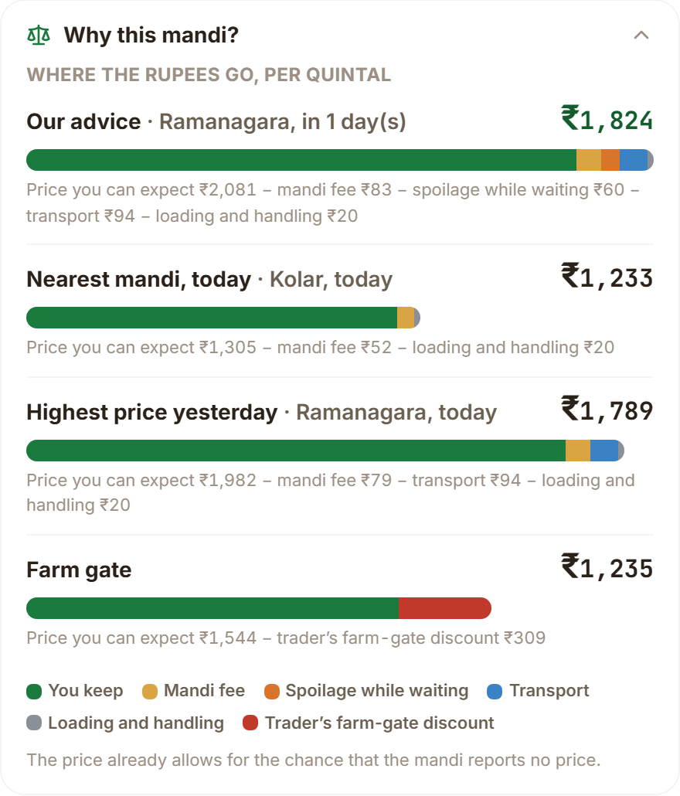
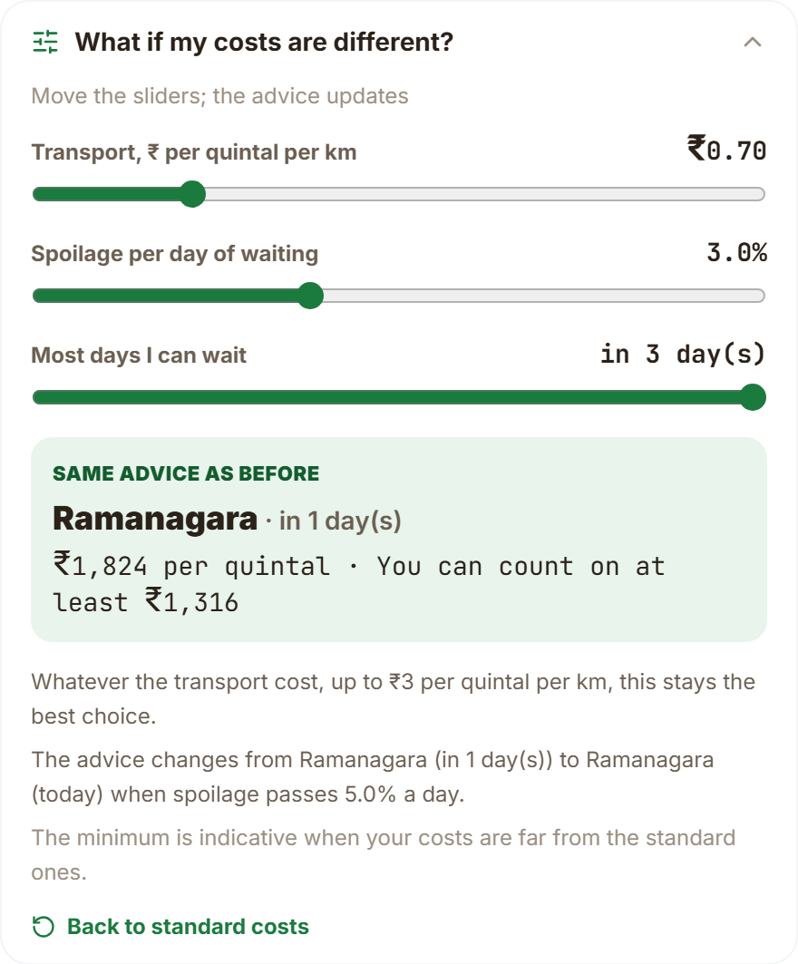
Explaining the Advice: Why This Mandi, What If
Parts add up. ₹2,081 − 83 − 60 − 94 − 20 = ₹1,824; nearest mandi keeps ₹1,232.
Why it wins. Expected price is ₹776 higher; extra transport ₹94 and spoilage ₹60 do not cancel it.
Robust to the truck. Transport up to ₹3.00 per q-km: same advice (net ₹1,515).
Sensitive to shelf life. At 5.0% spoilage a day, or no waiting: Ramanagara today, ₹1,789.
Floor is indicative when costs are far from the defaults; the screen says so.
Department of Computer Science & Engineering(Data Science)
Notes:
[CORE · about 1.2 min]
SAY
These are the first two panels from the demo. On the left, the breakdown: expected price two thousand and eighty-one, minus fee eighty-three, spoilage sixty, transport ninety-four and handling twenty, gives one thousand eight hundred and twenty-four. The nearest mandi keeps one thousand two hundred and thirty-two. The advice wins because the price it expects is seven hundred and seventy-six rupees higher, which outweighs ninety-four of extra transport and sixty of spoilage.
On the right, the what-if. Transport can rise to three rupees per quintal-kilometre, over four times the tempo rate, and the advice does not change; net falls to one thousand five hundred and fifteen. Spoilage of five percent a day, or a farmer who cannot wait, changes it to Ramanagara today at one thousand seven hundred and eighty-nine.
SHOW / CLICK
Left image: Why this mandi? Right image: What if? Then the bullets.
NUMBERS TO QUOTE
- Rs 2,081 - 83 - 60 - 94 - 20 = Rs 1,824
- Nearest Rs 1,232 (screen shows Rs 1,233 after rounding)
- Spoilage flip at 5.0 percent a day
TRANSITION
The track record.

Slide 19
Public Track Record on Days the Advice Had Not Seen
Crop | vs nearest: win / tie / loss | vs yesterday's best: win / tie / loss | Floor held
Tomato | 93 / 0 / 7 % | 24 / 68 / 8 % | 84%
Onion | 82 / 0 / 18 % | 34 / 39 / 27 % | 89%
Potato | 63 / 2 / 35 % | 52 / 12 / 36 % | 92%
Ginger | 90 / 0 / 10 % | 23 / 54 / 23 % | 86%
The honest part. The floor, set to hold 9 days in 10, held on 84 / 89 / 92 / 86% of replayed days.
Why lower than the back-test: one multiplier fitted on half the window is the strictest of three evaluations (served rule violated 9.6–12.3%).
165 out-of-sample days, 12 May to 23 Oct 2026. A tie is a difference of at most ₹1: against yesterday's highest price the advice often picks the same action, so most days tie.
Department of Computer Science & Engineering(Data Science)
Notes:
[CORE · about 1.2 min]
SAY
The public track record. We replay the advice over one hundred and sixty-five days it had not seen, May to October. Against the nearest mandi it wins on ninety-three percent of days for tomato, eighty-two for onion, sixty-three for potato and ninety for ginger. Against yesterday's highest price most days are ties because the advice often picks the same action; where it differs it wins more than it loses for tomato and onion, ties for ginger, and wins fifty-two percent to thirty-six for potato.
The honest part: the floor, set to hold nine days in ten, held on eighty-four percent for tomato, eighty-nine for onion, ninety-two for potato and eighty-six for ginger. This replay is the strictest of three evaluations: one multiplier fitted on half the window. The served rule's own back-test violated nine point six to twelve point three percent. We show the farmer the real score.
SHOW / CLICK
Table and line chart; point at the Floor held column.
NUMBERS TO QUOTE
- 165 days, 12 May to 23 Oct 2026
- Wins vs nearest: 93, 82, 63, 90 percent
- Floor held: 84, 89, 92, 86 percent (target 90)
IF ASKED
Q: Isn't 84 percent a failure of the floor?
A: It is below the 90 percent target on this short, strict replay. The three evaluations differ in how the floor multiplier is fitted; the served rule's own back-test violates 9.6 to 12.3 percent. We report all three side by side in the thesis, and the app shows the score rather than a promise.
TRANSITION
The silence tax.

Slide 20
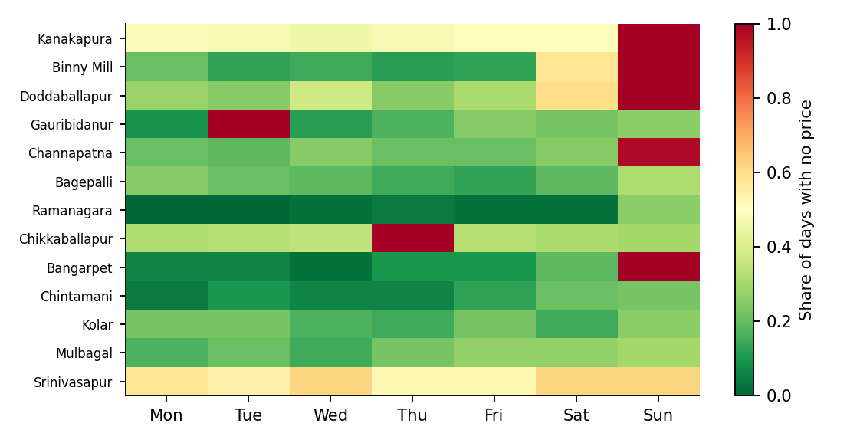
Silence Tax: What an Unreliable Mandi Costs a Trip
Mandi | Reported | Surprise silence | Known closed | Tax per quintal
Kanakapura | 44% | 49% | Sunday | ₹313 (16.5%)
Binny Mill | 67% | 22% | Sunday | ₹206 (8.5%)
Doddaballapur | 56% | 34% | Sunday | ₹135 (7.2%)
Gauribidanur | 70% | 19% | Tuesday | ₹121 (6.0%)
Channapatna | 67% | 22% | Sunday | ₹120 (6.3%)
Bagepalli | 79% | 21% | — | ₹69 (4.0%)
Ramanagara | 95% | 5% | — | ₹40 (1.8%)
Mean ₹78 per quintal per trip over 13 tomato mandis. Kanakapura loses ₹313 (16.5% of its price); Chikkaballapur reported on none of last year's Thursdays, so it is treated as closed that day.
Two cautions: a silent day may be a closed mandi or a missed upload; and ₹0 for a cheap mandi such as Kolar does not mean it is reliable, which is why surprise silence is shown beside it.
Department of Computer Science & Engineering(Data Science)
Notes:
[CORE · about 1 min]
SAY
The silence tax puts a rupee figure on unreliable reporting. Over thirteen tomato mandis, a trip loses seventy-eight rupees per quintal on average to surprise silence; Kanakapura loses three hundred and thirteen, sixteen and a half percent of its price. The heatmap shows each mandi by weekday: red columns are days it is effectively closed, like Sundays at several mandis and Thursdays at Chikkaballapur.
Two cautions. A silent day may be a closed mandi or a missed upload; the portal does not say. And a tax of zero for a cheap mandi does not mean reliable; it means its usual price is below the fallback, so we show surprise silence beside it.
SHOW / CLICK
Heatmap and table.
NUMBERS TO QUOTE
- 13 tomato mandis; mean Rs 78 per quintal per trip
- Kanakapura Rs 313 (16.5 percent)
- Chikkaballapur: 100 percent silent on Thursdays
TRANSITION
The crowd simulator.

Slide 21
Crowd Simulator: What If Everyone Follows the Advice?
−32.5%
price drop at the best yard (200 farmers)
₹241/q
gain of the coordinated split
₹482,705
gain for the group of 200
Scenario, not a measurement. The yard usually receives about 68 quintals a day. Price flexibility b = 0.115 is an association in past data; at b = 0 every policy is equal. A field pilot is needed to measure the real response.
Department of Computer Science & Engineering(Data Science)
Notes:
[CORE · about 1.2 min]
SAY
The question an examiner should ask: what if everyone follows your advice? One farmer alone nets one thousand eight hundred and twenty-four. With two hundred farmers all taking the best action, that mandi's price falls thirty-two and a half percent and each nets one thousand one hundred and ninety-four, no better than going to the nearest mandi. A coordinated split nets one thousand four hundred and thirty-six, two hundred and forty-one rupees per quintal more, about four point eight lakh for the group.
As the crowd grows to two thousand, every policy deteriorates and coordination matters more. This rests on a price flexibility of zero point one one five estimated as an association in past data. It is a scenario: at zero every policy is equal, and the real response to advised farmers has not been observed.
SHOW / CLICK
Line chart; stat boxes; point at the caveat card.
NUMBERS TO QUOTE
- 200 farmers x 10 quintals
- Alone Rs 1,824; follow-best Rs 1,194; nearest Rs 1,207; coordinated Rs 1,436
- Price drop 32.5 percent; gain Rs 241 per quintal; Rs 4,82,705 total
IF ASKED
Q: How would you measure the real effect?
A: A field pilot with advised and unadvised farmers at the same mandi, comparing price and quantity received. That is the first item in future work.
TRANSITION
The daily digest.

Slide 22
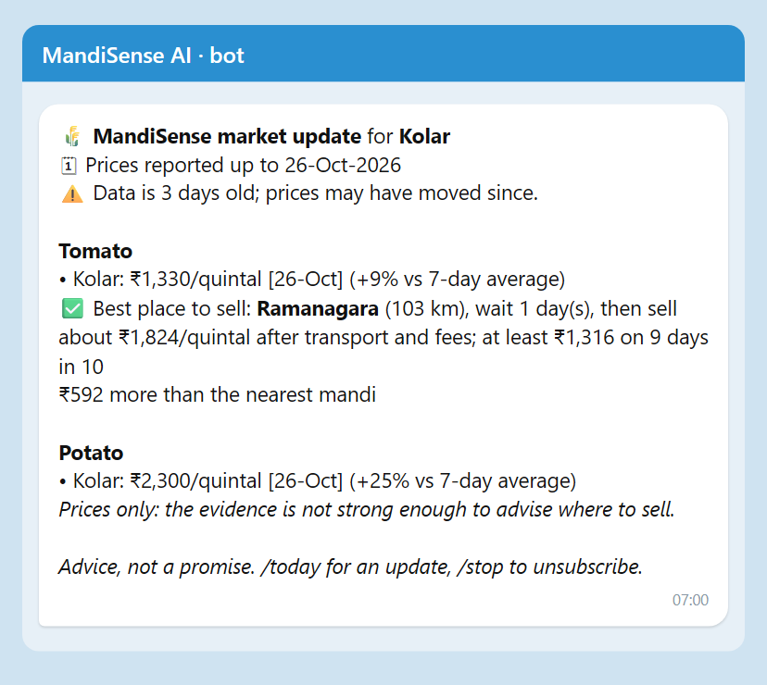
Daily Digest on Telegram
Dated, always. Every price shows its date; the second line says how old the data is (there is no live feed).
Advice only with evidence. Tomato, onion, ginger: best place and day with the floor. Potato, garlic: prices only.
Warns about silent days. If the recommended mandi is usually silent on the sale weekday, it says so.
Three languages, free. English, Kannada, Hindi; Telegram Bot API; /start, /today, /stop, or type “tomato kolar”.
Logged and tested. Every send is logged (2 logged sends to a real account); 8 unit tests with a fake client.
Not claimed: a farmer pilot, or a live price feed.
Department of Computer Science & Engineering(Data Science)
Notes:
[CORE · about 1 min]
SAY
This is the morning digest as the bot sends it. The second line gives the date of the data and, below it, how old it is, because we have no live feed. Each crop shows the latest reported price with its date and the change against the previous week. Advice appears only where the evidence is strong: tomato and onion here; potato gets prices only.
Built on the free Telegram Bot API: onboarding with buttons, languages English, Kannada and Hindi, slash today, slash stop, and free-text questions. Every send is logged, and the log shows deliveries to a real account. Eight unit tests pass with a fake client. Not claimed: a pilot with farmers and a live price feed.
SHOW / CLICK
Message image on the left; the bullets on the right.
NUMBERS TO QUOTE
- Bot: @MandiAis_BOT
- 8 digest tests; every price dated
- Scheduled by Windows Task Scheduler at 07:00
IF ASKED
Q: Why Telegram and not SMS?
A: SMS in India needs sender and template registration (DLT) and a paid provider. Telegram is free and lets us demonstrate the whole flow now. The message builder is channel-independent.
Q: Privacy?
A: Only chat id, first name, language, district and crops are stored, in a local file; users can stop at any time.
TRANSITION
Back to the research results: the leakage audit.

Slide 23
Look-Ahead Audit of Decompose-then-Forecast Models
+27 … +62%
skill under the published protocol
−15 … −1%
the same models, causal decomposition
Why: STL and VMD are two-sided smoothers, so the component at day t already contains later prices. Zero-shot Chronos-Bolt [17] scores −9.4% at 1 day: no model here beats the random walk on the daily tomato series.
Department of Computer Science & Engineering(Data Science)
Notes:
[CORE · about 1.2 min]
SAY
A third result: the audit of decompose-then-forecast models. Published studies decompose the whole series and report skill of twenty-seven to sixty-two percent against the random walk. We ran the same models under two protocols that differ only in how components at the forecast origin are computed. Decomposing once over the whole series reproduces the large skill; decomposing only the data available at each origin gives minus fifteen to minus one percent, no better than the raw series. The difference, thirty to seventy-one points, is look-ahead leakage: STL and VMD are two-sided smoothers.
A zero-shot foundation model, Chronos-Bolt, scored minus nine point four percent at one day. On the daily tomato series no model beat the random walk. We audited the protocol they describe, not the specific papers.
SHOW / CLICK
Bar chart: red published, blue causal.
NUMBERS TO QUOTE
- Published +27 to +62 percent; causal -15 to -1 percent
- Chronos-Bolt -9.4 percent at one day
TRANSITION
Studies that did not clear their bar.

Slide 24
Council, Shocks, Spillover and Language Layer
Study | What was tested | Result | Verdict
Specialist council | 4 feature-family agents, weights ≤ 1, 4 folds | council +0.2…+0.4% vs single +0.6…+0.8% skill; wins 0–1 of 4 folds | Not promoted
Supply-shock event study | 30 crop–horizon tests, placebo shifts, Holm | 0 robust, 5 suggestive; effects as large as the detectable minimum | Not served
Cross-commodity spillover | 5 crops, 40 edges, FDR 10%, ≥8 episodes | 0 shock episodes in all 10 source cells; 40/40 insufficient evidence | Withheld
District forecasts | 3-, 5-, 7-day vs no change, 90% band | skill +3.0…+4.0%, coverage 89.8%; 1-day not distinguishable | Served 3/5/7 d
Explanation layer | 24 texts, 120 sentences, EN/KN/HI, independent judge | kept: EN 0.83–0.99, KN 0.62–0.88, HI 0.68–0.91; judge caught 9/9 corrupted, 0/3 false alarms | Verified, small n
Zero spillover episodes is also a finding about the pipeline: the detector depends on supply-regime labels that the real panel does not yet supply. Listed under future work.
Department of Computer Science & Engineering(Data Science)
Notes:
[SKIP IF SHORT · about 1.2 min]
SAY
Not everything worked and we report it. The specialist council of four agents did not beat a single model and wins zero or one of four folds, so it is not promoted. The supply-shock event study found zero robust effects out of thirty tests and five suggestive. Spillover published none. District forecasts at three, five and seven days are served because they beat no-change with ninety percent bands that cover eighty-nine point eight percent; one day is not served. The explanation layer keeps eighty-three to ninety-nine percent of English sentences and fewer in Kannada and Hindi after an independent judge, and the judge caught nine of nine corrupted sentences.
Zero spillover episodes is also a finding about our pipeline: the detector depends on supply-regime labels that the real panel does not yet supply.
SHOW / CLICK
Table; read down the Verdict column.
NUMBERS TO QUOTE
- Council wins 0 to 1 of 4 folds
- Shocks: 0 robust, 5 suggestive of 30
- Spillover: 40 of 40 insufficient evidence
IF ASKED
Q: What would you do about spillover next?
A: Define shock episodes directly from arrivals, as the shock study does, and rerun the forty edges.
TRANSITION
Benchmarking.

Slide 25
Comparative Benchmarking
Same split, same metric, all retrained: no published study scores mandi choice by regret on real reporting-gap data, so baselines are the heuristics farmers use and the standard predict-then-optimise models.
Where we win: all four crops vs every heuristic and every observed-price model. Where we do not:
potato back-test gain is not distinguishable from the best heuristic, and SPO+ ties the squared-error loss.
Gap closed (nearest → oracle) / silent-market trips | Tomato | Onion | Potato | Ginger
Nearest mandi, sell today | 0.00 / 34% | 0.00 / 34% | 0.00 / 34% | 0.00 / 24%
Highest price yesterday | 0.43 / 28% | 0.26 / 43% | 0.17 / 35% | 0.69 / 11%
LightGBM, observed prices | 0.43 / 29% | 0.24 / 43% | 0.12 / 34% | 0.69 / 12%
LightGBM, realised outcomes (ours) | 0.57 / 12% | 0.48 / 18% | 0.31 / 21% | 0.76 / 5%
Neural SPO+, realised outcomes (ours) | 0.58 / 12% | 0.50 / 20% | 0.28 / 17% | 0.76 / 5%
Department of Computer Science & Engineering(Data Science)
Notes:
[SKIP IF SHORT · about 0.8 min]
SAY
The benchmark. Same split, same metric, every baseline retrained. No published study scores mandi choice by regret on real reporting-gap data, so the baselines are the heuristics a farmer uses and the standard predict-then-optimise models. Where we win: all four crops against every heuristic and every observed-price model. Where we do not: potato's back-test gain over the best heuristic is not significant and SPO-plus ties squared error.
SHOW / CLICK
Table; the two blue rows are ours.
NUMBERS TO QUOTE
- Gap closed: tomato 0.57; onion 0.48; potato 0.31; ginger 0.76
TRANSITION
Novelty.

Slide 26
Novelty and Research Contribution
In one sentence: supervise market choice on realised, silence-aware revenue, certify it with delayed-feedback conformal floors, and audit the leakage in published hybrids.
Already exists
New here
Ours vs adapted
Forecasters of agricultural prices [9]–[14]
SPO+ and decision-focused learning [21], [22]
Adaptive conformal inference [25]–[28]
Revenue labels that include silent markets, on real mandi data
Floors for selected actions whose outcome resolves k days later
Measured size of look-ahead leakage in STL/VMD hybrids
Verified language briefs and a withheld-by-default spillover engine
Ours: formulation, pipeline, leakage protocol, grounding verifier, engines, app
Adapted: SPO+ [21], ACI [26], DeepSets [29], Optuna [20], Chronos [17]
Honest scope: the positive contribution that survived testing is the label effect, the floor validity and the audit; the loss, reporting head, silence features, council and spillover are bounded negative results.
Department of Computer Science & Engineering(Data Science)
Notes:
[SKIP IF SHORT · about 1 min]
SAY
In one sentence: we supervise market choice on realised, silence-aware revenue, certify it with delayed-feedback conformal floors, and audit the leakage in published hybrids. What already exists: agricultural forecasters, SPO-plus, adaptive conformal inference. What is new here: revenue labels that include silent markets on real data, floors for selected actions whose outcome resolves later, a measured size of look-ahead leakage, and now an inspectable layer: breakdown, break-even, track record, silence tax and crowd scenario. What is ours and what is adapted is on the right.
SHOW / CLICK
Three cards, left to right.
IF ASKED
Q: What exactly is novel?
A: The combination, and the audit. SPO+ and adaptive conformal inference are adapted. We did not find prior work that evaluates crowd effects for mandi choice, and we cite none.
TRANSITION
Optimisation and ablation.

Slide 27
Optimization and Ablation Study
Tuning: Optuna TPE per fold on each method's native criterion; same budget for all. Tuning on forecast loss instead of regret: no reliable change.
Cost: served boosting model chosen over the neural one: equal decisions, far cheaper to train, run and explain.
One change at a time | Δ regret, Rs/q (95% CI) | Holm p | Verdict
SPO+ loss instead of squared error | −25 [−53, +3] | 0.505 | no reliable difference
Add reporting head (SPO+) | +23 [+8, +36] | 0.012 | worse
Add network-silence features (GBM) | −12 [−31, +3] | 0.695 | no reliable difference
Tried and did not work: reporting head (worse, p = 0.012), silence features, decision-regret tuning, unconstrained council weights (summed 2.4–3.1, significantly worse), SPO+ over squared error. Ablations shown for tomato; the other crops agree.
Department of Computer Science & Engineering(Data Science)
Notes:
[SKIP IF SHORT · about 1 min]
SAY
Each row changes one thing. Changing squared error to SPO-plus: no reliable difference. Adding a reporting head, which models whether a market will report: worse, p equals zero point zero one two. Adding network-silence features: no reliable difference. Tuning on forecast loss instead of decision regret: no change. We chose the boosting model for serving because it ties the neural model and is cheaper to run and explain. Failures are documented, not hidden.
SHOW / CLICK
Ablation table, then the orange note.
NUMBERS TO QUOTE
- Reporting head: +23 Rs regret, p = 0.012 (worse)
TRANSITION
Planning.

Slide 28
Project Planning: WBS and Critical Path
WBS package | Hours | Primary owner
1 Management & documentation | 130 h | Shreejith
2 Data | 100 h | Manohara
3 Models & research | 290 h | Manohara
4 Application | 360 h | Srijan
5 Verification | 90 h | Shreejith / Manohara
Total | 970 h
A
Requirements
2 wk
B
Data
3 wk
C
Market choice
4 wk
F
Forecasters
3 wk
G
Experiments
4 wk
K
Report
3 wk
J
Integration
2 wk
I
Testing
3 wk
D
Backend
4 wk
E
Web app
5 wk
H
LLM layer
3 wk
Critical path (red):
A→B→C→F→G→I→J→K
2+3+4+3+4+3+2+3 = 24 weeks
D, E, H have slack
Hours are team estimates, not logged time. Each leaf task has one owner; children sum to parents.
Worked slack, activity E: LF(E) = LS(I) = 16 weeks, so LS(E) = 16 − 5 = 11; ES(E) = 6; slack = 11 − 6 = 5 weeks. For H: LS = 16 − 3 = 13, ES = 6, slack = 7. For D: LF = min(LS(E), LS(H)) = 11, LS = 7, ES = 2, slack = 5.
RAM: every work package has one primary owner (R) and the guide is accountable (A); Manohara 430 h, Srijan 360 h, Shreejith 180 h.
Department of Computer Science & Engineering(Data Science)
Notes:
[CORE · about 1.5 min]
SAY
Planning. The work breakdown has five packages and nine hundred and seventy estimated hours: management and documentation, data, models and research, application, and verification. Each leaf task has one primary owner: Manohara owns data and research, Srijan the application, Shreejith documentation and test planning. The hours are team estimates, not logged time.
The network shows the critical path A, B, C, F, G, I, J, K, twenty-four weeks. D, E and H are on slack. Worked example for E: the latest finish equals the latest start of I, sixteen weeks, so latest start of E is sixteen minus five, eleven; earliest start is six; slack is five weeks. For H slack is seven; for D, five.
SHOW / CLICK
Table left, network on the right; point at red path, then the blue boxes, then the worked-slack box.
NUMBERS TO QUOTE
- 970 estimated hours; Manohara 430, Srijan 360, Shreejith 180
- Critical path 24 weeks; slack E 5, H 7, D 5
IF ASKED
Q: The commit history shows mostly one author.
A: Yes, and our report states it plainly in the planning chapter. The repository history does not capture work done on other machines; the owner split is the team's agreed assignment. We do not hide the record.
TRANSITION
Schedule and risks.

Slide 29
Schedule Tracking and Risk Management
0
4
8
12
16
20
24
28
Risk | P×I | Response | Status
R1 Source data synthetic | 15 | Re-acquired Agmarknet exports, integrity check, removed synthetic | Occurred
R2 Look-ahead leakage | 20 | Leakage unit tests; caught 2 whole-series-centred features | Occurred
R3 Hard deletion broke trader pages | 9 | Soft delete, re-seeding, id aliasing | Occurred
R4 NumPy 2 broke pandas | 9 | Pinned 1.26.4; lock file | Occurred
R5 LLM rate limit 8k tokens/min | 8 | Throttling, small evaluation set | Occurred
R6 Uneven team contribution | 12 | Contribution record; owner split | Open
R7 Deployment unverified | 9 | Docker + Render files; to verify | Open
R8 No field trial | 12 | Stated limitation; survey ready | Open
R10 Stale server served old code | 6 | Restart; smoke test lists every endpoint | Occurred
A Requirements
B Data
C Market choice
D Backend API
E Web application
F Forecasters
G Experiments
H LLM layer
I Testing
J Integration
K Report
baseline
actual
Slip: 24 weeks planned, about 27 actual (+3.3 weeks, 14%). Data (B) was reopened after the first dataset proved synthetic, which pushed C and G on the critical path; D, E and H sat on slack and absorbed their delay.
Milestones: M1 requirements (wk 3), M2 first deployed prototype 9 Jun, M3 farmer suite 30 Sep, M4 research results 29 Oct, M5 report (wk 27).
Materialised: R1. Trigger: results that looked too clean. Action: discard, rebuild from portal exports, re-run every experiment (see report Ch. 4).
Department of Computer Science & Engineering(Data Science)
Notes:
[CORE · about 1.5 min]
SAY
Baseline against actual. We planned twenty-four weeks from 27 April and took about twenty-seven, a slip of three point three weeks, fourteen percent. The cause was the data: the first dataset in the repository proved synthetic, so we re-acquired the exports and re-ran every experiment, which pushed critical-path activities C and G; D, E and H sat on slack and absorbed their delay. The baseline was reconstructed from the Phase-1 roadmap and the actual spans come from commit dates.
The risk register: five risks occurred, including the synthetic data, look-ahead leakage that our tests caught, a NumPy break, and a stale server during testing; three remain open: team contribution, deployment verification and the lack of a field trial. For the materialised risk R1 the trigger was results that looked too clean; the action was to discard, rebuild from portal exports and rerun everything.
SHOW / CLICK
Gantt chart left; risk table right; point at the orange actual bars.
NUMBERS TO QUOTE
- 24 weeks planned; about 27 actual; +3.3 weeks (14 percent)
- Milestones M1 to M5
TRANSITION
Report and documentation.

Slide 30
Project Report and Documentation Status
Report: BMSCE thesis template, 83 pages, compiled in LaTeX; Chapters 1–7 written, now including the insight features and the digest; every table generated from experiment artefacts.
Appendices: A code (read from source), B survey instrument, C per-fold evaluation, D dataset, E PO and SDG mapping, F similarity record.
Remaining: official Drillbit report, CO–PO matrix from the course file, declaration date, supervisor corrections.
Item | State
Chapters 1–7 | complete
Appendices A–E | complete (E: CO–PO table to be inserted)
Appendix F similarity record | pending: Drillbit not yet run
Figures and tables | numbered, captioned, referenced
Citations | 40 IEEE-style entries, all cited
Similarity: target ≤ 20% with Drillbit, references excluded. The official check has not been run yet; no percentage is claimed. A self-check of the conference draft found no verbatim web matches, which is not a substitute.
Department of Computer Science & Engineering(Data Science)
Notes:
[CORE · about 0.8 min]
SAY
The report follows the BMSCE template: seven chapters, six appendices and a bibliography. Every table is generated from the experiment artefacts. It now includes the insight features and the digest. What remains: the official Drillbit similarity report, which has not been run, so we claim no percentage; the CO-PO matrix from the course file; and supervisor corrections.
SHOW / CLICK
Table of status; the right box on similarity.
IF ASKED
Q: What is the similarity score?
A: Not yet measured with Drillbit; we will insert the report in Appendix F. We will not quote a number we have not measured.
TRANSITION
SDGs.

Slide 31
SDG Mapping and Societal Impact
Stakeholders: smallholder farmers (need a plain answer and a floor), traders (need evidence tiers and arrivals), mandi officials and policy makers (need transparent data use).
SDG / target | Link | Support in our results | Status
2 / 2.3 | income of small-scale producers through market information | back-test gains Rs 60–202 per quintal over the best simple rule in 3 of 4 crops; morning digest on a free channel (untested with farmers) | Measured offline
1 / 1.4 | access to economic services | free trilingual tool for small sellers | Not measured
12 / 12.3 | reduce food loss along supply chains | spoilage built into advice; kg avoided not measured | Potential
9 / 9.c | access to information technology | open pipeline on a public data feed | Engineering
Impact is claimed only where held-out numbers support it; the benefit to farmers' real income needs a field trial.
Department of Computer Science & Engineering(Data Science)
Notes:
[CORE · about 1 min]
SAY
SDG mapping with numbered targets. Target 2.3, the incomes of small-scale producers through market information: the advice earned sixty to two hundred and two rupees per quintal over the best simple rule in three crops in the offline back-test; measured offline, not real income. Target 1.4, access to economic services: a free trilingual tool, not measured. Target 12.3, food loss: spoilage is built into the advice, but kilograms avoided are not measured. Target 9.c, information technology access: the open pipeline on a public data feed. The morning digest puts the same information on a free channel; whether farmers use it is untested.
SHOW / CLICK
Table; point at the Status column.
TRANSITION
Paper status.

Slide 32
Research Paper Status
Primary target: IEEE Access, a broad applied-engineering journal that accepts long empirical papers with negative results.
Status: manuscripts drafted; none submitted yet, so there is no acknowledgement, review or acceptance to show.
Manuscript | Venue | Pages | Status
Where and When to Sell: Outcome-Supervised Market Choice with Conformal Revenue Floors, and a Look-Ahead Audit of Decomposition Forecasters | IEEE Access | 14 | Drafted, not submitted
Fusing Specialist Agents and Market Signals into Calibrated Price Ranges: A Pre-Registered Evaluation on Indian Agricultural Mandis | CICPS 2027 (Springer LNNS) | 12 | Drafted, not submitted
MandiSense project proposal | KSCST SPP 50th series | 14 | Proposal drafted
Similarity: only a self-conducted check exists for the conference draft (no verbatim web matches). Official Drillbit percentages will be added at submission.
Department of Computer Science & Engineering(Data Science)
Notes:
[SKIP IF SHORT · about 0.8 min]
SAY
Research papers. Two manuscripts are drafted: the main one for IEEE Access, fourteen pages, on outcome-supervised market choice with conformal floors and the leakage audit; and a conference paper for CICPS 2027, twelve pages. Neither is submitted, so there is no acknowledgement to show, and we state that plainly. The next step is to submit the IEEE Access manuscript and attach the acknowledgement mail.
SHOW / CLICK
Table of manuscripts and status.
TRANSITION
Conclusion.

Slide 33
Conclusion and Future Work
Key outcome: advice trained on realised revenue beats the best simple rule by Rs 170 per quintal for tomato and Rs 202 for ginger, with floors that hold their level.
Against objectives: 7 met, 1 partly met, 1 null result, 1 built and tested (the digest); negative results reported.
Limitations
Future work (from those limits)
One region, one source, 5.8 years
Offline only; no farmer acted on the advice; digest not piloted
Revenue and crowd parameters are scenarios; replayed floors held 84–92% (aim 90%)
Briefs checked for traceability, not user-tested
Spillover found no episodes; deployment unverified
Field pilot through the bot, with an outcome form and the survey
Estimate transport, spoilage and silence from data
Diagnose the spillover labelling; define episodes from arrivals
User test of briefs; native-speaker review of KN/HI
Verify deployment and monitor live floor violations
Department of Computer Science & Engineering(Data Science)
Notes:
[CORE · about 1.2 min]
SAY
The key outcome: advice trained on realised revenue beats the best simple rule by one hundred and seventy rupees per quintal for tomato and two hundred and two for ginger in the back-test, with floors that hold close to their level, and now the advice can be inspected, stress-tested and audited. Against our ten objectives: seven met, one partly, one null, one built and tested.
Limitations: one region, one source, five point eight years; offline only; revenue parameters are scenarios; the crowd effect is a scenario; the replayed floors held on eighty-four to ninety-two percent of days; spillover found no episodes; deployment unverified; the digest is not piloted.
Future work follows from those limits: a field pilot through the bot with an outcome form, estimating transport, spoilage and silence from data, fixing the spillover labelling, user-testing the briefs, and verifying deployment.
SHOW / CLICK
Left card then right card.
NUMBERS TO QUOTE
- +Rs 170 tomato; +Rs 202 ginger vs best simple rule
- 7 met, 1 partly, 1 null, 1 built and tested
TRANSITION
References, then thank you and questions.

Slide 34
References
[1] P. Birthal et al., J. Agribusiness Develop. Emerg. Econ., 2019
[2] AGMARKNET, Directorate of Marketing and Inspection, Govt. of India
[3] R. Jensen, Quart. J. Econ., 122(3), 2007
[4] J. Aker, AEJ: Appl. Econ., 2(3), 2010
[5] S. Ray et al., Appl. Soft Comput., 149, 2023
[6] K. Meena, B. Chaitra, IEEE Access, 12, 2024
[7] G. Jha, K. Sinha, Neural Comput. Appl., 24, 2014
[8] Wu et al., Expert Syst., 2026
[9] R. Cleveland et al., J. Official Statist., 6(1), 1990
[10] Hyndman, Athanasopoulos, Forecasting: Principles and Practice, 3e, 2021
[11] A. Sathe et al., Results Eng., 27, 2025
[12] B. Celik, S. Celik, Borsa Istanbul Rev., 2025
[13] K. Dragomiretskiy, D. Zosso, IEEE TSP, 62(3), 2014
[14] Bergmeir, Benítez, Inf. Sci., 191, 2012
[15] Cerqueira et al., Mach. Learn., 109, 2020
[16] Bundak et al., IEEE Access, 13, 2025
[17] Ansari et al., Chronos, TMLR, 2024
[18] Wang, Zhang, arXiv:2601.06371, 2026
[19] Grinsztajn et al., NeurIPS D&B, 2022
[20] Akiba et al., Optuna, KDD, 2019
[21] Elmachtoub, Grigas, Manage. Sci., 68(1), 2022
[22] Mandi et al., J. Artif. Intell. Res., 80, 2024
[23] Chen, Guestrin, XGBoost, KDD, 2016; Ke et al., LightGBM, NeurIPS, 2017
[24] Diebold, Mariano, JBES, 13(3), 1995
[25] Newey, West, Econometrica, 55(3), 1987
[26] Gibbs, Candès, NeurIPS, 2021
[27] Hansen, Lunde, Nason, Econometrica, 79(2), 2011
[28] Vovk et al., Algorithmic Learning in a Random World, 2005; Angelopoulos, Bates, 2023
[29] Zaheer et al., Deep Sets, NeurIPS, 2017
[30] Holm, Scand. J. Statist., 6(2), 1979
[31] Künsch, Ann. Statist., 17(3), 1989
[32] Romano et al., CQR, NeurIPS, 2019
[33] Rubin, Biometrika, 63(3), 1976
[34] Che et al., Sci. Rep., 8, 2018
Full 40-entry list with all details is in the thesis bibliography.
Department of Computer Science & Engineering(Data Science)
Notes:
[SKIP IF SHORT · about 0.2 min]
SAY
References are in IEEE style and in the order cited; the full forty-entry list is in the thesis.
SHOW / CLICK
Do not read.

Slide 35
THANK YOU
Department of Computer Science & Engineering(Data Science)
Notes:
[CORE · about 0.2 min]
SAY
Thank you. We are happy to take questions, and to show any part of the system again.
SHOW / CLICK
Keep the browser and phone ready for follow-up questions.

