Slide 1

B.M.S. College of
Engineering
Project work – Phase II
23DS7PWPP2 | Review 2
MandiSense AI: Where and When to Sell, with Verified Revenue Floors
Srijan C Vachadmath (1BM23CD060)
Manohara Salmani (1BM23CD035)
Shreejith Shah (1BM23CD057)
Dr. Kalyan N
Assistant Professor
Department of CSE(Data Science)
BMSCE, Bengaluru
Notes:
[CORE · about 0.5 min]
SAY (in these simple words)
Good morning, respected panel. We are Srijan, Manohara and Shreejith. Our guide is Dr. Kalyan N.
Our project is called MandiSense AI.
It helps a farmer near Bengaluru and Kolar to decide two things: where to sell the crop, and whether to wait a day or two.
It also tells the farmer a minimum amount they can count on.
First we will explain the idea. Then the results, including what did not work. Then a live demo, and our plan.
SHOW / CLICK
Title slide. Stand still. Say the project name once.
TRANSITION
Go to the contents slide.

Slide 2

Table of Contents
INTRODUCTION AND OBJECTIVES
METHODOLOGY AND SYSTEM ARCHITECTURE
IMPLEMENTATION AND CODE QUALITY
RESULTS, VALIDATION AND BENCHMARKING
NOVELTY AND OPTIMIZATION
PROJECT PLANNING AND RISK MANAGEMENT
REPORT, DOCUMENTATION AND SDG MAPPING
RESEARCH PAPER STATUS
CONCLUSION AND FUTURE WORK
REFERENCES
Department of Computer Science & Engineering(Data Science)
Notes:
[CORE · about 0.3 min]
SAY (in these simple words)
This is the plan of our talk. It follows the review checklist.
We will spend the most time on the results, the live demo, and the planning.
SHOW / CLICK
Contents slide. Do not stay here long.

Slide 3
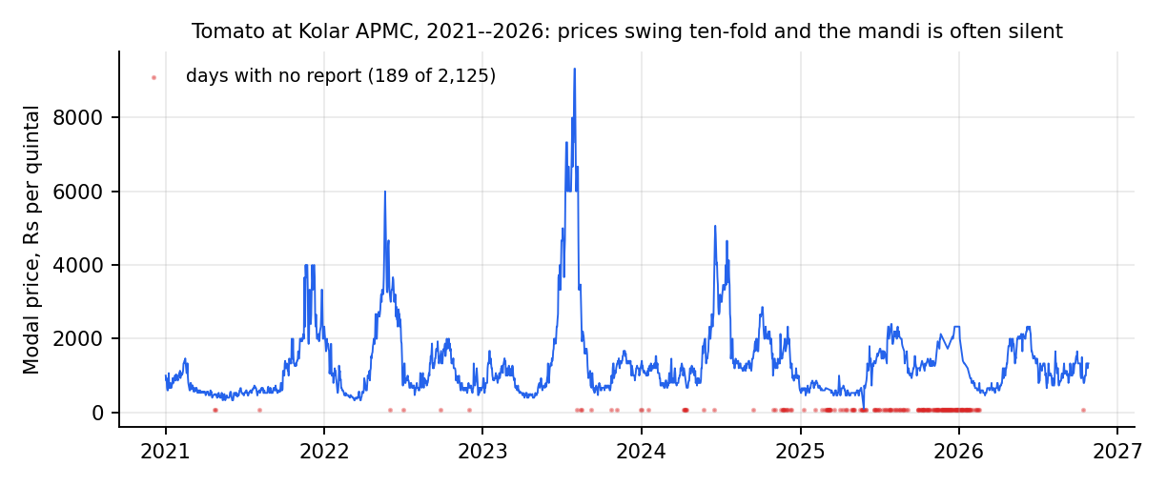
Introduction and Problem Statement
Context: farmers in the Bengaluru–Kolar belt choose a mandi and a day with only yesterday's price. Kolar tomato ranged Rs 100–9,330 per quintal and was silent on 189 of 2,125 days.
Problem: choose (mandi, hold 0–3 days) or the farm gate to maximise net revenue, and state a floor that holds.
Gap: models are judged on forecast error, not decisions; reporting gaps are ignored; decompose-then-forecast gains are unaudited [1]–[6].
Scope: tomato, onion, potato, ginger; Agmarknet only; offline evaluation. Garlic refused (one eligible mandi).
63,524
36,821
4 crops
real Agmarknet records
mandi-days in the panel
plus garlic refused
Why it matters: a farmer who gambles a harvest needs a minimum expected revenue, not just a forecast. Information frictions of exactly this kind measurably hurt small sellers [7], [8].
Department of Computer Science & Engineering(Data Science)
Notes:
[CORE · about 1.5 min]
SAY (in these simple words)
Look at this graph. It shows the tomato price at Kolar market for five years.
The price went from 100 rupees to over 9,000 rupees per quintal. That is a huge swing.
The red dots show days when the market posted no price at all. That happened on 189 days out of about 2,100.
Today a farmer decides using only yesterday's price. That is not enough.
So our problem is simple: which market, and which day, gives the farmer the most money in hand after transport, fees and spoilage?
Most earlier work only predicts prices. It does not check the real decision. It also ignores markets that post no price.
We used 63,000 real records from the government price website Agmarknet, for tomato, onion, potato and ginger.
We did not use garlic, because only one market has enough data, so there is no choice to make.
SHOW / CLICK
Point at the red dots on the graph. Then point at the three number boxes.
NUMBERS TO QUOTE
- 63,524 real records; 36,821 market-days
- Tomato at Kolar: Rs 100 to Rs 9,330 per quintal
- 189 days with no price out of 2,125
- Garlic left out: only one usable market
IF ASKED
Q: Why not just predict the price?
A: A price prediction does not tell the farmer what to do. We teach the system to aim at what the farmer really keeps, and that works better.
Q: Is the data real?
A: Yes. It is from Agmarknet. Two separate downloads match almost perfectly. We found and removed an early fake dataset; it is in our risk list.
TRANSITION
Now our objectives and how each one went.

Slide 4
Objectives
Status: 7 met · 1 partly met (floors) · 1 null result (spillover) · 1 built and tested (digest, shown live today).
# | Objective (approved scope) | Status | Evidence
1 | Real-data panel, ≥30,000 mandi-days, exclusions recorded | Met | 36,821 mandi-days; 63,524 records
2 | Revenue formulation + market-choice model; ≥500 held-out days per crop | Met | 511–963 scored days per crop
3 | Test label and loss effects with paired tests | Met | Realised labels: −87 to −157 Rs/q; SPO+ no gain
4 | Floor violation within 2 points of nominal 10% | Partly | Tomato 9.0%, ginger 10.5%; onion 6.3%, potato 6.9%
5 | FastAPI + trilingual app, tests, reproducible pipeline | Met | 669 backend + 11 web tests; one-command pipeline
6 | Audit decompose-then-forecast leakage; foundation-model baseline | Met | +27…62% skill → −15…−1% when causal
7 | LLM decision intelligence, grounded and verified | Met | Judge caught 9/9 corrupted; 30 unit tests
8 | Cross-commodity spillover with FDR control | Null result | 0 of 40 edges published: no shock episodes
9 | Inspectable advice: breakdown, what-if, track record, silence tax, crowd | Met | Parts add up to net; replay 165 days; 11 tests
10 | Dated morning digest on a free channel (Telegram), EN/KN/HI | Built, tested | 8 tests; live demo today; no farmer pilot
Department of Computer Science & Engineering(Data Science)
Notes:
[CORE · about 1.5 min]
SAY (in these simple words)
We set ten objectives. This table shows how each one went, including the ones that did not fully work.
Seven are fully done. These are: the data, the revenue model, the tests of what helps, the app, the check of other people's methods, the AI summaries, and the five new features.
One is partly done: the minimum amount we promise. For tomato and ginger it works as planned. For onion and potato it was more careful than needed.
One gave no result: whether a shortage in one crop moves another crop's price. Our method found nothing strong enough, so we published nothing, and we say so.
The last one is the morning message. It is built and tested. You will see it live in a few minutes.
SHOW / CLICK
Run your finger down the Status column: green, one orange, one red, and the last row.
NUMBERS TO QUOTE
- 7 done, 1 partly, 1 no result, 1 built and tested
- 669 tests for the system and 11 for the app, all passing
IF ASKED
Q: Why report something that gave no result?
A: Because a number we cannot support is worse than no number. Our rule is to publish only when there is enough evidence.
Q: Is objective 4 a failure?
A: Partly. The minimum amount was met for two crops. For two crops it was safer than needed, which is the safe side.
TRANSITION
Next, how it works, in simple words.

Slide 5
Proposed Methodology and System Architecture
Idea: train on what the farmer would actually receive (price net of transport, shrinkage and silent markets), not on the posted price.
Action: (mandi, hold 0–3 days) or farm gate; recommendation = best guaranteed revenue, with an adaptive conformal floor.
Rejected: predict-then-optimise on posted prices and decompose-then-forecast hybrids (they never see a silent market, and leak the future).
Market-choice engines
+ conformal floors
Agmarknet
exports
Clean + audit
loader, checks
Market panel,
observation store
FastAPI service
farmer · trader · chat
Next.js app
EN · KN · HI
Forecasters
+ specialist council
Shock study
+ spillover
Language layer: decision-intelligence briefs,
explanation writer + independent judge
Data layer → model layer → service layer (engines + five insight features) → language layer → presentation. All results use real portal records; no synthetic data enter any result.
Telegram bot · 7 am digest
Department of Computer Science & Engineering(Data Science)
Notes:
[CORE · about 2 min]
SAY (in these simple words)
Here is the main idea in simple words.
Most systems predict the price at each market and pick the highest. But they forget that some markets post no price on some days. And they forget the cost of going there.
We do it differently. We teach the system to aim at what the farmer really keeps: the price, minus the market fee, minus the loss while waiting, minus transport. If the market turns out to be silent, we count that as a loss too.
The farmer's choices are: a market and a waiting time of 0 to 3 days, or sell at the farm gate.
For the answer we also give a safe minimum, learned from how wrong the system was in the past.
The picture shows how it is built. Government data is cleaned. Our engines work on it. One service gives the answers. The app and a Telegram bot show them to the farmer.
SHOW / CLICK
Move your finger left to right along the boxes. Point at the orange box and the green Telegram box.
NUMBERS TO QUOTE
- Five layers: data, models, service, AI summaries, app
- Only real data in every result
IF ASKED
Q: Why not a simple average for the safe minimum?
A: A simple average is often wrong. Our check showed it failed up to 35 days in 100. Ours stays close to the target.
TRANSITION
A little more detail on the formula.

Slide 6
Key Formulation: Revenue, Loss and Verified Floor
Net revenue of action (m, k) from origin ℓ
Sym. | Meaning | Default
f | market fee + commission | 4 %
c₀ | handling per trip | Rs 20
τ | transport, Rs per quintal-km | 0.35
ρ | road / great-circle distance | 1.3
δ | daily spoilage (tomato / onion / potato) | 3 / 0.8 / 0.4 %
φ | price discount if mandi silent | 0.85
φ_g | farm-gate discount | 0.80
α, γ | floor level, ACI step | 0.10, 0.01
R(m,k | ℓ) = (1 − f)(1 − δ)ᵏ · P̃(m, t+k) − τ·ρ·d(ℓ,m) − c₀
P̃ = P if market m reported on day t+k, else φ · P̄(t+k) (wasted trip); farm gate pays φ_g · P̄(t)
Decision-focused loss (SPO+)
L(r̂, r) = max_a (2r̂ₐ − rₐ) − 2r̂ₐ* + rₐ*
non-negative, zero at the truth, upper-bounds regret; tested against squared error
Guaranteed floor and adaptive level
Parameters are scenario assumptions, not estimates. τ, δ and φ are swept at evaluation time; conclusions hold across all 10 settings per crop.
L = r̂ − q·σ̂ ; αₜ₊₁ = αₜ + γ (α − 1[R < L])
q = (1 − αₜ) quantile of past normalised scores; outcomes of a k-day hold are released only after the sale date
Department of Computer Science & Engineering(Data Science)
Notes:
[SKIP IF SHORT · about 1.5 min]
SAY (in these simple words)
Do not read the symbols. Say it like this.
The first box is how we count the money. Price, minus market fee, minus loss from waiting, minus transport, minus handling.
If the market is silent, the farmer gets only part of the day's usual price.
The second box is a special training method that aims at good decisions. We tested it. It did not help much.
The third box is the safe minimum. It is the expected money minus a safety margin that is learned from past mistakes.
The table on the right gives the cost numbers we assumed, such as 4 percent fee and 20 rupees handling.
These are assumptions, so the app lets the farmer change them.
SHOW / CLICK
Point at the three boxes and the small table. Do not read the formulas.
NUMBERS TO QUOTE
- Fee 4%; handling Rs 20; transport Rs 0.35 per quintal per km; spoilage 3% a day for tomato
IF ASKED
Q: Where do the cost numbers come from?
A: They are our assumptions. The farmer can change them in the app, and we tested many different values.
TRANSITION
Two more parts: the AI summaries and the crop-to-crop effect.

Slide 7
Decision Intelligence and Cross-Commodity Spillover
Objective 7: grounded decision briefs
Objective 8: spillover between crops
1. Evidence bundle: flat map of dotted keys (forecast.h5.point, market-choice, arrivals, spillover) + what was unavailable
2. Provider fills a fixed schema: action BUY/SELL/HOLD/WAIT, confidence (may be INSUFFICIENT_EVIDENCE), factors that each cite an evidence key
3. Grounding check: every figure within 1% of an evidence value, every key exists, no market named outside the evidence
4. Never fails silently: failing provider → deterministic fallback; ungrounded brief served as grounded:false with issues listed
Policy: a HOLD is overridden when spoilage outruns the expected gain
Panel: weekly returns of 5 crops, 232 weeks, one reference market each
Clean: remove first common factor (24.5% of variance) and calendar-month means so shared shocks are not read as transmission
Episodes: source crop in squeeze or glut; onsets <4 weeks apart merged
Effect: mean response of target over h = 1–4 weeks minus its unconditional baseline
Inference: bootstrap over whole episodes (2,000 draws, 90%); Benjamini–Hochberg FDR 10% across 40 edges
Gates: ≥8 episodes, CI excludes 0, |effect| ≥ 1%; otherwise INSUFFICIENT_EVIDENCE
Department of Computer Science & Engineering(Data Science)
Notes:
[SKIP IF SHORT · about 1.5 min]
SAY (in these simple words)
Two smaller parts.
On the left, the AI summary. A language model writes a short explanation. But a checker then compares every number in it with our data. If a number is wrong or missing, the summary is marked as not checked. We also tried deliberately wrong summaries. The checker caught all nine of them.
On the right, a question: if tomato becomes scarce, does the onion price move? We tested all 40 pairs. We needed at least eight clear shortage events for each pair. We found none. So we published nothing.
The same rule applies to both parts: say only what the evidence supports.
SHOW / CLICK
Point at the left box, then the right box.
NUMBERS TO QUOTE
- Wrong summaries caught: 9 of 9
- Crop-to-crop effect: 40 pairs tested, 0 published
IF ASKED
Q: Does the AI decide the advice?
A: No. Our engines decide. The AI only writes it in words, and its numbers are checked.
TRANSITION
Now the five features that let anyone check the advice.

Slide 8
Insight Features: Method
1 Breakdown: why this mandi
4 Silence tax
R = P − fP − (1−f)·P·[1 − (1−δ)ᵏ] − τρd − c₀
Tₘ = sₘ · max( P̄ₘ − φ·P̄day , 0 )
the parts add up to the served net revenue; the code asserts it
s = surprise silence on open days; weekdays silent ≥ 90% are known closed days
2 What if: break-even cost
5 Crowd simulator
x* = min { x on grid : a*(x) ≠ a*(x₀) }
Pₘ(x) = Pₘ · (1 + x / Aₘ)^(−b)
re-price every action under the farmer's costs; report where the best action flips
Aₘ = median daily arrivals; b = 0.115 is an association (SE 0.023): a scenario
3 Track record
None of these fits a model at request time. Each reads the served engine and the ingested panel, and every assumption is returned with the answer.
win: gain > ₹1 · tie: |gain| ≤ ₹1 · loss: gain < −₹1
only days after the floor multiplier was fitted; floor held if R ≥ L
Department of Computer Science & Engineering(Data Science)
Notes:
[CORE · about 1.5 min]
SAY (in these simple words)
The advice must not be a black box. So we added five features.
One: a breakdown that shows where each rupee goes, and it always adds up exactly.
Two: a what-if tool. The farmer changes the costs, and the advice updates. It also shows the exact point where the advice would change.
Three: a track record. We replay the advice on past days it had not seen, and show how often it won.
Four: a silence tax. It shows how much money a trip loses when a market posts no price.
Five: a crowd test. If many farmers follow the same advice, that market's price falls. We show how much, and a better way to spread the farmers.
The crowd test uses one assumed number. We say clearly that it is a scenario, not a measurement.
SHOW / CLICK
Point at the five boxes one by one. Do not read the formulas.
NUMBERS TO QUOTE
- Crowd test uses a price sensitivity of 0.115, taken from past data; it is an assumption
IF ASKED
Q: Is the crowd result a real measurement?
A: No. It is a scenario. With the sensitivity set to zero, nothing changes. A trial with real farmers is needed to measure it.
TRANSITION
Now how it is built, and then the live demo.

Slide 9
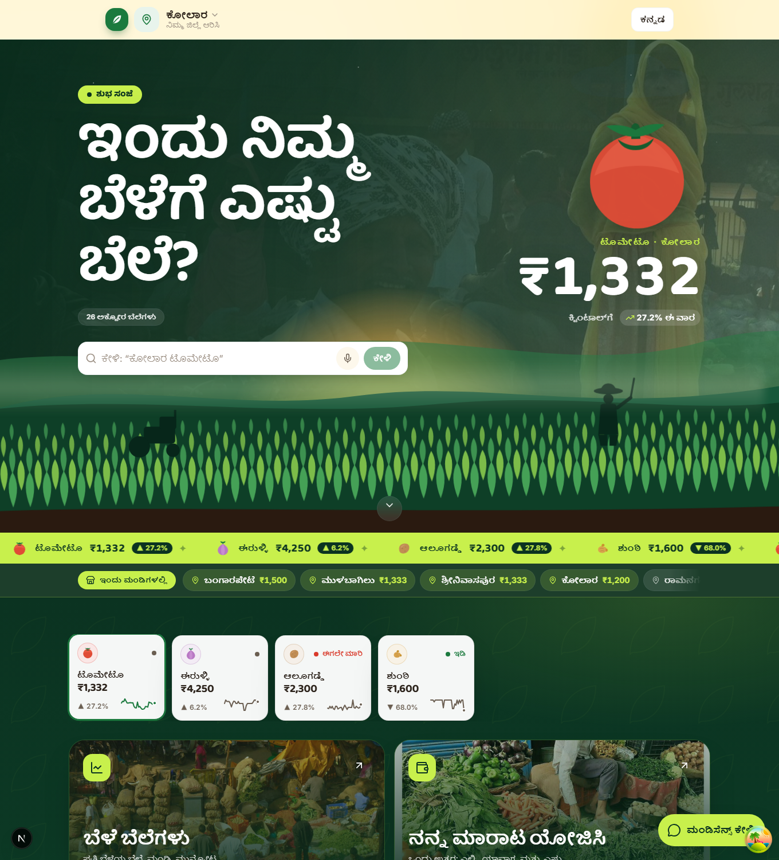
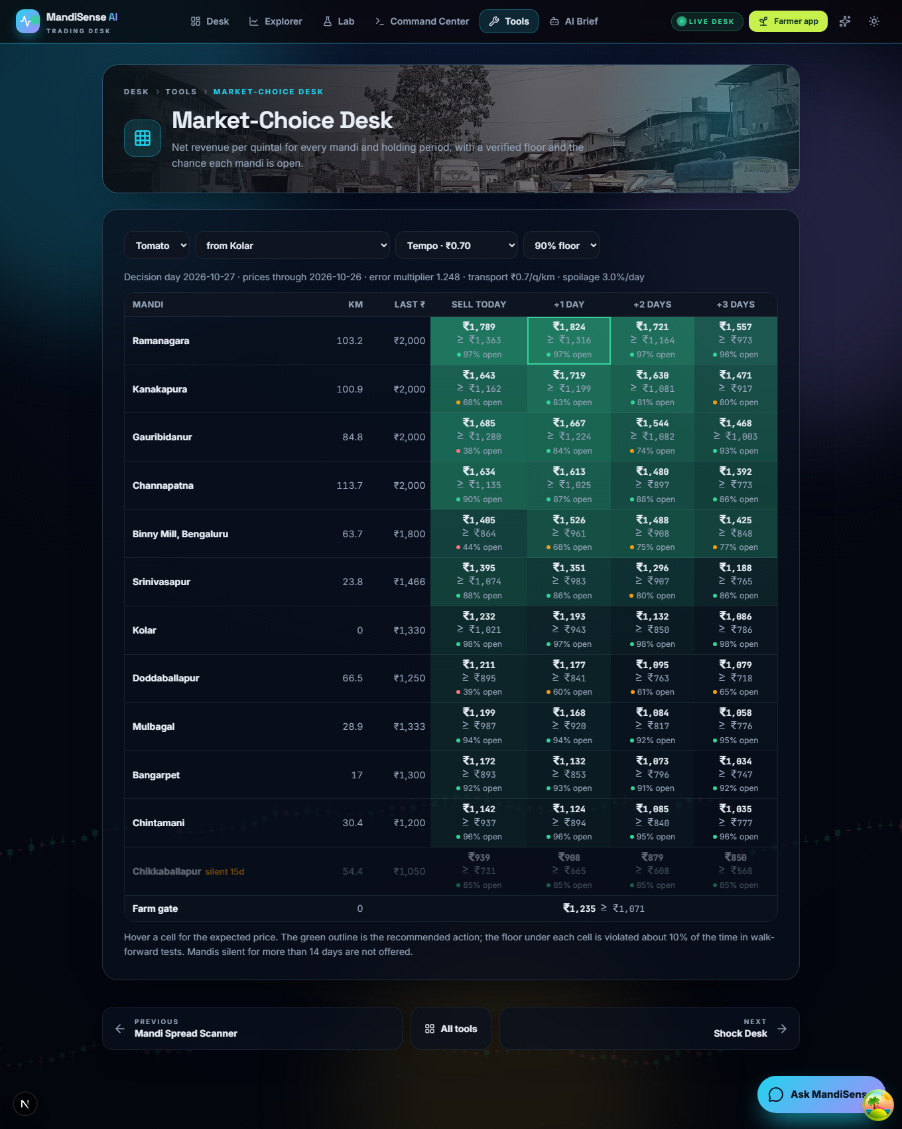
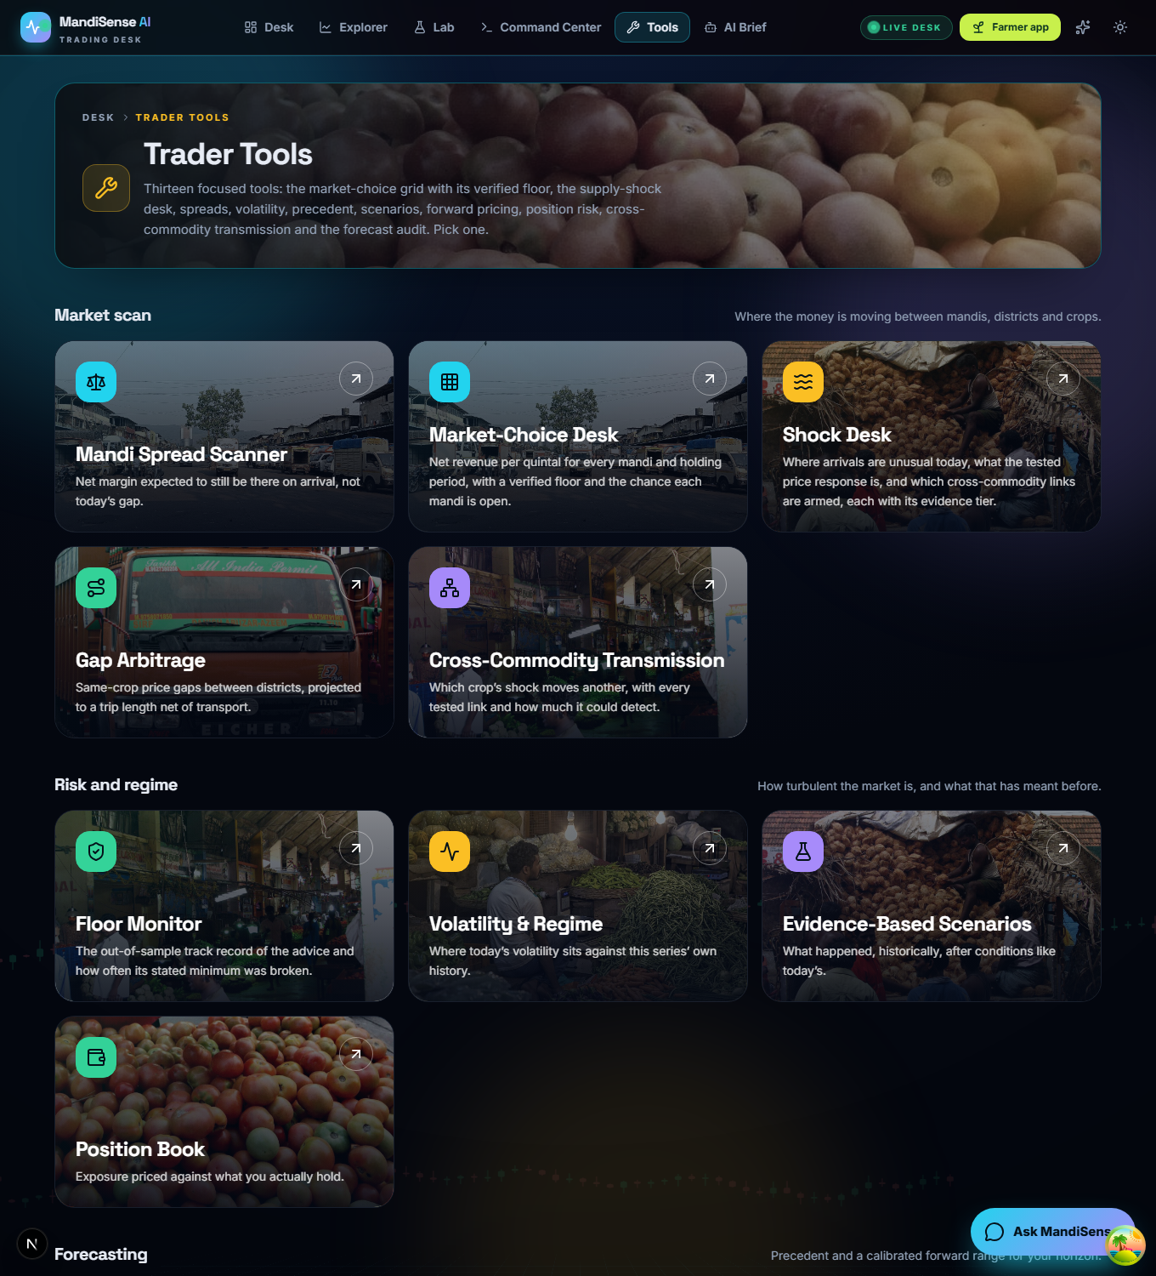
Implementation and System Integration
Integrated: one pipeline command runs 13 stages from raw exports to tests; API, web app, engines and language layer share one data store.
Manual: refreshing Agmarknet exports (download by hand); public deployment config exists but is not verified live.
Defects fixed: NumPy 2 broke pandas; fresh clone missed the observation store; hard deletion emptied trader pages; council weights summed above 1.
world
forecasts
market
choice
track
record
transmission
shock
spillover
council
research
evidence
results
doc
tests
scripts/pipeline.py: each stage has declared outputs; run alone, skipped, or dry-run (--list, --only, --skip, --dry-run)
Endpoints: /v1/market-choice (+5 insight routes), /v1/farmer, /v1/trader, /v1/shock, /v1/council, /v1/spillover, /v1/intelligence, /v1/chat, /v1/notify
Department of Computer Science & Engineering(Data Science)
Notes:
[CORE · about 1.5 min]
SAY (in these simple words)
Everything is connected end to end.
One command runs the whole chain, from the raw data to the final tests. Each step can also be run alone.
What is still manual: we download the government data by hand, because we have no live feed. And we have not tested the online deployment.
We also found and fixed some problems. A software update broke the data tools. A fresh copy of the project was missing a file. And an old server gave wrong errors during testing.
The next two slides are the live demo.
SHOW / CLICK
Point along the boxes. The small screenshots are only a reminder.
NUMBERS TO QUOTE
- 13 steps in one command; 669 + 11 tests; a 60-point check of every page and service
TRANSITION
A quick map of the demo, then we start it.

Slide 10
What You Will See: Five Features and a Digest
1 Why this mandi?
2 What if my costs differ?
3 Has this advice worked?
Per-quintal arithmetic of the advice: price − fee − spoilage − transport − handling = net.
Farmer app · /breakdown
Sliders for transport, spoilage and longest wait; the advice updates and says where it flips.
Farmer app · /simulate
The advice replayed on 165 days it had not seen: wins, ties, losses; floor score.
Farmer app · /track-record
4 Silence Tax
5 Crowd Simulator
6 Daily digest
Rupees lost per quintal on a trip because a mandi reports no price; weekday strip.
Trader desk · /reporting-value
What happens to a mandi's price when 200 farmers follow the same advice; coordinated split.
Trader desk · /crowd
A dated morning message with advice only where evidence is strong.
Telegram bot · /v1/notify
Department of Computer Science & Engineering(Data Science)
Notes:
[CORE · about 1 min]
SAY (in these simple words)
Before we open the browser, here is the map of what you will see.
Six things. Each answers one simple question.
Why this market? What if my costs are different? Has the advice really worked? What does an unreliable market cost? What if everyone follows the advice? And what does the farmer receive at seven in the morning?
Three are inside the farmer's tool. Two are for traders. And one is the Telegram message.
SHOW / CLICK
Point at the six boxes. Read only the question on each.
TRANSITION
Now the browser: demo part one.

Slide 11
Live Demonstration (1/2): Farmer Tool
Step | Do | You will see
A1 | Tools → Best Place & Day to Sell · Kolar, tomato, 10 q, tempo | Ramanagara, Wed 28 Oct, 103 km · ₹1,824 expected · ₹1,316 floor · ₹592 above nearest
A2 | Open “Why this mandi?” | 2,081 − 83 − 60 − 94 − 20 = ₹1,824; nearest Kolar ₹1,233
A3 | What if: drag transport to ₹3.00 | Same advice, net ₹1,515
A4 | What if: drag spoilage to 5% | Advice changes: Ramanagara today, ₹1,789
A5 | Open “Has this advice worked?” | 93% better than nearest · floor held 84% (aim 90%)
A6 | Switch language to Kannada, then back | All panels in Kannada
Live: the demonstration runs from the repository. Figures are from the data loaded on 29 October 2026 (prices to 26 October).
Department of Computer Science & Engineering(Data Science)
Notes:
[CORE · about 4 min]
SAY (in these simple words)
(Open the browser, farmer app. Follow the steps on the slide. The full clicks are in the demo script.)
This is the farmer's screen. The farmer is in Kolar with 10 quintals of tomato.
The advice is: sell at Ramanagara, tomorrow. It is about 103 kilometres away.
The farmer keeps about 1,824 rupees per quintal after transport and fees. And can count on at least 1,316 rupees on 9 days out of 10.
Open Why this mandi. The long green bar is what the farmer keeps. The small coloured parts are fee, loss while waiting, transport and handling. They add up exactly. The nearest market, Kolar, would give only 1,233.
Open What if my costs differ. Move the transport slider to the maximum. Even then, the advice does not change. So the advice is safe against truck cost.
Now move the spoilage slider up. At 5 percent a day, the advice changes to selling today. So the crop's shelf life matters.
Open Has this advice worked. On past days it had not seen, it beat the nearest market 93 days out of 100. The minimum amount held on 84 days out of 100. We aim for 90. We show the real score, not a promise.
SHOW / CLICK
Browser: http://localhost:3000/tools, then Best Place and Day to Sell. The exact clicks and values are in the run-of-show.
NUMBERS TO QUOTE
- Ramanagara, tomorrow, 103 km
- Keeps Rs 1,824; at least Rs 1,316; for 10 quintals Rs 18,238 and Rs 13,165
- Nearest market Kolar: Rs 1,233; advice earns Rs 592 more per quintal
- Transport at Rs 3.00: same advice, keeps Rs 1,515
- Spoilage 5% a day: sell at Ramanagara today, Rs 1,789
- Beat the nearest market 93%; minimum held 84%
IF ASKED
Q: Why not the nearest market?
A: Because the price at Ramanagara is about 776 rupees higher. That is more than the extra transport of 94 and the extra loss of 60. The breakdown shows it.
TRANSITION
Demo part two: the trader screens and the phone.

Slide 12
Live Demonstration (2/2): Trader Desk and Telegram
Step | Do | You will see
B1 | Trader tools → Silence Tax (tomato) | Kanakapura ₹313 (16.5%); Chikkaballapur closed Thursdays; Kolar ₹0 ≠ reliable
B2 | Crowd Simulator: 200 farmers × 10 q | Alone ₹1,824 · all follow best ₹1,194 (−32.5%) · nearest ₹1,207 · coordinated ₹1,436
B3 | Drag farmers to 1; flexibility b to 0 | All policies equal: the assumption is explicit
C1 | Phone: @MandiAis_BOT → /today | Dated digest: Ramanagara, ₹1,824, floor ₹1,316; potato prices only
C2 | Send “onion chintamani” | Digest for that crop and place
C3 | Run send_daily_digest.py (the 7 am job) | Phone buzzes; log line shows sent
D1 | Optional: API docs | Five insight endpoints + notify routes
Fallback if the network is down: the digest builder runs offline (--dry-run); every screen also appears as a real screenshot on the results slides.
Department of Computer Science & Engineering(Data Science)
Notes:
[CORE · about 4 min]
SAY (in these simple words)
(Now the trader screens, and then the phone.)
First, the Silence Tax. Each row is a tomato market. The small week strip shows the days it posts prices: green is reliable, red means closed.
Kanakapura loses a trip about 313 rupees per quintal, because it often posts no price. Chikkaballapur posted nothing on any Thursday last year. So the farmer is warned not to bring a Thursday load there.
Look at Kolar. It shows zero. That does not mean it is reliable. It means its prices are usually lower anyway. That is why we also show how often a market goes silent.
Second, the Crowd Test. One farmer alone gets 1,824 per quintal. If 200 farmers all follow the best advice, that market is flooded, its price drops by about one third, and each farmer gets only about 1,194.
If we send different farmers to different markets, each gets about 1,436. That is 241 rupees more per quintal.
Move the slider to one farmer, and everything becomes equal. Move the sensitivity to zero, and again equal. So the result depends on that assumption, and we say it.
Now the phone. Open the Telegram bot and send slash today. This is the morning message. Every price has its date. Advice appears only where our evidence is strong. Type onion Chintamani, and it answers for that crop and place. Every morning at seven a scheduled script sends it.
SHOW / CLICK
Browser tabs: Silence Tax and Crowd Simulator. Then the phone with the bot chat open.
NUMBERS TO QUOTE
- Kanakapura loses Rs 313 per quintal per trip (16.5% of price)
- Chikkaballapur: no price on any Thursday last year
- 200 farmers: alone Rs 1,824; all follow best Rs 1,194; split Rs 1,436
- Gain Rs 241 per quintal, about Rs 4.8 lakh for the group
- The best market normally gets about 68 quintals a day
IF ASKED
Q: Do farmers use Telegram?
A: Few today. Telegram is free and lets us show the whole flow now. The same message can go by SMS or WhatsApp later.
Q: Where does the message data come from?
A: From the downloaded government data. There is no live feed, so the message says how old the data is.
TRANSITION
Back to the slides: tools and quality.

Slide 13
Tools, Technology Stack and Code Quality
Repository: Git, 69 commits; README, requirements.lock, docs for architecture, tool choices, shock study, council and LLM evaluation; CI workflow.
Reproducible: pipeline.py regenerates all artefacts; the thesis tables are generated from them, not typed.
Tested: 669 backend tests and 11 web tests passing; a 60-check smoke test of every endpoint and page; fresh-clone check; CI.
Layer | Tool (version) | Why chosen
Data / stats | NumPy 1.26.4, pandas 2.1.4, SciPy 1.11.4, statsmodels 0.14.1 | tested, pinned stack
Learning | LightGBM 4.6.0, XGBoost 2.0.3, scikit-learn 1.3.2, Optuna, PyTorch (research env) | trees win on tabular [19]; Optuna TPE [20]
Backend | FastAPI 0.136.1, Uvicorn 0.46.0, Pydantic 2.13.3 | typed requests, auto API docs
Frontend | Next.js 16.2.4, React 19.2.4, TypeScript 5, Tailwind 4 | fast pages on weak connections
Language layer | gpt-oss-120b writer, Qwen judge (Groq); Claude provider optional | two model families; deterministic fallback
Quality | pytest 9.0.3, vitest 3.2, GitHub Actions, Docker, Render file | automated checks on every push
Department of Computer Science & Engineering(Data Science)
Notes:
[SKIP IF SHORT · about 1 min]
SAY (in these simple words)
These are the tools we used, and why.
Python for the data and models. Standard tools like LightGBM that work well on tables of numbers. FastAPI and Next.js to build the service and the app. Pinned versions, so anyone can repeat our work.
Our checks: 669 tests for the system, 11 for the app, and a 60-point check that opens every page and service. All pass.
The project is easy to repeat. One command rebuilds everything. Our report tables are produced by code, not typed by hand.
SHOW / CLICK
Table of tools. Point at the Tested line.
NUMBERS TO QUOTE
- 669 system tests + 11 app tests pass
- 60-point check of every page and service passed
IF ASKED
Q: Who wrote the code?
A: The project history is in our report, with the split of work. We show it openly.
TRANSITION
How we tested it.

Slide 14
Experimental Setup and Evaluation Metrics
Split: nested walk-forward, 5 outer blocks (2024-H1 → 2026-10); inner validation by Optuna (20 neural / 25 boosting trials); K+2-day gap before every block.
Setup: Core i9-13900HX, 31.7 GB, RTX 4060; fixed seeds recorded in configuration; same tuning budget for every method.
Metrics: realised revenue, regret to hindsight oracle, share of oracle gap closed, silent-market trips, floor violation, forecast skill.
Baselines (all retrained): random walk, LightGBM/XGBoost on observed prices, nearest mandi, highest price yesterday, best 7-day mean, farm gate.
Crop | Mandi-days | Mandis | Eligible | Test days | Studied
Tomato | 17,582 | 14 | 12 | 963 | yes
Onion | 5,343 | 11 | 4 | 511 | yes
Potato | 5,000 | 12 | 3 | 569 | yes
Ginger | 6,423 | 10 | 3 | 776 | yes
Garlic | 2,473 | 7 | 1 | — | refused
Total | 36,821
Inference: moving-block bootstrap (block 14); Newey–West Diebold–Mariano; Holm across all pre-specified comparisons; model confidence set [24]–[27].
Pre-specified: model ladder, 12 paired comparisons, silence tests and leakage protocol were fixed before tuned results were seen.
Department of Computer Science & Engineering(Data Science)
Notes:
[CORE · about 1.2 min]
SAY (in these simple words)
How we tested it, in simple words.
We trained the system only on older data, and tested it only on later days. That is how it works in real life. We did this five times, for different time periods, from 2024 to October 2026.
We tested on about 500 to 960 days per crop.
Every method got the same tuning effort. We compared against what farmers really do: the nearest market, and yesterday's highest price. We also compared with standard prediction models.
We measured: money actually kept, money lost compared with the best choice in hindsight, and how often the minimum amount held.
We fixed what to compare before looking at the results, so we could not pick favourites.
SHOW / CLICK
Dataset table on the left; the bullet points on top.
NUMBERS TO QUOTE
- Test days: tomato 963, onion 511, potato 569, ginger 776
- 5 tests over time, from 2024 to October 2026
TRANSITION
The results.

Slide 15
Results and Validation: Decision Quality
Result: models trained on realised revenue earn the most in every crop; the oracle bounds what is possible.
Why: observed-price models send 12–43% of trips to a silent market; realised-label models cut that to 5–21%.
Rs 2,156
tomato, realised-label model (oracle 2,570)
+Rs 556
over nearest mandi, tomato (1,600 → 2,156)
Holm p < 0.002
labels effect in all four crops
Department of Computer Science & Engineering(Data Science)
Notes:
[CORE · about 1.2 min]
SAY (in these simple words)
Here are the results. Each group of bars is one crop. The bars show the average money the farmer keeps per quintal.
The two blue bars are our method. They are the highest in every crop. The last grey bar is the best choice in hindsight, the ceiling.
For tomato: our method gives 2,156 rupees. Yesterday's highest price gives 2,021. The nearest market gives only 1,600.
Why does ours do better? Older methods sent 12 to 43 trips out of 100 to a market that posted no price that day. Ours cuts that to 5 to 21.
SHOW / CLICK
Point at the blue bars, then at the three boxes on the right.
NUMBERS TO QUOTE
- Tomato: Rs 2,156 vs Rs 2,021 vs Rs 1,600; best in hindsight Rs 2,570
- Trips to a silent market: from 12-43 in 100 down to 5-21
TRANSITION
Is the improvement real?

Slide 16
Statistical Validation: What Actually Improved Decisions
Crop | Labels: realised vs observed (Δ regret, Rs/q) | 95% CI | Holm p | SPO+ vs squared error (Δ regret, Rs/q) | Holm p
Tomato | −140 | [−181, −102] | < 0.0001 | −25 [−53, +3] | 0.51
Onion | −157 | [−224, −89] | < 0.0001 | −23 [−62, +11] | 0.21
Potato | −87 | [−142, −39] | 0.002 | +1 [−27, +32] | 0.95
Ginger | −149 | [−232, −80] | < 0.0001 | −66 [−180, +30] | 0.17
Finding
Model confidence set
Limits
Better labels, not a fancier loss: realised-outcome supervision cuts regret in all four crops; SPO+ adds nothing reliable.
Only realised-label models survive in every crop; no observed-price model does. Tomato keeps 7 specifications; the others 3.
One region, one source, 5.8 years; revenue parameters are scenarios; silent day treated as no sale; offline only.
Department of Computer Science & Engineering(Data Science)
Notes:
[CORE · about 1 min]
SAY (in these simple words)
Is the improvement real, or just luck? We checked.
On the left: changing what we teach the system to aim at, from the posted price to what the farmer really keeps. That saved 87 to 157 rupees per quintal in all four crops. The difference is real, not luck.
On the right: a special training method that many research papers like. On our data it made no real difference.
So the gain comes from aiming at the right thing, not from a fancier method.
SHOW / CLICK
Point at the left block, then the right block, then the three cards.
NUMBERS TO QUOTE
- Gain from the right target: Rs 140, 157, 87, 149 per quintal
- Special training method: no reliable gain
IF ASKED
Q: So the special method failed?
A: On our problem it added nothing once the target was right. We planned this comparison in advance and report it as it is.
TRANSITION
The minimum amount, and the back-test of the served system.

Slide 17
Verified Floors and Served-Engine Back-test
Floor violation (%) target 10% | Adaptive 5% | Adaptive 10% | Adaptive 20% | Static 10% | Naive Gaussian
Tomato | 3.0 | 9.0 | 21.3 | 6.0 | 27.4
Onion | 1.6 | 6.3 | 15.5 | 4.0 | 34.5
Potato | 2.5 | 6.9 | 17.7 | 6.2 | 25.8
Ginger | 4.3 | 10.5 | 20.4 | 8.9 | 11.9
Back-test, last 330 days | Gain vs highest yesterday (Rs/q) | vs nearest | Gap closed | Evidence
Tomato | +170 [+104, +255] | +571 | 62% | strong
Onion | +60 [+16, +119] | +300 | 46% | strong
Potato | +15 [−38, +60] | +69 | 11% | limited
Ginger | +202 [+25, +429] | +1,595 | 67% | strong
Adaptive floors track the nominal level; the static quantile is cautious; a naive Gaussian floor is breached on 26–35% of days in three crops.
Department of Computer Science & Engineering(Data Science)
Notes:
[CORE · about 1.2 min]
SAY (in these simple words)
Now the safe minimum. We aim for it to fail on about 10 days in 100.
In our test it fails about 6 to 10 days in 100. A simpler method fails on up to 35 days in 100. So our safety margin really works.
On the right, the system as served, tested on the last 330 days, using only what was known each day.
It beats the highest-price-yesterday habit by 170 rupees for tomato, 60 for onion, and 202 for ginger. These gains are real.
For potato, the gain is only 15 rupees and could be luck. So the app does not give selling advice for potato. It shows prices only.
SHOW / CLICK
Left table, then the bar chart on the right.
NUMBERS TO QUOTE
- Minimum fails on 9.0, 6.3, 6.9, 10.5 days in 100 (target 10)
- Simple method fails on up to 34.5 days in 100
- Gain over yesterday's best market: Rs 170, 60, 202; potato 15 (not reliable)
TRANSITION
Now the new features, starting with why this market.

Slide 18
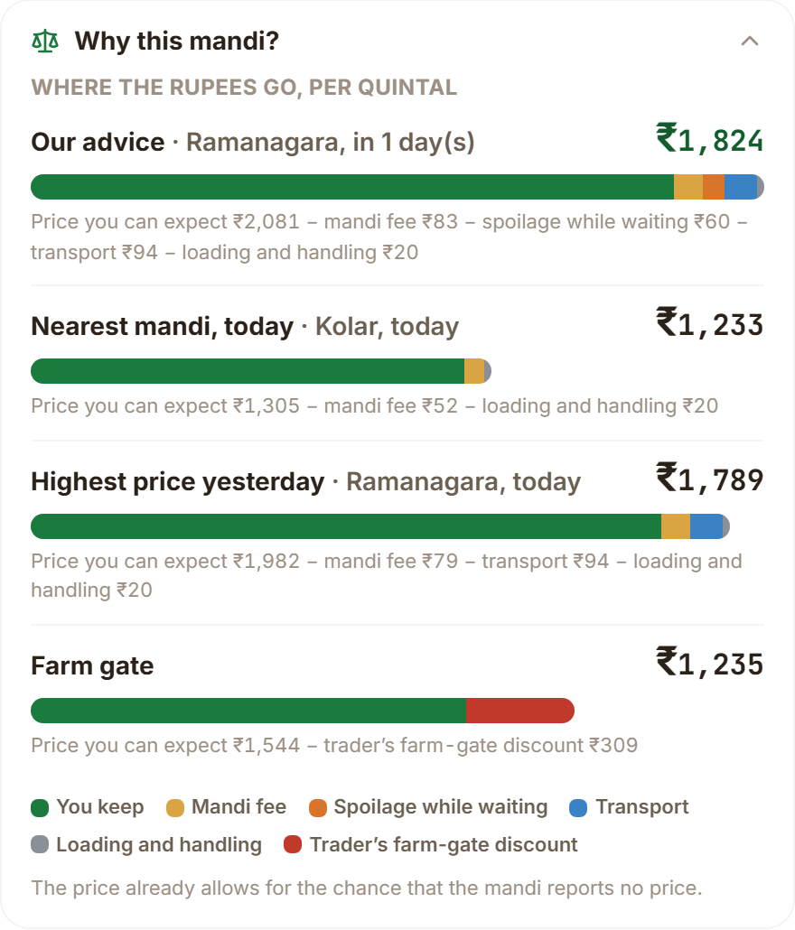
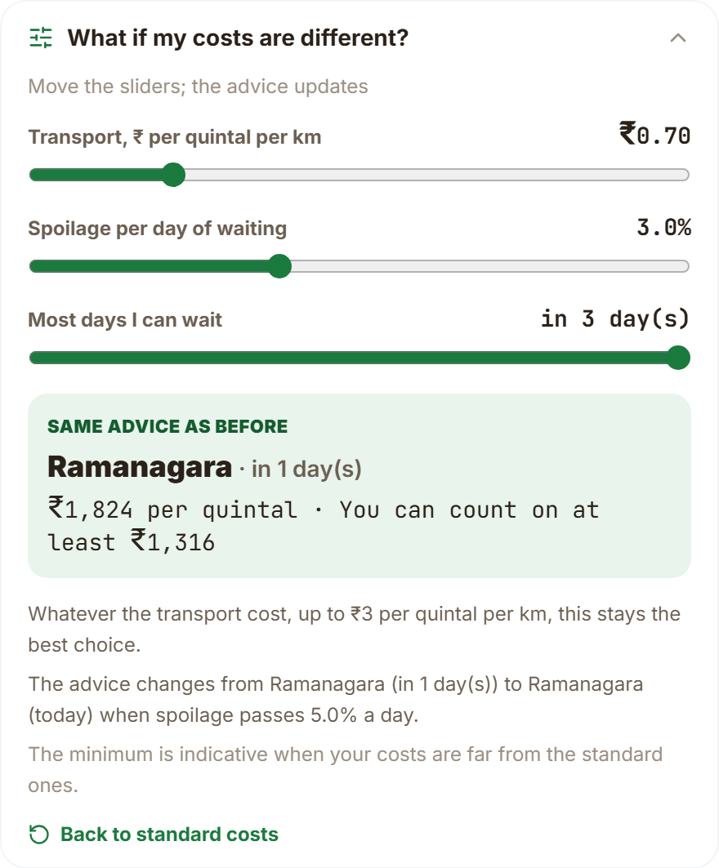
Explaining the Advice: Why This Mandi, What If
Parts add up. ₹2,081 − 83 − 60 − 94 − 20 = ₹1,824; nearest mandi keeps ₹1,232.
Why it wins. Expected price is ₹776 higher; extra transport ₹94 and spoilage ₹60 do not cancel it.
Robust to the truck. Transport up to ₹3.00 per q-km: same advice (net ₹1,515).
Sensitive to shelf life. At 5.0% spoilage a day, or no waiting: Ramanagara today, ₹1,789.
Floor is indicative when costs are far from the defaults; the screen says so.
Department of Computer Science & Engineering(Data Science)
Notes:
[CORE · about 1.2 min]
SAY (in these simple words)
These are the first two panels you saw in the demo.
On the left: the breakdown. Price 2,081, minus fee 83, minus loss while waiting 60, minus transport 94, minus handling 20, equals 1,824. The nearest market keeps only 1,232.
The advice wins because its price is 776 rupees higher. That is far more than the extra transport and extra loss.
On the right: what if. Even if transport costs 4 times more, the advice stays the same. But if spoilage reaches 5 percent a day, or the farmer cannot wait, the advice changes to selling today.
So the farmer sees what the advice depends on.
SHOW / CLICK
Left picture: Why this mandi. Right picture: What if. Then the bullets.
NUMBERS TO QUOTE
- 2,081 - 83 - 60 - 94 - 20 = 1,824
- Nearest market Rs 1,232 (the screen shows 1,233 after rounding)
- Advice changes at 5% spoilage a day
TRANSITION
Has the advice really worked?

Slide 19
Public Track Record on Days the Advice Had Not Seen
Crop | vs nearest: win / tie / loss | vs yesterday's best: win / tie / loss | Floor held
Tomato | 93 / 0 / 7 % | 24 / 68 / 8 % | 84%
Onion | 82 / 0 / 18 % | 34 / 39 / 27 % | 89%
Potato | 63 / 2 / 35 % | 52 / 12 / 36 % | 92%
Ginger | 90 / 0 / 10 % | 23 / 54 / 23 % | 86%
The honest part. The floor, set to hold 9 days in 10, held on 84 / 89 / 92 / 86% of replayed days.
Why lower than the back-test: one multiplier fitted on half the window is the strictest of three evaluations (served rule violated 9.6–12.3%).
165 out-of-sample days, 12 May to 23 Oct 2026. A tie is a difference of at most ₹1: against yesterday's highest price the advice often picks the same action, so most days tie.
Department of Computer Science & Engineering(Data Science)
Notes:
[CORE · about 1.2 min]
SAY (in these simple words)
Has the advice really worked? We replayed it over 165 past days it had not seen.
Against the nearest market, it did better on 93 days out of 100 for tomato, 82 for onion, 63 for potato, and 90 for ginger.
Against yesterday's highest-price market, many days are the same, because both give the same advice. When they differ, ours wins more often for tomato and onion.
Now the honest part. The minimum amount held on 84 days out of 100 for tomato, not 90. For onion 89, potato 92, ginger 86.
This replay is a strict test. In the larger test earlier, the minimum failed on 10 to 12 days out of 100. We show the farmer the real score.
SHOW / CLICK
Table and line graph. Point at the Floor held column.
NUMBERS TO QUOTE
- 165 days, 12 May to 23 Oct 2026
- Better than nearest market: 93, 82, 63, 90 days in 100
- Minimum held: 84, 89, 92, 86 days in 100 (target 90)
IF ASKED
Q: Is 84 percent a failure?
A: It is a little below our 90 percent target in a short, strict replay. The longer test was closer. The app shows the real score, not a promise.
TRANSITION
What does an unreliable market cost?

Slide 20
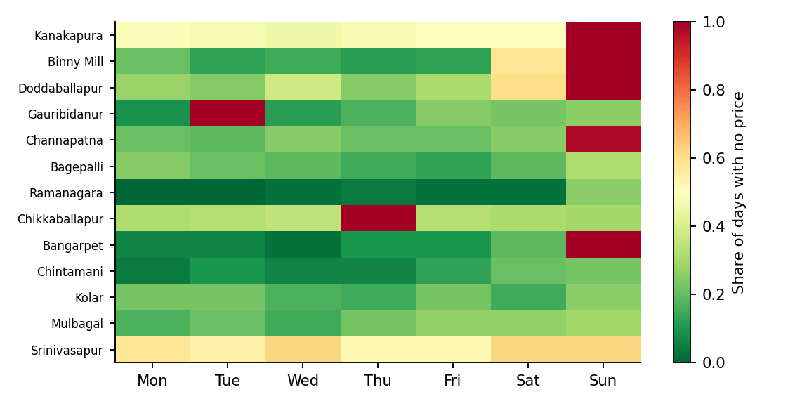
Silence Tax: What an Unreliable Mandi Costs a Trip
Mandi | Reported | Surprise silence | Known closed | Tax per quintal
Kanakapura | 44% | 49% | Sunday | ₹313 (16.5%)
Binny Mill | 67% | 22% | Sunday | ₹206 (8.5%)
Doddaballapur | 56% | 34% | Sunday | ₹135 (7.2%)
Gauribidanur | 70% | 19% | Tuesday | ₹121 (6.0%)
Channapatna | 67% | 22% | Sunday | ₹120 (6.3%)
Bagepalli | 79% | 21% | — | ₹69 (4.0%)
Ramanagara | 95% | 5% | — | ₹40 (1.8%)
Mean ₹78 per quintal per trip over 13 tomato mandis. Kanakapura loses ₹313 (16.5% of its price); Chikkaballapur reported on none of last year's Thursdays, so it is treated as closed that day.
Two cautions: a silent day may be a closed mandi or a missed upload; and ₹0 for a cheap mandi such as Kolar does not mean it is reliable, which is why surprise silence is shown beside it.
Department of Computer Science & Engineering(Data Science)
Notes:
[CORE · about 1 min]
SAY (in these simple words)
Some markets post no price on some days. That wastes the farmer's trip. We put a rupee figure on it.
Across 13 tomato markets, a trip loses about 78 rupees per quintal on average. Kanakapura loses 313, which is 16.5 percent of its price.
The colour picture shows each market by weekday. Red means the market is usually silent that day, like Sundays at several markets, and Thursdays at Chikkaballapur.
Two warnings. A silent day may mean the market is closed or the data was not uploaded. We cannot tell. And a zero for a cheap market such as Kolar does not mean it is reliable, so we show the silence rate too.
SHOW / CLICK
The colour picture, then the table.
NUMBERS TO QUOTE
- 13 tomato markets; average loss Rs 78 per quintal per trip
- Kanakapura Rs 313 (16.5%)
- Chikkaballapur: no price on any Thursday
TRANSITION
What if everyone follows the advice?

Slide 21
Crowd Simulator: What If Everyone Follows the Advice?
−32.5%
price drop at the best yard (200 farmers)
₹241/q
gain of the coordinated split
₹482,705
gain for the group of 200
Scenario, not a measurement. The yard usually receives about 68 quintals a day. Price flexibility b = 0.115 is an association in past data; at b = 0 every policy is equal. A field pilot is needed to measure the real response.
Department of Computer Science & Engineering(Data Science)
Notes:
[CORE · about 1.2 min]
SAY (in these simple words)
Here is the question an examiner should ask: what if everyone follows your advice?
One farmer alone gets 1,824 rupees per quintal.
If 200 farmers all go to the best market, it gets flooded. Its price drops by about one third. Each farmer gets only about 1,194. That is no better than going to the nearest market.
If we send different farmers to different markets, each gets about 1,436. That is 241 rupees more per quintal, about 4.8 lakh for the group.
The more farmers there are, the worse the flooding, and the more the split helps.
This uses an assumed price sensitivity taken from past data. It is a scenario, not a measurement. With zero sensitivity, nothing changes.
SHOW / CLICK
The line graph, then the three boxes, then the grey caution note.
NUMBERS TO QUOTE
- 200 farmers, 10 quintals each
- Alone Rs 1,824; all follow best Rs 1,194; nearest Rs 1,207; split Rs 1,436
- Price drop 32.5%; gain Rs 241 per quintal; Rs 4,82,705 in total
IF ASKED
Q: How would you measure the real effect?
A: By a trial: some farmers get the advice, some do not, at the same market. Then compare prices. This is our first future task.
TRANSITION
The morning message.

Slide 22
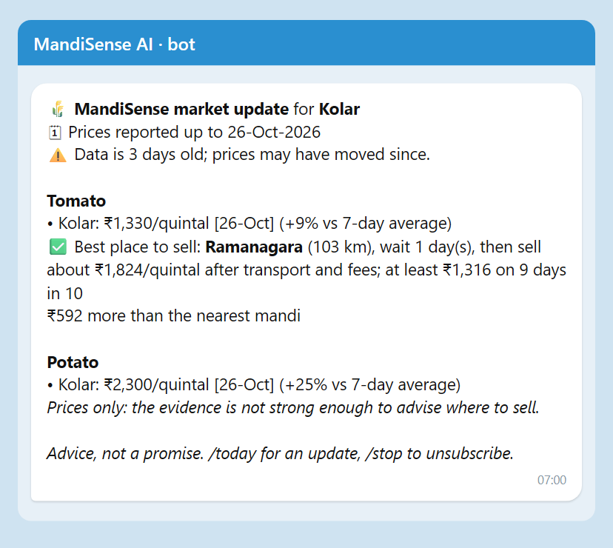
Daily Digest on Telegram
Dated, always. Every price shows its date; the second line says how old the data is (there is no live feed).
Advice only with evidence. Tomato, onion, ginger: best place and day with the floor. Potato, garlic: prices only.
Warns about silent days. If the recommended mandi is usually silent on the sale weekday, it says so.
Three languages, free. English, Kannada, Hindi; Telegram Bot API; /start, /today, /stop, or type “tomato kolar”.
Logged and tested. Every send is logged (2 logged sends to a real account); 8 unit tests with a fake client.
Not claimed: a farmer pilot, or a live price feed.
Department of Computer Science & Engineering(Data Science)
Notes:
[CORE · about 1 min]
SAY (in these simple words)
This is the morning message exactly as the bot sends it.
The first lines say the date of the latest prices, and how old the data is, because we have no live feed.
Each crop shows the latest price with its date, and the change from last week.
Advice appears only where our evidence is strong: tomato, onion, ginger. For potato we show prices only.
It is free, it works in English, Kannada and Hindi, and the farmer can ask by typing, for example, tomato Kolar.
Every message sent is recorded, and it has already been delivered to a real phone. What we have not done: a trial with farmers, or a live price feed.
SHOW / CLICK
The message picture on the left, then the bullets on the right.
NUMBERS TO QUOTE
- Bot name: @MandiAis_BOT
- 8 tests; every price carries its date
- Sent every morning at 7 by a scheduled script
IF ASKED
Q: Why Telegram and not SMS?
A: SMS in India needs registration and a paid service. Telegram is free, so we could build and show the full flow now. The same message can go by SMS later.
Q: What about privacy?
A: We store only the chat id, first name, language, district and crops. The farmer can stop at any time.
TRANSITION
Back to the research results: a check on other people's method.

Slide 23
Look-Ahead Audit of Decompose-then-Forecast Models
+27 … +62%
skill under the published protocol
−15 … −1%
the same models, causal decomposition
Why: STL and VMD are two-sided smoothers, so the component at day t already contains later prices. Zero-shot Chronos-Bolt [17] scores −9.4% at 1 day: no model here beats the random walk on the daily tomato series.
Department of Computer Science & Engineering(Data Science)
Notes:
[CORE · about 1.2 min]
SAY (in these simple words)
Many papers say they predict prices very accurately by splitting the price into parts first. They report gains of 27 to 62 percent.
We tested this. We found that their way of splitting secretly uses future prices. It is like the model peeking at tomorrow.
When we split the series using only the past, as in real life, the gains vanish. The result is minus 15 to minus 1 percent. The red bars are the claimed gain. The blue bars are the honest result.
A modern ready-made forecasting model also did not beat a simple rule on this daily tomato series.
We checked the method that these papers describe, not each specific paper.
SHOW / CLICK
Bar chart: red is the claimed gain, blue is the honest result.
NUMBERS TO QUOTE
- Claimed gain +27 to +62%; honest result -15 to -1%
TRANSITION
Things that did not make the cut.

Slide 24
Council, Shocks, Spillover and Language Layer
Study | What was tested | Result | Verdict
Specialist council | 4 feature-family agents, weights ≤ 1, 4 folds | council +0.2…+0.4% vs single +0.6…+0.8% skill; wins 0–1 of 4 folds | Not promoted
Supply-shock event study | 30 crop–horizon tests, placebo shifts, Holm | 0 robust, 5 suggestive; effects as large as the detectable minimum | Not served
Cross-commodity spillover | 5 crops, 40 edges, FDR 10%, ≥8 episodes | 0 shock episodes in all 10 source cells; 40/40 insufficient evidence | Withheld
District forecasts | 3-, 5-, 7-day vs no change, 90% band | skill +3.0…+4.0%, coverage 89.8%; 1-day not distinguishable | Served 3/5/7 d
Explanation layer | 24 texts, 120 sentences, EN/KN/HI, independent judge | kept: EN 0.83–0.99, KN 0.62–0.88, HI 0.68–0.91; judge caught 9/9 corrupted, 0/3 false alarms | Verified, small n
Zero spillover episodes is also a finding about the pipeline: the detector depends on supply-regime labels that the real panel does not yet supply. Listed under future work.
Department of Computer Science & Engineering(Data Science)
Notes:
[SKIP IF SHORT · about 1.2 min]
SAY (in these simple words)
We also tried other ideas. They did not work, and we say so.
A team of four small forecasting models did not beat one model. So we do not use it.
A study of supply shocks found no strong effects out of 30 tests, and only five weak hints.
The crop-to-crop effect: none published.
Forecasts for 3, 5 and 7 days do beat the simple rule, so we serve them, with honest ranges. One-day forecasts do not, so we do not serve them.
The AI summaries keep most sentences; fewer in Kannada and Hindi, so those need a native speaker to check.
Zero crop-to-crop events also tells us something about our own method: it needs labels that our data does not yet have.
SHOW / CLICK
Table. Read down the Verdict column.
NUMBERS TO QUOTE
- Team of models: no better than one
- Shocks: 0 strong, 5 weak hints out of 30
- Crop-to-crop: 0 of 40 pairs published
IF ASKED
Q: What would you do next about crop-to-crop effects?
A: Define the shortage events directly from market arrivals, then test all 40 pairs again.
TRANSITION
Comparison with other methods.

Slide 25
Comparative Benchmarking
Same split, same metric, all retrained: no published study scores mandi choice by regret on real reporting-gap data, so baselines are the heuristics farmers use and the standard predict-then-optimise models.
Where we win: all four crops vs every heuristic and every observed-price model. Where we do not:
potato back-test gain is not distinguishable from the best heuristic, and SPO+ ties the squared-error loss.
Gap closed (nearest → oracle) / silent-market trips | Tomato | Onion | Potato | Ginger
Nearest mandi, sell today | 0.00 / 34% | 0.00 / 34% | 0.00 / 34% | 0.00 / 24%
Highest price yesterday | 0.43 / 28% | 0.26 / 43% | 0.17 / 35% | 0.69 / 11%
LightGBM, observed prices | 0.43 / 29% | 0.24 / 43% | 0.12 / 34% | 0.69 / 12%
LightGBM, realised outcomes (ours) | 0.57 / 12% | 0.48 / 18% | 0.31 / 21% | 0.76 / 5%
Neural SPO+, realised outcomes (ours) | 0.58 / 12% | 0.50 / 20% | 0.28 / 17% | 0.76 / 5%
Department of Computer Science & Engineering(Data Science)
Notes:
[SKIP IF SHORT · about 0.8 min]
SAY (in these simple words)
This compares everything on the same days and the same measure.
No other published study judges market choice this way, so we compare with what farmers really do, and with standard prediction methods.
We win in all four crops against every habit and every standard method.
Where we do not clearly win: for potato, the gain is not reliable. And the special training method did not beat the ordinary one.
SHOW / CLICK
Table. The two blue rows are ours.
NUMBERS TO QUOTE
- Share of the possible gain captured: tomato 0.57, onion 0.48, potato 0.31, ginger 0.76
TRANSITION
What is new in our work.

Slide 26
Novelty and Research Contribution
In one sentence: supervise market choice on realised, silence-aware revenue, certify it with delayed-feedback conformal floors, and audit the leakage in published hybrids.
Already exists
New here
Ours vs adapted
Forecasters of agricultural prices [9]–[14]
SPO+ and decision-focused learning [21], [22]
Adaptive conformal inference [25]–[28]
Revenue labels that include silent markets, on real mandi data
Floors for selected actions whose outcome resolves k days later
Measured size of look-ahead leakage in STL/VMD hybrids
Verified language briefs and a withheld-by-default spillover engine
Ours: formulation, pipeline, leakage protocol, grounding verifier, engines, app
Adapted: SPO+ [21], ACI [26], DeepSets [29], Optuna [20], Chronos [17]
Honest scope: the positive contribution that survived testing is the label effect, the floor validity and the audit; the loss, reporting head, silence features, council and spillover are bounded negative results.
Department of Computer Science & Engineering(Data Science)
Notes:
[SKIP IF SHORT · about 1 min]
SAY (in these simple words)
What is new here, in one sentence? We teach the system to aim at what the farmer really keeps, even when markets are silent. We give a tested minimum. And we showed that a popular price-prediction trick secretly uses the future.
What already existed: price forecasting, the special training method, and the safety-margin idea.
What is new: we use the money the farmer really keeps, on real market data. Our minimum is learned from past mistakes. We measured the false gain in other methods. And we added checks that let anyone inspect the advice.
Some parts are ours, some are adapted from earlier work. The right-hand card lists which.
SHOW / CLICK
Three cards, left to right.
IF ASKED
Q: What exactly is new?
A: The combination, and the check of other methods. The training idea and the safety-margin idea are adapted from earlier work. We did not find earlier work on the crowd effect for market choice.
TRANSITION
What we tried to improve.

Slide 27
Optimization and Ablation Study
Tuning: Optuna TPE per fold on each method's native criterion; same budget for all. Tuning on forecast loss instead of regret: no reliable change.
Cost: served boosting model chosen over the neural one: equal decisions, far cheaper to train, run and explain.
One change at a time | Δ regret, Rs/q (95% CI) | Holm p | Verdict
SPO+ loss instead of squared error | −25 [−53, +3] | 0.505 | no reliable difference
Add reporting head (SPO+) | +23 [+8, +36] | 0.012 | worse
Add network-silence features (GBM) | −12 [−31, +3] | 0.695 | no reliable difference
Tried and did not work: reporting head (worse, p = 0.012), silence features, decision-regret tuning, unconstrained council weights (summed 2.4–3.1, significantly worse), SPO+ over squared error. Ablations shown for tomato; the other crops agree.
Department of Computer Science & Engineering(Data Science)
Notes:
[SKIP IF SHORT · about 1 min]
SAY (in these simple words)
Each row changes one thing and checks whether it helps.
The special training method: no real difference.
Adding a part that guesses whether a market will post a price: it made things worse.
Adding signals from neighbouring markets: no real difference.
Tuning for forecast accuracy instead of decisions: no change.
We chose the lighter model for serving, because it gives the same decisions, and is cheaper to run and easier to explain.
We keep the failures in the report. They are part of the result.
SHOW / CLICK
Table, then the note below it.
NUMBERS TO QUOTE
- Reporting part: 23 rupees worse, a real difference
TRANSITION
Planning.

Slide 28
Project Planning: WBS and Critical Path
WBS package | Hours | Primary owner
1 Management & documentation | 130 h | Shreejith
2 Data | 100 h | Manohara
3 Models & research | 290 h | Manohara
4 Application | 360 h | Srijan
5 Verification | 90 h | Shreejith / Manohara
Total | 970 h
A
Requirements
2 wk
B
Data
3 wk
C
Market choice
4 wk
F
Forecasters
3 wk
G
Experiments
4 wk
K
Report
3 wk
J
Integration
2 wk
I
Testing
3 wk
D
Backend
4 wk
E
Web app
5 wk
H
LLM layer
3 wk
Critical path (red):
A→B→C→F→G→I→J→K
2+3+4+3+4+3+2+3 = 24 weeks
D, E, H have slack
Hours are team estimates, not logged time. Each leaf task has one owner; children sum to parents.
Worked slack, activity E: LF(E) = LS(I) = 16 weeks, so LS(E) = 16 − 5 = 11; ES(E) = 6; slack = 11 − 6 = 5 weeks. For H: LS = 16 − 3 = 13, ES = 6, slack = 7. For D: LF = min(LS(E), LS(H)) = 11, LS = 7, ES = 2, slack = 5.
RAM: every work package has one primary owner (R) and the guide is accountable (A); Manohara 430 h, Srijan 360 h, Shreejith 180 h.
Department of Computer Science & Engineering(Data Science)
Notes:
[CORE · about 1.5 min]
SAY (in these simple words)
Our plan. The work is in five packages, about 970 hours in total: management and documents, data, models and research, the application, and testing.
Every task has one owner. Manohara has data and research. Srijan has the application. Shreejith has the report and test plan. The hours are our estimates, not a timesheet.
The picture shows the tasks in order. The red path is the one that sets the total time: 24 weeks. A delay on the red path delays the whole project.
The blue tasks have spare time. For example, the web app has 5 weeks of spare time, the AI summaries have 7.
Worked example for the web app: it must finish by week 16, it takes 5 weeks, so it must start by week 11. It can start at week 6. The difference is 5 weeks of spare time.
SHOW / CLICK
Table on the left, picture on the right. Point at the red path, then the blue boxes, then the worked example.
NUMBERS TO QUOTE
- About 970 hours; Manohara 430, Srijan 360, Shreejith 180
- Red path 24 weeks; spare time: web app 5, AI summaries 7, backend 5
IF ASKED
Q: The code history shows mostly one author.
A: Yes, and our report says so plainly. The history does not show work done on other computers. The split of work is our agreement. We do not hide it.
TRANSITION
How the schedule went, and risks.

Slide 29
Schedule Tracking and Risk Management
0
4
8
12
16
20
24
28
Risk | P×I | Response | Status
R1 Source data synthetic | 15 | Re-acquired Agmarknet exports, integrity check, removed synthetic | Occurred
R2 Look-ahead leakage | 20 | Leakage unit tests; caught 2 whole-series-centred features | Occurred
R3 Hard deletion broke trader pages | 9 | Soft delete, re-seeding, id aliasing | Occurred
R4 NumPy 2 broke pandas | 9 | Pinned 1.26.4; lock file | Occurred
R5 LLM rate limit 8k tokens/min | 8 | Throttling, small evaluation set | Occurred
R7 Public deployment | 9 | Docker + Render deployment completed and verified live | Done
R8 No field trial | 12 | Stated limitation; survey ready | Open
R10 Stale server served old code | 6 | Restart; smoke test lists every endpoint | Occurred
A Requirements
B Data
C Market choice
D Backend API
E Web application
F Forecasters
G Experiments
H LLM layer
I Testing
J Integration
K Report
baseline
actual
Slip: 24 weeks planned, about 27 actual (+3.3 weeks, 14%). Data (B) was reopened after the first dataset proved synthetic, which pushed C and G on the critical path; D, E and H sat on slack and absorbed their delay.
Milestones: M1 requirements (wk 3), M2 first deployed prototype 9 Jun, M3 farmer suite 30 Sep, M4 research results 29 Oct, M5 report (wk 27).
Materialised: R1. Trigger: results that looked too clean. Action: discard, rebuild from portal exports, re-run every experiment (see report Ch. 4).
Department of Computer Science & Engineering(Data Science)
Notes:
[CORE · about 1.5 min]
SAY (in these simple words)
Planned against actual. We planned 24 weeks and took about 27. That is a delay of about three weeks, or 14 percent.
The main cause was the data. Our first dataset turned out to be fake. We replaced it with the real government data and ran every experiment again. That delayed the tasks on the red path.
The orange bars are the actual time. The blue bars are the plan. The plan was rebuilt from our earlier roadmap, and the actual dates come from our work history.
The risk table shows what could go wrong. Six risks really happened, including the fake data, a hidden problem where the model peeked at the future, and a software update that broke the tools. We caught and fixed each.
One is still open: no trial with farmers. The online version is now deployed.
SHOW / CLICK
Chart on the left, risk table on the right. Point at the orange bars.
NUMBERS TO QUOTE
- Planned 24 weeks; actual about 27 (+3.3 weeks, 14%)
TRANSITION
The report.

Slide 30
Project Report and Documentation Status
Report: BMSCE thesis template, 112 pages, compiled in LaTeX; Chapters 1–7 written, now including the insight features and the digest; every table generated from experiment artefacts.
Appendices: A code (read from source), B survey instrument, C per-fold evaluation, D dataset, E PO and SDG mapping, F similarity record.
Remaining: CO–PO matrix from the course file, declaration date, supervisor corrections.
Item | State
Chapters 1–7 | complete
Appendices A–E | complete (E: CO–PO table to be inserted)
Appendix F similarity record | complete: Drillbit check done
Figures and tables | numbered, captioned, referenced
Citations | 63 IEEE-style entries, all cited
Similarity: the Drillbit check has been run on the thesis (target ≤ 20%, references excluded). The result is recorded in Appendix F.
Department of Computer Science & Engineering(Data Science)
Notes:
[CORE · about 0.8 min]
SAY (in these simple words)
Our report follows the college template. It has seven chapters, six appendices, and the references.
Every table is produced by code from our results, so nothing is typed by hand.
It now includes the new features and the morning message.
The official plagiarism check (Drillbit) is done. Still to do: the table of course outcomes from the course file, and our guide's corrections.
SHOW / CLICK
The status table, and the box on plagiarism.
IF ASKED
Q: What is the similarity score?
A: The Drillbit check has been done and the result is in Appendix F.
TRANSITION
The goals for society.

Slide 31
SDG Mapping and Societal Impact
Stakeholders: smallholder farmers (need a plain answer and a floor), traders (need evidence tiers and arrivals), mandi officials and policy makers (need transparent data use).
SDG / target | Link | Support in our results | Status
2 / 2.3 | income of small-scale producers through market information | back-test gains Rs 60–202 per quintal over the best simple rule in 3 of 4 crops; morning digest on a free channel (untested with farmers) | Measured offline
1 / 1.4 | access to economic services | free trilingual tool for small sellers | Not measured
12 / 12.3 | reduce food loss along supply chains | spoilage built into advice; kg avoided not measured | Potential
9 / 9.c | access to information technology | open pipeline on a public data feed | Engineering
Impact is claimed only where held-out numbers support it; the benefit to farmers' real income needs a field trial.
Department of Computer Science & Engineering(Data Science)
Notes:
[CORE · about 1 min]
SAY (in these simple words)
These are the United Nations goals our work touches, with the exact target numbers.
Target 2.3, helping small farmers earn more through better market information. In our test the advice earned 60 to 202 rupees per quintal more than the best simple habit in three crops. That is a test result, not real income yet.
Target 1.4, access to services: a free tool in three languages. Not measured.
Target 12.3, less food loss: we count spoilage in the advice. We did not measure kilograms saved.
Target 9.c, access to technology: our open code, built on public data.
The morning message puts this on a free channel. Whether farmers use it, we do not know yet.
SHOW / CLICK
Table. Point at the Status column.
TRANSITION
Our research papers.

Slide 32
Research Paper Status
Status: our research paper has been submitted.
Submitted to: COMPSIF, https://bmsit.ac.in/compsif/
Department of Computer Science & Engineering(Data Science)
Notes:
[SKIP IF SHORT · about 0.8 min]
SAY (in these simple words)
We have submitted our research paper to COMPSIF, the conference at BMS Institute of Technology and Management. The link is on the slide.
It has been submitted, so it is now under review; we have no decision to report yet.
SHOW / CLICK
The venue name and link.
TRANSITION
Conclusion.

Slide 33
Conclusion and Future Work
Key outcome: advice trained on realised revenue beats the best simple rule by Rs 170 per quintal for tomato and Rs 202 for ginger, with floors that hold their level.
Against objectives: 7 met, 1 partly met, 1 null result, 1 built and tested (the digest); negative results reported.
Limitations
Future work (from those limits)
One region, one source, 5.8 years
Offline only; no farmer acted on the advice; digest not piloted
Revenue and crowd parameters are scenarios; replayed floors held 84–92% (aim 90%)
Briefs checked for traceability, not user-tested
Spillover found no episodes; deployment unverified
Field pilot through the bot, with an outcome form and the survey
Estimate transport, spoilage and silence from data
Diagnose the spillover labelling; define episodes from arrivals
User test of briefs; native-speaker review of KN/HI
Verify deployment and monitor live floor violations
Department of Computer Science & Engineering(Data Science)
Notes:
[CORE · about 1.2 min]
SAY (in these simple words)
To conclude. The system tells a farmer where and when to sell, and a minimum they can count on. In our tests it earns 170 rupees per quintal more than the best simple habit for tomato, and 202 more for ginger.
Now the advice can also be inspected. Why it is what it is. What happens if costs change. How it did on days it had not seen.
Of our ten objectives, seven are fully met, one is partly met, one gave no result, and one is built and tested.
Our limits: one region, one data source, and no trial with real farmers. The crowd test is a scenario. The minimum held on 84 to 92 days out of 100.
Our next steps follow from those limits: a trial with farmers through the bot, a better way to find shortage events, and testing the online version.
SHOW / CLICK
Left card, then right card.
NUMBERS TO QUOTE
- Rs 170 more for tomato; Rs 202 more for ginger
- 7 done, 1 partly, 1 no result, 1 built and tested
TRANSITION
References, then thank you.

Slide 34
References
[1] P. Birthal et al., J. Agribusiness Develop. Emerg. Econ., 2019
[2] AGMARKNET, Directorate of Marketing and Inspection, Govt. of India
[3] R. Jensen, Quart. J. Econ., 122(3), 2007
[4] J. Aker, AEJ: Appl. Econ., 2(3), 2010
[5] S. Ray et al., Appl. Soft Comput., 149, 2023
[6] K. Meena, B. Chaitra, IEEE Access, 12, 2024
[7] G. Jha, K. Sinha, Neural Comput. Appl., 24, 2014
[8] Wu et al., Expert Syst., 2026
[9] R. Cleveland et al., J. Official Statist., 6(1), 1990
[10] Hyndman, Athanasopoulos, Forecasting: Principles and Practice, 3e, 2021
[11] A. Sathe et al., Results Eng., 27, 2025
[12] B. Celik, S. Celik, Borsa Istanbul Rev., 2025
[13] K. Dragomiretskiy, D. Zosso, IEEE TSP, 62(3), 2014
[14] Bergmeir, Benítez, Inf. Sci., 191, 2012
[15] Cerqueira et al., Mach. Learn., 109, 2020
[16] Bundak et al., IEEE Access, 13, 2025
[17] Ansari et al., Chronos, TMLR, 2024
[18] Wang, Zhang, arXiv:2601.06371, 2026
[19] Grinsztajn et al., NeurIPS D&B, 2022
[20] Akiba et al., Optuna, KDD, 2019
[21] Elmachtoub, Grigas, Manage. Sci., 68(1), 2022
[22] Mandi et al., J. Artif. Intell. Res., 80, 2024
[23] Chen, Guestrin, XGBoost, KDD, 2016; Ke et al., LightGBM, NeurIPS, 2017
[24] Diebold, Mariano, JBES, 13(3), 1995
[25] Newey, West, Econometrica, 55(3), 1987
[26] Gibbs, Candès, NeurIPS, 2021
[27] Hansen, Lunde, Nason, Econometrica, 79(2), 2011
[28] Vovk et al., Algorithmic Learning in a Random World, 2005; Angelopoulos, Bates, 2023
[29] Zaheer et al., Deep Sets, NeurIPS, 2017
[30] Holm, Scand. J. Statist., 6(2), 1979
[31] Künsch, Ann. Statist., 17(3), 1989
[32] Romano et al., CQR, NeurIPS, 2019
[33] Rubin, Biometrika, 63(3), 1976
[34] Che et al., Sci. Rep., 8, 2018
Full 40-entry list with all details is in the thesis bibliography.
Department of Computer Science & Engineering(Data Science)
Notes:
[SKIP IF SHORT · about 0.2 min]
SAY (in these simple words)
The references are in the standard format, in the order we cite them. The full list of 40 is in the report.
SHOW / CLICK
Do not read.

Slide 35
THANK YOU
Department of Computer Science & Engineering(Data Science)
Notes:
[CORE · about 0.2 min]
SAY (in these simple words)
Thank you. We are happy to answer your questions, and to show any part of the system again.
SHOW / CLICK
Keep the browser and the phone ready for follow-up questions.

