Slide 1

IBM SkillsBuild Decoding Data PBL Program 2025 Final Project Presentation Final Project Presentation
Project Name :Retail Store Sale Analysis Team Name :Hexabytes
College Name :Bapuji Institute of Engineering and Technology

Slide 2
Team Members
Manu K C (Team Leader)
Naresh Patel
Animesh H M
Shradha G Vernekar
Pavithra B
Shreya K S

Slide 3
Introduction
In today’s competitive retail landscape, data-driven decision-making is essential for business growth and efficiency. Our team developed a Power BI dashboard to analyze retail store sales data, aiming to uncover insights related to sales performance, customer behavior, product trends, and store profitability.
Project Overview
Used Power BI to visualize and analyze retail sales data.
Covered multiple dimensions: time, location, product, and customer.
Key insights include:
Sales & revenue trends
Store & product performance
Customer segmentation
Inventory & profit analysis
Enabled interactive filtering and drill-downs.
Objectives
Provide a clear view of sales performance
Identify top-performing products and stores
Detect trends and anomalies for better planning
Support informed, data-driven decisions
Improve inventory and stock management
Enhance customer experience through behavior insights

Slide 4
Problem Identification
Problem Statement:
Retail businesses often lack real-time visibility into sales, inventory, and customer behavior. Manual reporting is slow and prone to errors, making it hard to identify trends or make quick decisions. This project uses Power BI to solve these issues through interactive and insightful data visualization.
Significance of the Problem:
Affects revenue generation and business growth
Causes delays in responding to market trends or inventory issues
Reduces customer satisfaction due to poor data utilization
Leads to inefficient operations and missed opportunities
Relevant SDGs (Sustainable Development Goals)
SDG 8 – Decent Work and Economic Growth
SDG 9 – Industry, Innovation, and Infrastructure
SDG 12 – Responsible Consumption and Production

Slide 5
Data Collection
1. Sources of Data
The dataset was provided for the PBL program by IBM Skills Build.
Contains real-world retail sales data, covering transactions across metro cities.
2. Data Description
Features include: Invoice ID, Branch, City, Customer Type, Gender, Product Line, Unit Price, Quantity, Tax 5%, Total, Date, Time, Payment, COGS, Gross Income, and Rating.
3. Data Collection Methods
Data was collected via the internal retail store transaction system.
Each row corresponds to a unique transaction.
Dataset reflects real-time transactions from stores in three metro cities.

Slide 6
Data Preprocessing
1. Data Cleaning Methods
Removed duplicate entries based on Invoice ID.
Standardized text columns (Customer Type, Product Line) to maintain consistency.
Parsed Date and Time columns to datetime format.
2. Handling Missing Values
Checked for null or missing values: No significant missing data observed.
Minor inconsistencies handled using forward-fill for categorical data.
3. Data Transformation Techniques
Created new columns:
Hour extracted from Time for hourly sales analysis.
Day and Month derived from Date for temporal analysis.
Aggregated metrics like Daily Sales, City-wise Sales, and Product-wise Revenue.

Slide 7
Data Analysis
1. Analytical Tools and Methods Used
•Used Power BI for data visualization and filtering.
•Visuals: cards, bar-line combo charts, maps, line graphs, pie charts, and tables.
•Filters applied: Year, Month, City, Gender.
•Key metrics derived using DAX measures and aggregation.
2. Key Findings
•Total Sales: ₹39.44K
•Average Rating: 7.24
•Total Tax: ₹4.57K
•Top-selling category: Health and Beauty
•Highest rated category: Fashion Accessories (7.47)
•Peak sales in Month 12 (₹5.1K)
3. Insights Derived
Branch C had the highest gross income.
Weekends showed higher footfall and purchases.
Ratings were generally high (Avg: ~7), with Electronics scoring best.

Slide 8
Hypothesis Development
1. Formulated Hypothesis
“Metro city stores with higher footfall during peak hours generate significantly more revenue than those with low footfall.”
2. Rationale Behind the Hypothesis
Preliminary data suggested revenue spikes during afternoon hours in densely populated cities.
3. Method for Testing the Hypothesis
Compared revenue across time slots and cities.
Analyzed correlation between customer count and total sales.
Validated using visualizations (heatmaps, bar charts) in Power BI.

Slide 9
Solution Design
Proposed Solution:
Developed a dynamic and interactive Power BI dashboard to visualize retail store sales data.
Addressed key business needs: sales trends, inventory management, customer behavior, and profitability insights
Implementation plan:
Data understanding
Preprocessing and transformation
Visualization Design in Power BI
Insights Generation
Alignment with SDGs:
SDG 8 – Promotes data-driven operational efficiency, contributing to economic growth.
SDG 9 – Applies modern technology (BI tools) to drive innovation in retail infrastructure.
SDG 12 – Improves resource planning, reduces overstocking, and supports responsible consumption patterns.

Slide 10
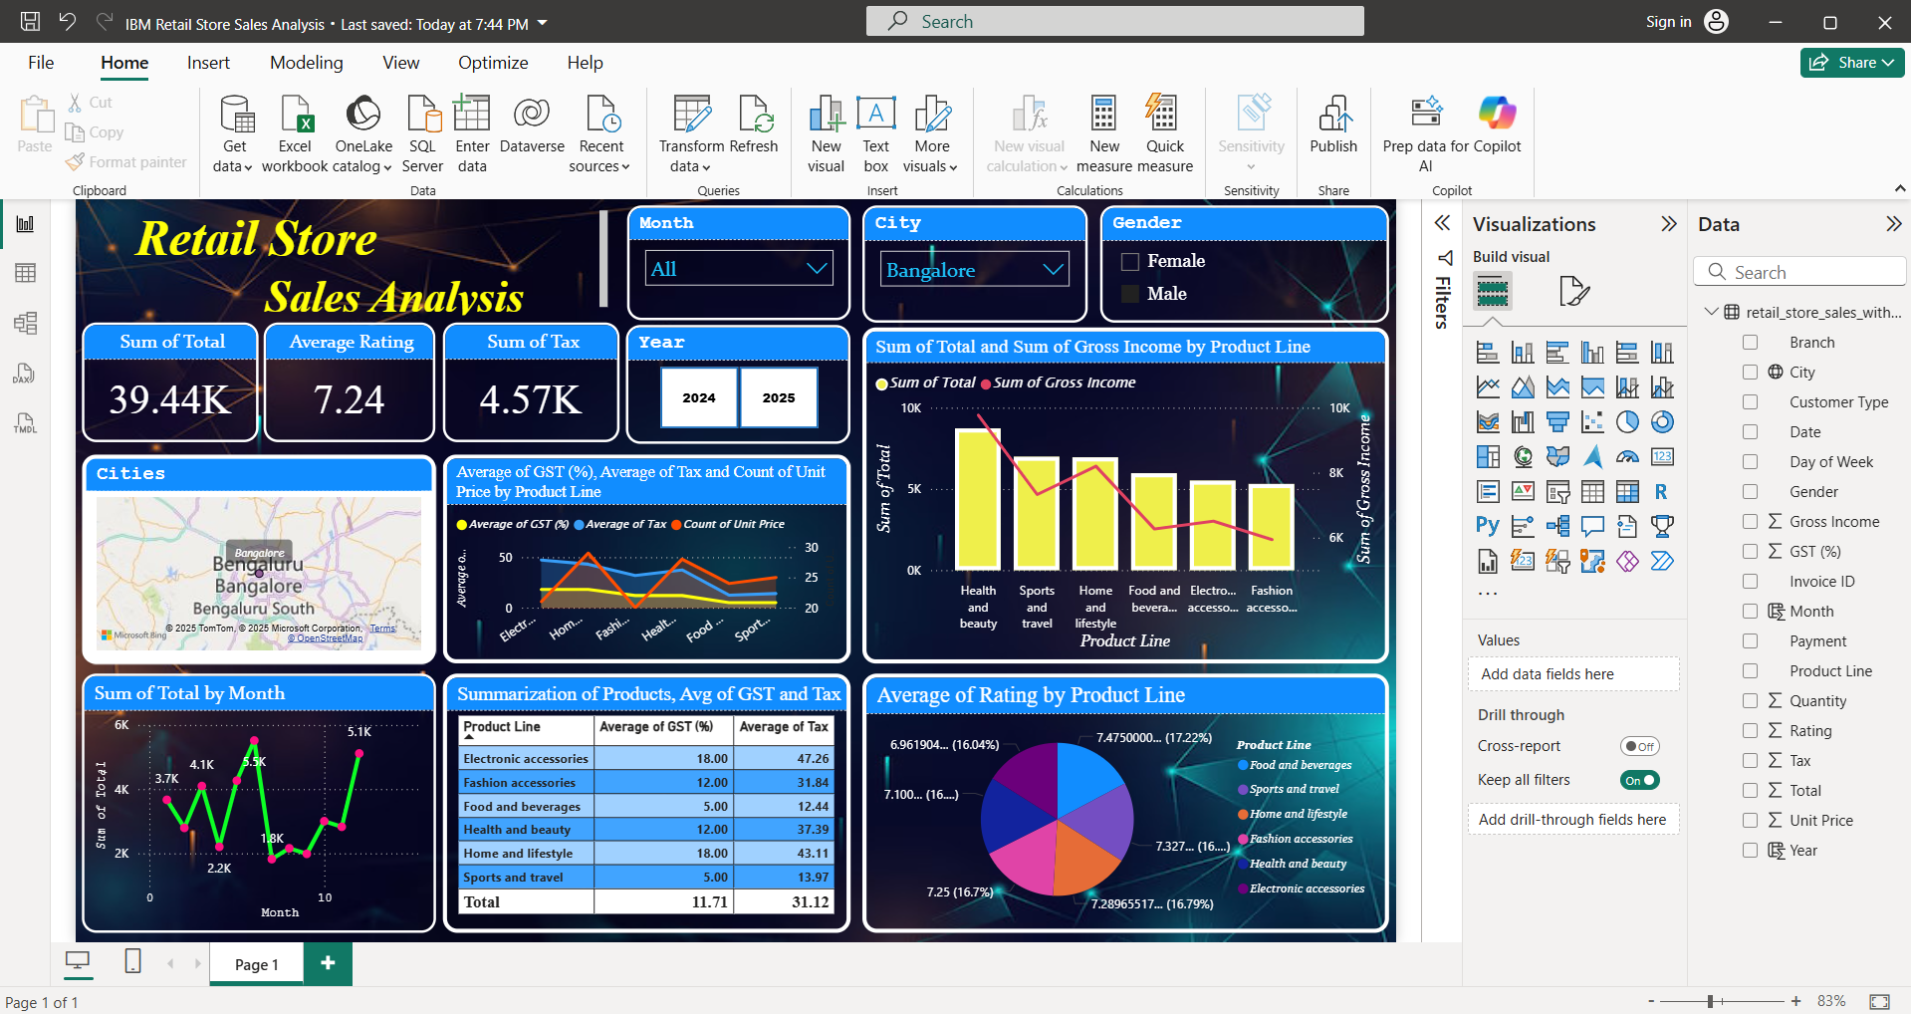
Visualization
Prominent features of the platform:
Site Map:
Interactive Visuals: Charts and graphs automatically update based on filter selections.
Comprehensive KPIs: Real-time summary cards display total sales, tax, and average rating.
Geo-Spatial Analysis: Map view highlights performance across major Indian metro cities.
Time-Based Analysis: Monthly sales trends visualized to detect seasonality.
Product-Level Insights: Drill-down into product line performance by rating, tax, GST, and income.
Comparative Metrics: Gross income vs total sales to measure profitability.
Data Summarization: Aggregated statistics for product lines—GST, tax, ratings, and units sold.
Top Summary Cards
Total Sales, Tax, Average Rating
Trend Analytics
Monthly sales trends
Product Analysis
Bar and line charts: Total Sales vs Gross Income by product line
Pie chart: Average Rating per product line
Statistical Summary
Average GST, Tax per product line
Count of unit prices and sales comparisons

Slide 11
Conclusion:
Impact of Proposed Solution:
Future Work:
Boosted data accessibility for retail managers.
Enabled strategic product and stock planning.
Improved customer segmentation understanding.
Aligned with SDG 8, 9, and 12 for sustainable business innovation.
Real-Time Data Integration: Connect dashboard to live databases for up-to-the-minute analytics.
Forecasting Module: Integrate predictive models for demand forecasting using Python or Azure ML.
Inventory Optimization: Add insights on reorder points and low-stock alerts.
Customer Clustering: Implement machine learning models for behavior-based customer segmentation.

Slide 12
References
Tools and Software Used:
Power BI
Primary tool for building interactive dashboards.
Used for data visualization, drill-down analysis, filtering, and KPI tracking.
Python (with Pandas)
Used for initial data cleaning, transformation, and exploratory data analysis (EDA).
Helped in deriving new features like hour, day, month, and basic statistical summaries.
Microsoft Excel
Utilized for manual inspection and basic manipulation of dataset before importing into Power BI.
Helped in checking null values, formatting, and early-stage preprocessing.
PowerPoint
Used to design the final project report and presentation slides.
Incorporated visuals from Power BI to explain insights clearly.
IBM Skills Build Dataset
Provided real-world retail sales transaction data.
Source of key metrics such as invoice details, product lines, payment modes, customer types, etc

