Slide 1

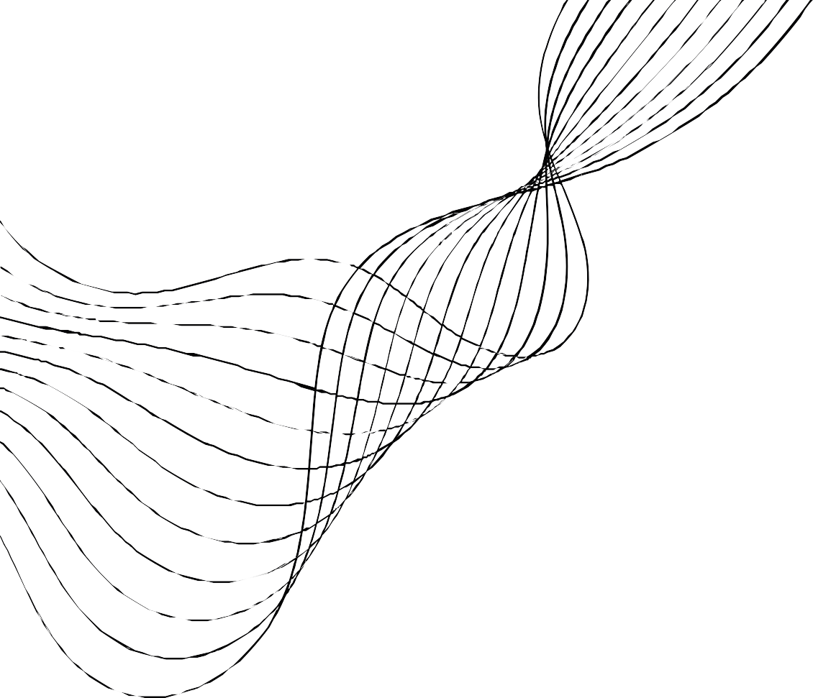
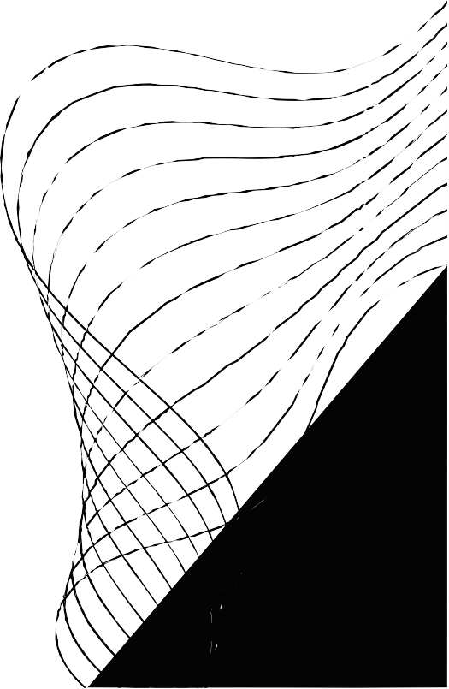
SELF LEARNING TIC TAC TOE
UNDER GUIDENCE OF SRINIVASA K G
TEAM MEMBER
MANU SAI 221000032 PRIYANSHU PRADHAN 221000041

Slide 2
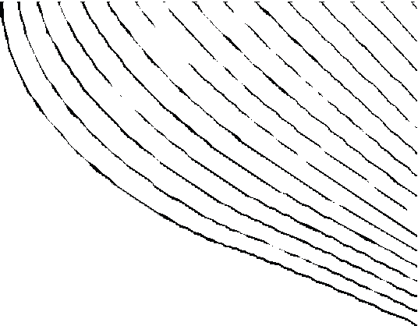

ABSTRACT
Our project is a self learning tic tac toe program(bot) that learn with in game experence.
After each game the records the sequence of steps and the final out come.
it gets sufficent data, it then for every step calculate the most optimal step for winning from the present
data set.
It does the same until it has data of all possible games possible.
When it gets all possible permutations its impossible to beat this bot.

Slide 3





OBJECTIVE // OUTCOME
Our objective is to make a program (bot) who learns with experience like human and get better with each and every round
Outcome should be a program which at start play random move and with time records and analysis every to use its experience in upcoming games.

Slide 4
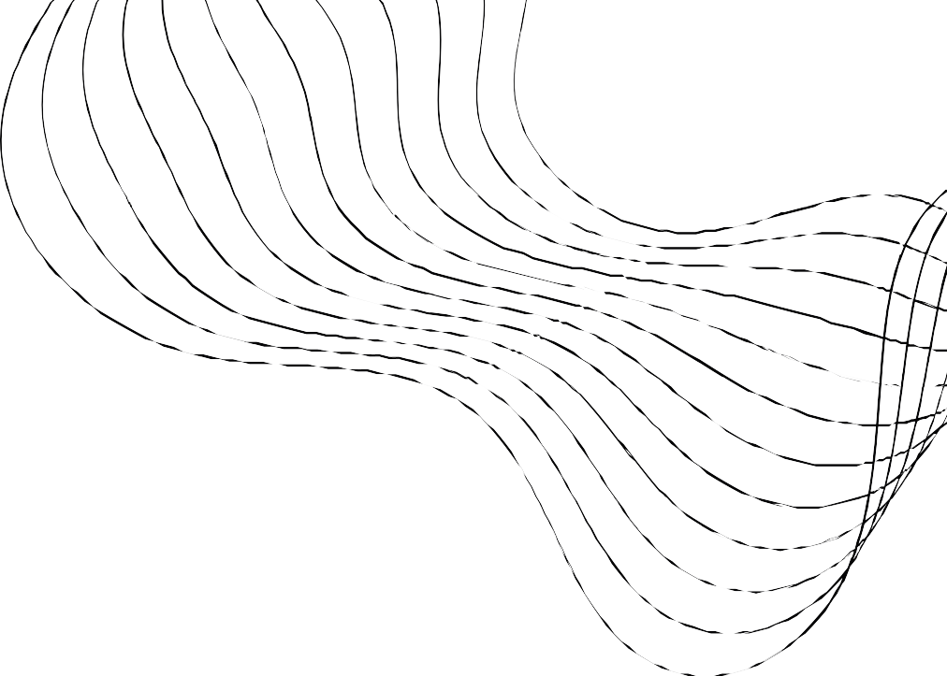
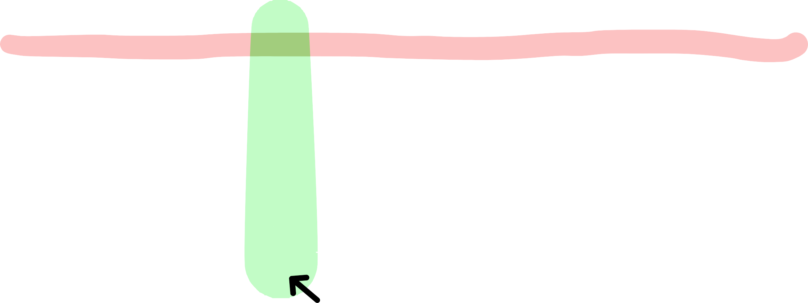
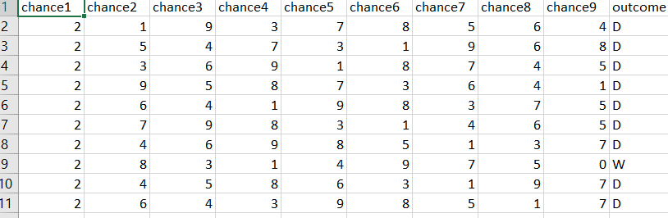
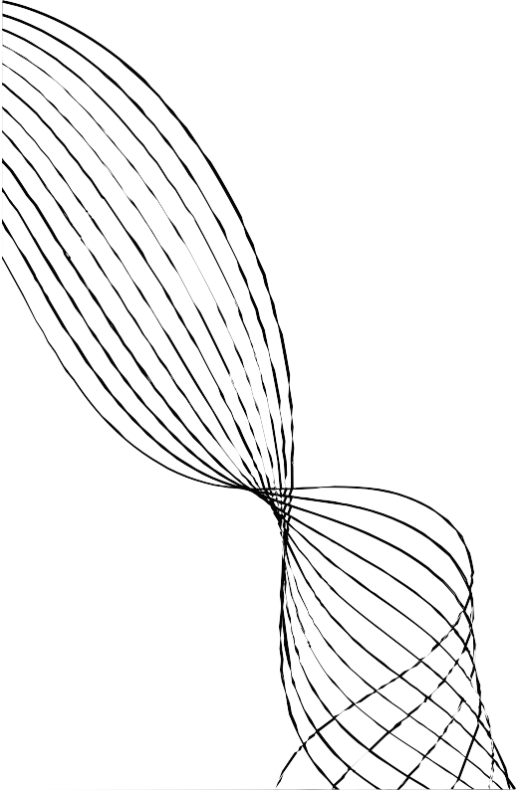
INPUT AND DATASET
USED CSV FILE TO STORE DATA
INPUT
Our dataset
We used csv module i ts very easy to
integrate csv f i le type with python and i t also stores
data in manner we needed.
Input will be the the sequence of the steps
that resulted in
particular outcome. ( WIN// LOSE// DRAW)
I ts will be a 10 x N data table where
row will represent a sequence in one game with outcome.
N represent number of games played with the bot
ROW
COLUMN

Slide 5
DATAFLOW
UNTIL
LOSE / DRAW / WIN
DISPLAY THE INPUT OF FINAL RESULT
INPUT OF THE USER
OUTPUT
PROCESS THE INPUT
STORE DATA

Slide 6

LANGUAGE USED // IDE
VS CODE
Simple to install modules in it.
PYTHON
Easier to implement ,
process and handle data.
Extension can be added to making coding easy (code runner etc.)
Easy to integrate with other file type (our case csv)
Many module defined for gui (PyQt5, tkinter etc)
Graphic user interface is very good.

Slide 7

TESTING
We will give the code known inputs with known results to know how the system behaves with the inputs.
If we will get the expected result in the first step we will give 10-15 input dataset manually with known output.
If the Program ran successfully as expected we will write a program to create a dataset and test that against our
program.
If any dataset mismatches during step 3 we will update and modify our program accordingly.
We will do step 3 until our program completely matches with the data set.
If the dataset matches completely our program is working perfectly.

Slide 8

PROBLEM ENCOUNTERED SUTING THE EXECUTION
) THE BOT WAS GIVING ERROR IF THE INPUT OF THE USER WAS NOT PRESENT IN DATA SET.
SOLUTION -( RANDOMLY CHOOSE A MOVE)
) HOW TO GENERATE ALL THE POSSIBLE SEQUENCE OF MOVE POSSIBLE IN GAME. SOLUTION-( STILL NOT SOLVED)

Slide 9



LESSON LEARNED
Learned about a algorithm called min - max.
It attach numerical value with every possibilty and choose its output from the data set which have greatest numerical value.
Learned about module called PyQt5 which we used to make gui.
Learned that testing the program is hardest part while malking a porgram to solve problem.

Slide 10
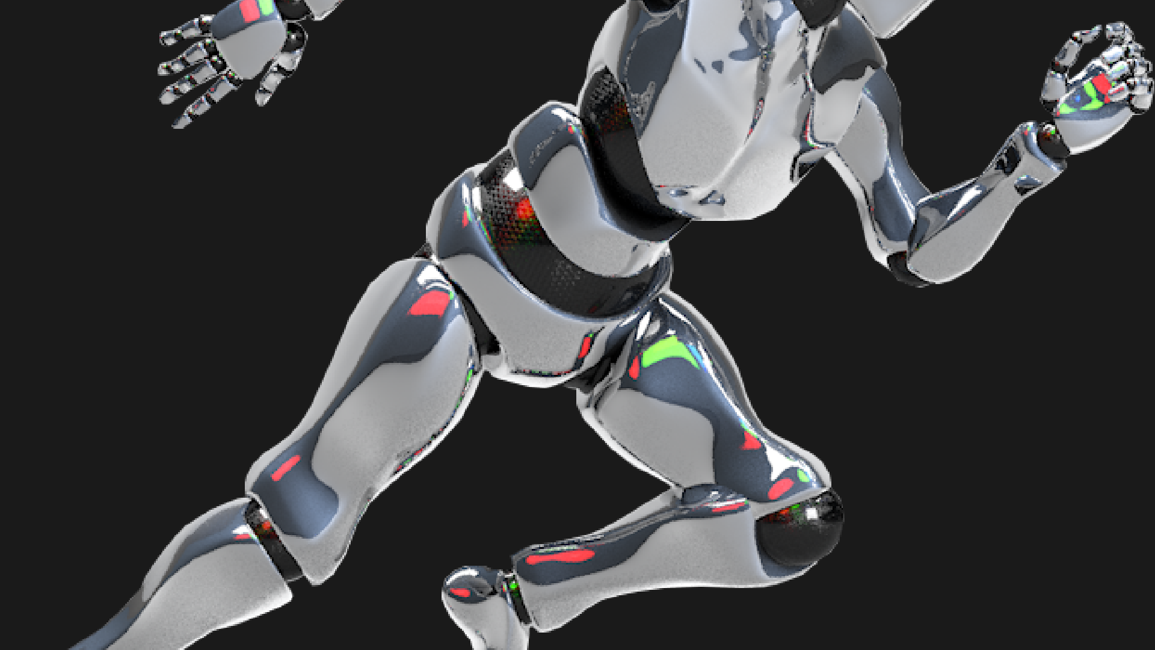
AIML PART
The AIML part is the min max algorithm we used to find the optimal move for the bot
Min Max is a search algorithm that can be used to determine the best move in a two-player game, such as chess. It works by considering all possible moves by both players (given a certain “depth”) and choosing the move that maximizes the value for the current player while minimizing the value for the opponent.

Slide 11
THANK you!!!
GitHub link - https://github.com/Manu839/Selflearning_tictactoe.git

