Slide 1







ADVENTURE WORKS
P R E S E N T E D B Y
Manish Kumar
Kavya V
Anusha Dasari
Kavya Patil

Slide 2

PROJECT OVERVIEW
The Adventure Works project is a comprehensive data analysis initiative based on a fictional, multinational bicycle manufacturer.
Key Aspects of the Adventure Works Project:
Context: The company is a large manufacturer producing bicycles, parts, and accessories for international markets (North America, Europe, Asia).
Goal: To analyze sales data, manage customer feedback, and identify key performance indicators (KPIs) like revenue, profit, and returns.
Core Components:
Data Modeling: Designing relational models using Adventure Works datasets, including SQL
Data Analysis (DAX): Creating calculated columns and measures to analyze sales, employee performance, and product trends.
Data Visualization: Creating interactive dashboards (often in Power BI) to visualize sales performance and identify high-value customers.

Slide 3
TOOLS USED
EXCEL
SQL was used to query the
Excel was used for initial data cleaning,
relevant sales data for analysis.
Complex queries were written to filter, join, and aggregate data from multiple tables.
Data was cleaned and structured in SQL to ensure it was ready for further analysis in other tools.
Data modelling using power pivot.
Pivot tables and charts in Excel were employed to create quick visualizations of year-wise sales amounts and other KPIs.
TABLEAU
Power BI was used to develop interactive reports and dashboards.
The tool’s capabilities in handling large datasets and creating dynamic visuals.
Power BI's integration features allowed for combining data from various sources, enhancing the overall analysis.
A data visualization tool used for creating advanced visualizations and interactive dashboards.
Tableau's ability to create interactive visualizations helped in exploring the data more comprehensively and identifying hidden patterns.

Slide 4
Project Pipeline
Extract The Data
Create The Visuals
Create Dashboard
Clean The Data

Slide 5
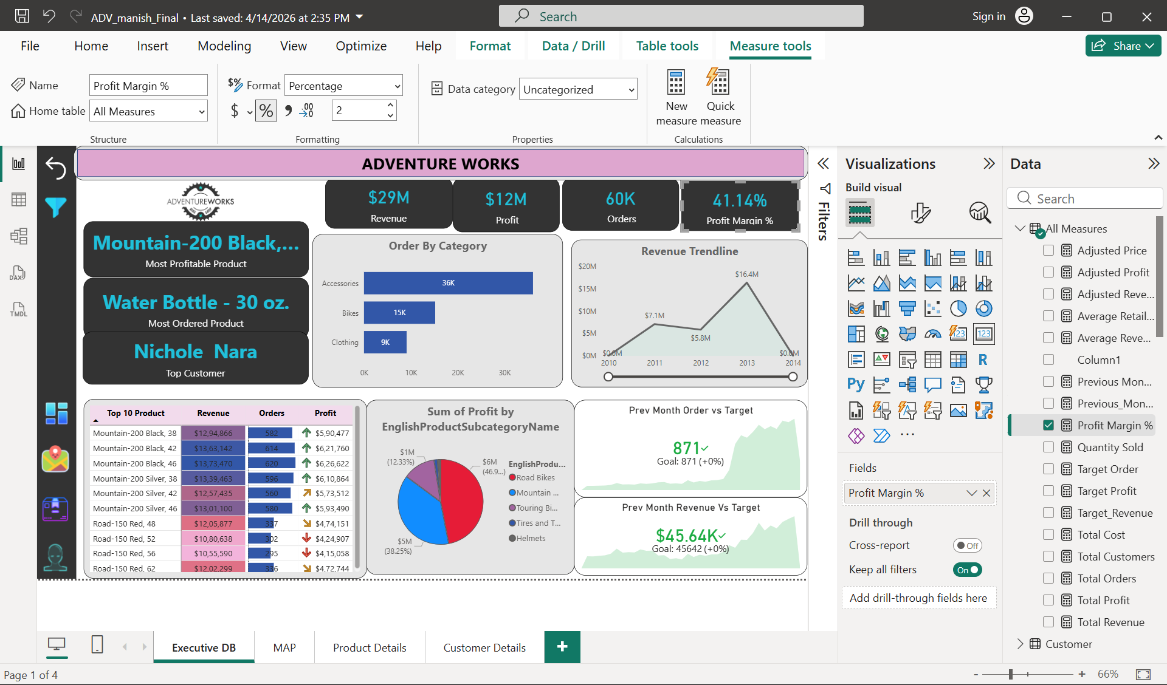
KPI’S USED IN DASHBOARD

Slide 6
📊KPI’S USED IN DASHBOARD
Revenue: $29M Total sales generated across all products.
Profit: $12M Net earnings after deducting costs
Orders: 60K Total number of customer orders fulfilled. Indicates sales volume and demand.
Profit Margin: 41.14% Ratio of profit to revenue. A strong margin above 40% suggests efficient cost management and healthy profitability.

Slide 7
🏆Highlighted Metrics
Most Profitable Product: Mountain-200 Black This product contributes the highest profit, making it a key driver of financial success.
Most Ordered Product: Water Bottle – 30 oz. While not the most profitable, it has the highest sales volume, showing popularity among customers.
Top Customer: Nichole Nara Identifies the most valuable customer, useful for loyalty programs and targeted marketing.

Slide 8
📈Visualizations
Orders by Category (Bar Chart)
Accessories: 36K orders
Bikes: 15K orders
Clothing: 9K orders → Accessories dominate in volume, though bikes likely drive higher revenue per order.
Revenue Trendline (2010–2014) : Shows steady growth, peaking at $16.4M in 2013. Indicates strong upward momentum before stabilizing.
Top 10 Products (Table) : Lists revenue, orders, and profit for leading products. Mountain-200 (Black & Silver) and Road-150 Red variants are consistently high performers.
Profit Distribution (Pie Chart)
Road Bikes: $6M (46.9%)
Mountain Bikes: $5M (38.25%)
Touring Bikes: $1M (12.33%)
Smaller shares: Tires, Tubes, Helmets → Road bikes are the largest profit contributor, followed closely by mountain bikes.

Slide 9
📈Visualizations
🎯 Performance vs Targets
Previous Month Orders: 871 (Goal: 871) → Target met exactly.
Previous Month Revenue: $45.64K (Goal: $45.642K) → Target achieved with near-perfect accuracy
✅ Overall Insight
The dashboard shows a profitable and growing business, with strong margins, balanced product mix, and reliable target achievement. Accessories drive order volume, while bikes (especially Mountain-200 and Road-150) generate the bulk of revenue and profit. Customer loyalty is evident, with top buyers contributing significantly.
.

Slide 10
Actionable Insights
🚀 Growth & Sales Strategy
Leverage Accessories for Upselling Accessories account for the highest order volume (36K). Bundle them with bikes or clothing to increase average order value. Example: offer discounts on helmets or water bottles with bike purchases.
Capitalize on Bike Profitability Although bikes have fewer orders than accessories, they generate the majority of revenue and profit. Focus marketing campaigns on premium bike models (Mountain-200, Road-150) to maximize profitability.
🎯 Customer & Market Focus
Reward Top Customers Nichole Nara is the top customer. Implement loyalty rewards or personalized offers to retain and expand high-value customers.
Target Repeat Buyers of Popular Products Water Bottle – 30 oz. is the most ordered product. Use this insight to cross-sell higher-margin items to these customers.

Slide 11
Actionable Insights
🔑 Action Priorities
Upsell accessories with bikes to lift margins.
Expand profitable bike lines (Mountain-200, Road-150).
Introduce loyalty programs for top customers.
Cross-sell higher-margin items to frequent accessory buyers.
Optimize inventory by trimming low-profit categories.
Explore new markets/channels to reignite revenue growth.

Slide 12
📊 Conclusion
Adventure Works is profitable and well-balanced, with bikes as the profit backbone and accessories sustaining volume. The company should focus on sustaining bike profitability while leveraging accessory sales for steady order flow.

Slide 13






THANK YOU

