Slide 1

NLP-to-BraneScript Translation for Distributed Scientific Workflows
Master's Thesis Defence
University of Amsterdam · 2025

Slide 2
The Problem
• Brane: federated workflow framework — data stays local, computations travel
• Workflows written in BraneScript, a custom domain-specific language (DSL)
• Barrier: scientists must learn DSL syntax to run analyses
• Goal: translate plain-English intent → working BraneScript workflow
Example
"Compute the mean age of diabetic patients"
↓
val result := compute_mean(dataset := ..., column := "age", filter := "diabetic == true"); println(result);
Notes:
Frame the problem as a usability gap: Brane is powerful for privacy-preserving workflows, but writing correct BraneScript remains a barrier for domain scientists.

Slide 3
Research Questions
RQ1 How does model scale affect translation accuracy?
RQ2 What is the effect of retrieval, prompt engineering, and decomposition?
RQ3 Does supervised fine-tuning on domain examples improve accuracy?
RQ4 Can a semantic cache provide reproducibility for equivalent intents?

Slide 4
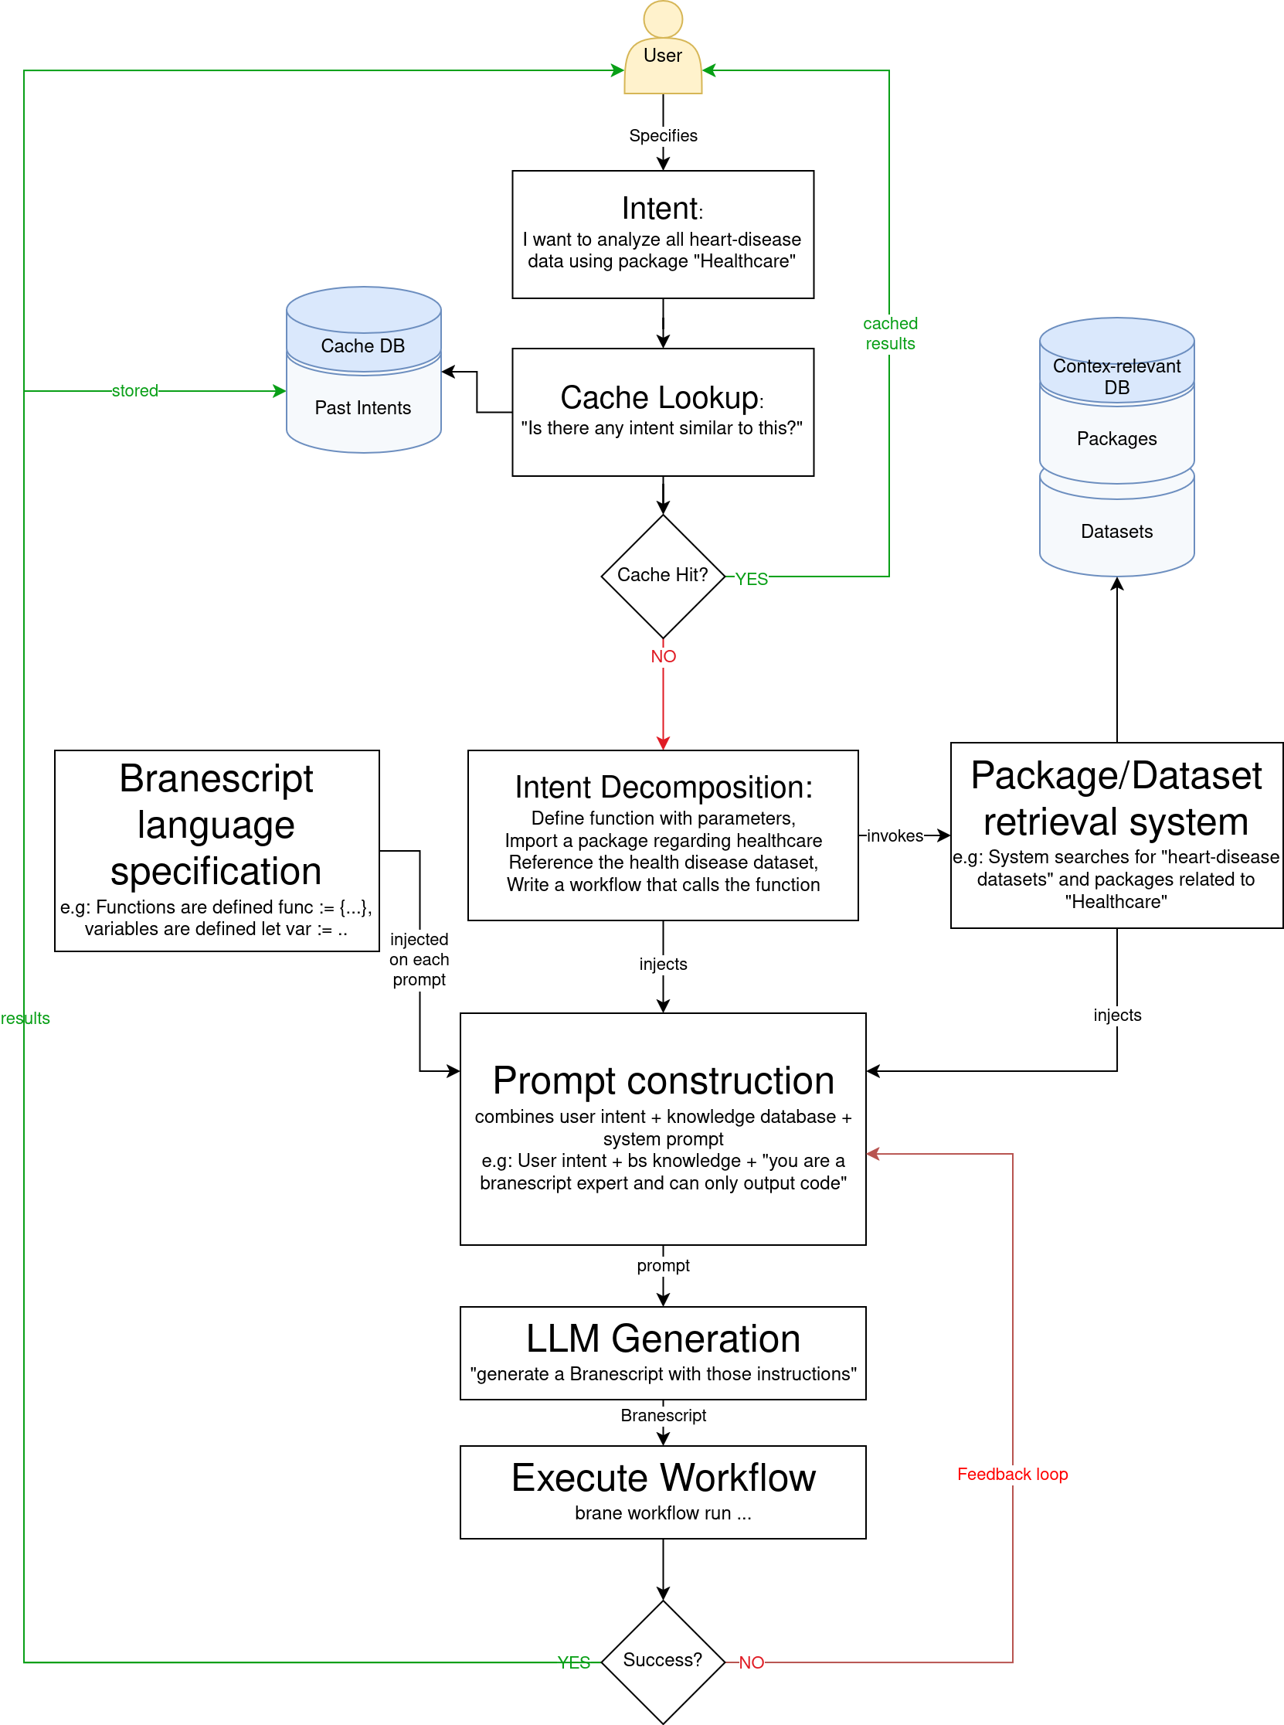
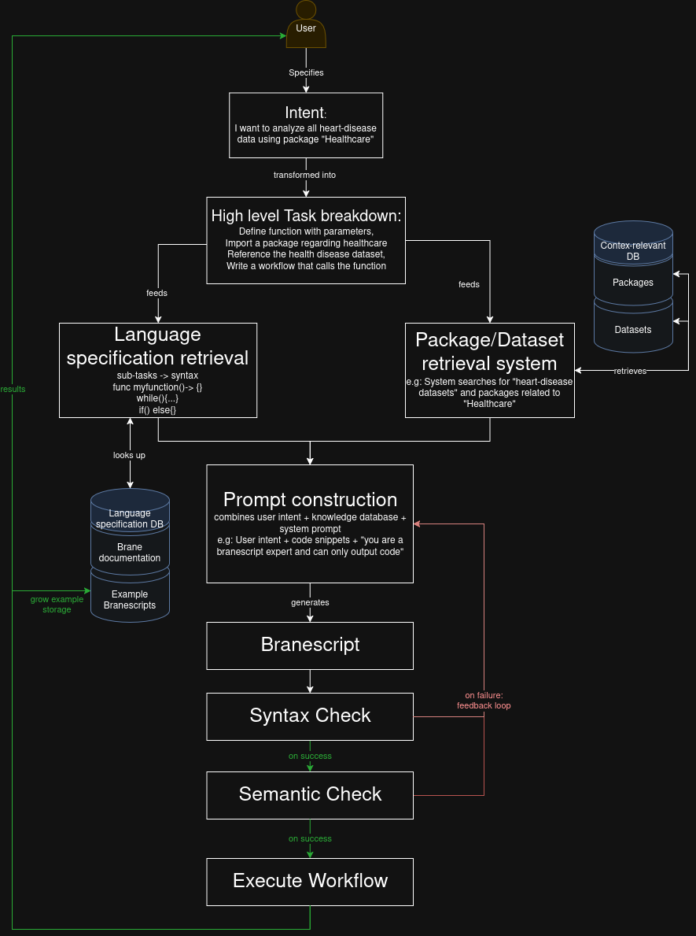
System Architecture
RAG · Decomposition · Generation · Cache

Slide 5
Dataset & Evaluation Setup
• 584 unique intent–BraneScript pairs
• 7 domain packages: healthcare, genomics, epidemics, statistics, text analysis, data masking, datetime
• Split: 497 training / 87 test (stratified)
• 3 paraphrases per intent → 1,752 cache evaluation queries
Evaluation pipeline
Compile rate
→
Execution rate
→
Output match rate

Slide 6
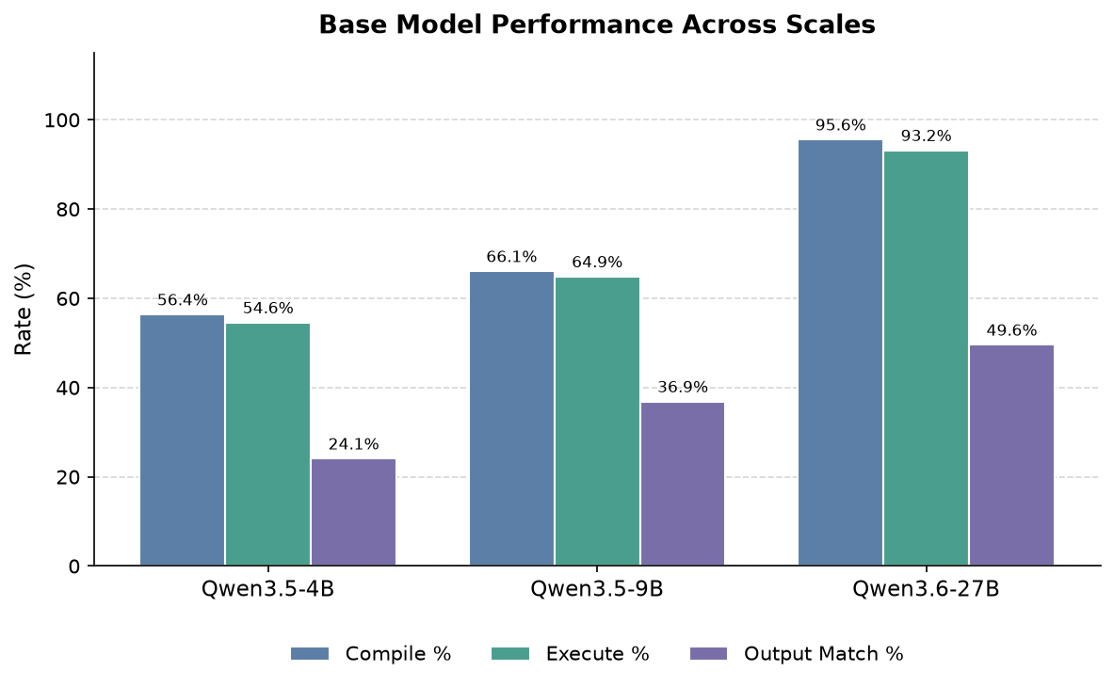
RQ1 — Translation Accuracy Across Model Scales
• Largest jump: 9B → 27B
• 27B achieves 49.6% output match
• 4B model dominated by undefined variable errors
• Scale is the strongest single lever
Notes:
Highlight the nonlinear improvement with scale: the step from 9B to 27B changes the error profile from compile failures to mostly harder semantic errors.

Slide 7
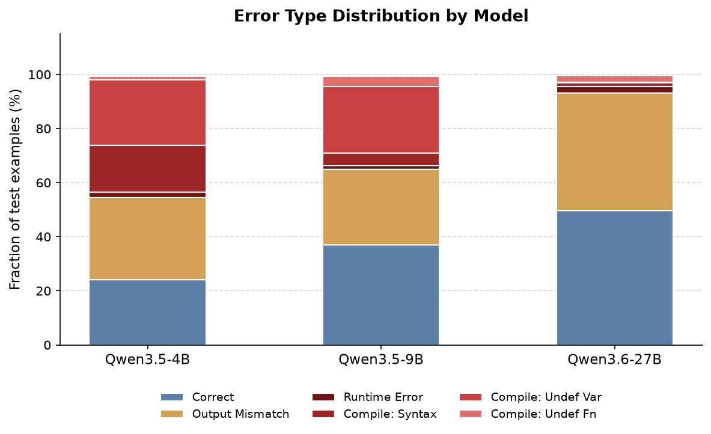
RQ1 — Error Type Breakdown
Error categories across model sizes. 27B largely eliminates compile failures.

Slide 8
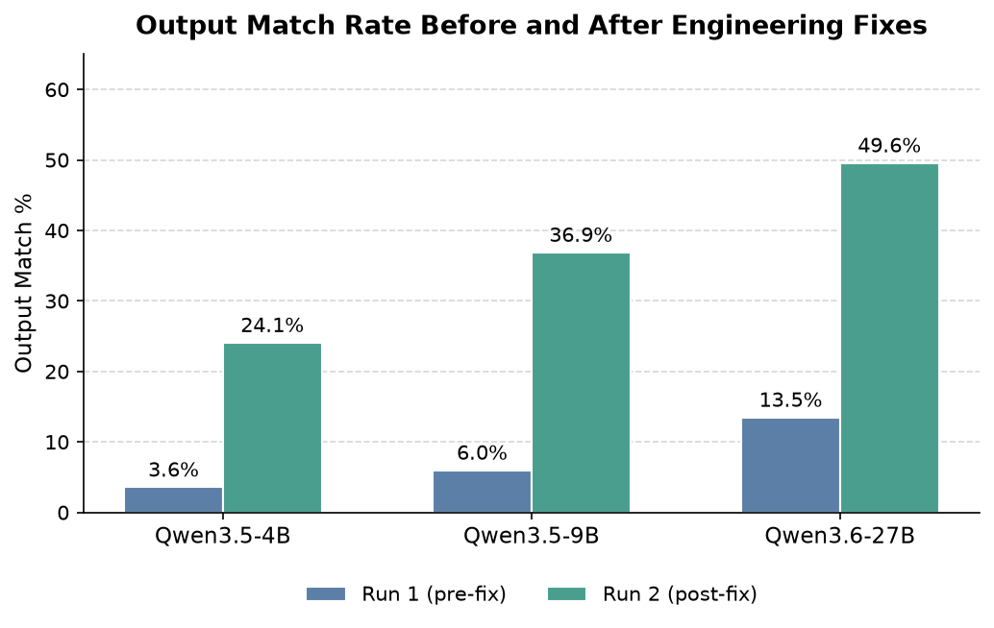
RQ2 — Effect of Prompt Engineering
• Same 27B weights — two rounds
• Round 1: 13.5% output match
• Round 2: 49.6% output match
• +36.1 percentage points
• ⚠ Multiple variables changed simultaneously
Notes:
Stress that prompt engineering matters almost as much as scale here, while also flagging the confound: retrieval, prompting, and decomposition evolved together between rounds.

Slide 9
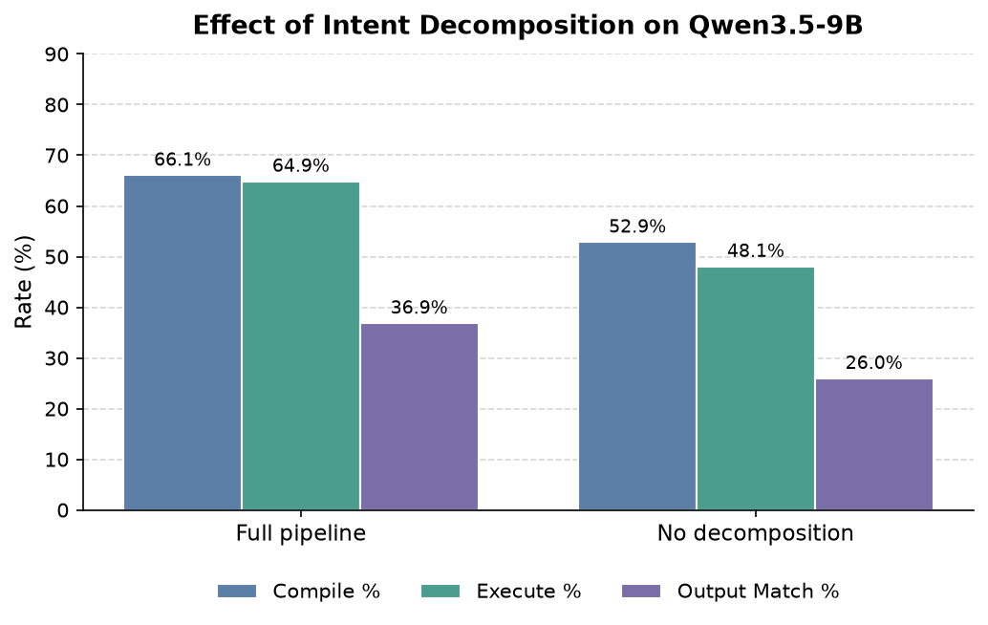
RQ2 — Decomposition Ablation
• Removing decomposition: −13.2 pp compile
• −16.8 pp execution
• −10.9 pp output match
• Breaking intents into sub-intents is necessary

Slide 10
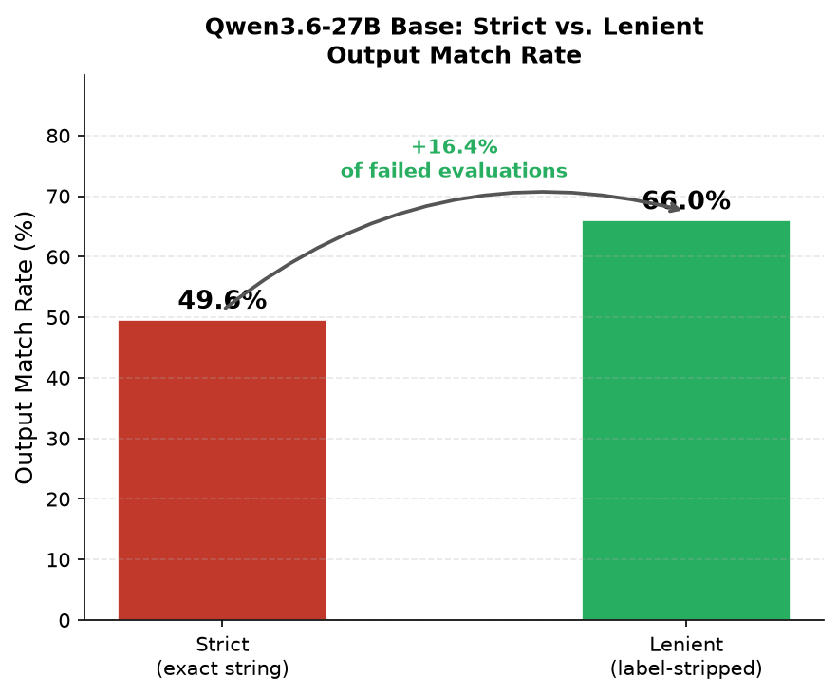
RQ2 — Output Match Sensitivity
Why the strict metric misses some successes
• Strict metric penalises correct computations with over-annotated output
• 26/159 failures: correct values, wrong format
• Example: "52.27" vs "Mean: 52.27"
• Lenient: 49.6% → 66.0% (+16.4% of failures)
• All primary results use strict metric

Slide 11
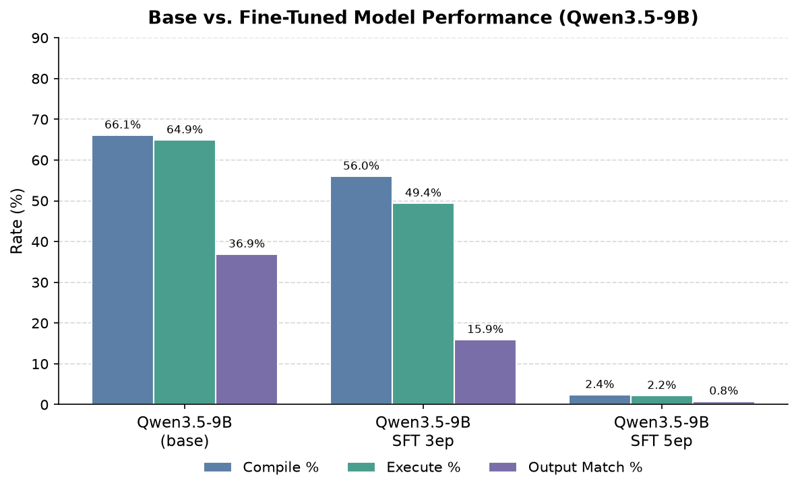
RQ3 — Effect of Supervised Fine-Tuning
• 3-epoch SFT: decline across all metrics
• 5-epoch SFT: near-total collapse (~0%)
• Base model + good prompt outperforms SFT
• Training data bootstrapped from same pipeline — likely limits signal
Notes:
Present this as a useful negative result: when the supervision comes from the same imperfect pipeline, fine-tuning can reinforce errors instead of adding signal.

Slide 12
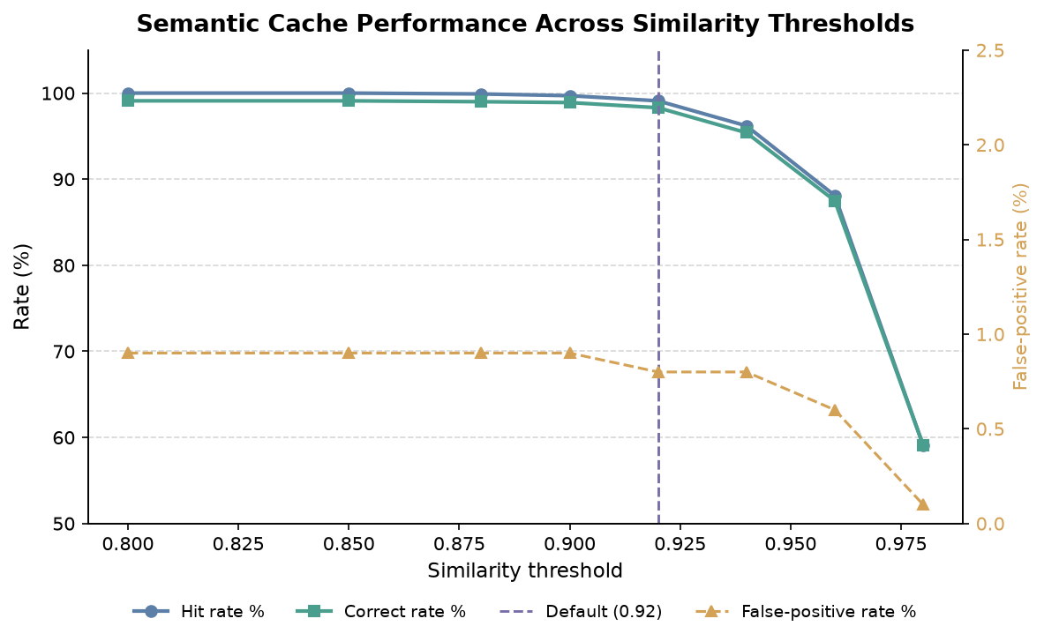
RQ4 — Semantic Cache as Reproducibility Layer
• At threshold 0.92:
• Hit rate: 99.1%
• Correct rate: 98.3%
• False-positive rate: 0.8%
• Threshold = confidence dial
• Higher → fresh generation on uncertain matches
Notes:
Explain the cache as a reproducibility layer rather than just an optimisation: equivalent intents resolve to the same workflow unless similarity falls below the confidence threshold.

Slide 13
Threats to Validity
INTERNAL
Round 1→2 multi-variable confound; SFT test/train overlap
EXTERNAL
Single DSL · single model family · English-only · single author
CONSTRUCT
Execution rate ≠ correctness; output match = string equality
CONCLUSION
87-example test set; single trial per configuration

Slide 14
Discussion
• Scale + prompt engineering: strongest lever
• ~50% output match ceiling is structural (multi-step logic, package selection)
• Semantic cache: effective reproducibility layer — errors caught by execution verification
• SFT negative result is itself informative: bootstrapped data insufficient

Slide 15
Future Work
• Controlled ablation of each component independently
• Real scientist users as intent authors (diverse phrasing)
• Closed-model comparison (GPT-4, Claude)
• Parameter-aware cache embeddings
• SFT with human-verified, independently authored training data

Slide 16
Plain-English → BraneScript translation is feasible
• 27B + RAG + decomposition: 49.6% strict / 66% lenient output match
• Prompt engineering as important as model scale
• Semantic cache: 99.1% hit rate, 98.3% correct rate
• SFT in this configuration does not help — a finding in itself
Thank you

