Slide 1


College-API FrontEnd CA2
Manu Jose
N00200555

Slide 2


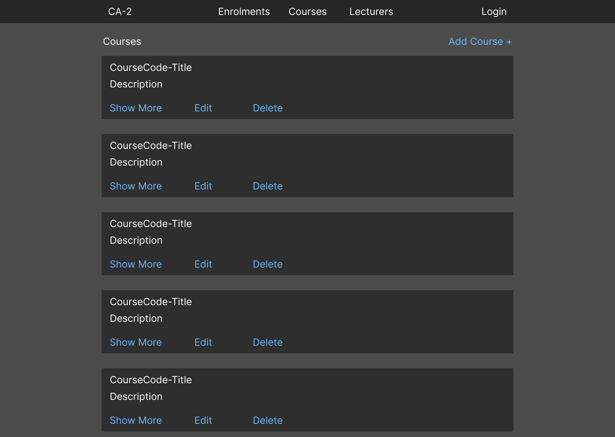
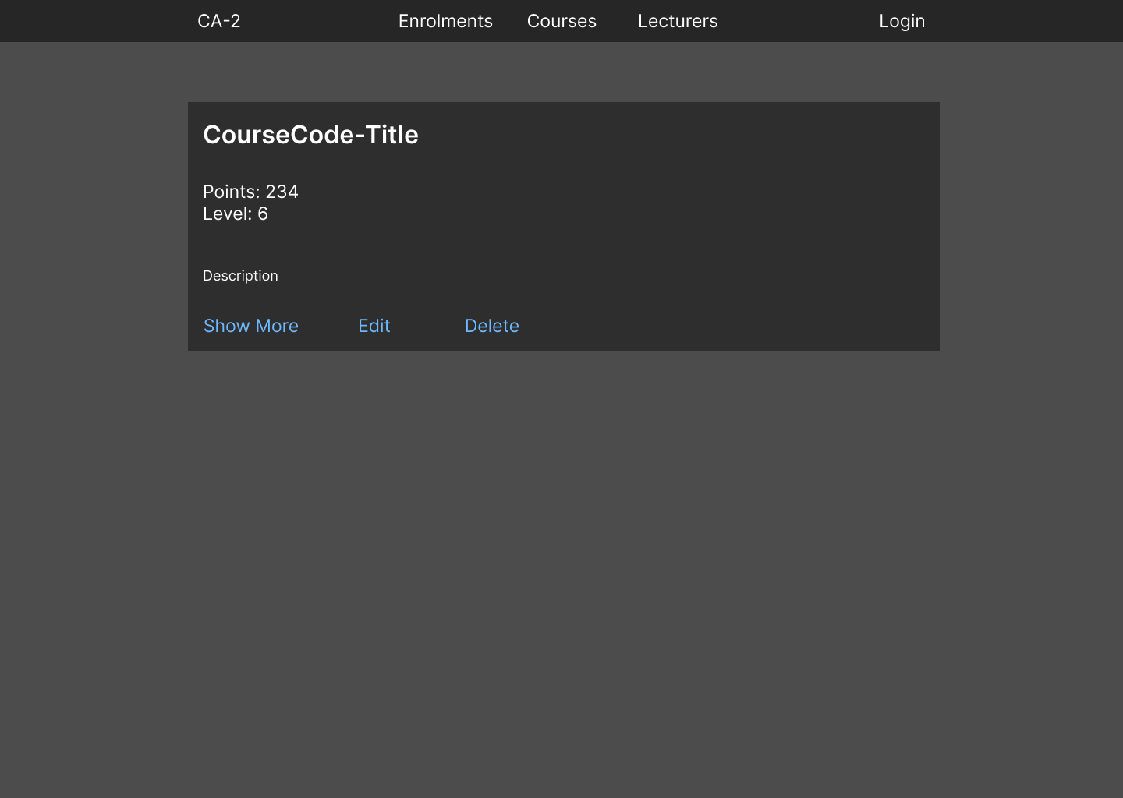
Design
My design is based mainly off of MUI’s dark mode theme. I like the simplicity of it and how easy it is to look at. It’s not complicated but it works well.
My only complaint would be that it does look a little plain and un-exciting.

Slide 3

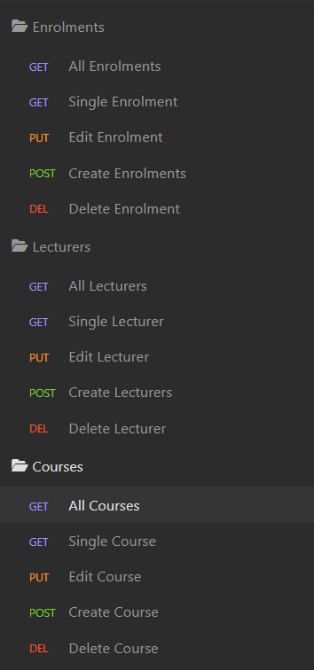
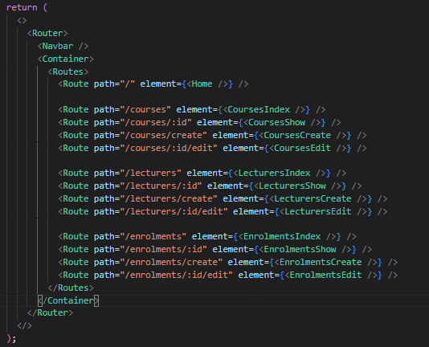
Routes
This project has a lot more routes than the first CA so I organised them into 3 different files within insomnia to manage them easier.
There was

