Slide 1

SoftCost

Slide 2
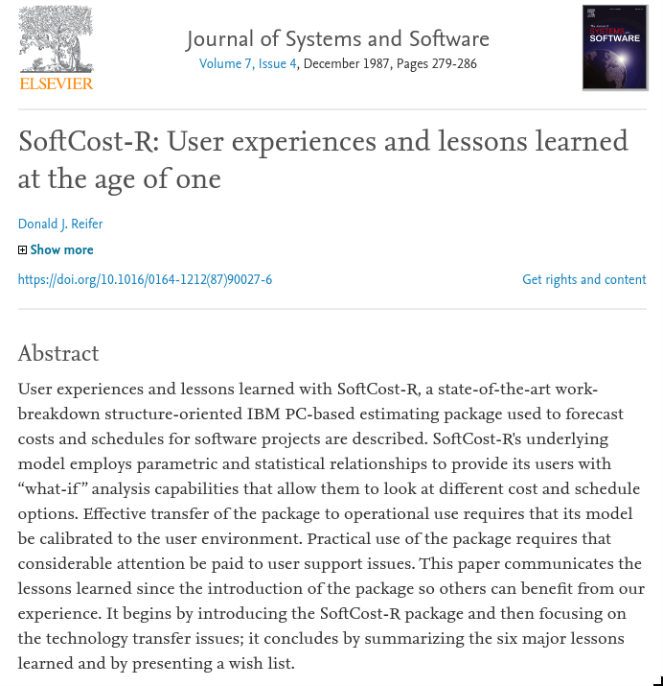

Slide 3
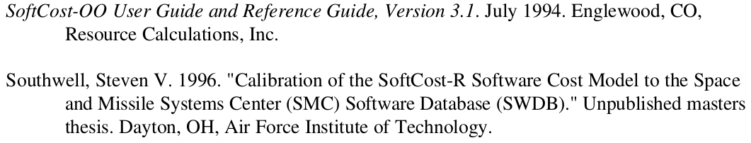
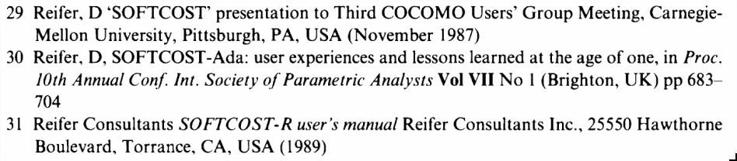
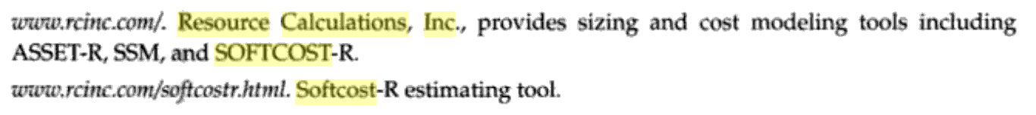
Referencias?

Slide 4
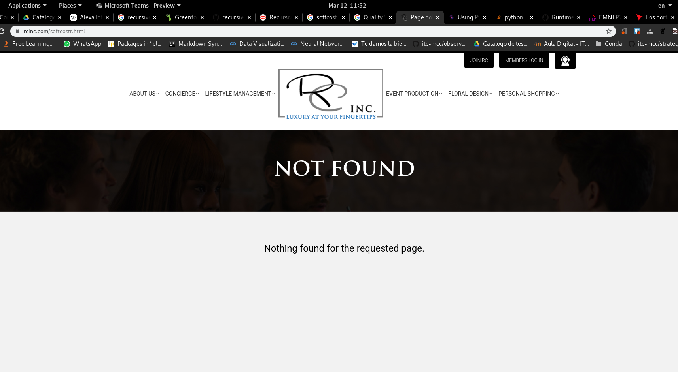

Slide 5
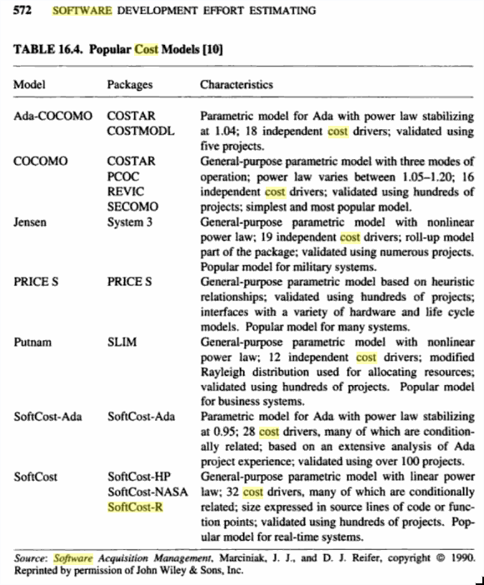
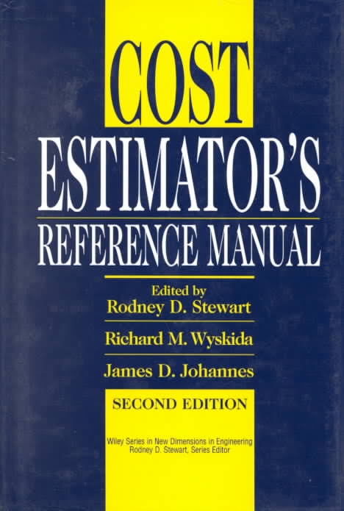
https://books.google.com.mx/books?id=TzOSUPJsumcC&pg=PA572&lpg=PA572&dq=softcost-r+software+cost&source=bl&ots=v3E4U8n4YG&sig=ACfU3U1zxjS_zKv_oJdLwTsXc0eefgPw6w&hl=es-419&sa=X&ved=2ahUKEwiCkuyXlpDoAhXRKH0KHSn6BCAQ6AEwCHoECAkQAQ#v=onepage&q=softcost-r%20software%20cost&f=false
1987

Slide 6

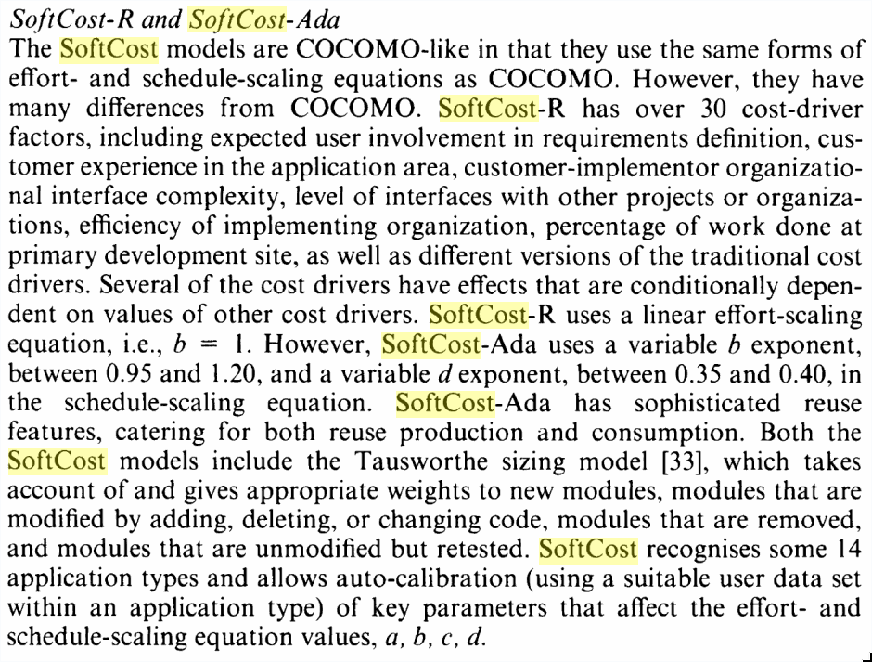
1991

Slide 7
Factores
Mas de 30 factores de manejo de costo incluyendo
Involucramiento del usuario en la definición de requisitos
Experiencia del consumidor en el area de aplicación
Interface organizacional de complejidad consumidor-implementador
Nivel de interfaces con otros proyectos
Eficiencia de implementación de organización
Porcentaje de trabajo realizado en el sitio de desarrollo primario

Slide 8

CoStar
CoStar is a faithful implementation of the COCOMO model that is easy to use on small projects and yet powerful enough to control large projects.
CoStar offers these advantages:
COCOMO estimates are more objetive and repeatable than estimates made by methods relying on proprietary models.
COCOMO can be calibrated to reflect your software development environment, and to prodeuce more accurate estimates.

Slide 9
CoStar
Typically, you’ll start with only a rough description of the software system that you’ll be developing, and you’ll use CoStar to give you early estimates about the proper Schedule and staffing levels.
As you define your knowledge of the problem, and as you design more of the system you can use CoStar to produce more and more refined estimates.
CoStar allows you to define a software structure to meet your needs. Your initial estimate might be made on basis of a system containing 3000 lines of code.

Slide 10
Warning:
It is easy to use CoStar to make software cost estimations, that it’s posible to misuse it; every CoStar user should spend the time to learn the underlying COCOMO assumptions and definitions from COCOMO II

