Slide 1
How to build a recommender system based on Mahout and Java EE
Berlin Expert Days 29. – 30. March 2012 Manuel Blechschmidt CTO Apaxo GmbH

Slide 2
„All the web content will be personalized in three to five years.“
Sheryl Sandberg COO Facebook – 09.2010

Slide 3
What is personalization?
Personalization involves using technology to accommodate the differences between individuals. Once confined mainly to the Web, it is increasingly becoming a factor in education, health care (i.e. personalized medicine), television, and in both "business to business" and "business to consumer" settings.
Source: https://en.wikipedia.org/wiki/Personalization

Slide 4
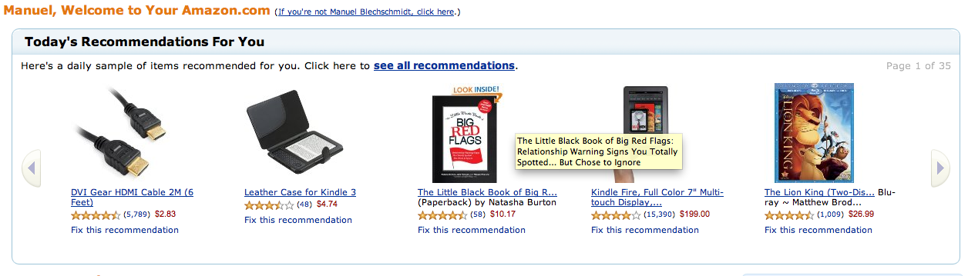
Amazon.com

Slide 5
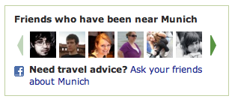
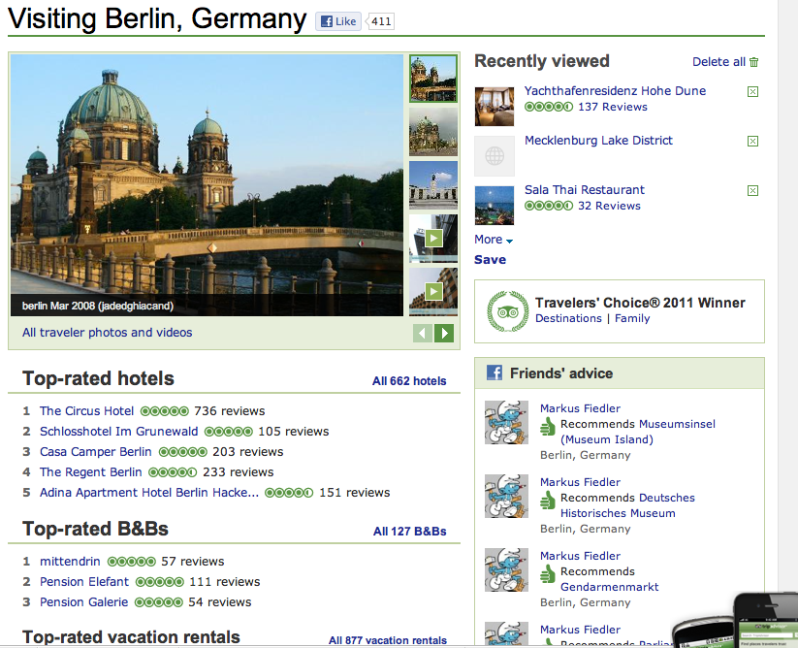
TripAdvisor.com

Slide 6

eBay

Slide 7
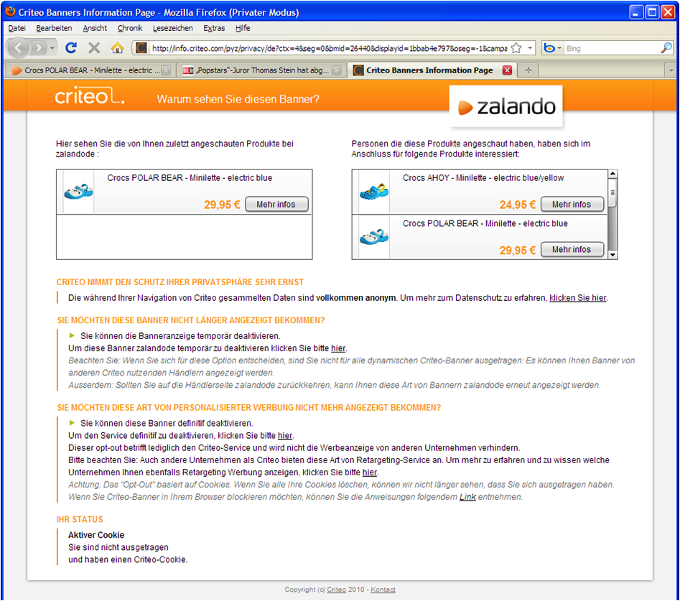
criteo.com - Retargeting

Slide 8
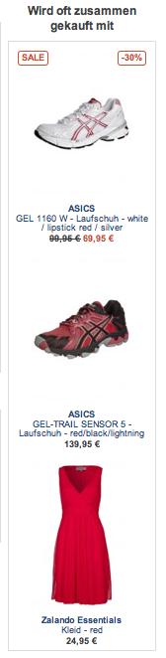
Zalando

Slide 9
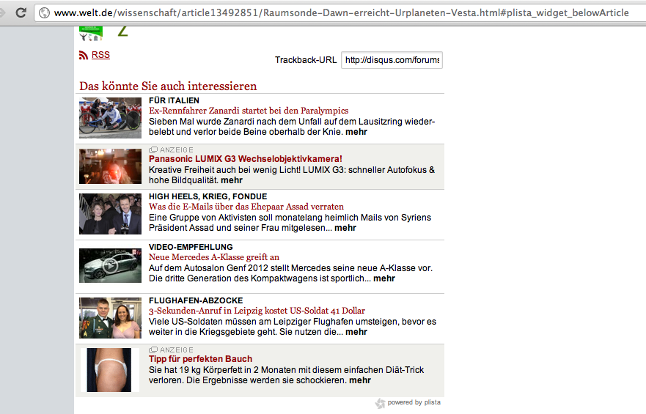
Plista

Slide 10
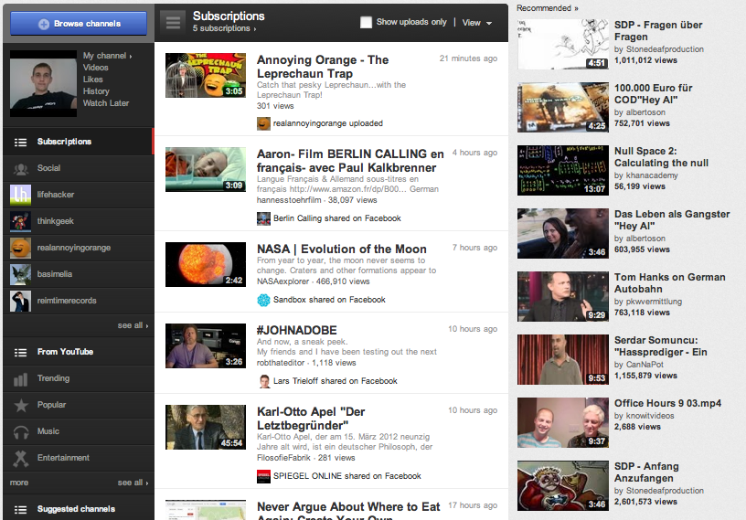
YouTube

Slide 11
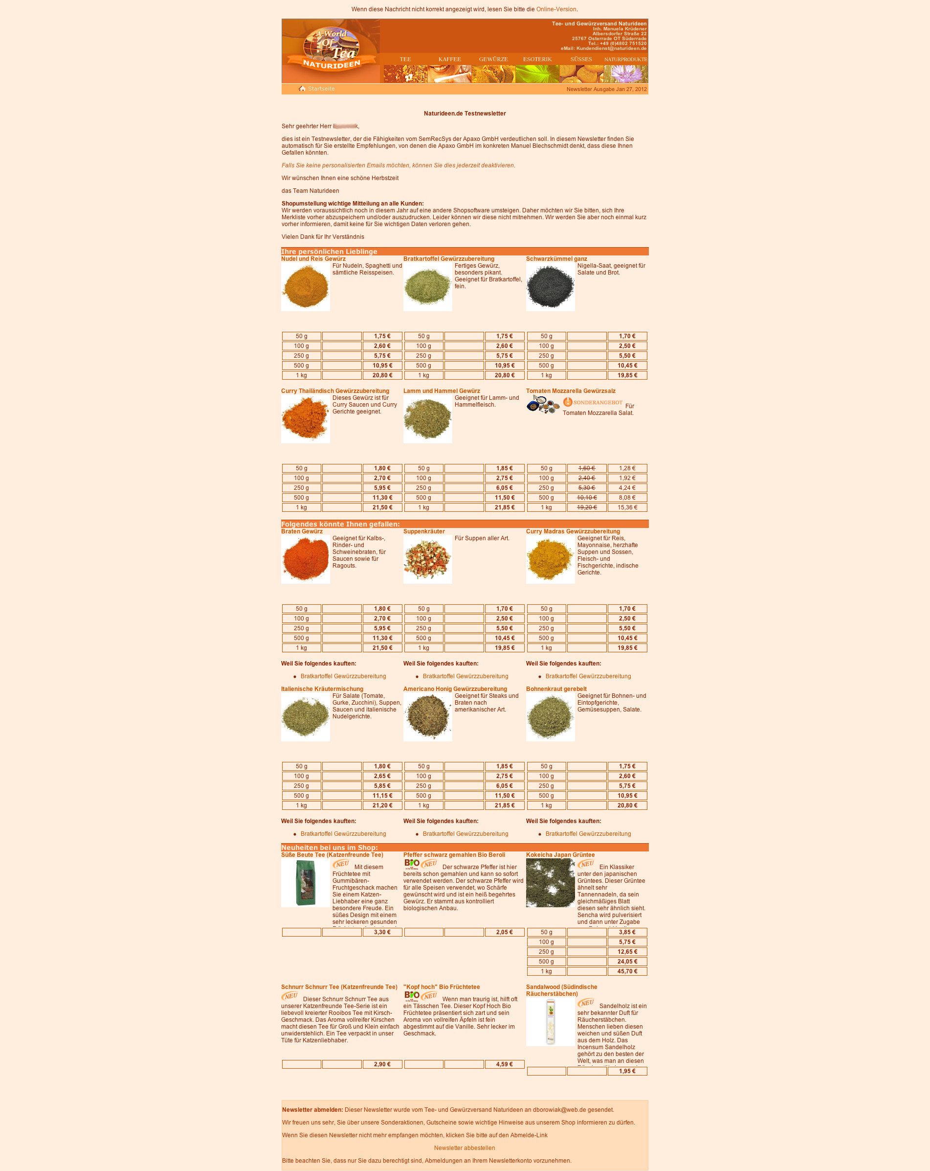
Naturideen.de (coming soon)

Slide 12
Recommender
This talk will concentrate on recommender technology based on collaborative filtering (cf) to personalize a web site
- a lot of research is going on
- cf has shown great success in movie and music industry
- recommenders can collect data silently and use it without manual maintenance

Slide 13
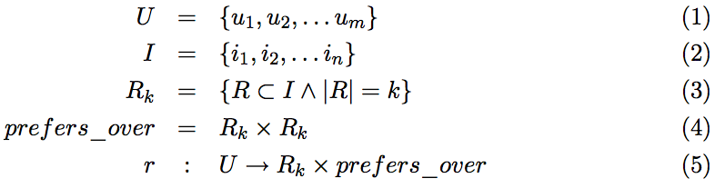
What is a recommender?
Let U be a set of users of the recommendation system and I be the set of items from which the users can choose. A recommender r is a function which produces for a user ui a set of recommended items Rk with k entries and a binary, transitive, antisymmetric and total relation prefers_overui which can be used for sorting the recommendations for the user. The recommender r is often called a top-k recommender.

Slide 14
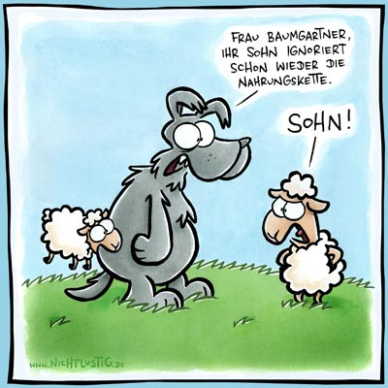
What should wolf and sheep eat?

Slide 15
Demo Data
 | Carrots | Grass | Pork | Beef | Corn | Fish
Rabbit | 10 | 7 | 1 | 2 | ? | 1
Cow | 7 | 10 | ? | ? | ? | ?
Dog | ? | 1 | 10 | 10 | ? | ?
Pig | 5 | 6 | 4 | ? | 7 | 6
Chicken | 7 | 6 | 2 | ? | 10 | ?
Pinguin | 2 | 2 | ? | 2 | 2 | 10
Bear | 2 | ? | 8 | 8 | 2 | 7
Lion | ? | ? | 9 | 10 | 2 | ?
Tiger | ? | ? | 8 | ? | ? | 8
Antilope | 6 | 10 | 1 | 1 | ? | ?
Wolf | 1 | ? | ? | 8 | ? | 6
Sheep | ? | 8 | ? | ? | ? | 2

Slide 16
Characteristics of Demo Data
Ratings from 1 – 10
Users: 12
Items: 6
Ratings: 43 (unusual normally 100,000 – 100,000,000)
Matrix filled: ~60% (unusual normally sparse around 0.5-2%)
Average Number of Ratings per User: ~3.58
Average Number of Ratings per Item: ~7.17
Average Rating: ~5.607
https://github.com/ManuelB/facebook-recommender-demo/tree/master/docs/BedConExamples.R

Slide 17
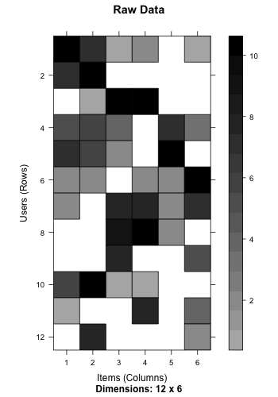

Slide 18
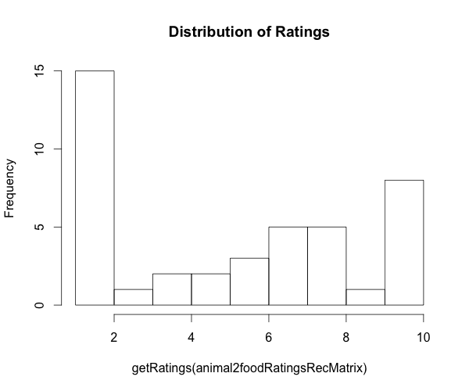

Slide 19
Model and Memory Approaches
- Item(User) Based Collaborative Filtering
- Matrix Factorization e.g
- Singular Value Decomposition
Main difference:
A model base approach tries to extract the underlying logic from the data.

Slide 20
User Based Approach
- Find similar animals like wolf
- Checkout what these other animals like
- Recommend this to wolf

Slide 21
Find animals which voted for beef, fish and carrots too
 | Carrots | Grass | Pork | Beef | Corn | Fish
Wolf | 1 | ? | ? | 8 | ? | 4
Pinguin | 2 | 2 | ? | 2 | 2 | 10
Bear | 2 | ? | 8 | 8 | 2 | 7
Rabbit | 10 | 7 | ? | 2 | ? | 1
Cow | 7 | 10 | ? | ? | ? | ?
Dog | ? | 1 | 10 | 10 | ? | ?
Pig | 5 | 6 | 4 | ? | 7 | 3
Chicken | 7 | 6 | 2 | ? | 10 | ?
Lion | ? | ? | 9 | 10 | 2 | ?
Tiger | ? | ? | 8 | ? | ? | 5
Antilope | 6 | 10 | 1 | 1 | ? | ?
Sheep | ? | 8 | ? | ? | ? | ?

Slide 22
Pearson Correlation
- 1 = very similar
- (-1) = complete opposite votings
- similarty between wolf and pinguin: -0.08219949
- cor(c(1,8,4),c(2,2,10))
- similarity between wolf and bear: 0.9005714
- cor(c(1,8,4),c(2,8,7))
- similarity between wolf and rabbit: -0.7600371
- cor(c(1,8,4),c(10,2,1))

Slide 23
Predicted ratings
- Wolf should eat: Pork Rating: 10.0
- Wolf should eat: Grass Rating: 5.645701
- Wolf should eat: Corn Rating: 2.0

Slide 24
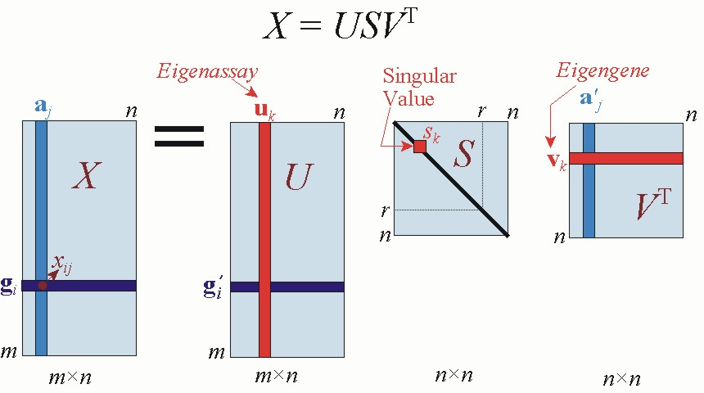
SVD
http://public.lanl.gov/mewall/kluwer2002.html

Slide 25
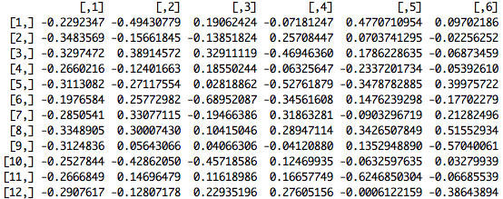
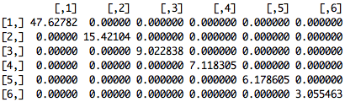
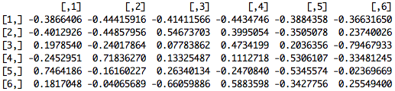
Factorized Matrixes

Slide 26
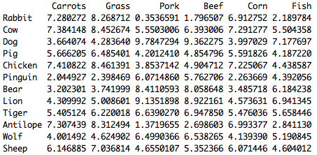
Predicted Matrix (k = 2)

Slide 27
What other algorithms can be used?
Similarity Measures for Item or User based:
- LogLikelihood Similarity
- Cosine Similarity
- Pearson Similarity
- etc.
Estimating algorithms for SVD:
- ALSWRFactorizer
- ExpectationMaximizationSVDFactorizer

Slide 28
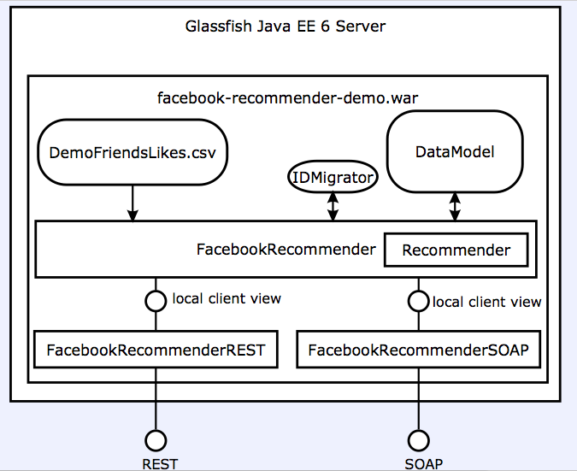
Architecture of the recommender

Slide 29
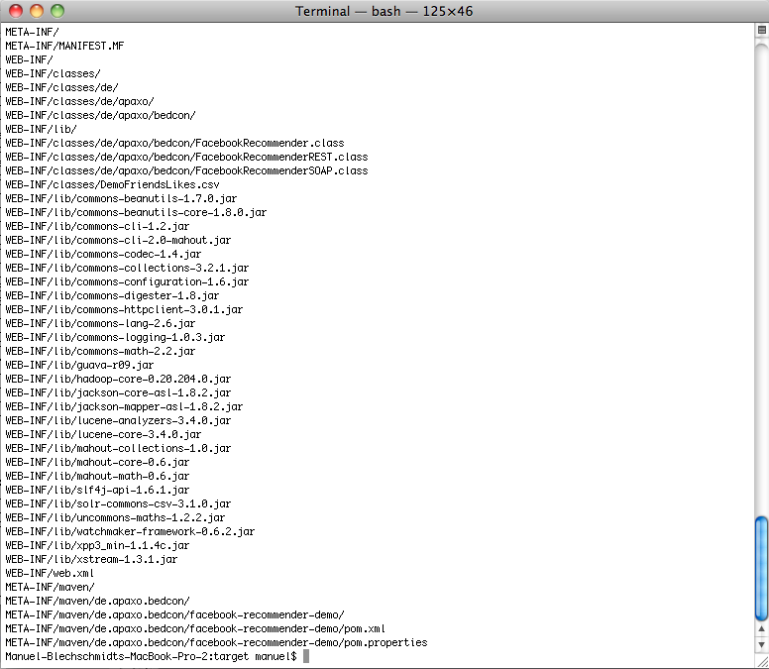
Packaging

Slide 30
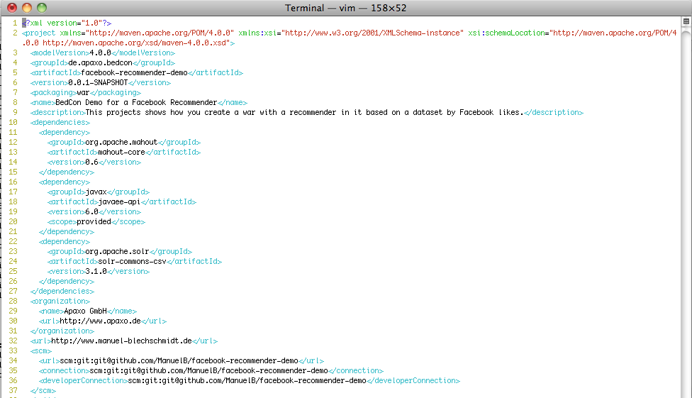
Maven pom.xml

Slide 31
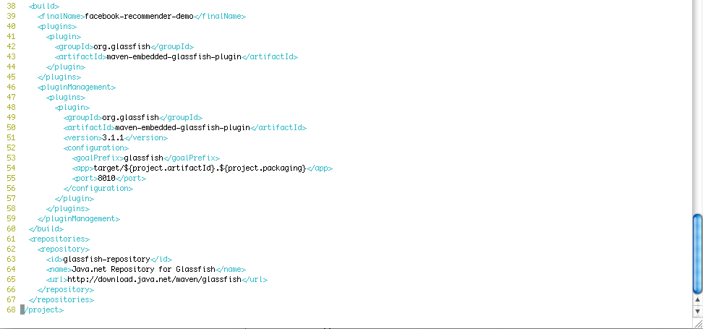

Slide 32
Conclusion
Recommendation is a lot of math
You shouldn't implement the algorithms again
There are a lot of unsanswered questions
- Scalibility, Performance, Usability
You can gain a lot from good personalization

Slide 33
More sources
http://www.apaxo.de
http://mahout.apache.org
http://research.yahoo.com
http://www.grouplens.org/
http://recsys.acm.org/
https://github.com/ManuelB/facebook-recommender-demo/

