Slide 1
The Evidence for God
A Probabilistic Model of Divine Existence and the Role of Moral Evil

Slide 2
Objective
• Develop a Bayesian logistic model estimating P(God)
• Integrate eight philosophical, empirical, and scientific variables
• Use Monte Carlo simulation and decision tree to model uncertainty
• Assess role of moral evil as both neutral and negative evidence

Slide 3
Model Structure
• Eight evidential variables: FT, MO, CG, RE, EV, BC, QM, MN
• Logistic regression + Monte Carlo simulation (100,000 trials)
• Variables justified by peer-reviewed literature and philosophical arguments

Slide 4
Monte Carlo Results – Main Model (EV Neutral)
• Median P(God) ≈ 98.6%
• Mean P(God) ≈ 94.6%
• P(God) > 90% in ~85% of simulations
• P(God) < 50% in <1.3% of simulations

Slide 5
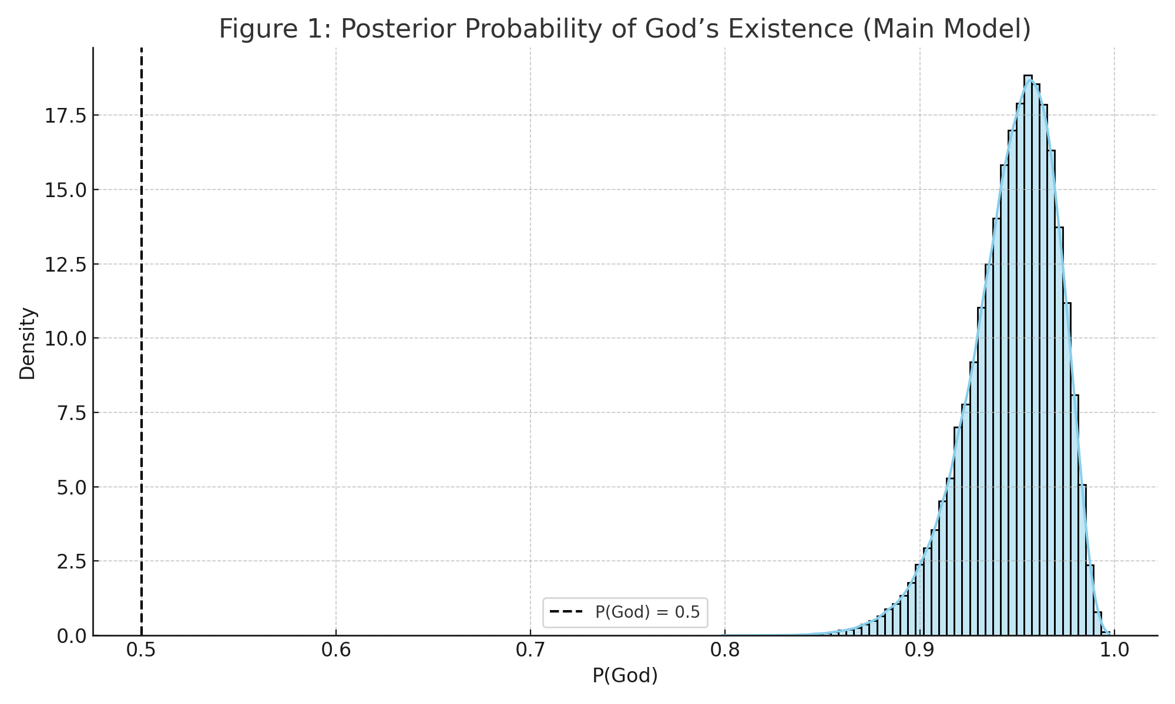
Figure 1: Posterior Probability Distribution (Main Model)

Slide 6
Appendix C – Moral Evil as Negative Evidence
• β_EV ~ Uniform(–1.5, –0.5)
• Median P(God) ≈ 95–97%
• Mean P(God) ≈ 90–92%
• Still favors theism in >95% of cases

Slide 7
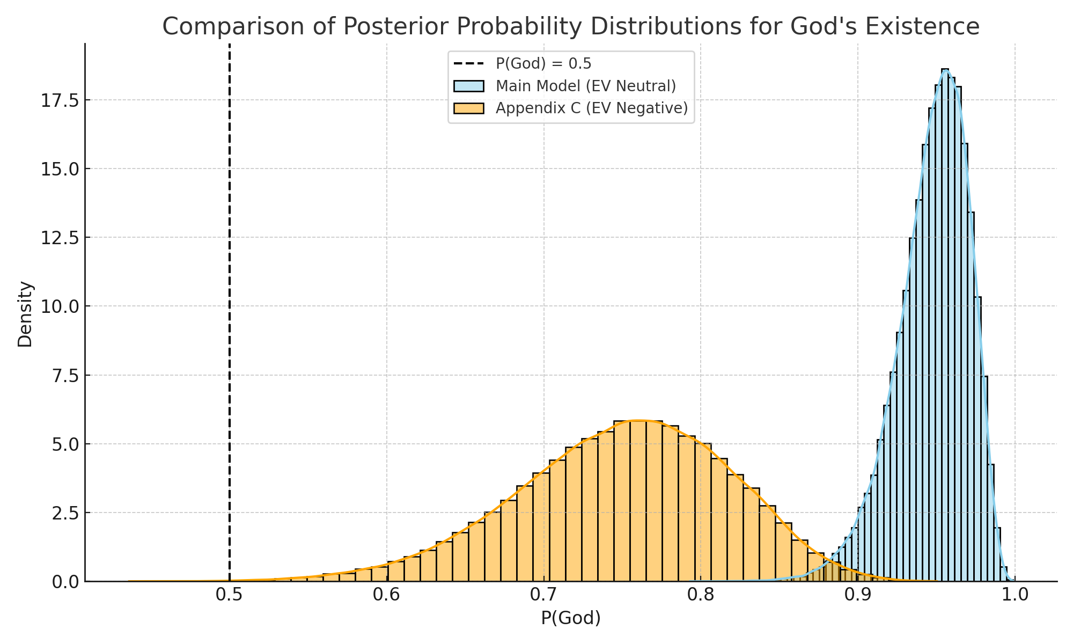
Figure 3: Comparison – EV Neutral vs. EV Negative

Slide 8
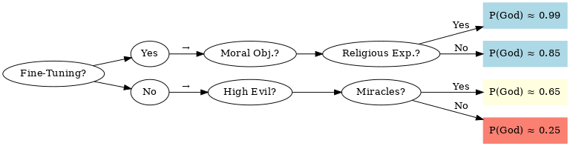
Figure 2: Decision Tree — Evidence Paths

Slide 9
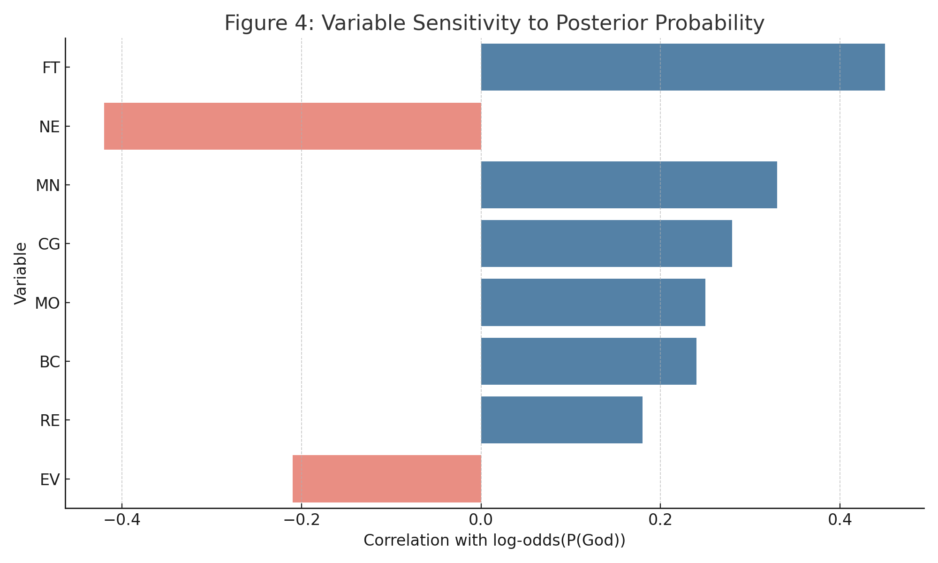
Figure 4: Variable Sensitivity

Slide 10
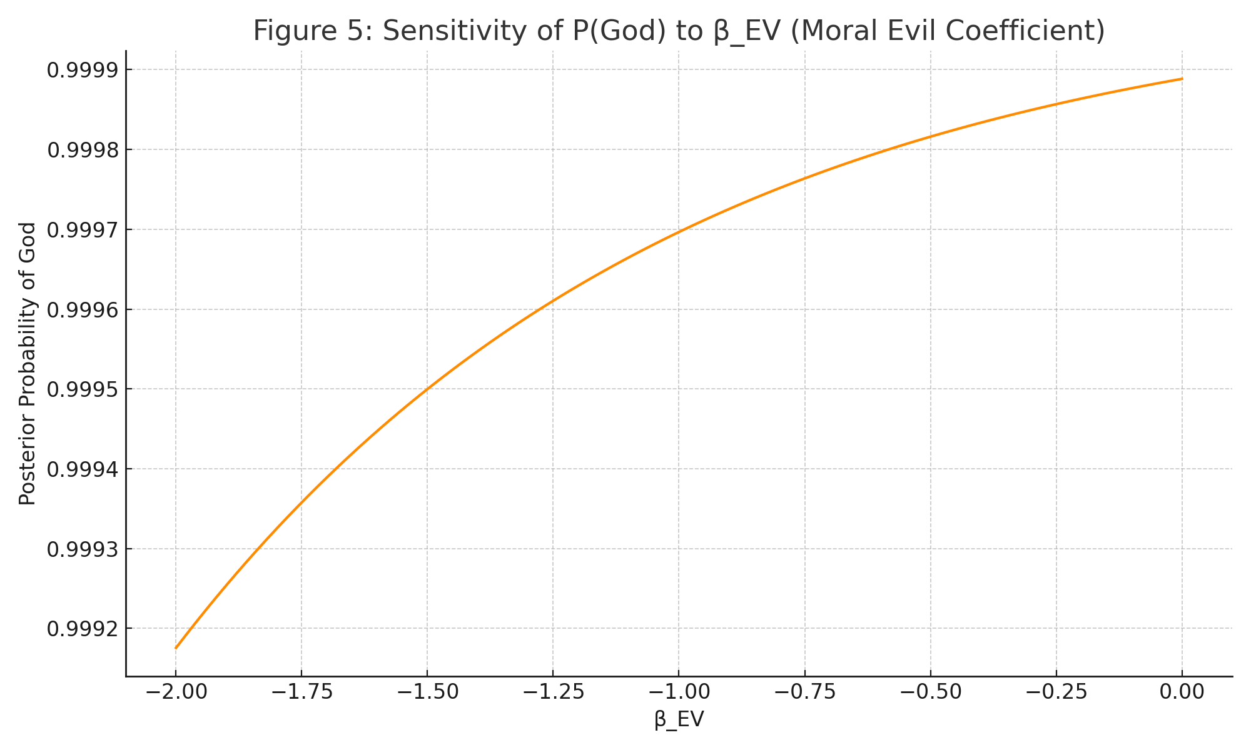
Figure 5: Sensitivity of P(God) to β_EV

Slide 11
Figure 6: Model Flow Diagram

Slide 12
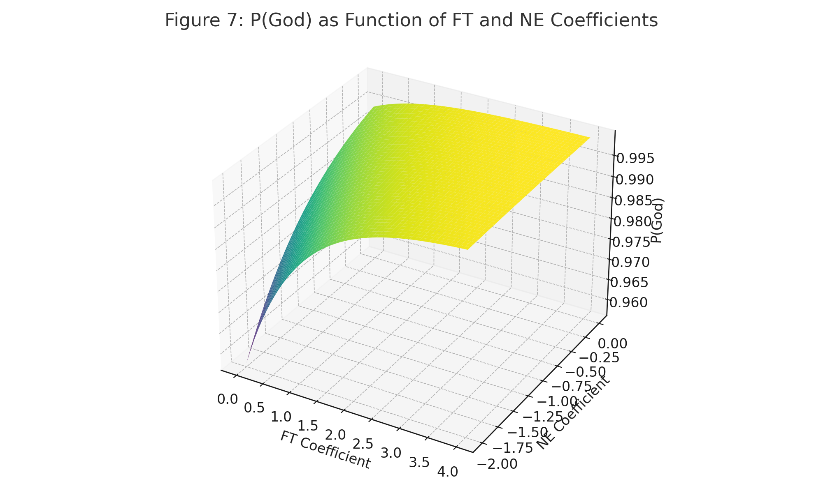
Figure 7: P(God) as Function of FT and NE

Slide 13
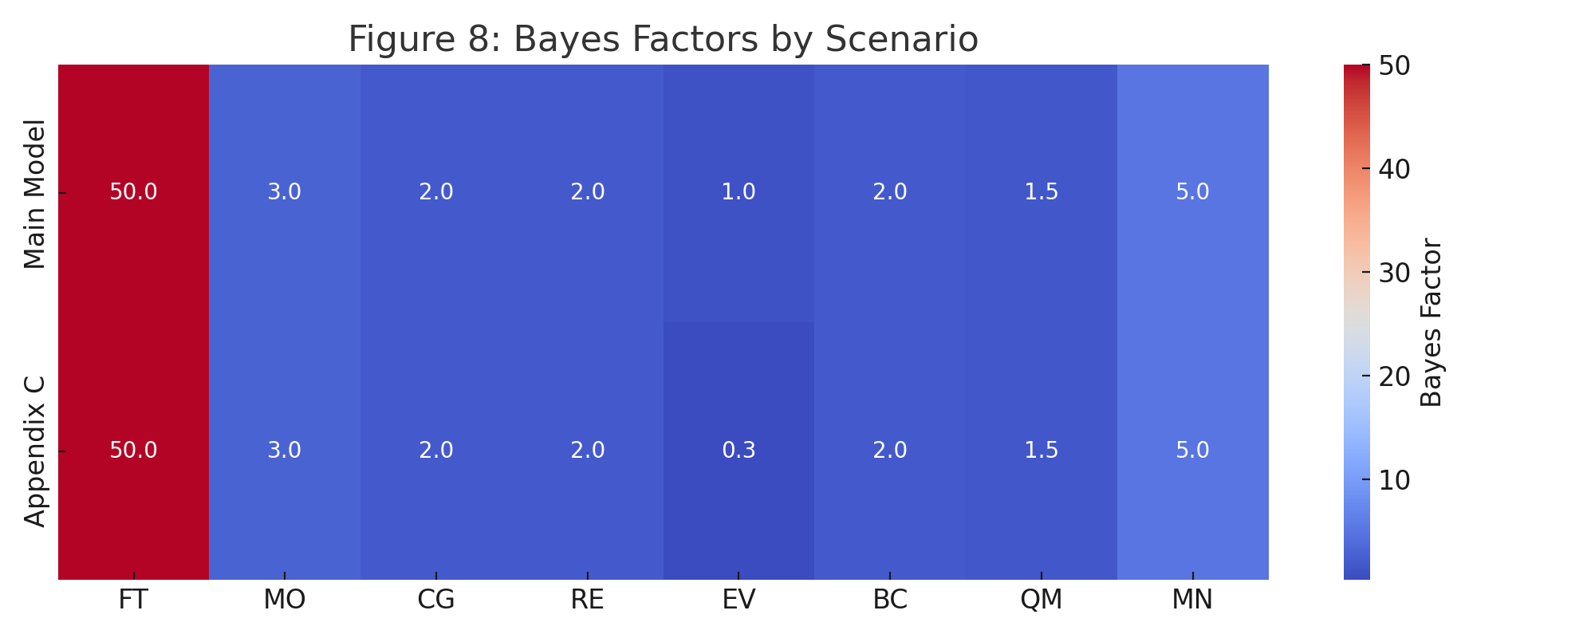
Figure 8: Bayes Factor Heatmap by Scenario

