Slide 1
CGS_AI Demo
From a process flow to code you can run anywhere.
A claims-analysis pipeline built in SAS Enterprise Guide
Prepared by Manuel Figallo · cgs_ai v1.0beta

Slide 2
THE DEMO IN THREE ACTS
What You Will See
One pipeline, followed from the point-and-click interface to a scheduled job.
1
2
3
Build it in the GUI
Export it to code
Run it anywhere
Three cgs_ai functions wired together in a SAS Enterprise Guide process flow. No script written by hand.
Three clicks turn the process flow into one .sas program containing the very same calls.
That program runs outside Enterprise Guide, in Python or PowerShell, and on a schedule.
The point: you never rewrite the logic. The GUI and the code are the same three function calls.
cgs_ai · Demo
Prepared by Manuel Figallo
2 / 12

Slide 3
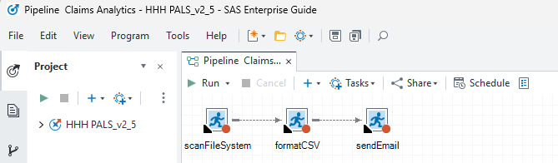
ACT 1 · THE GUI
The Pipeline an Analyst Builds
Three cgs_ai functions, dragged into one Enterprise Guide process flow and run end to end.
Nothing custom here. Each node is a cgs_ai function called with parameters — not a one-off script written for this project.
cgs_ai · Demo
Prepared by Manuel Figallo
3 / 12

Slide 4
THE THREE FUNCTIONS
What Each Node Actually Does
Every function exists in Python, PowerShell and as a SAS wrapper, with identical names and parameters.
Function | What it does in this pipeline
scanFileSystem | Sweeps the claims log shares for keywords and returns one row per match, with the matched line and context lines.
formatCSV | Turns that raw result into a styled Excel workbook: navy banner, blue header, zebra striping.
sendEmail | Notifies the operations mailbox that the run finished, with the row count and the output path.
Read it top to bottom: scan, then format, then alert. That order is the whole pipeline.
cgs_ai · Demo
Prepared by Manuel Figallo
4 / 12

Slide 5
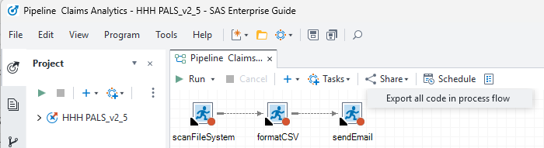
ACT 2 · FROM GUI TO CODE · STEP 1 OF 3
Export the Process Flow
In the process flow, choose Share → “Export all code in process flow”.
One menu item. Enterprise Guide writes out everything the flow just ran — in order, as a single program.
cgs_ai · Demo
Prepared by Manuel Figallo
5 / 12

Slide 6
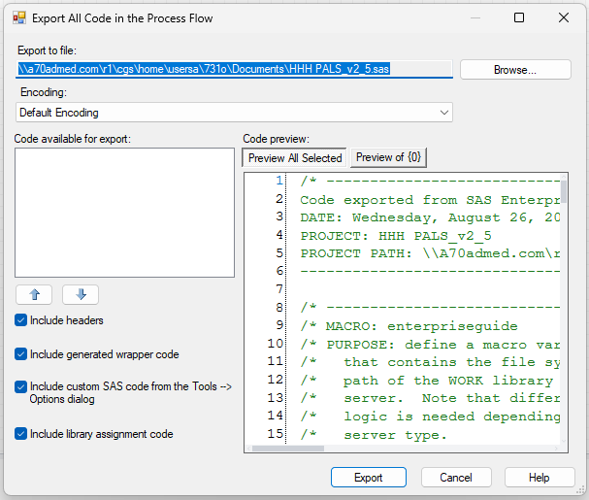
ACT 2 · FROM GUI TO CODE · STEP 2 OF 3
Choose Where the Code Lands
Pick a path, keep the default encoding, and leave the four “include” boxes ticked.
Keep the includes on. They add the library and WORK assignments, so the exported program still runs when Enterprise Guide is not the one running it.
cgs_ai · Demo
Prepared by Manuel Figallo
6 / 12

Slide 7
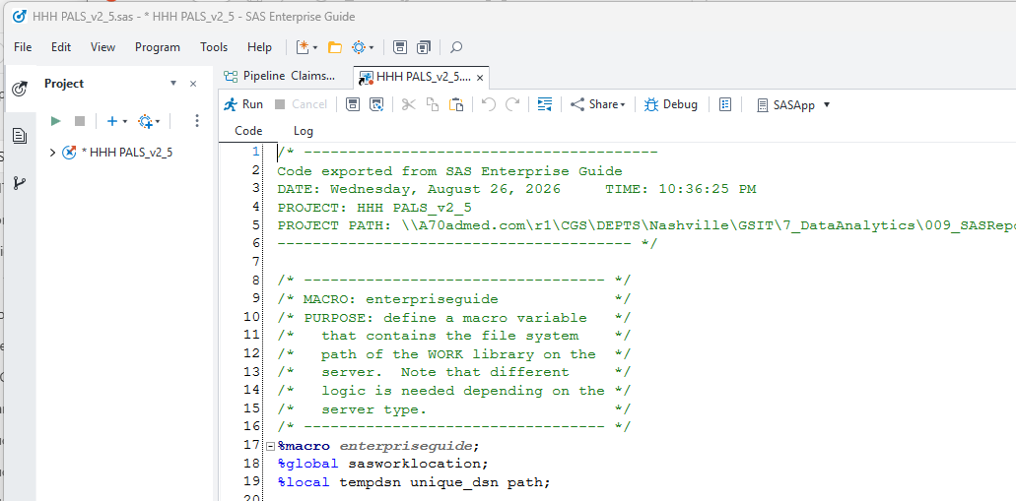
ACT 2 · FROM GUI TO CODE · STEP 3 OF 3
Review the Generated Code
The result is one self-contained .sas program — the same work, now in text you can read, diff and version.
This is the handoff. What was a diagram is now a file an engineer can review and a scheduler can run.
cgs_ai · Demo
Prepared by Manuel Figallo
7 / 12

Slide 8
ACT 3 · WHAT YOU NOW HAVE
What Is Inside the Exported File
Two parts: a preamble Enterprise Guide adds, and the three calls you actually care about.
HHH PALS_v2_5.sas
/* Code exported from SAS Enterprise Guide */
%macro enterpriseguide; ... %mend; /* libraries, WORK path */
%scanFileSystem(input_folder_root=..., extract_keyword=...,
output_file_path=..., metric_profile=sas_log);
%formatCSV(InputCsvPath=..., OutputExcelPath=...);
%sendEmail(To=..., From=..., Subject=..., Body=...);
The preamble is the only Enterprise Guide part. Everything below it is ordinary SAS.
The three calls are the pipeline. Same function names, same parameter names as the Python and PowerShell versions.
cgs_ai · Demo
Prepared by Manuel Figallo
8 / 12

Slide 9
ACT 3 · WHY THE EXPORT MATTERS
The Same Calls, Three Languages
Identical function names and parameter names. Only the surrounding syntax changes.
SAS · Enterprise Guide
%scanFileSystem(
extract_keyword=
%str(real time),
metric_profile=sas_log
);
Python · VS Code
cgs_ai.scanFileSystem(
extract_keyword=
['real time'],
metric_profile='sas_log')
PowerShell · Scheduler
.\scanFileSystem.ps1 `
-extract_keyword
'real time' `
-metric_profile sas_log
Nobody translates anything. The analyst hands over a working call; the engineer and the scheduler run that same call.
cgs_ai · Demo
Prepared by Manuel Figallo
9 / 12

Slide 10
ACT 3 · THE PAYOFF
Now It Can Be Scheduled
The step that turns a useful click-through into an operational service.
Environment | Scheduled by | How it runs
Desktop | Manual / F5 | Development only. Not a place to schedule business work.
UNIT Server | Windows Task Scheduler | A .bat calling the PowerShell or Python entry point.
PROD Server | Task Scheduler / SAS | Unattended, service account, exit codes the scheduler reads.
Snowflake | Snowflake TASK | Runs next to the data. No server to patch, no share to mount.
Built to be scheduled. No cgs_ai function ever prompts — a prompt would hang an unattended run forever.
cgs_ai · Demo
Prepared by Manuel Figallo
10 / 12

Slide 11
RECAP
What This Demo Showed
One pipeline, three acts, no logic rewritten at any point.
The GUI is a first-class way in. An analyst built a real pipeline without writing a script.
The export is three clicks. Share → Export all code → choose a file. No conversion project.
The code is the same three calls. scanFileSystem, formatCSV, sendEmail — with the parameters the analyst chose.
From there it moves. Run it outside Enterprise Guide, in Python, in Snowflake, or on a schedule — unchanged.
The whole loop: build it where you are comfortable, then move it where it belongs.
cgs_ai · Demo
Prepared by Manuel Figallo
11 / 12

Slide 12
WHERE IT STANDS
cgs_ai Is in Beta
Documented and covered by automated tests, but early — and shaped by how people actually use it.
1
2
3
Try it on real work
Tell me what is awkward
Ask for a walkthrough
Pick a routine you run by hand today and point cgs_ai at it. That is the fastest way to find what is missing.
Function names and parameter names are still easy to change. Feedback on those is especially welcome now.
Happy to sit down with anyone and set it up against your own folders and data.
Next step: pick one manual routine you run every week and schedule it. That single move buys performance, reliability and your time back.
cgs_ai · Demo
Prepared by Manuel Figallo
12 / 12

