Slide 1
Generic Entity
Data base
Function
Procedure Call
Object
Object with
internal Tread)
Dispatch
Actor
Request
Reply
Service
Event
ANatali - DISI - University of Bologna

Slide 2
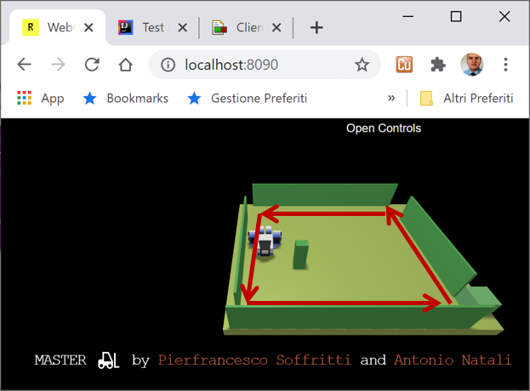

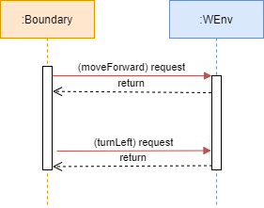
…

Slide 3
HTTP POST
(request)
application
8090
WEnv
8091
socket
send
(dispatch)

Slide 4
command (request)
Procedure Call
shyRobotExplorer
Dispatch
answer (reply)
WEnv
Request
Reply
sonardata (dispatch)
Event

Slide 5
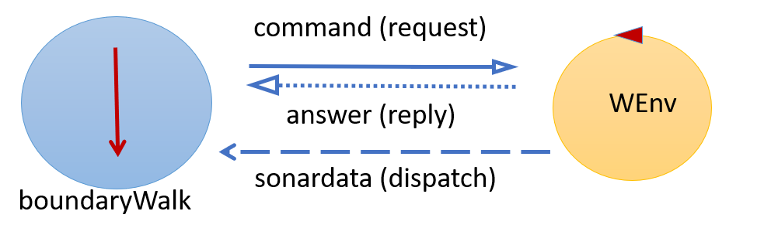
command (request)
answer (reply)
WEnv
sonardata (dispatch)
application

Slide 6
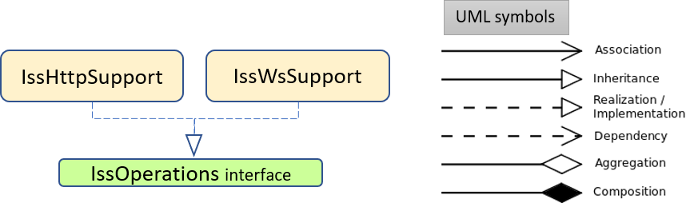
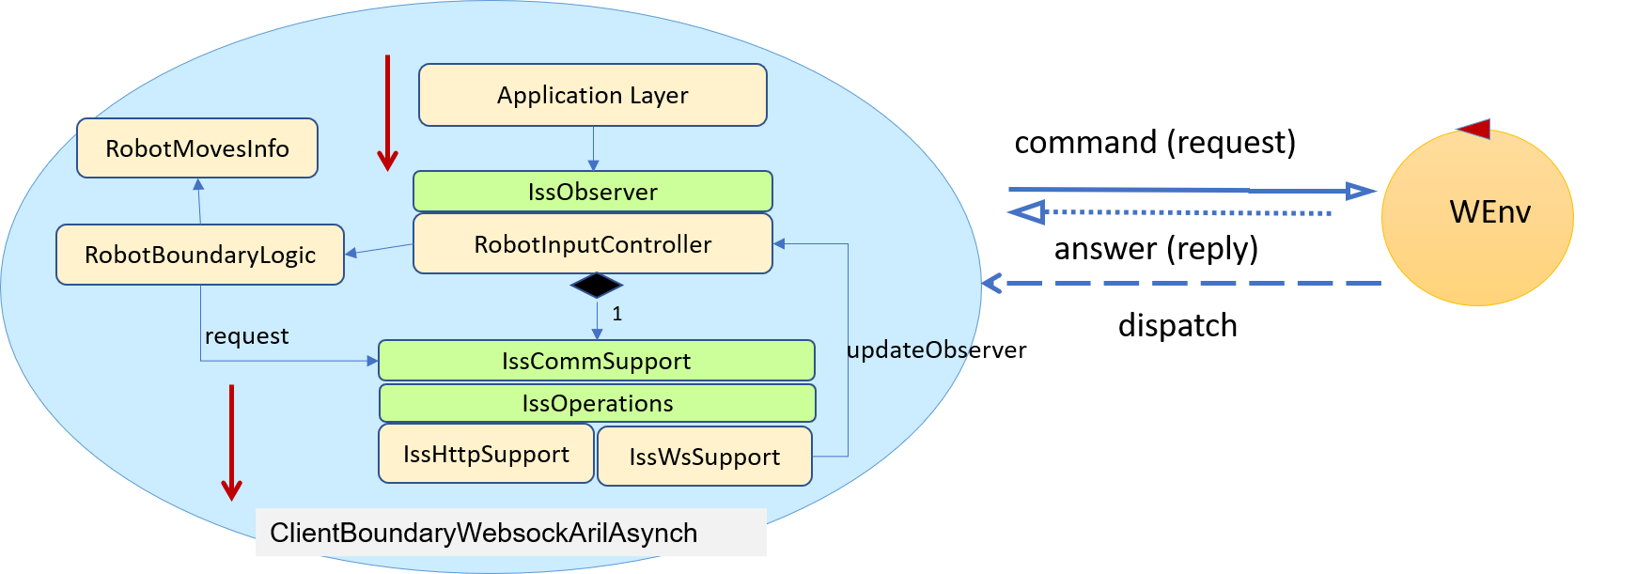

Slide 7
ApplicationLayer
Observer
RobotMovesInfo
creates
ConsoleGui
IssObserver
RobotBoundaryLogic
RobotInputController
1
request
updateObserver
IssCommSupport
IssOperations
IssHttpSupport
IssWsSupport
Application

