Slide 1
FireSpotters

Slide 3
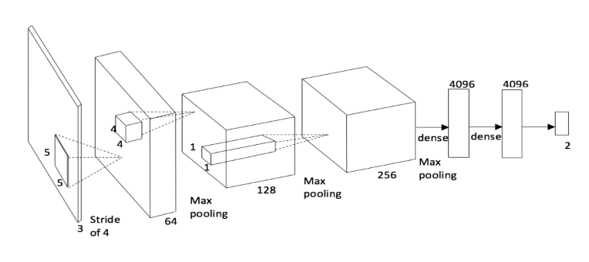
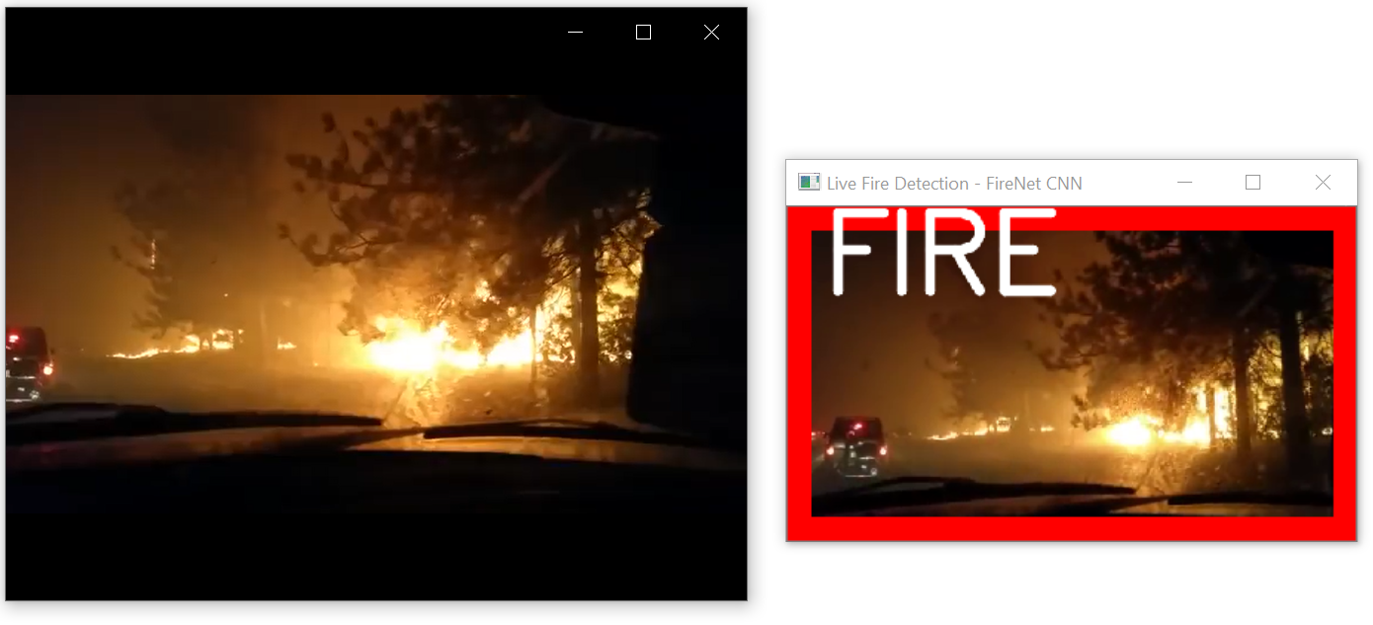
CNN (Red Neuronal)
89% - 93%
Dunnings, A., y T. P. Breckon.
Notes:
Experimentally defined convolutional neural network architecture variants for non-temporal real-time fire detection.
https://github.com/tobybreckon/fire-detection-cnn

